Slide 1
SPINAL POISONS
Dr. Filza Ali
Dr. Naila
Forensic Medicine & Toxicology

Slide 3
Motto Of RMU
Wisdom
Truth
Service

Slide 4
Vision of Rawalpindi Medical University The Dream/ Tomorrow
To impart evidence based research oriented medical education
To provide best possible patient care
To inculcate the values of mutual respect and ethical practice of medicine

Slide 5
Professor Umar Model of Integrated Lecture
60%
CORE SUBJECT
20%
HORIZONTAL
INTEGRATION
Physiology
biochemistry
8%
VERTICAL INTEGRATION
Pathology
pharmacology
7%
VERTICAL INTEGRATION
Clinical integration
5%
VERTICAL INTEGRATION
Research, professionalism
Ethics
Digital library

Slide 6
SEQUENCE OF LGIS
Learning Objectives
Core concept 70 %
Horizontal integration related to Pathology and Pharmacology 15 %
Relevant clinical concepts and medico legal application of core knowledge / Vertical integration 10%
Research article relevant to the topic 3%
Ethics and family medicine 2%

Slide 7
Learning Objectives
Briefly state the mechanism of action of spinal poison.
Mention the fatal dose, management & medico-legal importance of spinal poison.
Briefly explain the autopsy findings of a victim of spinal poison.
State the medicolegal importance of spinal poisons.
Differentiate between symptoms of spinal poisons and tetanus.

Slide 8
Strychnine (Nux Vomica) Properties
Core Concept
ALKALOID
Obtained from the seeds of the plant STRYCHNOS NUX VOMICA
Seeds are hard , flat , slightly convex on one side , otherside concave
Seed is 2 cm in diameter and half a centimeter thick
Outer coat is very hard and cannot be digested
Extremely bitter in taste

Slide 9
Core Concept

Slide 10
Strychnine (Nux Vomica) Properties
Core Concept
ACTIVE PRINCIPLES : strychnine , brucine, loganin
MECHANISM OF ACTION:
Strychnine antagonizes the inhibitory neurotransmitter glycine at post ganglionic receptors
Stimulates all parts of the CNS … especially anterior horn cells of spinal cord
When there is no inhibitory effect, victim will have constant muscle contractions

Slide 11
Fatal Dose & Fatal Period
Core Concept
FATAL DOSE:
strychnine ….15-50mg
1 crushed seed
FATAL PERIOD:
1-2 hrs

Slide 12
SIGNS AND SYMPTOMS
Core Concept
Bitter taste , difficulty in swallowing
Anxiety , restlessness
Increased heart rate, raised blood pressure
Stiffness of muscles before onset of specific convulsions
Twitching and convulsions of the muscles
First clonic (intermittent) and then become tonic (sustained)
Both flexors and extensor muscles are affected at a time

Slide 13
RISUS SARDONICUS:
Core Concept
It is the contraction of the muscles of the face causing widening of the angle of the mouth
Raising of eyebrows, bulging of eyes
Muscles contract forcefully and become stiff
Evil looking grin

Slide 14
RISUS SARDONICUS
Core Concept

Slide 15
RISUS SARDONICUS
Core Concept

Slide 16
OPISTHOTONUS , EMPROSTHOTONUS & PLEUROTHOTONUS
Core Concept
OPISTHOTONUS
It is due to hyperextension of the muscles of the back
The body assumes an arched position
Only head and heels touch the surface
EMPROSTHOTONUS
It is a condition opposite to opisthotonus
The curve of the body is in the opposite direction
PLEUROTHOTONUS
Condition in which body assumes a laterally curved posture

Slide 17
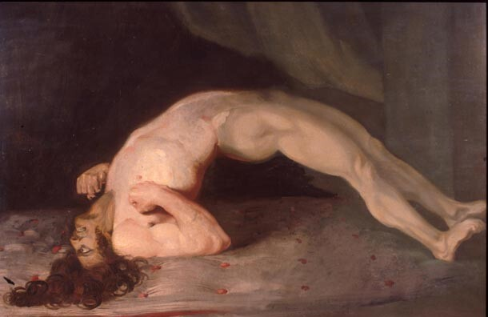
OPISTHOTONUS
Core Concept

Slide 18
DIFFERENTIAL DIAGNOSIS
Core Concept
The signs and symptoms of strychnine poisoning resemble
Tetanus
Epilepsy,
Hysteria ,
Dystonic drug reactions
Hypocalcemia,
Neuroleptic malignant syndrome
Malignant hyperthermia
Stimulant use

Slide 19
DIAGNOSIS
Core Concept
Confirmation of strychnine poisoning is done by analysis of
Urine or
Gastric aspirate
By thin layer chromatography(TLC)

Slide 20
TREATMENT
Core Concept
Patient should be kept in dark , quiet room
Quick anesthesia with chloroform or i/v barbiturates till the patients muscles relax
Stomach wash with KMNO4 solution
Light anesthesia should be continued as needed
Sedatives like Diazepam or chloral hydrate
Activated charcoal
Muscle relaxants if respasm persists

Slide 21
AUTOPSY FINDINGS
VERTICAL INTEGERATION
These are of asphyxia
Rigor mortis sets in early immediately after death
Strychnine resists putrefaction
In suspected cases the brain and spinal cord should be preserved for analysis in addition to routine viscera
It can be detected easily even in a decomposed body

Slide 22
MEDICO LEGAL ASPECTS
VERTICAL INTEGERATION
Core Concept
Accidental death due to
Overdose
Quack remedies
Children ingesting the seeds
Exposure to rodenticide
HOMICIDE IS RARE
Used as cattle and arrow poison

Slide 23
Research
RESEARCH
Strychnine poisoning due to Traditional Chinese Medicine : a case series
https://www.ncbi.nlm.nih.gov/pmc/articles/PMC8817065/
https://www.amjmed.com/article/0002-9343(83)90999-3/abstract
https://www.ncbi.nlm.nih.gov/pmc/articles/PMC130147/

Slide 24
The principle of beneficence is the obligation of physician to act for the benefit of the patient and supports a number of moral rules to protect and defend the right of others, prevent harm, remove conditions that will cause harm, help persons with disabilities, and rescue persons in danger. It is worth emphasizing that, the language here is one of positive requirements. The principle calls for not just avoiding harm, but also to benefit patients and to promote their welfare.
Ethics
Biomedical Ethics
Beneficence
TAKE HOME MESSAGE
Vertical integration

Slide 25
Family Medicine
FAMILY MEDICINE
A successful treatment for any poisoning must do one of three things:
Empty the stomach before the poison is absorbed.
Prevent the absorption of the poison.
Counteract the systemic effects of the poison.
https://www.researchgate.net/publication/8623171_A_Case_of_Acute_Strychnine_Poisoning

Slide 26
How To Access Digital Library
Steps to Access HEC Digital Library
Go to the website of HEC National Digital Library.
On Home Page, click on the INSTITUTES.
A page will appear showing the universities from Public and Private Sector and other Institutes which have access to HEC National Digital Library HNDL.
Select your desired Institute.
5. A page will appear showing the resources of the institution
6. Journals and Researches will appear
7. You can find a Journal by clicking on JOURNALS AND DATABASE and enter a keyword to search for your desired journal.

Slide 27
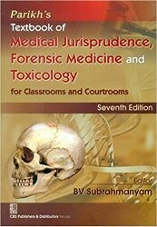
TEXT BOOKS & PRACTICAL NOTEBOOK:
Principles & Practice of Forensic Medicine.
by Nasib R. Awan
Parikh’s Textbook of Medical Jurisprudence,
Forensic Medicine & Toxicology.
Practical Manual Of Forensic Medicine
& Toxicology

Slide 28
THANK TOU

