Slide 2
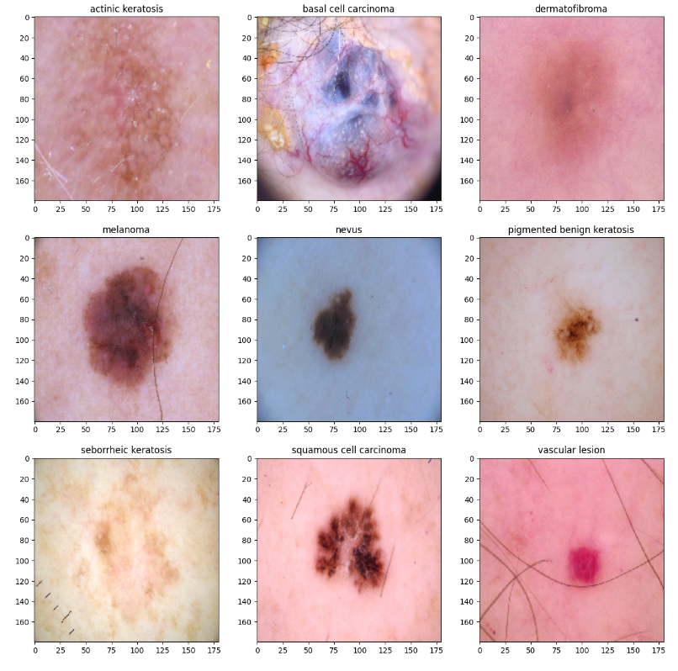
Skin Tumors
CNS & Psychiatry II 4th year MBBS
Dr Mudassira Zahid
Department of Pathology
Rawalpindi Medical University

Slide 3
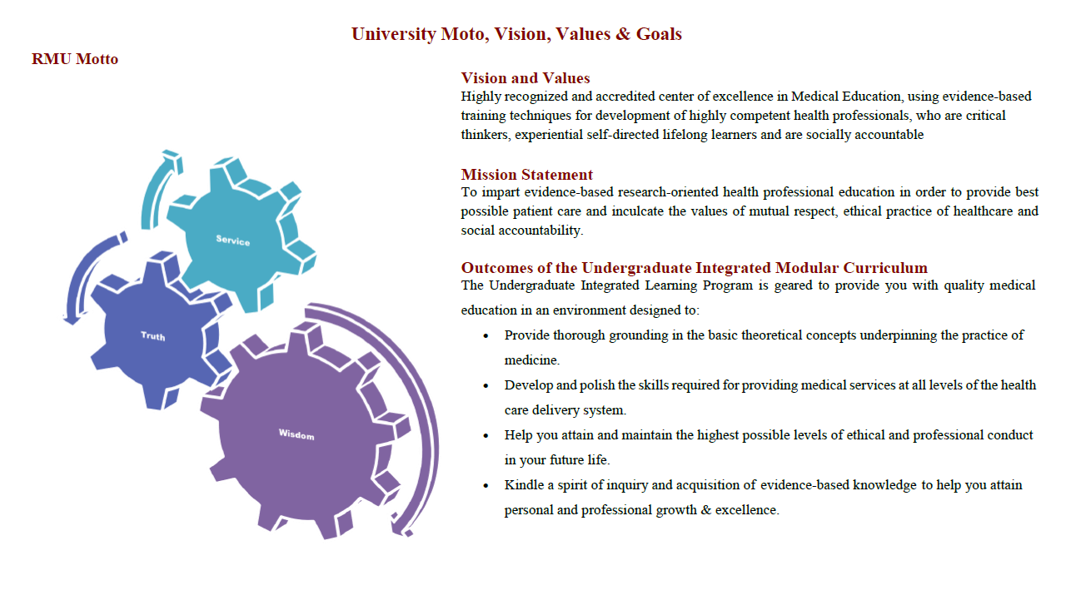

Slide 4
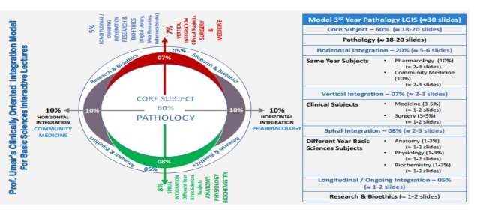

Slide 5
Learning Objectives
Enlist the Etiological Factors for Skin Tumors
Describe the Pathogenesis of Skin Tumors
Describe the Morphological Features of SCC, BCC, and Melanoma
Differentiate Between the Morphology of Various Nevi
Differentiate Between a Nevus and a Melanoma
Enlist the Good and Bad Prognostic Signs for Melanoma
Learning Resources: Robbins & Cotran Pathologic Basis Of Disease 10th Edition

Slide 6
VERTICAL INTEGRATION
PHYSIOLOGY
ANATOMY
Cells of the Epidermis
Keratinocytes: The most abundant cells in the epidermis.
Melanocytes: Pigment-producing cells located deep in the epidermis.
Merkel Cells: Specialized sensory cells involved in touch sensation.
Langerhans Cells: Fixed macrophages that play a role in immune response.

Slide 7
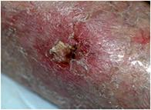
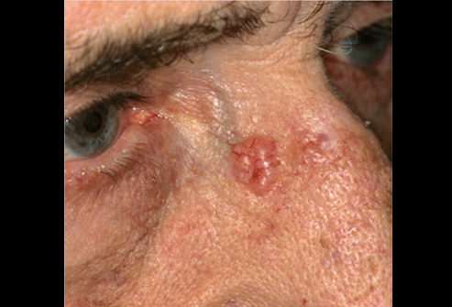
Clinical Presentation
VERTICAL INTEGRATION
DERMATOLOGY
Skin cancer presentation
A new growth on the skin.
A change in an existing skin growth.
A wound or ulcer that does not heal..
The lesion may bleed, ooze fluid, crust or scab over, and then ooze or bleed again.
Skin cancer can occur on almost any area of the skin but is most common on areas frequently exposed to the sun.
Skin cancer is usually painless.

Slide 8
Risk factors
HORIZONTAL INTEGRATION
COMMUNITY MEDICINE
UV Radiation: Damages DNA in cutaneous cells and suppresses Langerhans cell function.
actinic keratosis or a patch of Bowen’s disease – precursor lesions.
HPV Infection: Implicated in genital SCCs.
Genetic Predisposition: Individuals with xeroderma pigmentosum are at higher risk of developing SCCs.
Chronic Osteomyelitis Ulcers
Smoking: Especially associated with SCC of the lip
Thermal burns can also be a contributing factor
Immunosuppression: Medications like Azathioprine and Cyclosporine.
Organ transplantation patients are highly susceptible.

Slide 9
CORE PATHOLOGY
Pathogenesis
Normal Sequence of Events
Uv light --- DNA damage
ATM ATR (check point kinases)
Up regulation of p53
G phase cell cycle Arrest
DNA repair /Apoptosis

Slide 10
CORE PATHOLOGY
Carcinogenesis in Susceptible Person
Uv light --- DNA damage
ATM ATR mutation (check point kinases ineffective )
Defective p53
No G phase cell cycle arrest
Defective DNA repair No Apoptosis

Slide 11
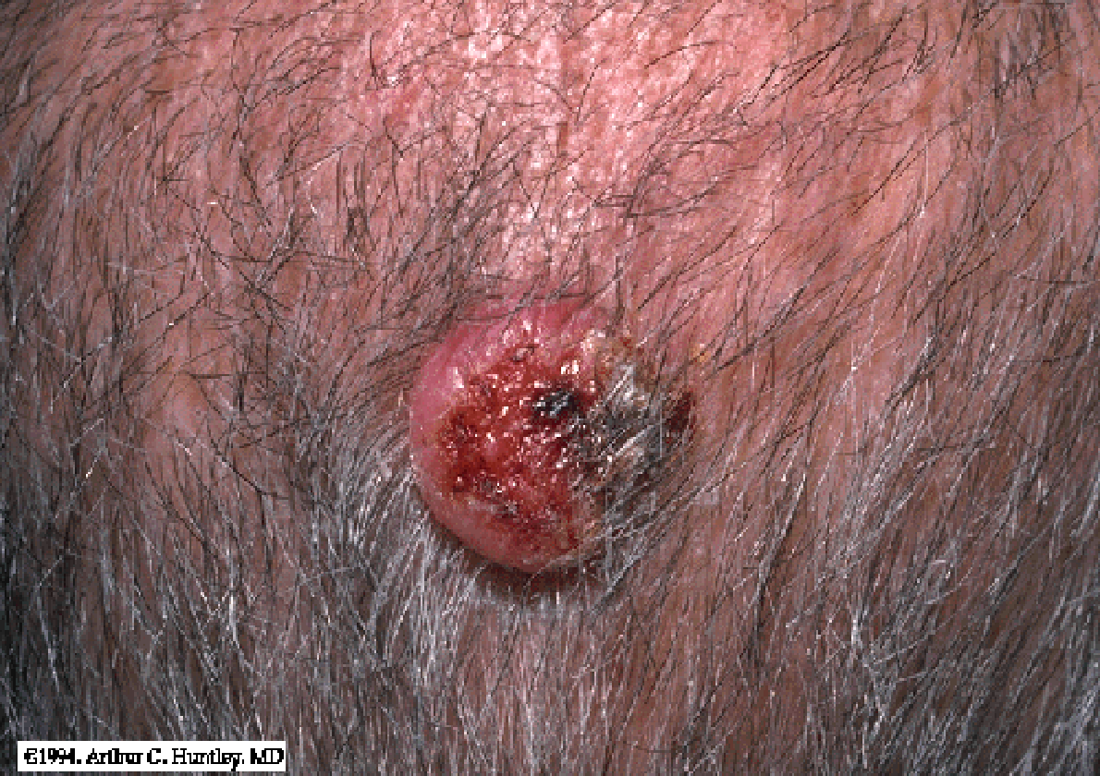
Squamous Cell Carcinoma
VERTICAL INTEGRATIONS
Squamous Cell Carcinoma
A crusted and eroded tumor with raised margins present on the scalp in this elderly man was histologically confirmed as SCC.
Cutaneous Squamous Cell Carcinoma
Has potential for metastasis, but is much less aggressive than squamous cell carcinoma at mucosal sites.
SCC of pinna with LN metastasis

Slide 12
Actinic Keratosis -- Precursor Lesion
CORE PATHOLOGY
These are scaly papules that occur on exposed skin of older, fair-skinned individuals, resulting from chronic overexposure to ultraviolet (UV) light from the sun. A small percentage of these lesions develop into invasive squamous cell carcinoma.

Slide 13
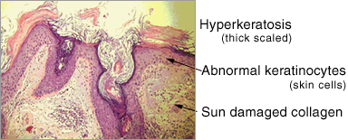
Actinic Keratosis
CORE PATHOLOGY
Precursor Lesion for Squamous Cell Carcinoma
Up to 1% of these lesions can develop into Squamous Cell Carcinoma (SCC).

Slide 14
Actinic Keratosis
CORE PATHOLOGY
(A) Excessive keratotic scale in this lesion has produced a “cutaneous horn.”
(B) Basal cell layer atypia (dysplasia) is associated with marked hyperkeratosis (increase in keratin layer at the top) and parakeratosis (abnormal maturation of keratinocytes with retention of nuclei in superficial squamous cells).
(C) Progression to full-thickness nuclear atypia (arrow), with or without the presence of superficial epidermal maturation, heralds the development of squamous cell carcinoma in situ.

Slide 15
Invasive Squamous Cell Carcinoma
CORE PATHOLOGY
Tongues of atypical squamous epithelium have transgressed the basement membrane and invaded deeply into the dermis.
Invasive tumor cells show enlarged nuclei with angulated contours and prominent nucleoli.
An inflammatory reaction is also present against tumor cells.

Slide 16
Basal cell carcinoma
VERTICAL INTEGRATION
DERMATOLOGY
Slow-growing and rarely metastasizes.
Develops on sun-exposed parts of the body, especially the head and neck.
Not present on mucosal surfaces.
Appears as a pearly white or waxy growth, often with visible blood vessels.
The growth may bleed, develop a crust, or form a depression in the center.
In darker-skinned individuals, this type of cancer is usually brown or black.

Slide 17
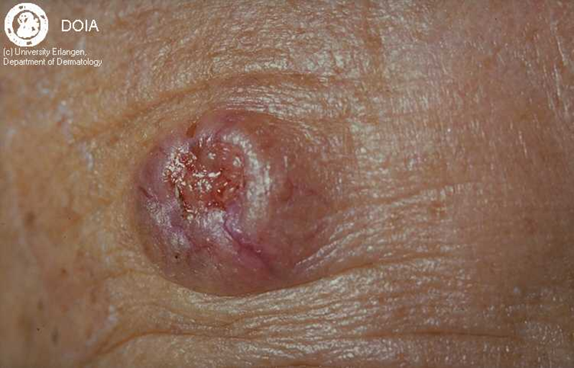
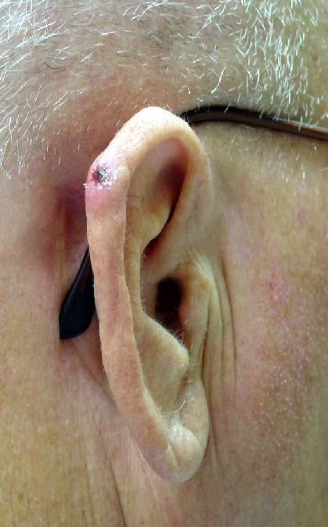
Basal cell carcinoma
VERTICAL INTEGRATION
DERMATOLOGY

Slide 18
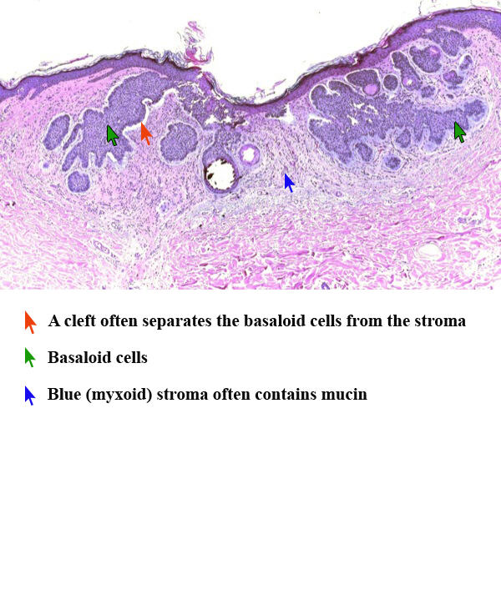
BCC Morphology
CORE PATHOLOGY
Basal Cell Carcinoma (BCC)
Tumor cells resemble basal cells.
Can be multifocal or nodular.
Locally aggressive, but metastasis is very rare.
Composed of nests of uniform basaloid cells within the dermis, often separated from the adjacent stroma by thin clefts—an artifact of sectioning.

Slide 19
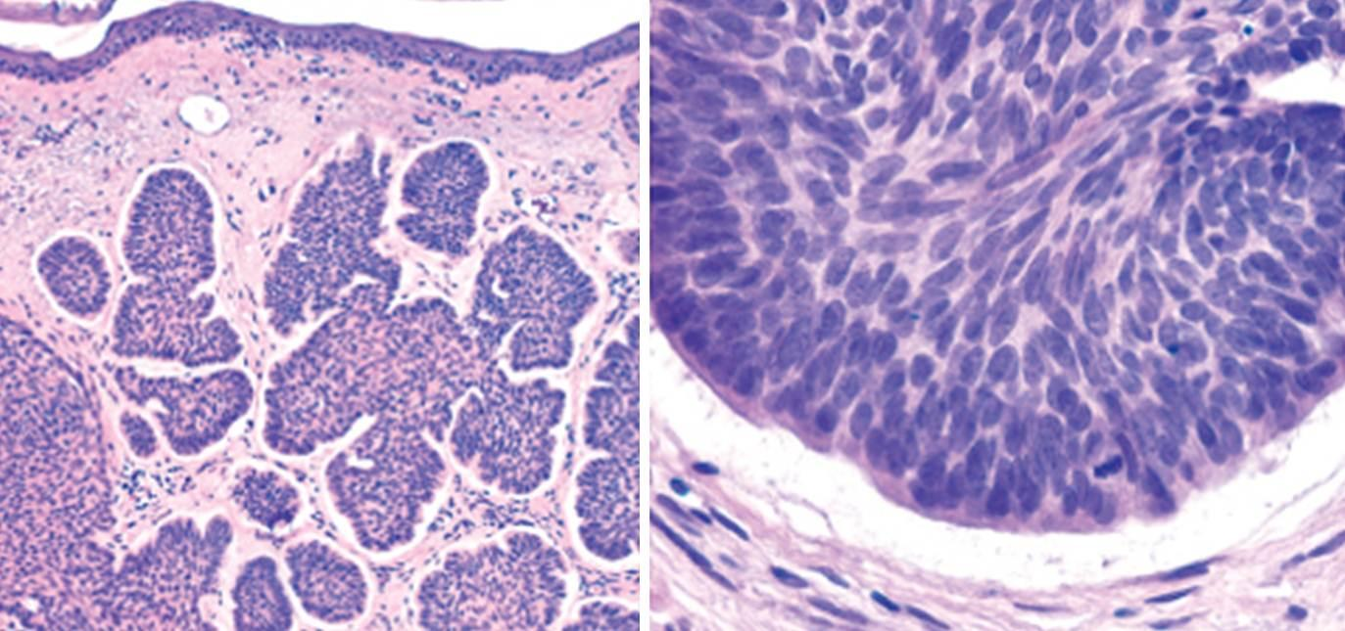
Basal Cell Carcinoma
CORE PATHOLOGY
Nests of uniform basaloid cells within the dermis that are often separated from the adjacent stroma by thin clefts—an artifact of sectioning.

Slide 20
Melanocytic Lesions
CORE PATHOLOGY
Benign: Nevus
Malignant: Melanoma
Most nevi are benign and do not progress to atypical lesions.
Dysplastic nevus is a precursor to malignant melanoma.

Slide 21
Nevus
CORE PATHOLOGY
Melanocytic Nevi
Benign neoplasms derived from melanocytes.
Pigmented growth with well-defined, regular borders.
Uniform pigmentation.
Small diameter.
Benign cells.
Microscopically, the nevus cells are round and uniform.
Do not have prominent nucleoli or any mitosis.

Slide 22
Nevus
CORE PATHOLOGY
3 Types Based on Growth Patterns
Junctional Nevi
Compound Nevi
Intradermal Nevi

Slide 23
CORE PATHOLOGY

Slide 24
CORE PATHOLOGY

Slide 25
Malignant Melanoma
CORE PATHOLOGY
Pathogenesis
Sun Exposure
Inherited Genes:
BRAF
P16
Cyclin-dependent kinases
Abnormal function of these genes results in the formation of nevus and melanoma.
Deadly if Not Treated Early
Primary Sites:
Skin
Anogenital mucosa
Eye

Slide 27
CORE PATHOLOGY
A: Normal skin shows only scattered melanocytes.
B: Lentiginous melanocytic hyperplasia.
C: Lentiginous compound nevus with abnormal architecture and cytologic features (dysplastic nevus).
D: Early or radial growth phase melanoma (large dark cells in the epidermis) arising in a nevus.
E: Melanoma in the vertical growth phase with metastatic potential.

Slide 28
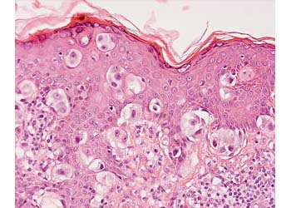
Malignant Melanoma
CORE PATHOLOGY
The epidermis shows atypical melanocytic proliferation, consisting of irregular nested and single melanocytes.
Atypical melanocytes are visible in all layers of the epidermis, from the basal layer to the granular layer.
Atypical Melanocytes:
Larger.
enlarged nuclei with irregular contours.
Prominent red (eosinophilic) nucleoli are seen.

Slide 29
Warning Signs in a Pigmented Lesion
VERTICAL INTEGRATION
DERMATOLOGY
What is the ABCDEEFG Principle?
A: Asymmetry
B: Borders (irregular)
C: Color change
D: Diameter (greater than 6 mm or 0.24 in., about the size of a pencil eraser)
E: Evolving over time
E: Elevated above the skin surface
F: Firm to the touch
G: Growing

Slide 30
Progression of Melanoma
VERTICAL INTEGRATION
DERMATOLOGY
Radial Growth
Tumor cells lack the capacity to metastasize and grow in the horizontal direction.
Vertical Growth
Appearance of a nodule.
Appearance of a clone of cells with metastasizing potential.

Slide 31
Prognostic Factors
VERTICAL INTEGRATION
DERMATOLOGY
Tumor depth
Number of mitoses
Evidence of tumor regression
Presence and number of Tumor Infiltrating Lymphocytes (TILs)
Gender
Location in the body
Presence of ulceration
Status of sentinel lymph node

Slide 32
Treatment
HORIZONTAL INTEGRATION
PHARMACOLOGY
Systemic and Topical Chemotherapy
Various topical agents are used to treat patients with a history of extensive sun exposure, actinic keratosis, and SCC in situ, as well as superficial BCC.
Surgical excision is the mainstay of treatment.
In advanced disease, additional treatments such as chemotherapy, radiotherapy, and targeted therapy (e.g., BRAF inhibitors) may be used.

Slide 33
Biomedical Ethics
ETHICS
Prevention
Sustained cancer awareness programs inform people of the dangers of smoking, chewing tobacco, alcohol, and exposure to HPV.
Treatment
Taking informed consent when deciding on a course of medical or surgical intervention, as it encompasses a variety of combinations, including surgery, radiotherapy, chemotherapy, hormonal therapy, and immunotherapy.

Slide 34
Cancers 2023, 15(4), 1183; https://doi.org/10.3390/cancers15041183
RESEARCH AND AI
Simple Summary: The proposed research aims to provide a deep insight into the deep learning and machine learning techniques used for diagnosing skin cancer. While maintaining a healthy balance between both Machine Learning as well as Deep Learning, the study also discusses open challenges and future directions in this field. The research includes a comparison on widely used datasets and prevalent review papers discussing skin cancer diagnosis using Artificial Intelligence. The authors of this study aim to set this review as a benchmark for further studies in the field of skin cancer diagnosis by also including limitations and benefits of historical approaches

