Slide 1
Dr. Filza Ali & Dr Naila

Slide 3
To impart evidence based research oriented medical education
To provide best possible patient care
To inculcate the values of mutual respect and ethical practice of medicine

Slide 4
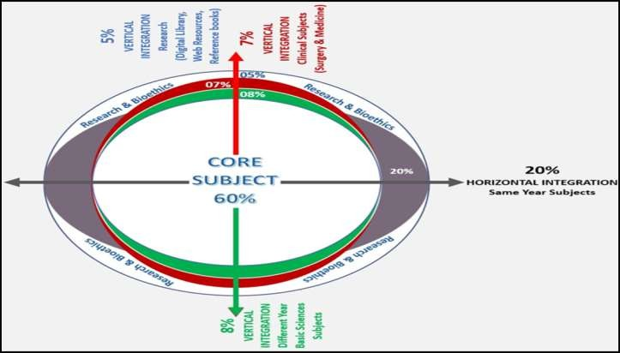

Slide 5
SEQUENCE OF LGIS
Learning Objectives
Core concept 70 %
Horizontal integration related to Pathology and Pharmacology 15 %(If Applicable)
Relevant clinical concepts and medico legal application of core knowledge / Vertical integration 10%
Research article relevant to the topic 3%
Ethics and family medicine 2%

Slide 6
Students will be able to
Define Rape ,enlist its types and state its punishment
Briefly explain the steps of an examination of a rape
victim and accused.
Enumerate the lab samples collected for chemical and DNA analysis.
Briefly explain the 5 steps you would like to take after examination.
Enlist the complications or dangers of sexual assault.

Slide 7
Core Concept

Slide 8
Core Concept
Definintion:
Section 375 of PPC defines rape as unlawful sexual intercourse by a man with a woman
against her will
without her consent
With or without her consent when she is under 16 years of age.

Slide 9
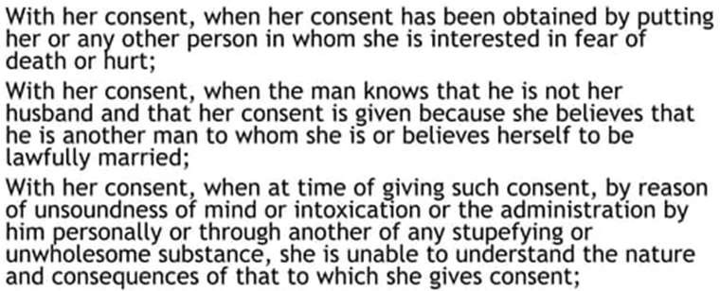
Core Concept
Impersonation:
A condition in which rape is done with the consent of the women e.g.
1.
2.
3.

Slide 10
Core Concept

Slide 11
Core Concept

Slide 12
Core Concept

Slide 13
Core Concept

Slide 14
Core Concept

Slide 15
Core Concept

Slide 16
Core Concept

Slide 17
Core Concept

Slide 18
Core Concept

Slide 19
Core Concept

Slide 20
Core Concept

Slide 21
Core Concept

Slide 22
Core Concept

Slide 23
Core Concept

Slide 24
Core Concept

Slide 25
Core Concept

Slide 26
Core Concept
Treatment of injuries
Tetanus prophylaxis
Prevention and termination of pregnancy(As per WHO)
Prevention and treatment of any sexually transmitted disease.
Referral to crisis intervention centres for support by psychiatrists and social workers

Slide 27
Core Concept

Slide 28
Core Concept

Slide 29
Core Concept

Slide 30
Core Concept

Slide 31
Core Concept

Slide 32
Research
https://www.ncbi.nlm.nih.gov/pmc/articles
/PMC5576571/
https://www.researchgate.net/publication/5 784808_Medico- legal_assessment_of_sexual_assault_victims_ in_Lahore
https://medforum.pk/article/30- medicolegal-examination-of-sexual-assault- survivors

Slide 33
Ethics
Sexual assault is more common in both genders in younger group who are also unmarried. Most of these victims’ record was insufficient due to lack of professionalism and expertise in the field of forensic medicine.
Sexual assault causes tremendous physical and psychological
trauma in women and children
Apart from medicolegal purposes, the victim gets adequate treatment including that for her physical injuries, sexually transmitted diseases, emergency contraception as well as psychological counseling and rehabilitation.
https://ejfs.springeropen.com/articles/10.1186/s41935-022-
00284-4
https://www.researchgate.net/publication/316332458_Legal_an d_ethical_complexities_in_the_examination_of_victims_of_sexua l_assault_in_India_A_medical_practitioner's_perspective

Slide 34
Family Medicine
Sexual Assault survivors examination may include a full body examination, including internal examinations of the mouth, vagina, and/or anus. It may also include taking samples of blood, urine, swabs of body surface areas, and sometimes hair samples.
https://pubmed.ncbi.nlm.nih.gov/7058167/

Slide 35
How to use HEC Digital Library
Go to the website of HEC National Digital Library
http://www.digitallibrary.edu.pk
On Home Page, click on the INSTITUTES.
A page will appear showing the universities from Public and Private Sector and other Institutes which have access to HEC National Digital Library (HNDL).
Select your desired Institute.
A page will appear showing the resources of the institution
Journals and Researches will appear
You can find a Journal by clicking on JOURNALS AND DATABASE and enter a keyword to search for your desired journal

Slide 36
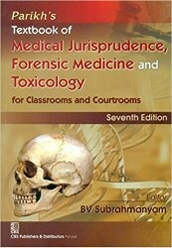
TEXT BOOKS & PRACTICAL NOTEBOOK:
Principles & Practice of Forensic Medicine.
by Nasib R. Awan
Parikh’s Textbook of Medical Jurisprudence,
Forensic Medicine & Toxicology.
Practical Manual Of Forensic Medicine
& Toxicology

Slide 37
THANK YOU

