Slide 1
Secondary Amenorrhea
Dr Sadia Khan
Professor OBS/GYN Benazir Bhutto Hospital Rawalpindi Medical University

Slide 2
MOTTO
To impart evidence- based research oriented medical education
To provide best possible patient care
To inculcate the values of mutual respect and ethical practice of medicine

Slide 3
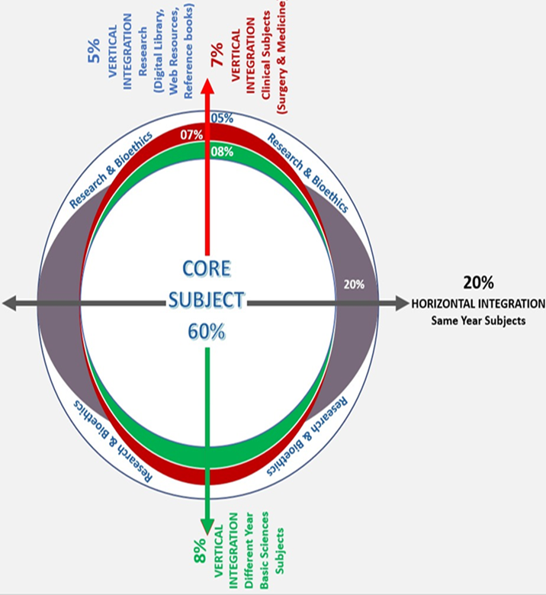

Slide 4
Multiple Choice Questions
Q1. What is the minimum duration of absent menstruation to be diagnosed as a case of secondary amenorrhea?
a) 1 month b) 2 months c) 3 months d) 6 months
e)12 months
✓

Slide 5
Multiple Choice Questions
Q2.Which of the following is a common hormonal cause of secondary amenorrhea?
a) Hyperprolactinemia b) Endometriosis c) Polycystic Ovary Syndrome (PCOS) d) Hyperprolctinemia and PCOS
e)Hyperthyroidism
✓

Slide 6
Multiple Choice Questions
Q3.Which of the following treatments is used to induce menstruation in women with secondary amenorrhea?
a) Metformin b) Clomiphene Citrate c) Progesterone therapy d) Letrazole
e)SERMS
✓

Slide 7
Multiple Choice Questions
Q4.Which lifestyle change can help manage or prevent secondary amenorrhea?
a) Increased caffeine intake b) Extreme weight loss c) Stress management d) Sedentary lifestyle
e)Reduce smoking
✓

Slide 8
Multiple Choice Questions
Q5.Which of the following is the most common cause of secondary amenorrhea in women of reproductive age?
a) Menopause b) Pregnancy c) Hypothalamic Dysfunction d) Thyroid Disorders
e)Hypogonadotrophic Hypogonadism
✓

Slide 9
Learning Objectives
By the end of this presentation, the students should be able to:
Define secondary amenorrhea
Enlist its important causes
Discuss clinical features and its diagnostic criteria
Discuss the management options

Slide 10
Definition
Absence of menstruation for more than 6 months in a normal female in reproductive age that is not due to pregnancy lactation or menopause

Slide 11
Causes of Secondary Amenorrhea
1
Hypothalamic disorders
⬇ FSH, LH releasing hormones ⬇ HPO axis
2
Pituitary disorders
⬇ FSH,LH
Ovarian disorders
⬆ LH:FSH 3:1
3
4
Endometrial disorders
FSH, LH and pituitary hormones normal

Slide 12
Secondary amenorrhea
Rule out pregnancy urine test/USG
FSH, LH, Prolactin, TSH, Testosterone
Raised FSH
Normal FSH/LH
Low FSH/LH
Premature ovarian failure
Asherman”s syndrome
Hysterectomy
Cervical stenosis
Hypothalamic / pituitary Stress prolactinoma

Slide 13
Summary of causes
MOST COMMON
LESS COMMON
RARE CAUSES
Pregnancy/lactation
Hypothalamic (Stress, exercise)
Pituitary (Prolactinomas)
Androgen disorders (PCOS)
Adult onset adrenal hyperplasia
Premature Ovarian failure
Asherman syndrome
Sheehan’s syndrome
Drug induced amenorrhea
Chronic illness e.g. diabetes, cushing disease, cirrhosis
Infections (T.B)
CKD
Malnutrition
Irradiation /chemotherapy

Slide 14
Most common causes presenting with secondary amenorrhea

Slide 15
Diagnosis
Progesterone Challenge test B-hCG is negative,
TSH+prolactin normal
Positive PCT
Negative PCT
Withdrawal bleed is diagnostic Of anovulation.
Absence of withdrawal = inadequate estrogen or outflow tract obstruction
Ovarian Failure
⬆ FSH
EPCT
Give 21 days of oral estrogen followed by 7 days of MPA Withdrawal bleed present
Absence of withdrawal–AS
HP insufficiency
⬇ FSH

Slide 16
OVARIAN CAUSES OF SECONDARY AMENORRHOEA

Slide 17
Polycystic ovarian syndrome
Ovarian dysfunction with hyperandrogenism and polycystic ovarian morphology
Prevalence : around 25%-30% of all women on ultrasound but not always associated with the full syndrome
5–10% of women of reproductive age
Associated with an increased risk of type 2 diabetes and cardiovascular events.
Etiology : Not completely clear
Frequent familial trend points to a genetic cause.
Notes:
Heterogenous collection of s/s that form a spectrum of disorders of reproductive , endocrine and metabolic function

Slide 18
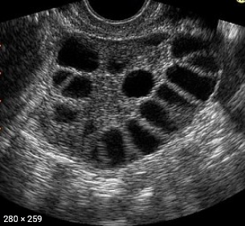
Diagnostic criteria
Rotterdam criteria: two out of the three
1. Anovulation/Oligo-ovulation
2. Clinical or biochemical hyperandrogenism
3. Polycystic ovaries on USG

Slide 19
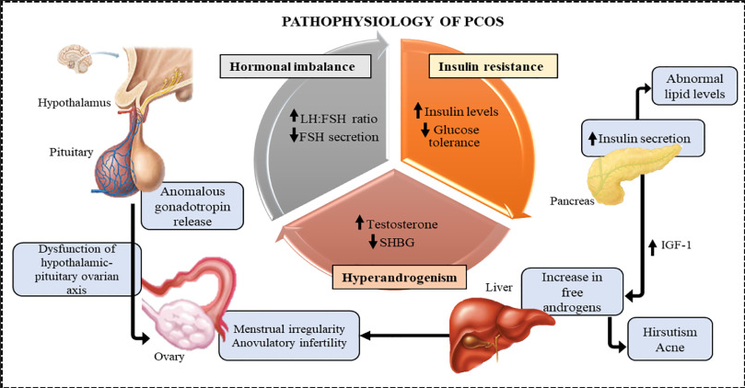
Pathophysiology

Slide 20
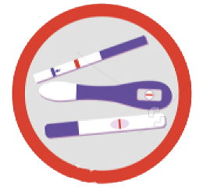
Clinical Features
Oligomenorrhea/amenorrhea - 75%
Hirsutism
Subfertility 75%
Obesity 45%
Acanthosis nigricans
Acne

Slide 21
Investigations
↑ Fasting insulin(OGTT)
↑ Androgens (testosterone and androstenedione)
↑ or normal LH, normal FSH (LH : FSH )
↓ SHBG, results in elevated free androgen index
↑ Estradiol, estrone
↑ Prolactin

Slide 22
Management
1. Lifestyle Modifications (exercise, weight loss)
2. Metformin (insulin resistance)
Fertility required
Fertility not required
3. Ovulation induction
4.Cyclical progestogens
5.COCP

Slide 23
Premature Ovarian Failure
Definition
Secondary amenorrhea for at least 4 months with raised FSH level on 2 separate occasions, raised FSH/ LH ratio and low E2 Level before the age of 40 years

Slide 24
Clinical features
Hot flushes & sweating 75%
Reduced libido
Vaginal dryness
Urinary incontinence
Mood swings
Spectrum of menopausal symtoms

Slide 25
Investigations
Hormone profile ( FSH levels >40mIU/L)
Decreased E2 levels
Thyroid profile
Blood sugar
USG

Slide 26
Management
Manage any treatable cause
Steroid therapy if autoimmune cause
Menopausal Hormonal Therapy (MHT)
Counselling

Slide 27
PITUITARY CAUSES OF SECONDARY AMENORRHOEA

Slide 28
Hyperprolactinemia
Causes
1. Medication Antipsychotic/antidepressants
2. Pituitary Adenomas
3. Hypothyroidism - Increased Thyrotropin level leads to increased Prolactin levels

Slide 29
Treatment of Hyperprolactinemia
Medical management
Bromocriptine 2.5 mg - 20mg/ day
Cabergoline 0.25-1mg twice weekly
In case of pituitary tumour <1cm medical treatment with bromocriptine
Surgical management
> 1cm tumour surgical treatment by Trans-sphenoidal adenectomy

Slide 30
HYPOTHALAMIC CAUSES OF SECONDARY AMENORRHOEA

Slide 31
Hypothalamic causes
Primary Hypothalamic Leisions
Secondary Hypothalamic Leisions
Craniopharyngiomas
Germinomas
Gliomas
Dermoid cysts
Sarcoidosis
Tuberculosis
Head injury
Cranial irradiation
Sheehans syndrome

Slide 32
Sheehans Syndrome
Definition
It is the result of profound and prolonged hypotension on the sensitive pituitary gland enlarged by pregnancy
Cause
Postpartum haemorrhage

Slide 33
Sheehans Syndrome
Investigations
Assess pituitary function
Treatment
Hormonal Replacement Therapy

Slide 34
GENITAL TRACT ABNORMALITIES

Slide 35
Asherman Syndrome
It is a condition characterized by the formation of scar tissue (adhesions) within the uterine cavity, which can lead to partial or complete obliteration of the uterine cavity.

Slide 36
Aetiology and Pathogenesis
Post-Surgical Scarring
Most commonly occurs after uterine surgery, particularly after dilation and curettage (D&C) following miscarriage, abortion, or postpartum haemorrhage.

Slide 37
Clinical Features
Hypomenorrhea or Amenorrhea:
Decreased menstrual flow or complete absence of menstruation is common due to the reduced surface area of the endometrium.

Slide 38
Aetiology and Pathogenesis
Infection: Pelvic infections like tuberculosis or severe pelvic inflammatory disease (PID) can also lead to adhesions.
Trauma: Other uterine surgeries, such as myomectomy or caesarean sections, can also contribute to the development of adhesions.

Slide 39
Clinical Features
Infertility: Adhesions can prevent implantation or disrupt the normal functioning of the endometrium, leading to infertility.
Recurrent Pregnancy Loss: Difficulty in maintaining a pregnancy due to an inadequate endometrial environment.

Slide 40
Diagnosis
Hysterosalpingography (HSG): X-ray imaging with contrast that can reveal the extent and location of adhesions within the uterine cavity.
Hysteroscopy: The most definitive diagnostic tool, allowing direct visualization of adhesions and assessment of their severity.
Ultrasound: May show a distorted uterine cavity or absent endometrial echo, but it is less sensitive than hysteroscopy.

Slide 41
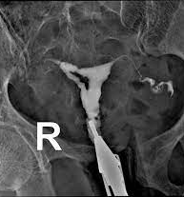
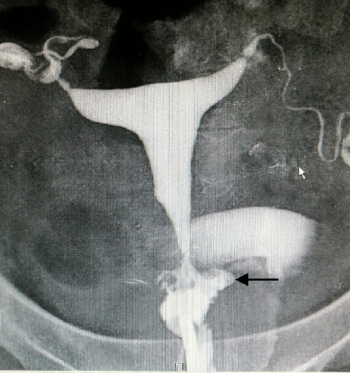
HSG in Asherman syndrome
HSG of normal uterus

Slide 42
Management
Hysteroscopic adhesiolysis:
The treatment of choice, involving the cutting and removal of adhesions using a hysteroscope. It’s often followed by hormonal therapy to promote healing and prevent reformation of adhesions.

Slide 43
Thank you

