Slide 2
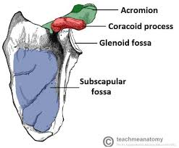
Foundation Module 1st year MBBS(SGD) Scapula
Presenter: Dr. Qurat ul ain Sharif Date: 26.2.2025
(Senior Demonstrator)

Slide 3
Vision; The Dream/Tomorrow
Motto
To impart evidence based research oriented medical education
To provide best possible patient care
To inculcate the values of mutual respect and ethical practice of medicine
Wisdom
Truth
Service

Slide 4
Professor Umar Model of Integrated Lecture

Slide 5
Learning Objectives
1. Determine the side.
2. Demonstrate anatomical position, general features, attachments, and articulation. (clavicle and shoulder joints)
3. Describe scapular anastomosis and its clinical significance Demonstrate Scapular movements
4.Practice principles of bioethics•
Apply the strategic use of artificial intelligence in healthcare
5. Focus on provision of curative and preventive health care services
6.Use HEC digital library.
7. Read a relevant research article

Slide 6
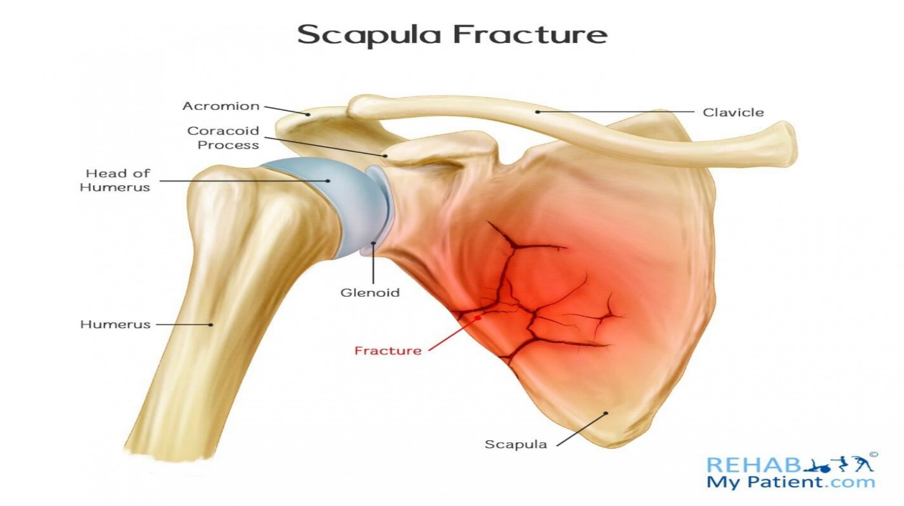
Scenario
A 32 YEAR MALE WAS BROUGHT TO THE SURGICAL EMERGENCY AFTER FIREARM INJURY TO THE NECK DURING SURGERY THE SUBCLAVIAN ATERY NEEDED TO BE LIGATED. THROUGH WHICH PHENOMENON THE BLOOD SUPPLY TO SHOULDER REGION WAS MAINTAINED ?

Slide 7
Features
Core Knowledge
Flat bone
Lies over 2nd to 7th rib
3 lateral projections
Coracoid
Spine
acromion

Slide 8
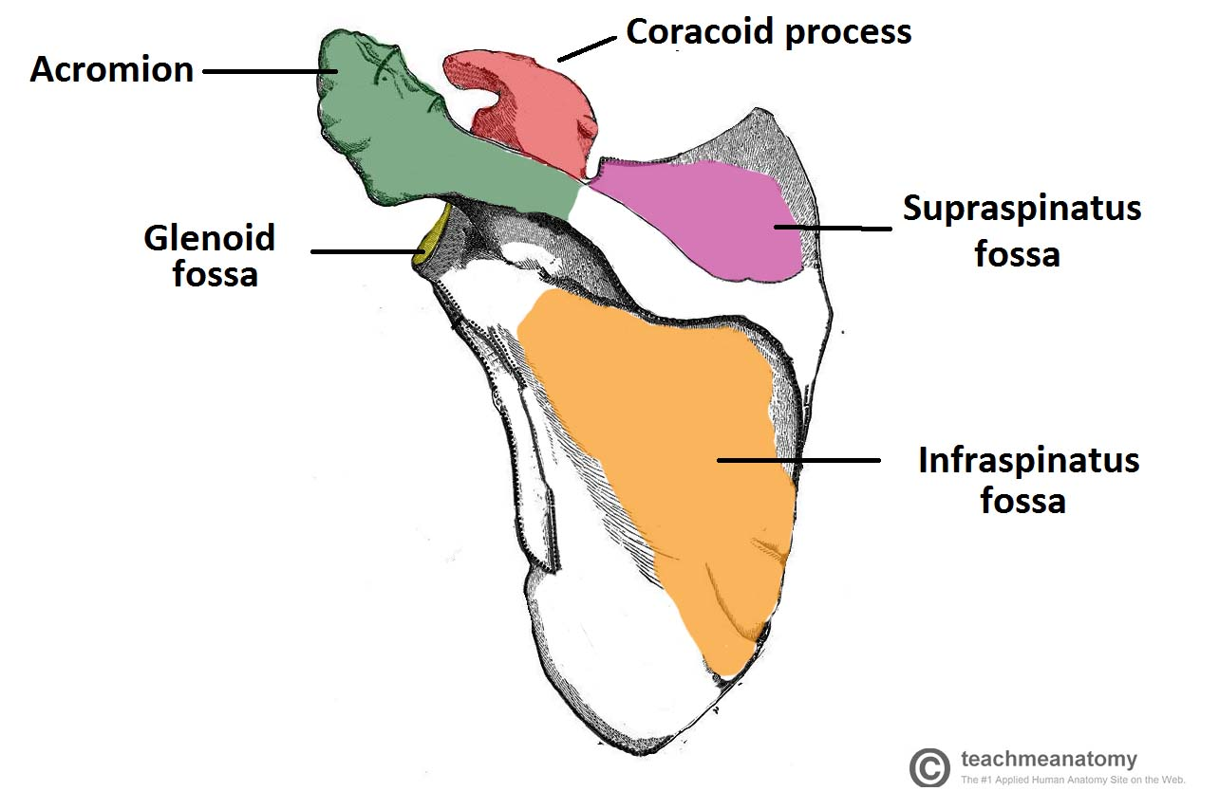
Core Knowledge

Slide 9
Surfaces 1. costal (anterior) 2. posterior
Core Knowledge
Fossa (3)
Subscapular – anterior surface
Supraspinuous fossa
Infraspinuous fossa
Posterior
surface

Slide 10
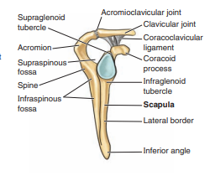
Core Knowledge

Slide 11
Core Knowledge

Slide 12
COSTAL SURFACE Borders Lateral Medial Superior
Core Knowledge

Slide 13
ANGLES Lateral Superior Inferior
Core Knowledge

Slide 14
POSTERIOR SURFACE Angles Borders
Core Knowledge

Slide 15
Attachments
Core Knowledge

Slide 16
ANASTOMOSIS
Core Knowledge
Communication Between The Blood Vessels To Develop Collateral Circulation
Around Acromion Process
Around Body Of The Scapula
subclavian artery and 3rd part of the axillary artery

Slide 17
Core Knowledge

Slide 18
Core Knowledge

Slide 19
Core Knowledge

Slide 20
MOVEMENTS
Core Knowledge

Slide 21
Clinical importance
Vertical Integration
Due to any injury or surgery if the axillary supply to shoulder region is interrupted
The subclavian blood flow will compensate for it (collateral circulation)

Slide 22
Scenario
Vertical Integration
A 32 YEAR MALE WAS BROUGHT TO THE SURGICAL EMERGENCY AFTER FIREARM INJURY TO THE NECK DURING SURGERY THE SUBCLAVIAN ATERY NEEDED TO BE LIGATED. THROUGH WHICH PHENOMENON THE BLOOD SUPPLY TO SHOULDER REGION WAS MAINTAINED ?

Slide 23
Family Medicine Of Scapula
Spiral Integration
Family Medicine
1. Scapular Fractures
Causes: Scapular fractures can occur due to high-impact trauma, like a car accident or fall. They can also result from sports injuries.
Symptoms: Pain, swelling, and difficulty moving the shoulder. Sometimes, fractures might be asymptomatic if they are minor.
Treatment: In most cases, non-surgical management such as rest, ice, and physical therapy is used. However, severe fractures might require surgery

Slide 24
Family Medicine Of Scapula
Spiral Integration
Rotator Cuff Tears
Description: A rotator cuff tear can involve damage to the tendons or muscles that surround the shoulder joint, and it often involves the scapula.
Causes: Acute trauma or gradual wear and tear due to overuse.
Symptoms: Pain, weakness, and difficulty lifting the arm.
Treatment: Non-surgical treatments may include physical therapy, corticosteroid injections, and pain management. Surgery may be necessary for larger tears.

Slide 25
Spiral Integration
Bioethics
Surgical Intervention: Ethical concerns arise in surgeries involving the scapula, such as joint replacements, fracture repairs, or reconstructions. Informed consent, risks, and the necessity of the procedure must be weighed carefully, especially when it involves potential long-term effects on mobility or quality of life.
Disability and Prosthetics: The ethical implications of developing and using prosthetics for scapular injuries (such as artificial shoulder blades or related shoulder components) raise questions around accessibility, fairness, and medical resource allocation. Additionally, considerations about the psychological and social impact of prosthetic use on the individual are significant.

Slide 26
Spiral Integration
Artificial Intelligence
AI in Medical Imaging for Scapula Conditions
AI Algorithms for Diagnostics: AI can be used to interpret medical images such as X-rays, MRIs, and CT scans, specifically focused on the scapula and shoulder. These algorithms can identify fractures, deformities, or other abnormalities in the scapula and shoulder joint with high precision. AI helps radiologists by offering automatic segmentation and detection, making it easier to detect conditions like fractures or rotator cuff tears.

Slide 27
Spiral Integration
Research Article

Slide 29
How To Access Digital Library
Steps to Access HEC Digital Library
Go to the website of HEC National Digital Library
On Home Page, click on the INSTITUTES
A page will appear showing the universities from Public and Private Sector and other Institutes which have access to HEC National Digital Library HNDL
Select your desired Institute
A page will appear showing the resources of the institution
Journals and Researches will appear
You can find a Journal by clicking on JOURNALS AND DATABASE and enter a keyword to search for your desired journal

Slide 31
Thank You

