Slide 1
SYSTEMIC DRUGS IN OPHTHALMOLOGY
Dr Wajeeha Rasool
(SR EYE)

Slide 2
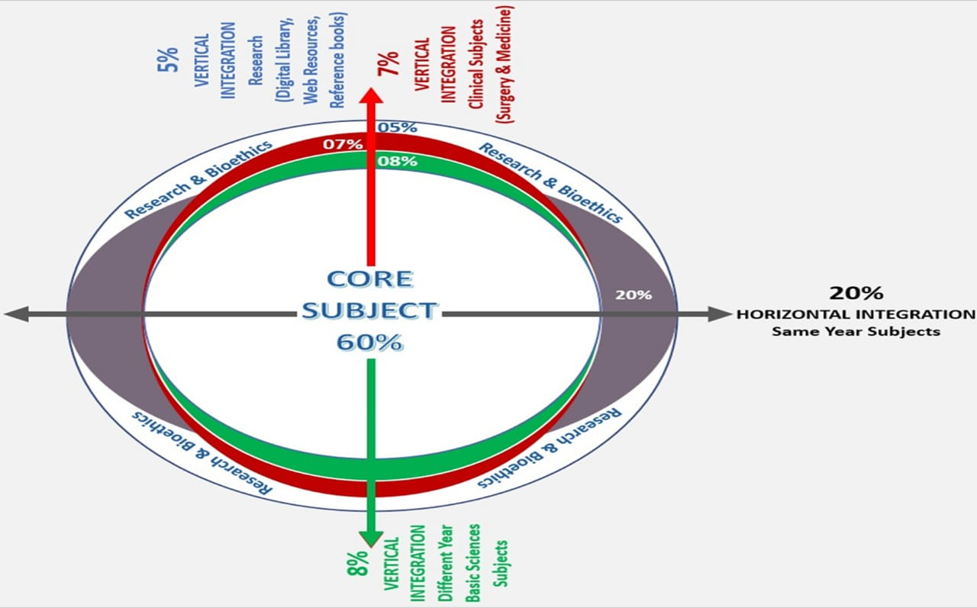
Components of Lecture
Core Subject
Spiral integration
Horizontal integration
Vertical integration
End of Lecture Assessment
Digital Library References (Recent advances, AI)

Slide 3
Learning Objectives
At the end of the lecture, student should be able to:
Classify the groups of systemic drugs used in ophthalmology
Enlist and understand the various systemic antiglaucoma, anti-inflammatory, antimicrobial, and cytotoxic drugs used in ophthalmology
Identify side effects associated with systemic drugs used in ophthalmology

Slide 4
Anti Glaucoma
Antiinflamatory
Antimicrobials
Cytotoxic
New

Slide 5
ANTI GLAUCOMA
CARBONIC ANHYDRASE INHIBITORS
Acetazolamide
250mg tablets TDS
500mg IV
Methazolamide
Dichlorophenamide

Slide 6
OSMOTIC AGENTS
Mannitol IV 20% sol
1g/kg bw or 5ml/kg bw
Glycerol PO 50% sol
1g/kg bw or 2ml/kg bw
Isosorbide

Slide 7
STEROIDS
TAB PREDNISOLONE 5mg
1mg/kg bw
TAB DEXAMETHASONE 5mg
IV METHYL PREDNISOLONE
IV push: OD 3days
Pulsed: once every alt day,3days

Slide 8
INDICATIONS
Severe uveitis
Complicated ocular surgery
Nectotizing Scleritis RA, wegners,PAN,SLE, Peripheral ulcerative keratitis RPC
Optic neuritis (MS, GCA)

Slide 9
NSAIDS
DISEASE | DRUG
EPISCLERITIS/NON NECROTIZING SCLERITIS | IBOPRUFEN 200MG TDS INDOMETHACIN

Slide 10
ANTIBIOTICS
DISEASE | ANTIBIOTICS
BACTERIAL PRESEPTAL CELLULITIS | CO-AOXICLAVULANATE/ FLUCLOXACILLIN
BACTERIAL ORBITAL CELLULITIS | CEFTAZIDIME+METRONIDAZOLE/ CEFUROXIME
SEV. GONOCOCCAL CONJUNCTIVITIS | CEFTRIAXONE/QUINOLONES/ MACROLIDES
SEV H. INFLUENZA CONJUNTIVITIS | CO-AOXICLAVULANATE
MENINGIOCOCCAL CONJUNCTIVITIS/KERATITIS | BENYL PENICILLIN/CEFTRIAXONE/ CEFOTAXIME/CIPROFLOXACILLIN
CHLAMYDIA TRACHOMATIS, BLEPHARITIS | AZITHROMYCIN/DOXICYCLIN
CORNEAL BURNS | DOXICYCLIN/TETRACYCLIN

Slide 11
ANTI FUNGAL DRUGS
DRUG | DISEASE
Voriconazole | Fungal keratitis
Itraconazole
Fluconazole
Amphotericin B | Mucormycosis

Slide 12
ANTI VIRAL DRUGS
DRUGS | DISEASE
Acyclovir | Herpes simplex keratitis (stromal & disciform) ,Uveitis HZO
Famcyclovir
Valacyclovir
Gancyclovir | PORN, ARN CMV retinitis.
Foscarnet

Slide 13
ANTI PARASITIC DRUGS
DRUGS | DISEASE
Pyrimethamine | Toxoplasmosis
Sulfadiazine
Cotrimoxzole
Atovequone
Azithromycin
Clindamycin
 | Toxocariasis
Mebandazole
Thibandazole

Slide 14
DRUG | DISEASE
Ivermectin | Onchocerciasis
Moxidectin
Doxycycline
Suramin
 | Cystesercosis
Albendazole

Slide 15
IMMUNOSUPRESSANTS
ANTIMETABOLITES
AZATHIOPRINE
METHOTREXATE
MYCOPHENOLATE
CALCINEURINE INHIBITORS
CYCLOSPORIN
TACROLIMUS
SIROLIMUS
CYTOTOXICS
CYCLPHOSPHAMIDE
CHLORAMBUCIL

Slide 16
NEW DRUGS
DRUGS | DISEASE
Interferon beta Teriflunomide Glatiramer | Multiple Sclerosis
Elperenone, Rifampacin | CSCR
Doxium | DR
Fenofibrates | DME

Slide 17
VITAMINS
DRUGS | DISEASE
Vitamin C,E | AMD
Zinc with copper
Lutein & Zeaxanthine
Vitamin A | RP

Slide 18
SYSTEMIC SIDE EFFECTS OF OCULAR DRUGS

Slide 19
OCULAR DRUGS | SYSTEMIC SIDE EFFECTS
TOP. BETA BLOCKERS | BRONCHOSPASM, BRADYCARDIA, HYPOTENSION, HEART BLOCK, WORSENING OF HEART FAILURE & RAYNAUDS, SLEEP DISORDERS, CONFUSION, DYSLIPIDEMIA, FATIGUE
TOP. ALPHA–2 AGONISTS | HYPOTENSION, CNS DEPRESSION IN YOUNG CHILDREN, HTN CRISIS WITH MAO INHIB
TOP. CAI INHIB. | BONE MARROW SUPPRESSION, SULPHA DRUG ALLERGIES
TOP. PILOCARPINE | HEADACHES, BRADYCARDIA, BRONCHOSPASM, URINARY FREQUENCY, GI DISTURB
TOP. ATROPINE | URINARY RETENTION,DRY MOUTH, CONSTIPATION

Slide 20
OCULAR DRUGS | SYSTEMIC SIDE EFFECTS
TOP. CYCLOPEN | FEVER IN YOUNG CHILDREN
TOP. PHENYLEPHRINE | CNS TOXIC IN YOUNG CHILDREN
INJ. ADRENALINE (per op) | HTN, TACHYCARDIA
INJ. LIGNOCAINE, BUPIVACAINE ( L/A) | RESP. DEPRESSION, ARRYTHMIAS CARDIOTOXICITY
INJ. KENACORT(I/L) | ADRENAL SUPRESSION
MITOMYCIN/ 5-FLOROURACIL (PER OP) | CARCINOGENIC

Slide 21
Recent Advancements: RHO Kinase Inhibitors
Rho kinase (ROCK) inhibitors may provide a new way to treat glaucoma.
This class of drugs is thought to increase aqueous outflow by reversing structural and functional damage at the trabecular meshwork, and the vasodilatory effect of some ROCK inhibitors reduces episcleral venous pressure.

Slide 22
End of Lecture Assessment
What are the systemic anti-glaucoma drugs used in ophthalmology?
Before prescribing a topical beta blocker, which systemic conditions should you enquire about from the patient?

Slide 23
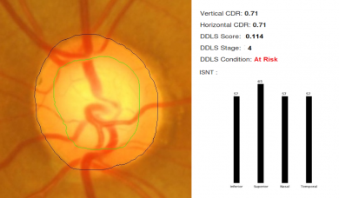
Role of Artificial Intelligence
Fundus Photographs, Li et al evaluated a deep learning algorithm that showed a high sensitivity (95.6%) and specificity (92%) to detect referable Glaucomatous Optic Neuropathy
AI software is being developed to map optic discs accurately and aid in glaucoma diagnosis

Slide 24
References
Kanski’s Clinical Ophthalmology
Clinical Ophthalmology – Shafi M. Jatoi
https://eyewiki.aao.org/Artificial_Intelligence_in_Glaucoma

