Slide 1
SYMPTOMATOLOGY IN SURGERY AND THEIR DIAGNOSTIC INVESTIGATIONS
Dr. Amna Nazir

Slide 2
What is symptomology ?
Study of symptoms and their clinical significance.
IMPORTANCE IN SURGERY ??
Guides initial evaluation.
Determines urgency of intervention.
Directs further diagnostic investigations.
Timely recognition and investigation guide surgical decision-making and improve patient outcomes.

Slide 3
Common Surgical Symptoms
Pain – Character, location, radiation, and duration.
Swelling – Gradual or sudden onset, associated symptoms.
Vomiting – Associated with gastrointestinal disorders.
Bleeding – Hematemesis, hematuria, melena.
Fever – Sign of infection or inflammation.
Jaundice – Suggestive of hepatobiliary disease.
Change in Bowel or Bladder Habits – Constipation, diarrhea, urinary retention.

Slide 4
Pain in Surgery – Key Considerations
Types of Pain:
Visceral pain: Dull, poorly localized (e.g., appendicitis, cholecystitis).
Somatic pain: Sharp, well-localized (e.g., peritonitis, trauma).
Referred pain: Pain felt at a distant site (e.g., gallbladder disease causing shoulder pain).
2. Acute vs Chronic pain
3. Site-Specific Diagnosis:
RUQ Pain: Cholecystitis, hepatitis, liver abscess.
Epigastric Pain: Peptic ulcer, pancreatitis, reflux.
RLQ Pain: Appendicitis, Crohn’s disease, Meckel’s diverticulum.
LLQ Pain: Diverticulitis, sigmoid volvulus.
Generalized Pain: Peritonitis, ischemic bowel, perforation

Slide 5
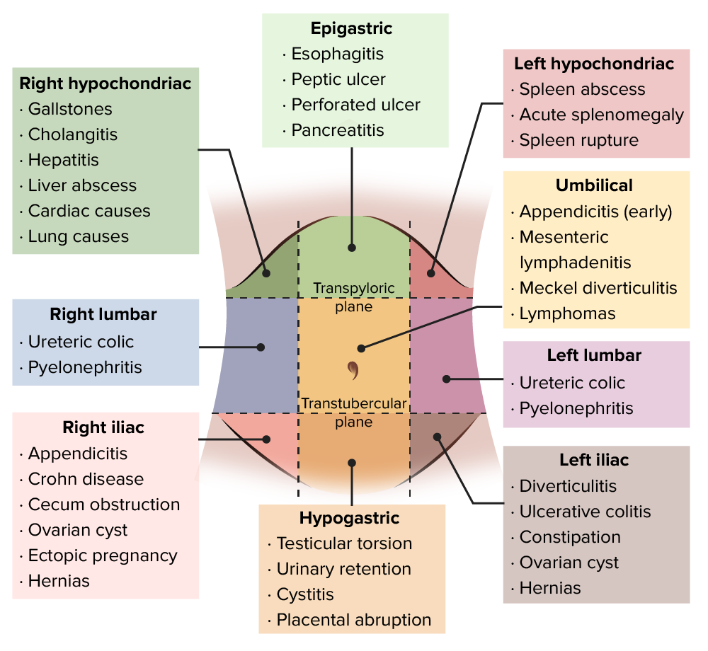
Investigations:
Blood tests (CBC, CRP, amylase/lipase, liver function tests).
Imaging: X-ray, ultrasound, CT scan, MRI.
Endoscopy (for GI causes like ulcers, malignancy).
Diagnostic laproscopy
Urine Pregnancy test to rule out ectopic pregnancy

Slide 6
Swellings and Masses
Characteristics to Consider:
Location, consistency, mobility.
Pulsatile (aneurysm?), fluctuant (abscess?), reducible (hernia?).
Common Causes: Hernia, lipoma, lymphadenopathy, abscess, neoplasm.
Investigations:
Ultrasound: Soft tissue, hernias, cysts.
CT/MRI: Deep-seated masses, malignancies.
Biopsy/FNAC: Cancer diagnosis.

Slide 7
Bleeding in Surgery
Types:
Hematemesis (upper GI bleed).
Melena (dark stools, upper GI bleed).
Hematochezia (bright red rectal bleeding).
Hematuria (urinary tract bleed).
Investigations:
CBC, coagulation profile.
Endoscopy (for GI bleeds).
Angiography (vascular causes).
CT scan (trauma-related bleeds).

Slide 8
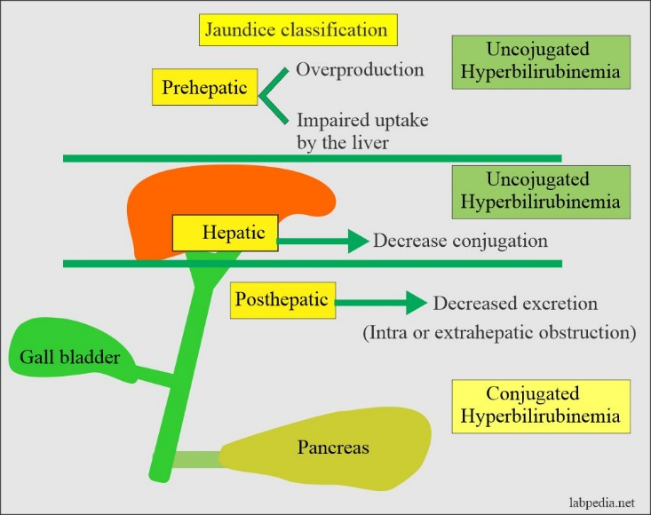
Jaundice in Surgical Patients
Types:
Pre-hepatic (hemolysis).
Hepatic (liver disease).
Post-hepatic (obstruction – gallstones, tumors).
Investigations:
LFTs (Bilirubin, AST, ALT, ALP, GGT).
Ultrasound (biliary obstruction).
MRCP/ERCP (choledocholithiasis, strictures).

Slide 9
Vomiting in Surgery
Causes:
Obstruction (pyloric stenosis, volvulus).Peritonitis.
Metabolic causes (electrolyte imbalance).
Investigations:
X-ray abdomen (air-fluid levels – obstruction).
CT abdomen (tumors, perforation).
Endoscopy (ulcers, gastritis).

Slide 10
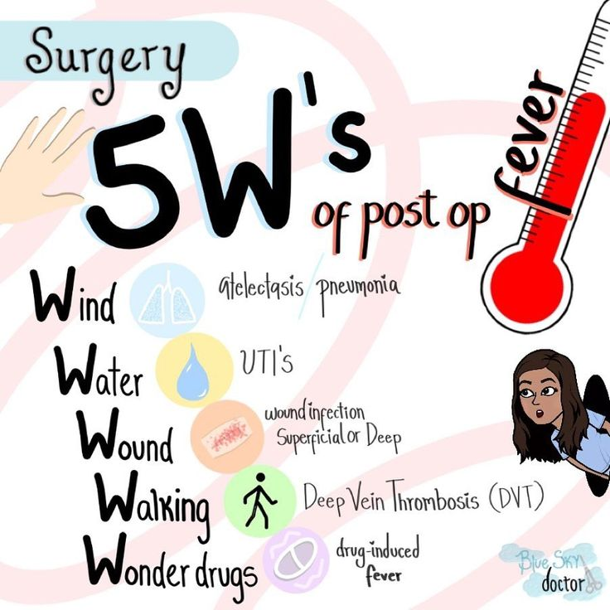
Fever in Surgical Conditions
Causes:
Post-operative infections, abscesses, septicemia, inflammatory diseases.
Investigations:
CBC (leukocytosis suggests infection).
Blood cultures (sepsis evaluation).
Imaging (CT, ultrasound to detect abscesses).
Urinalysis (for UTIs and pyelonephritis).

Slide 11
Investigations in Surgical Diagnosis
Laboratory Tests:
CBC (infection, anemia).
Electrolytes (renal function, dehydration).
LFTs, RFTs, Amylase/Lipase.
Imaging Studies:
X-ray: Free air (perforation), obstruction signs.
Ultrasound: Gallstones, hydronephrosis, abscess.
CT Scan: Tumors, trauma, ischemia, perforation.
MRI: Soft tissue tumors, biliary pathology.
Endoscopic Procedures:
Upper GI endoscopy (bleeding, ulcers).
Colonoscopy (colonic masses, inflammatory diseases).
ERCP/MRCP (biliary diseases).

Slide 12
THANK YOU

