Slide 2
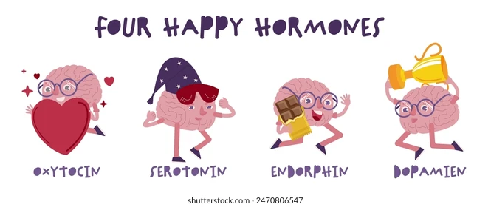
Special Senses Module 2nd Year MBBS(SGD) Neurotransmitters
Presenter: Sana Latif Date: 26-02-25
(Senior Demonstrator)

Slide 3
Motto, Vision, Dream
To impart evidence based research oriented medical education
To provide best possible patient care
To inculcate the values of mutual respect and ethical practice of medicine
Wisdom
Truth
Service

Slide 4
Professor Umar Model of Integrated Lecture

Slide 5
Learning Objectives
At the end of the SGD, students will be able to
Define & Classify Neurotransmitters
Discuss the Synthesis and Metabolism of Neurotransmitters
Explain diseases related to common neurotransmitters

Slide 6
Horizontal integration

Slide 7
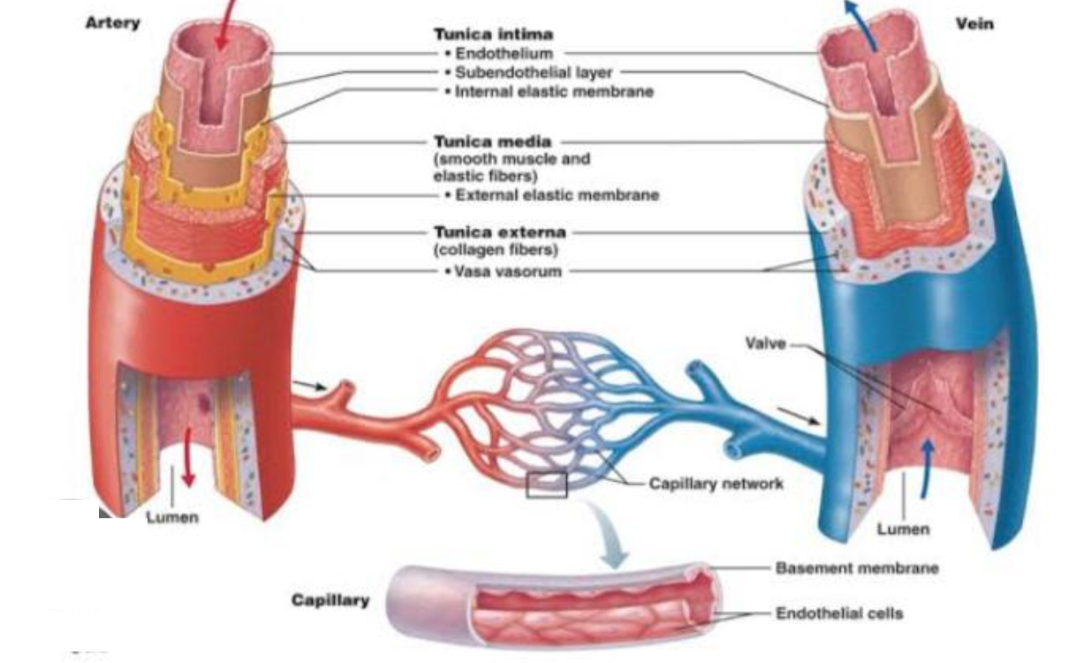
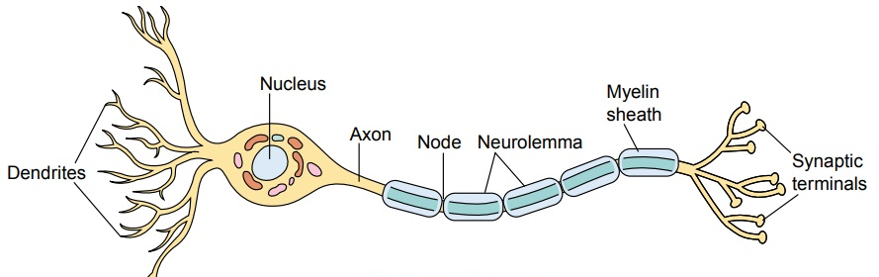
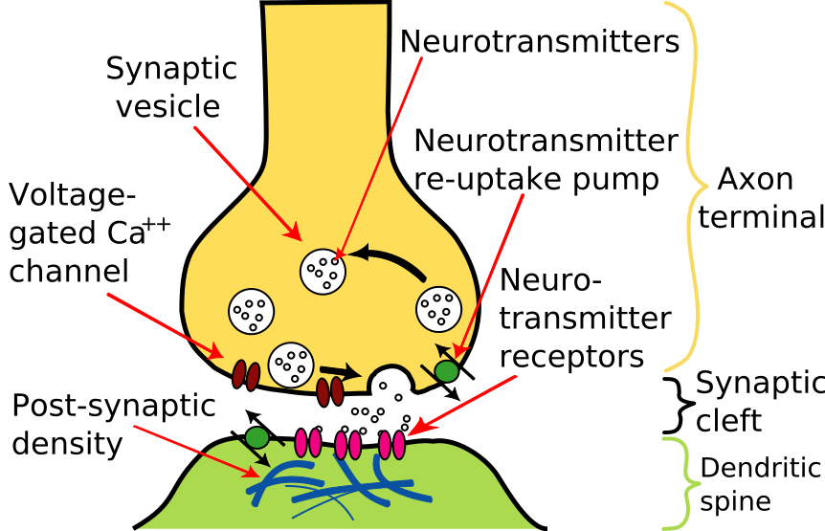
Anatomy of The Neuron
NEURON
SYNAPSE

Slide 8
Histology of the Synaptic Cleft
A synapse is the site of communication between a neuron and its target cell.
The term presynaptic cell/neuron refers to the neuron sending the signal, while
The term postsynaptic cell/neuron refers to the target cell receiving the signal.
Presynaptic cells communicate with postsynaptic cells by releasing neurotransmitters across a synapse through a process known as Synaptic Transmission.

Slide 9
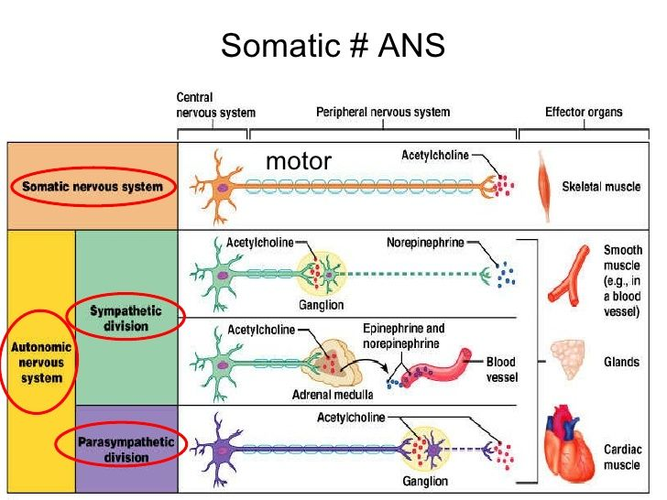
Physiology Of The Neurotransmitters
The nervous system uses neurotransmitters to help control a wide range of bodily functions, including:
Breathing
Heartbeat and blood pressure
Muscle movement/coordination
Hormone regulation
Digestion
Sensation/Perception
Sleep

Slide 10
Physiology Of The Neurotransmitters

Slide 11
Core Concept

Slide 12
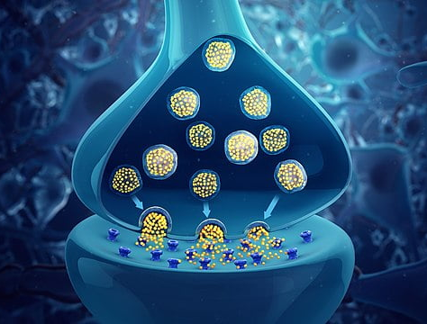
Neurotransmitters
Chemical messengers within the body which transmit cellular signals from neurons to various target cells in muscles, glands, or other nerves.

Slide 13
Classification of Neurotransmitters
Neurotansmitters can be classified on the basis of:
Chemical Structure
Effect on Post synaptic Cell

Slide 14
Chemical Classification of Neurotransmitters

Slide 15
Post Synaptic Effect Classification of Neurotransmitters

Slide 16
Esters
Acetylcholine
Precursor: Choline and Acetyl Co-A
Site: Nerve terminals
Degradation:
In the Synaptic Cleft by Acetyl Cholinesterase.

Slide 17
Monoamines
Catecholamines
Imidazolamines
Indolamines
Metabolised by Monoamine Oxidase Enzyme.

Slide 18
Catecholamines
Dopamine
Nor-epinephrine
Precursor: Tyrosine
Site: Brain

Slide 19
Catecholamines
Degradation:
Inactivation: Oxidative deamination by monoamine oxidase (MAO) and,
O-methylation by catechol-O methyltransferase(COMT) using SAM as the methyl donor.
The major end product of epinephrine and norepinephrine is Vanillyl Mandelic Acid( VMA).
Normal level of VMA excretion in urine is 2-4mg/2h hour.
The major end product of Dopamine is Homo Vanillic Acid (HVA)

Slide 20
Imidazolamines
Histamine
Precursor: Histidine
Site: Mast Cells

Slide 21
Indolamines
Serotonin
Precursor: Tryptophan
Site:
Throughout the body
Degradation:
by MAO to 5-hydroxy-3 indoleacetic acid (5-HIAA)

Slide 22
Amino Acids
GABA
Glutamate

Slide 23
Amino Acids
Glutamate
A Non-Essential Amino Acid.
Biosynthesis can occur throughout the body involving the reactions as shown.

Slide 24
Amino Acids
GABA
Precursor: Glutamate
Site: GABAergic Neurons

Slide 25
Nitric Oxide
Precursor: Arginine
Site: Cytosol
Function:
Affects other NTs such as on GABA for anti-anxiety and on Nor-Epinephrine release to inhibit pain.

Slide 26
Vertical Integration

Slide 27
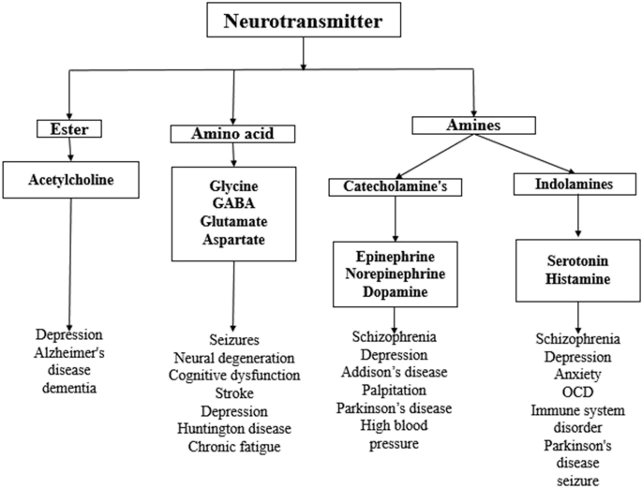
Vertical Integration

Slide 28
Spiral Integration

Slide 29
Family Medicine
Family Medicine plays important role in following manner:
Diagnosis through medical history ,physical examination and laboratory tests
Education and counselling of patient and family
Refer to Specialists
Monitoring and follow-up

Slide 30
Artificial Intelligence
Artificial Intelligence plays role in following aspects:
Personalized Nutrition
Diagnostic Tools
Food Recommendations
Drug Development

Slide 31
Suggested Research Article
Link:
https://www.e3s-conferences.org/articles/e3sconf/abs/2024/83/e3sconf_epec2024_05041/e3sconf_epec2024_05041.html
Journal Name:
E3S Web of Conferences
Volume 553 (2024)
Title:
Effects of sleep deprivation on typical neurotransmitters
Author Name:
Xuanyi Wang
Abstract:
Several evidence suggests that sleep deprivation (SD) leads to significant changes in the function of neurotransmitter receptors in different nerve cell types. So far, research in this area has focused on brain regions that promote wakefulness and sleep and the hippocampus, which is involved in learning and memory. When wakefulness is longer than the natural duration, there are some selective disruptions in the brain’s sensory processing and cognitive performance.The author of this article discusses sleep deprivation and brain self-clearance patterns, and then explores the relationship between three typical neurotransmitters and sleep deprivation, as well as the detection and change trends of neurotransmitters and their metabolites.It can then be used to assist in the early diagnosis of certain diseases.Of the three neurotransmitters, two can be defined as pleasure neurotransmitters and one is associated with the degenerative neurological disease AD(Alzheimer’s disease). The author also found that there are different response patterns between these neurotransmitters and SD.

Slide 32
Bioethics
Informed Consent
Health care must allocate sources fairly, transparently and equitably
Maintaining patient’s confidentiality
Research ethics
Spiral Integration

Slide 33
SGD Assessment
Q1. Which of the following belong to the Inhibitory type of neurotransmitters:
Glycine, GABA, Serotonin
Glutamate, Aspartate, Nitric Oxide
Acetylcholine, Norepinephrine, Dopamine
None of the above
Q2. Which of the following belong to the Excitatory type of neurotransmitters:
Glycine, GABA, Serotonin
Glutamate, Aspartate, Nitric Oxide
Acetylcholine, Norepinephrine, Dopamine
None of the above

Slide 34
SGD Assessment
Q3. Which of the following are both Excitatory & Inhibitory types of neurotransmitters:
Glycine, GABA, Serotonin
Glutamate, Aspartate, Nitric Oxide
Acetylcholine, Norepinephrine, Dopamine
None of the above
Q4. In Parkinson’s Disease levels of which neurotransmitter are reduced in the brain:
GABA
Dopamine
Acetylcholine
None of the above

Slide 35
SGD Assessment
Q5. In Alzheimer’s Disease levels of which neurotransmitter are reduced in the brain:
Serotonin
Dopamine
Acetylcholine
Norepinephrine

Slide 36
ASSESSMENT KEY
Q1: a
Q2: b
Q3: c
Q4: b
Q5: c

Slide 37
How to use HEC Digital Library
Steps to Access HEC Digital Library
Go to the website of HEC National Digital Library
http://www.digitallibrary.edu.pk
2. On Home Page, click on the INSTITUTES.
3. A page will appear showing the universities from Public and Private Sector and other Institutes which have access to HEC National Digital Library (HNDL).
4. Select your desired Institute.
5. A page will appear showing the resources of the institution
6. Journals and Researches will appear
7. You can find a Journal by clicking on JOURNALS AND DATABASE and enter a keyword to search for your desired journal.

Slide 38
Learning Resources
Text Book of Biochemistry Lippincott 8th Edition chapter 13, 19, 21
Google images
Google scholar

