Slide 2
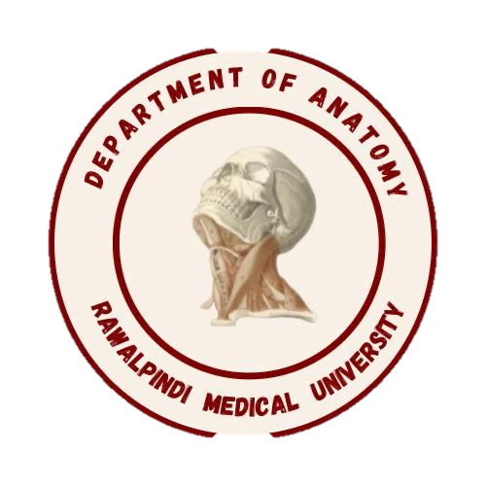
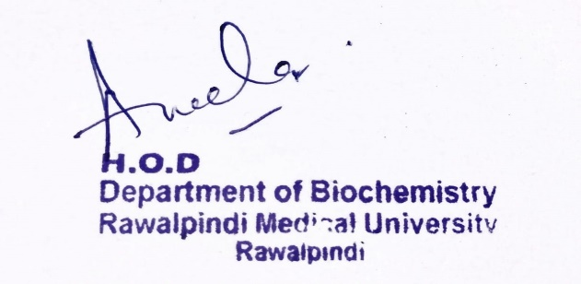
Blood and Immunity Module 1st Year MBBS(LGIS)
Presenter: Dr Uzma Zafar Date: 01-02-25
Deptt of Biochemistry
RMU

Slide 3
Motto, Vision, Dream
To impart evidence based research oriented medical education
To provide best possible patient care
To inculcate the values of mutual respect and ethical practice of medicine
Wisdom
Truth
Service

Slide 4
Professor Umar Model of Integrated Lecture

Slide 5
Learning Objectives
At the end of this session, students will be able to:
Understand the sources of heme and non heme iron
Describe the absorption of iron, its storage and transport
Explain the recycling, uptake and the deficiency of Iron in the body
Appreciate four principles of biomedical ethics

Slide 6
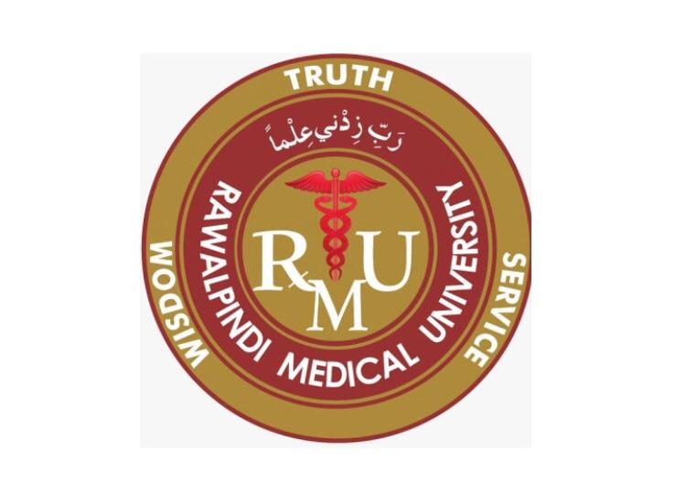
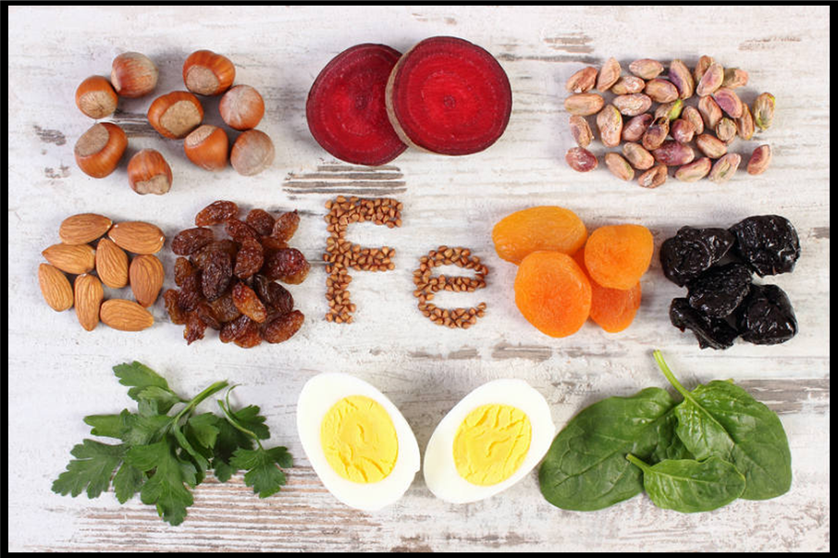
Iron: Introduction
Core Knowledge
Iron is a chemical element
With symbol Fe and atomic number 26
It is a metal and one of the micronutrient
It is, by mass, the most common element on Earth
Forming much of Earth's outer and inner core
Dietary requirements
Adult man - 10 mg/day
Menstruating woman - 18 mg/day
Pregnant and lactating woman - 40 mg/day

Slide 7
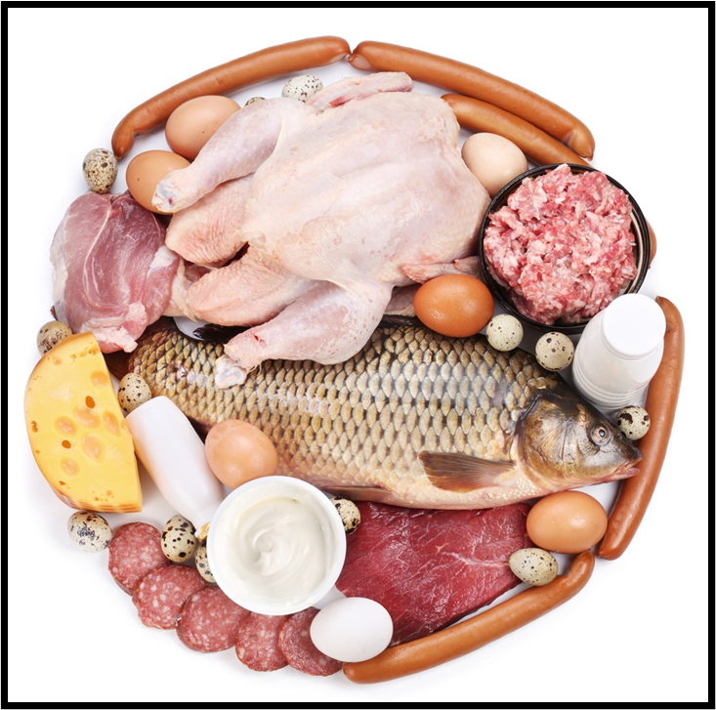
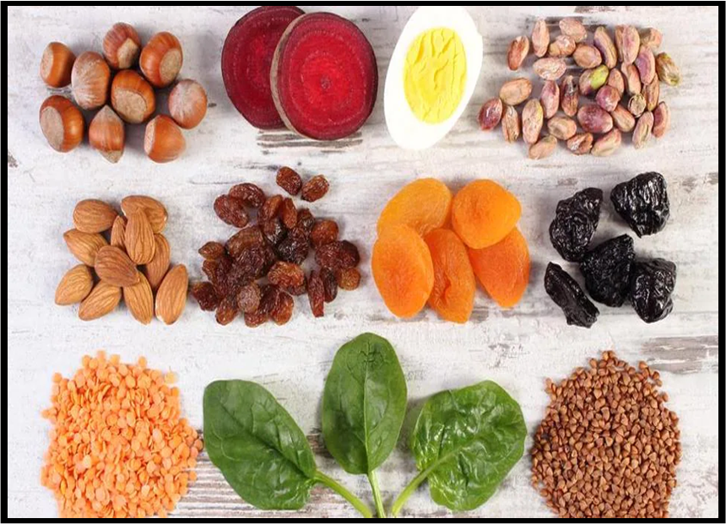
Core Knowledge
Sources of iron
Heme iron
Non-heme iron

Slide 8
Absorption, storage, and transport of Iron
Core Knowledge
Within the enterocytes, heme oxygenase releases Fe 2+ from heme.
Non-heme Fe is taken up via the apical membrane protein divalent metal ion transporter-1 (DMT-1).
Vitamin C enhances absorption of nonheme Fe because it is the coenzyme for duodenal cytochrome b [Dcytb], a ferrireductase that reduces Fe 3+ to Fe 2+.

Slide 9
Absorption, storage, and transport of Iron
Core Knowledge
Fate of Heme and Non Heme Iron Cont.
Cells other than enterocytes use the Cu-containing plasma protein ceruloplasmin in place of hephaestin.)
Ferroportin, the only known exporter of Fe from cells to the blood in humans, is regulated by the hepatic peptide hepcidin that induces internalization and lysosomal degradation of ferroportin.
Therefore, hepcidin is the central molecule in Fe homeostasis.

Slide 10
Absorption, storage, and transport of Iron
Core Knowledge
Fate of Heme and Non Heme Iron:
Absorbed Fe 2+ from heme and nonheme sources has two possible fates:
(1) oxidized to Fe 3+ and stored by the intracellular protein ferritin.
(2) transported out of the enterocyte by the basolateral membrane protein ferroportin, oxidized by the Cu-containing membrane protein hephaestin, and taken up by the plasma transport protein transferrin.

Slide 11
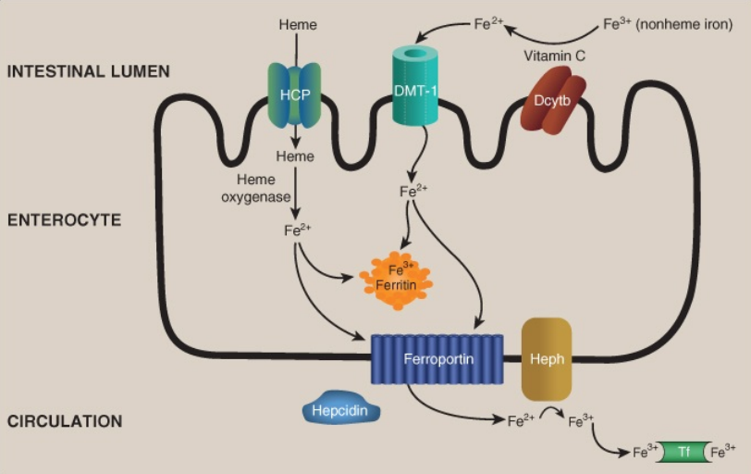
Core Knowledge
Absorption, storage, and transport of dietary iron (Fe). HCP = heme carrier protein; DMT = divalent metal ion transporter; Dcytb = duodenal cytochrome b (a ferrireductase); Heph = hephaestin; Tf = transferrin.

Slide 12
Recycling and uptake of Iron
Core Knowledge
The recycled Fe meets approximately 90% Of our daily need, which is predominantly for erythropoiesis.
Uptake: Tf-bound Fe 3+ from enterocytes and macrophages binds to receptors (TfR) on erythroblasts and other Fe-requiring cells and is taken up by receptor-mediated endocytosis.
The Fe 3+ is released from Tf for use (or stored on ferritin), and the TfR (and Tf) is recycled in a process similar to the receptor-mediated endocytosis seen with low-density lipoprotein particles.
Regulation of the translation of the messenger RNA for ferritin and the TfR by iron regulatory proteins and iron responsive elements.

Slide 13
Functions of iron in the body
Horizontal Integration
Iron mainly exerts its functions through the compounds in which it is present.
For example:
Haemoglobin and myoglobin are required for the transport of 02 and CO2
Cytochromes and certain non-heme proteins are necessary for electron transport chain and oxidative phosphorylation
Peroxidase, the lysosomal enzyme, is required for phagocytosis and killing of bacteria by neutrophils
lron boosts the immune system

Slide 14
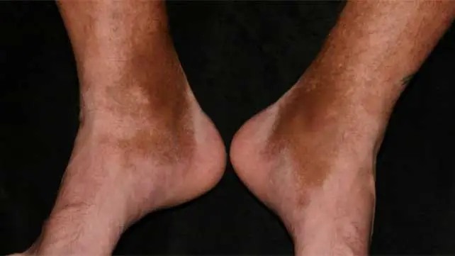
Vertical Integration
Hemosiderosis:
This is a less common disorder and is due to excessive iron in the body due to mutation of a protein hepcidin. It can result in hemosiderosis

Slide 15
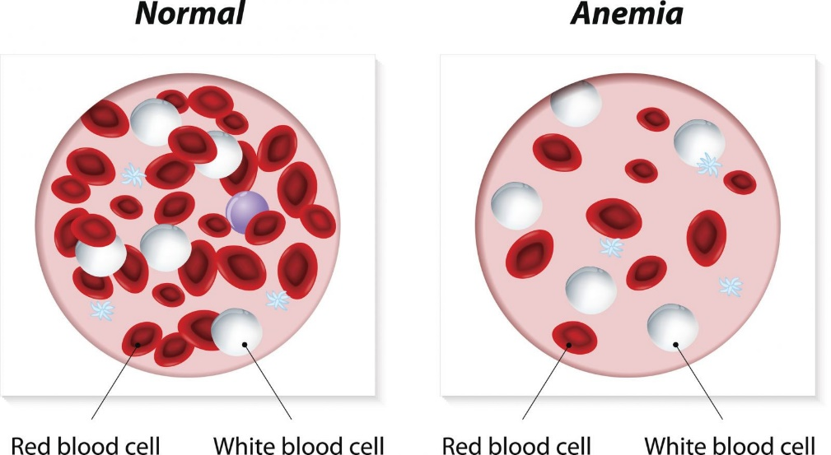
Disorders related to iron
Vertical Integration
Iron deficiency anemia:
This is the most prevalent nutritional disorder in World, including the well developed countries

Slide 16
Family Medicine
Spiral Integration
Family Medicine plays important role in following manner:
Diagnosis
Education
Dietary Guidance
Monitoring
Refer to Specialists

Slide 17
Artificial Intelligence
Spiral Integration
Artificial Intelligence plays role in following aspects:
Personalized Nutrition
Diagnostic Tools
Food Recommendations
Drug Development

Slide 18
Spiral Integration
Bioethics
Ethical Considerations
From an ethical standpoint, the scenario raises considerations regarding patient autonomy, informed consent, and confidentiality
The physician must ensure that patient fully understands her diagnosis, treatment options, and potential implications
Discuss the necessity of a healthy lifestyle & treatment plan. This requires clear communication and understanding of risks and benefits.
Additionally, the physician must respect patient’s privacy and confidentiality throughout the diagnostic and treatment process

Slide 19
Spiral Integration
Artificial Intelligence
Role of AI in (The Disease) Management
AI can potentially aid in enhancing diagnostic accuracy and efficiency.
AI-powered decision support systems can also help clinicians in selecting appropriate treatment modalities
AI-driven predictive models may help anticipate the risk of complications of the Disease in susceptible populations

Slide 20
Research Article
Iron deficiency anemia (IDA) is a global nutritional disorder affecting large population groups in varying magnitudes in different countries [1]. Such groups include vulnerable growing children, adolescent girls, pregnant and lactating women, and the aged. The physiological challenges of IDA, particularly those impacting growth and reproductive purposes, pose demands for increased daily iron requirements for these demographics. The daily iron needs of these vulnerable groups are commonly unmet because of inadequate iron intake, poor bioavailability, low absorption of iron due to the presence of inhibitors in the diet, or chronic blood loss, amongst others [2]. Consequently, evidence abounds regarding the deleterious and debilitating consequences of IDA on infants’ cognition, brain function, mental capability, work performance, and pregnancy outcomes [3,4]. Strategies to combat IDA include fortification of foods, iron supplementation to targeted groups, and attempts to explore and exploit food-based strategies to enhance iron absorption.
Link: https://www.mdpi.com/2072-6643/16/2/206
Journal name:
Nutrients 2024, 16(2), 206; https://doi.org/10.3390/nu16020206
Topic :
Iron Intake and Human Health
Authors:
Gladys O. Latunde-Dada

Slide 21
Reference
Lippincott Illustrated Reviews Biochemistry, 8th Edition, Chapter 29 , page no. 450
Google images
Textbook of Medical Biochemistry, 8th Edition MN Chatterjea Rana Shinde, page no 161

Slide 22
How To Access Digital Library
Steps to Access HEC Digital Library
Go to the website of HEC National Digital Library
On Home Page, click on the INSTITUTES
A page will appear showing the universities from Public and Private Sector and other Institutes which have access to HEC National Digital Library HNDL
Select your desired Institute
A page will appear showing the resources of the institution
Journals and Researches will appear
You can find a Journal by clicking on JOURNALS AND DATABASE and enter a keyword to search for your desired journal

Slide 23
Learning Resources
Lippincott Illustrated Reviews 8th Edition, Chap , pages -
Harper’s Illustrated Biochemistry 32nd Edition, Chap , pages –
Google images

Slide 24
THANK YOU

