Slide 1


Slide 2

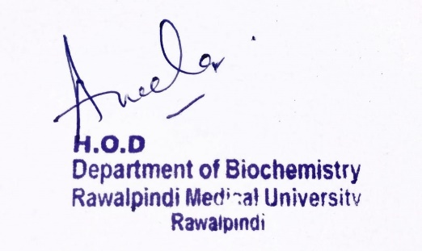
BIOCHEMISTRY
RESPIRATION MODULE
ELECTRON TRANSPORT CHAIN
SGD
Dept. of Biochemistry RMU DR Rahat Afzal
25-10-24 till 31-10-24
1

Slide 3
Motto, Vision, Dream
To impart evidence based research oriented medical education
To provide best possible patient care
To inculcate the values of mutual respect and ethical practice of medicine
Wisdom
Truth
Service

Slide 4
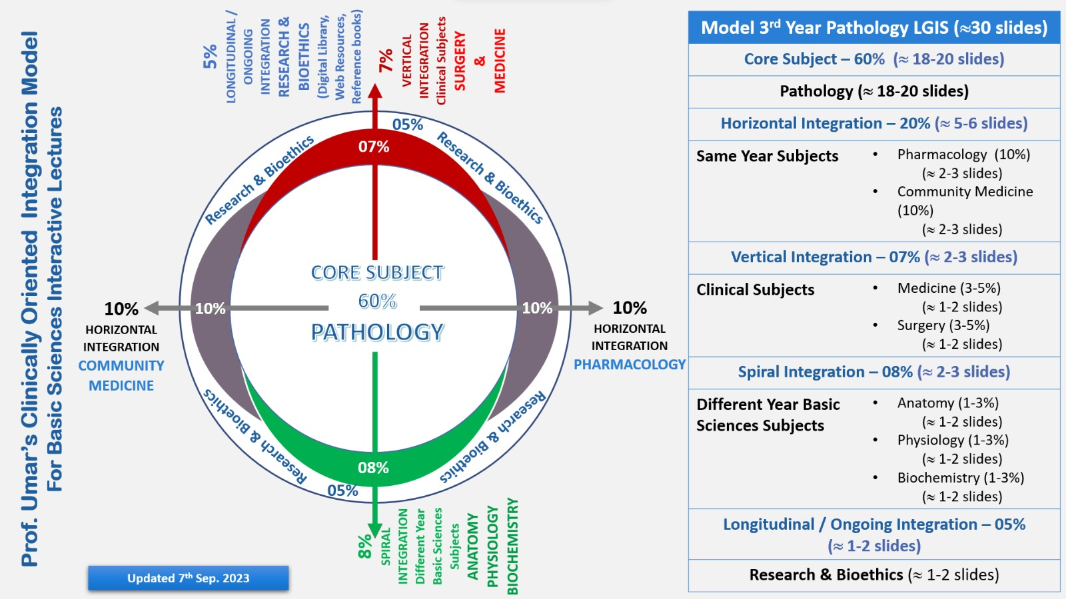
Professor Umar Model of Integrated Lecture

Slide 5
LEARNING OBJECTIVES
At the end of this session, students will be able to:
Understand Mitochondrial electron transport chain and its organization.
Describe the site specific inhibitors of ETC.
Explain the ETC reactions.

Slide 6
SGD
ELECTRON TRANSPORT CHAIN

Slide 7
CORE CONCEPT

Slide 8
INTRODUCTION
The metabolic intermediates of oxidation reactions donate electrons to specific coenzymes, nicotinamide adenine dinucleotide (NAD+) and flavin adenine dinucleotide (FAD), to form the energy-rich reduced forms,
NADH and FADH2.
These reduced coenzymes can, in turn, each donate a pair of electrons to a specialized set of electron carriers, collectively called the electron transport chain (ETC), As electrons are passed down the ETC, they lose much of their free energy.
This energy is used to move protons across the inner mitochondrial membrane, creating a proton gradient that drives the production of ATP from ADP and inorganic phosphate (Pi).
The coupling of electron transport with ATP synthesis is called oxidative phosphorylation, often denoted as OXPHOS

Slide 9
MITOCHONDRIAL ELECTRON TRANSPORT CHAIN
The ETC (except for cytochrome c; see p. 75) is located in the inner mitochondrial
Membrane
1. Membranes of the mitochondrion: The mitochondrion contains an outer and an
inner membrane separated by the intermembrane space. Although the outer
membrane contains special channels (formed by the protein porin), making it freely
permeable to most ions and small molecules, the inner membrane is a specialized
structure that is impermeable to most small ions, including protons and small
molecules such as ATP, ADP, pyruvate, and other metabolites important to
mitochondrial function
2. Matrix of the mitochondrion: These molecules include the enzymes responsible for the
oxidation of pyruvate, amino acids, and fatty acids (by β-oxidation) as well as those
of the tricarboxylic acid (TCA) cycle. The synthesis of glucose, urea, and heme
occurs partially in the matrix of mitochondria.

Slide 10
MITOCHONDRIAL ELECTRON TRANSPORT CHAIN
Organization of the electron transport chain
The inner mitochondrial membrane contains five separate protein complexes, called Complexes I, II, III, IV, and V. Complexes I–IV each contain part of the ETC.
These complexes accept or donate electrons to the relatively mobile electron carriers, coenzyme Q and cytochrome c. Each carrier in the ETC can receive electrons from an electron donor and can subsequently donate electrons to the next acceptor in the chain. The electrons ultimately combine with O2 and protons to form water. This requirement for O2 makes the electron transport process the respiratory chain, which accounts for the greatest portion of the body’s use of O2.

Slide 11
REACTIONS OF ELECTRON TRANSPORT CHAIN
With the exception of coenzyme Q, which is a lipid-soluble quinone, all members of
this chain are proteins. These may function as enzymes as is the case with the flavin containing
dehydrogenases, may contain iron as part of an iron-sulfur center, may
contain iron as part of the porphyrin prosthetic group of heme as in the cytochromes,
or may contain copper as does the cytochrome a + a3 complex
1. Formation of NADH: NAD+ is reduced to NADH by dehydrogenases that remove
two hydrogen atoms from their substrate. Both electrons but only one proton (that is, a hydride ion [:H–]) are transferred to the NAD+, forming NADH plus a free proton.

Slide 12
REACTIONS OF ELECTRON TRANSPORT CHAIN
2. NADH dehydrogenase: The free proton plus the hydride ion carried by NADH are
transferred to NADH dehydrogenase, a protein complex (Complex I) embedded in
the inner mitochondrial membrane. Complex I has a tightly bound molecule of flavin
mononucleotide (FMN), a coenzyme structurally related to FAD that accepts the two hydrogen atoms (2e– + 2H+), becoming FMNH2.
NADH dehydrogenase also contains peptide subunits with iron-sulfur centers. At Complex I, electrons move from NADH to FMN to the iron of the iron-sulfur centers and then to coenzyme Q. As electrons flow, they lose energy. This energy is used to pump protons across the inner mitochondrial membrane, from the matrix to the intermembrane space.
3. Succinate dehydrogenase: At Complex II, electrons from the succinate
dehydrogenase–catalyzed oxidation of succinate to fumarate move from the
coenzyme, FADH2, to an iron-sulfur protein, and then to coenzyme Q. [Note: No
energy is lost in this process, and, therefore, no protons are pumped at Complex II.]

Slide 13
REACTIONS OF ELECTRON TRANSPORT CHAIN
4. Coenzyme Q: Coenzyme Q (CoQ) is a quinone derivative with a long, hydrophobic
isoprenoid tail. It is also called ubiquinone because it is ubiquitous in biologic systems. CoQ is a mobile electron carrier and can accept hydrogen atoms from NADH dehydrogenase (Complex I), from succinate dehydrogenase (Complex II), and from other mitochondrial dehydrogenases: glycerophosphate dehydrogenase and acyl CoA dehydrogenase. CoQ transfers electrons to Complex III (cytochrome bc1). CoQ, then, links the flavoprotein dehydrogenases to the cytochromes.
5. Cytochromes: The remaining members of the ETC are cytochrome proteins. Each
contains a heme group (a porphyrin ring plus iron). Unlike the heme groups of
hemoglobin, the cytochrome iron is reversibly converted from its ferric (Fe3+) to its
ferrous (Fe2+) form as a normal part of its function as an acceptor and donor of
electrons. Electrons are passed along the chain from cytochrome bc1 (Complex III),
to cytochrome c, and then to cytochromes a + a3 (Complex IV) As
electrons flow, protons are pumped across the inner mitochondrial membrane at
Complexes III and IV.

Slide 14
REACTIONS OF ELECTRON TRANSPORT CHAIN
. Cytochrome a + a3: This cytochrome complex (Complex IV) is the only electron carrier in which the heme iron has an available coordination site that can react directly with O2 and so also is called cytochrome oxidase. At Complex IV, the transported electrons, O2, and free protons are brought together, and O 2 is reduced to water. Cytochrome oxidase contains copper (Cu) atoms that are required for this complicated reaction to occur. Electrons move from Cu A to cytochrome a to cytochrome a3 (in association with CuB) to O2.

Slide 15
REACTIONS OF ELECTRON TRANSPORT CHAIN
Site-specific inhibitors: Site-specific inhibitors of electron transport have been identified. These compounds prevent the passage of electrons by binding to a component of the chain, blocking the oxidation-reduction reaction. Therefore, all electron carriers before the block are fully reduced, whereas those located after the block are oxidized.

Slide 16
HORIZONTAL INTEGRATION

Slide 17
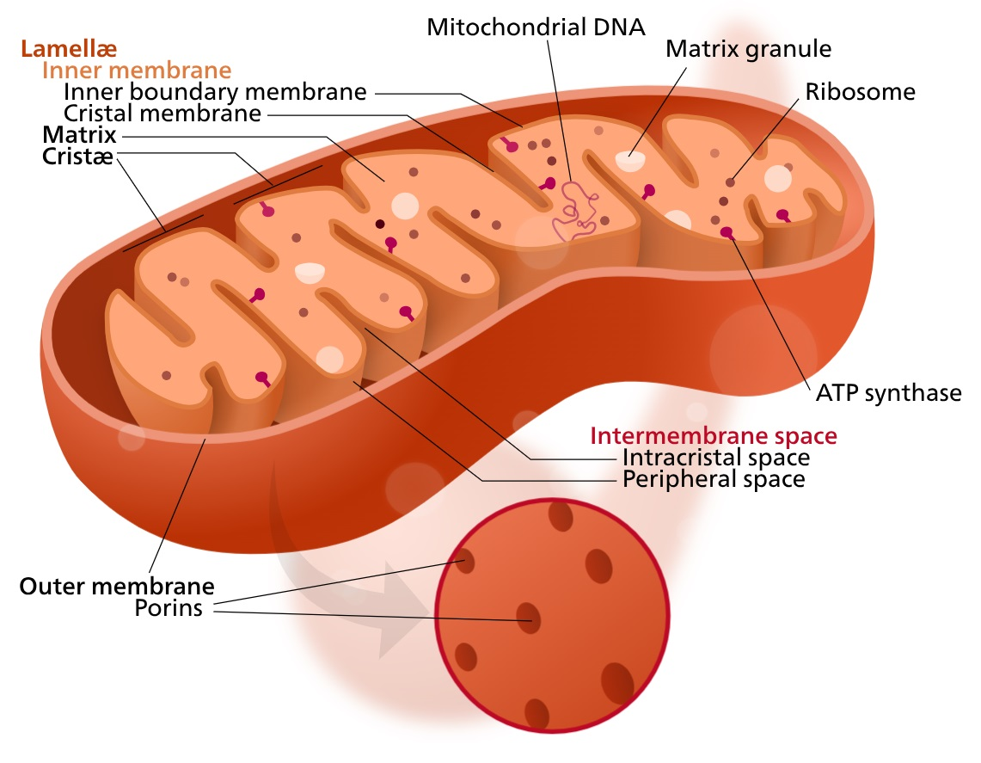
HORIZONTAL INTEGRATION

Slide 18
INTEGRATION WITH PHYSIOLOGY
1. ATP Production: The primary function of the ETC is to produce ATP, the molecule that stores and provides energy for various cellular activities
2. Redox Reactions: The ETC is responsible for transferring electrons from electron donors (such as NADH and FADH2) to electron acceptors (typically oxygen).
3. Proton Pumping: As electrons move through the protein complexes of the ETC, they actively pump protons (H+ ions) across the inner mitochondrial membrane, creating a proton gradient or electrochemical gradient.
4. Generation of Reactive Oxygen Species (ROS): During electron transport, some electrons may leak from the ETC and react with molecular oxygen to produce reactive oxygen species (ROS), such as superoxide radicals.
5. Oxygen Consumption: The ETC is the final destination for electrons in the process of aerobic respiration.

Slide 19
VERTICAL INTEGRATION

Slide 20
Disorders of ETC
Mitochondrial Myopathies
Leigh Syndrome
Leber's Hereditary Optic Neuropathy (LHON)
MELAS Syndrome (Mitochondrial Encephalomyopathy, Lactic Acidosis, and Stroke-like Episodes)
Kearns-Sayre Syndrome (KSS)
NARP Syndrome (Neuropathy, Ataxia, and Retinitis Pigmentosa

Slide 21
SPIRAL INTEGRATION

Slide 22

The principle of beneficence is the obligation of physician to act for the benefit of the patient and supports a number of moral rules to protect and defend the right of others, prevent harm, remove conditions that will cause harm, help persons with disabilities, and rescue persons in danger.
It is worth emphasizing that, the language here is one of positive requirements. The principle calls for not just avoiding harm, but also to benefit patients and to promote their welfare.
Beneficence

Slide 23
Family Medicine
Diagnosis
Education
Dietary guidance
Monitoring
Refer to specialist

Slide 24
Artificial Intelligence
Image Analysis
Patient monitoring
Robot assisted surgery
Drug development

Slide 25
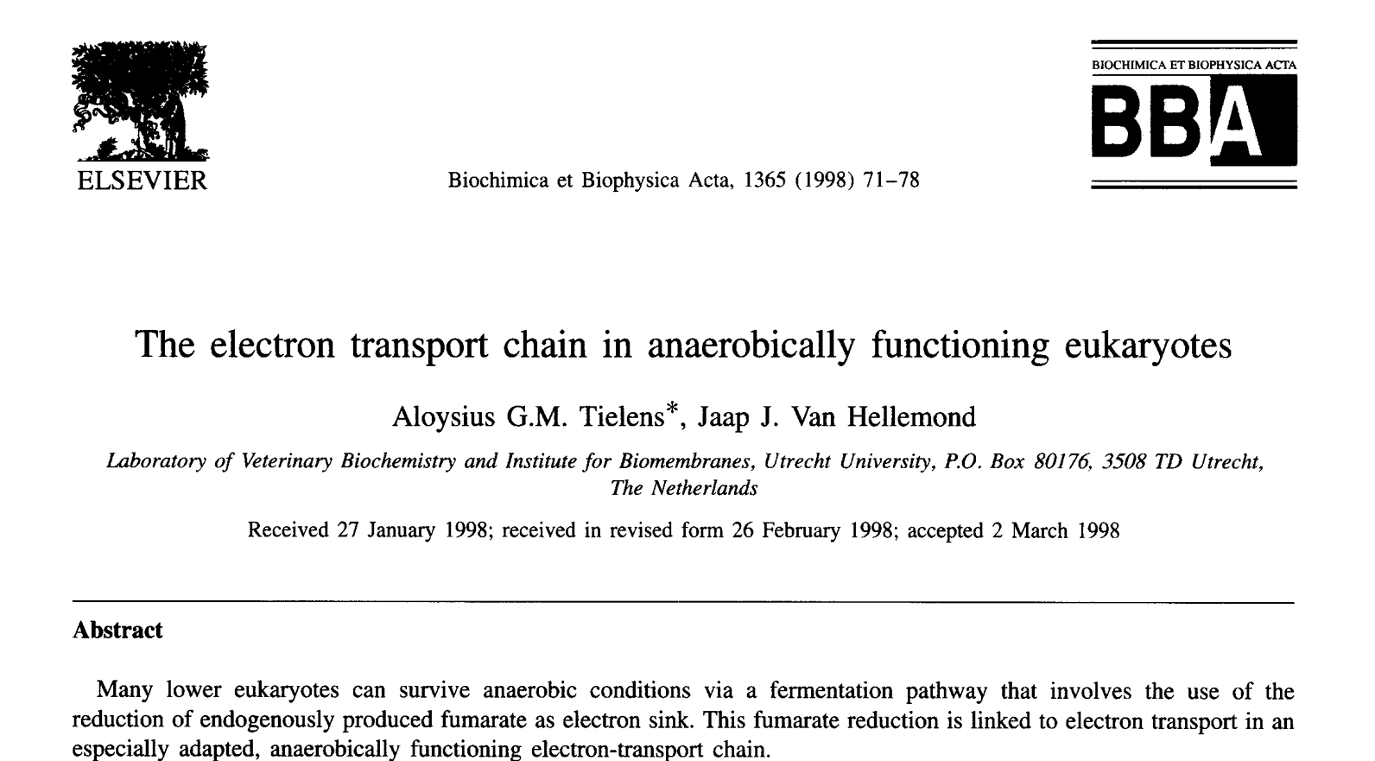
RESEARCH ARTICLE
https://www.sciencedirect.com/science/article/pii/S0005272898000450

Slide 26
Learning Resources
Textbook of Biochemistry, Lippincott 8th edition, chapter no 09
Google scholar
Google images

Slide 27
HOW TO USE HEC DIGITAL LIBRARY
Steps to Access HEC Digital Library:
Go to the website of HEC National Digital Library
http://www.digitallibrary.edu.pk
2. On Home Page, click on the INSTITUTES.
3. A page will appear showing the universities from Public and Private Sector and other Institutes which have access to HEC National Digital Library (HNDL).

Slide 28
How to use Digital Library
4. Select your desired Institute.
5. A page will appear showing the resources of the institution
6. Journals and Researches will appear
7. You can find a Journal by clicking on JOURNALS AND DATABASE and enter a keyword to search for your desired journal.

Slide 29
MCQS
1. 2,4-Dinitrophenol, an uncoupler of oxidative phosphorylation, was used as a weight loss agent in the 1930s. Reports of fatal overdoses led to its discontinuation in 1939. Which of the following would most likely be true concerning individuals taking 2,4- dinitrophenyl?
A. Adenosine triphosphate levels in the mitochondria are greater than normal.
B. Body temperature is elevated as a result of hyper metabolism.
C. Cyanide has no effect on electron flow.
D. The proton gradient across the inner mitochondrial membrane is greater than
normal.
E. The rate of electron transport is abnormally low

Slide 30
MCQS
2. Which of the following has the strongest tendency to gain electrons?
A. Coenzyme Q
B. Cytochrome c
C. Flavin adenine dinucleotide
D. Nicotinamide adenine dinucleotide
E. Oxygen

Slide 31
MCQS
3. Person with defects in oxidative phosphorylation most often developed their condition from
Acquired damage to autosomal genes
Inheritance of a mutation on mitochondrial DNA
Mutations inherited from their father
X-Linked inheritance from their mother
None of above

Slide 32
MCQS
4. Another source of electrons for the transport chain is
NAD
NADH2
FADH2
FAD

Slide 33
MCQS
5. Which is the first molecule of electron transport chain
NADH
Flavoprotien
NADH2
FADH

Slide 34
KEY
1. B
2. E
3. B
4. C
5. B

Slide 35


