Slide 2
RHESUS INCOMPATIBILITY
DR. FARAH DEEBA
MBBS, FCPS, HCQM,ACRM,MHPE
Assistant professor
Gynae/Obs unit II,HFH,RWP

Slide 3
Ground Rules
Notes:
Lets set some ground rules for discussion, may I request you to plrase put your mobiles on silent, Your active participation is highly appreciated , to ask questios please take your by raising hands, We will park the lengthy discussios for end of session.

Slide 4
University Motto, Vision, Values & Goals
Mission Statement
To impart evidence-based research-oriented health professional education
Best possible patient care
Mutual respect, ethical practice of healthcare and social accountability.
Vision and Values
Highly recognized and accredited centre of excellence in Medical Education, using evidence-based training techniques for development of highly competent health professionals, who are lifelong experiential learner and are socially accountable.
Goals
The Undergraduate Integrated Learning Program is geared to provide you with quality medical education in an environment designed to.

Slide 5
SEQUENCE OF LGIS
Learning objectives
Rh incompatibility
(core concept = 70%)
Related pathophysiology (horizontal integration 15%)
Related clinical findings (vertical integration – 10%)
Research article related to topic (3%)
Ethics (2%)

Slide 6
PROF UMER MODEL OF INTEGRATED LECTURE

Slide 7
Learning Objectives By the end of this lecture, you will be able to
Understand the pathophysiology of Rh incompatibility
Get an insight into fetal and maternal complication
Learn the basic management principles

Slide 8
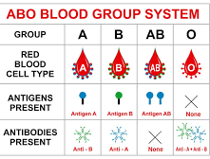
Blood groups are defined in 2 ways
ABO (A,B,O,AB) and Rhesus (C,D,E antigen)
Major difference from ABO system is antibodies don’t form spontaneously
Rh blood system is important in blood transfusion

Slide 9
What is Rh factor?
A type of protein on the outside or surface of your red blood cells.
You inherit the protein, which means you get your Rh factor from your biological parents.
If you have the protein, you’re Rh-positive.
If you don’t have the protein, you’re Rh-negative.
The majority of people, about 85%, are Rh-positive.

Slide 12
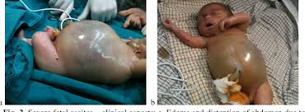
DEFINITION (Rh incompatibility)
Also known as erythroblastosis fetalis/ haemolytic disease of newborn
Disease of newborn or foetus characterised by agglutination and phagocytosis of fetus red blood cells

Slide 13
INCIDENCE
Chinese and Japanese 1 %
Basque 30-35%
In north American blacks 15% and in whites 7-8%
African American 4-8%
Caucasian 15-16%
In Pakistan 7.5%

Slide 14
Hemolytic Disease of Newborn
Mother is Rh negative and father is Rh positive
The baby inherits Rh positive antigen from father
Mother develops anti rh antibodies when exposed to fatal Rh antigen
Mothers antibodies diffuse through placenta and into foetus and cause fatal red cell agglutination

Slide 15
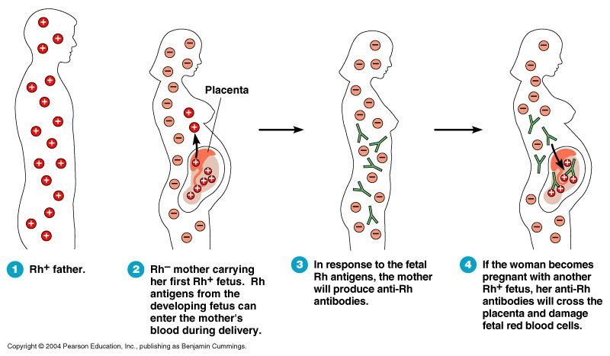

Slide 16
Risks of Rh Incompatibility Effect
Rh+ve father Rh-ve mother
Rhesus antibodies
Rh+ve cells
Miscarriage/ Termination of pregnancy
Ectopic pregnancy Amniocentesis Antepartum haemorrhage Delivery of placenta
Pass to 2nd Rh+ve baby
Hemolysis of Rh +ve cells
1st Rh+ve baby Usually unaffected
Fetal Anemia
Intrauterine transfusion Postnatal exchange transfusion
Hydrops fetalis
Treatment
Oct-15
Rhesus Incompatibility
16

Slide 17
AMOUNT NEEDED FOR SENSITISATION
EXPOSURE TO ML OF RH POSITIVE ERTHROCYTES | SENSITIZATION %
1 ml | 15%
40 ml | 30 %
250 ml | 65%

Slide 18
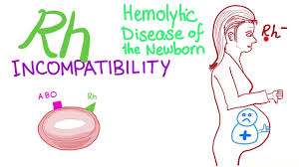
RH ISO IMMUNIZATION CAUSES
Mismatch blood transfusion
Rh negative mother bearing Rh positive baby with fetomaternal hemorrhage

Slide 19
CAUSES OF FETO MATERNAL HEMORRHAGE
Miscarraige
APH
Ectopic pregnancy
Molar pregnancy
Termination of pregnancy
Invasive prenatal testing (CVS ,Amniocentesis ,ands cordocentesis)
E.C.V
Delivery

Slide 20
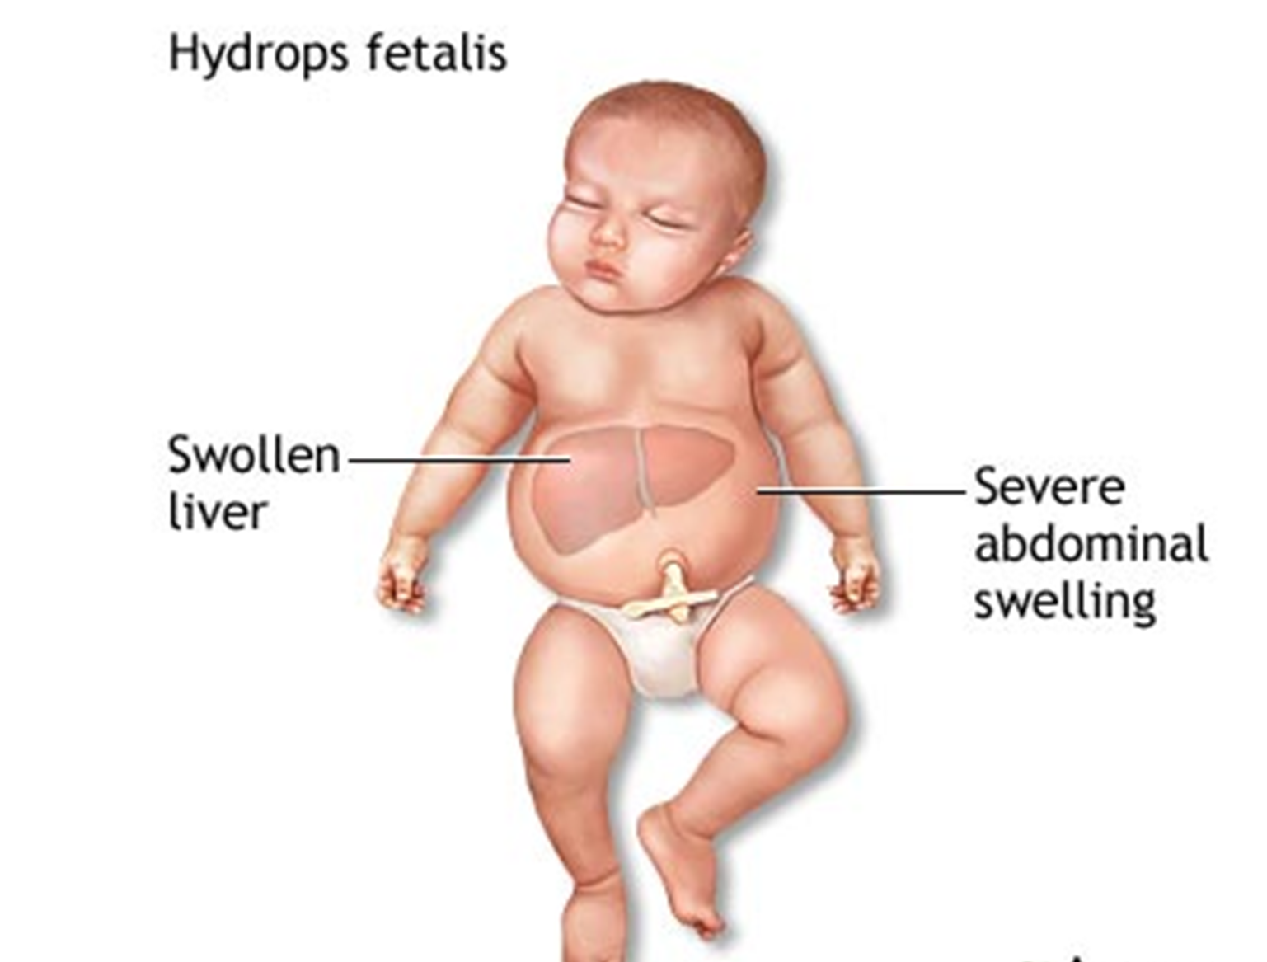
Complications
Hydrops fetalis and stillbirth
Neonatal jaundice
Complications of neonatal kernicterus (lethargy, hypertonicity, hearing loss, cerebral palsy, and learning disability)
Congenital anemia of new born`

Slide 21
Prevention
Prophylactic anti-D at 28 weeks,34 weeks
Prophylactic anti-D 250 IU after any sensitizing event before 20 weeks
Prophylactic anti-D 500 IU after any sensitizing event after 20 weeks
Prophylactic anti-D 500 IU after delivery within72hrs (max 10 days)

Slide 22
Screening and Diagnosis
Maternal blood grouping at their 1st antenatal visit
Presence of anti –D antibodies in serum is diagnostic of maternal rh isoimmunization

Slide 23
Investigations:
Anti-D level | Outcome
<4IU/mL | HDFN unlikely
4-15IU/mL | Moderate risk of HDFN
>15IU/mL | High risk of hydrops fetalis
If antibody levels rise, the baby should be examined for signs of anemia.
Fetal middle cerebral artery (MCA) blood flow is measured at intervals of 1 to 2 weeks depending on titers and patient history.
The purpose is to detect high-output heart failure and fetal anemia.

Slide 24
Ultrasound findings

Slide 27
Management of Sensitized Mother
Measurement of antibody levels in titers at regular intervals,
Amniocentesis for bilirubin levels
Serial ultrasound for detection of hydrops and management of neonatal anemia and hyperbilirubinemia. MCA doppler
Referral of these women is the correct approach at fetal medicine center.

Slide 28
Treatment
Intrauterine transfusion
Decide mode and time of delivery
Exchange transfusion after delivery
Phototherapy after delivery
Top-up transfusion
(Hb falls below 7g/dl, prophylactic :oral folate)
28

Slide 29
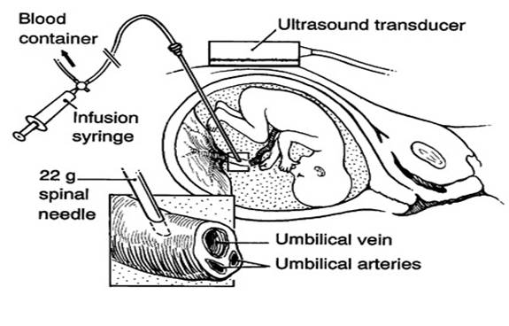

Slide 30
RESEARCH
Costumbrado J, Mansour T, Ghassemzadeh S. Rh Incompatibility. 2022 Dec 11. In: StatPearls [Internet]. Treasure Island (FL): StatPearls Publishing; 2023 Jan–. PMID: 29083656.
Pegoraro V, Urbinati D, Visser GHA, Di Renzo GC, Zipursky A, Stotler BA, Spitalnik SL. Hemolytic disease of the fetus and newborn due to Rh(D) incompatibility: A preventable disease that still produces significant morbidity and mortality in children. PLoS One. 2020 Jul 20;15(7):e0235807. doi: 10.1371/journal.pone.0235807. PMID: 32687543; PMCID: PMC7371205.

Slide 31
BIOMEDICAL ETHICS
All women at risk should be given inj Anti-D
All pregnant women should be screened at first visit

Slide 32
FAMILY MEDICINE
All sensitized pregnant women should be referred to Fetal medicine unit for proper monitoring and early treatment.

Slide 33
Oct-15
Rhesus Incompatibility
33

