Slide 1



Slide 2
RHESUS INCOMPATIBILITY
DR. FARAH DEEBA
MBBS, FCPS, HCQM,ACRM,MHPE
Assistant professor
Gynae/Obs unit II,HFH,RWP

Slide 3


Prof. Umar’s Model of Teaching Strategy
Self Directed Learning Assessment Program
First Ten Minutes
Objectives :
To cultivate critical thinking, analytical reasoning, and problem-
solving competencies.
To instill a culture of self-directed learning, fostering lifelong
learning habits and autonomy.
How to Assess?
➢
Ten randomly selected students will be evaluated within the first 10 minutes of the lecture through 10 multiple-choice questions (MCQs) based on the PowerPoint presentation shared on Students Official WhatsApp group, one day before the teaching session.
➢
The number of MCQs from the components of the lecture will follow
the guidelines outlined in the Prof. Umar model of Integrated Lecture.
Component of LGIS
Core Know ledge
Horizontal Integration
Vertical Integration
Spiral Integration
No of MCQs
6-7
1-2
1
1

Slide 4
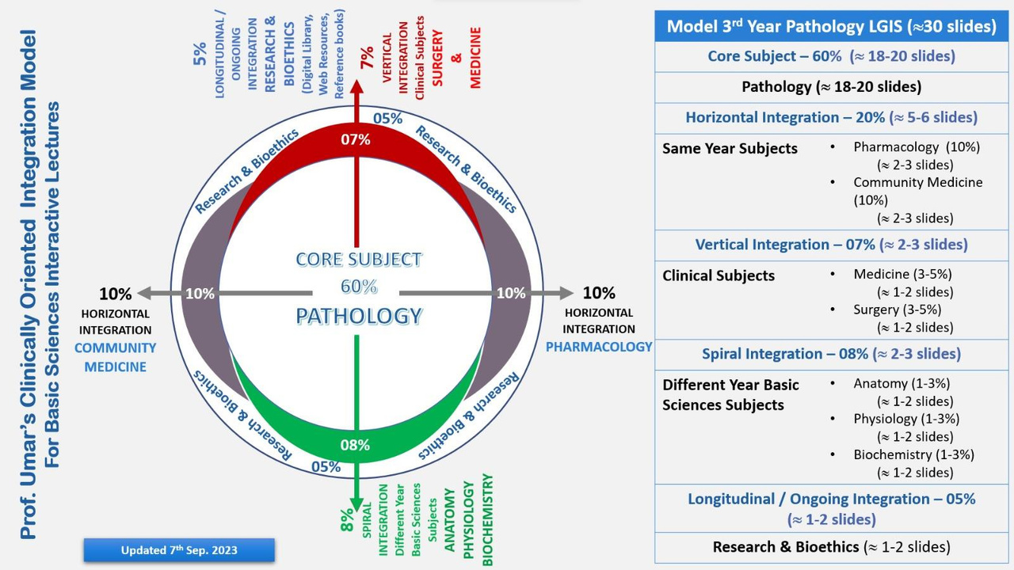
Professor Umar Model of Integrated Lecture
3

Slide 5


Ground Rules
Notes:
Lets set some ground rules for discussion, may I request you to plrase put your mobiles on silent, Your active participation is highly appreciated , to ask questios please take your by raising hands, We will park the lengthy discussios for end of session.

Slide 6
University Motto, Vision, Values & Goals
Mission Statement
To impart evidence-based research-oriented health professional education
Best possible patient care
Mutual respect, ethical practice of healthcare and social accountability.
Vision and Values
Highly recognized and accredited centre of excellence in Medical Education, using evidence-based training techniques for development of highly competent health professionals, who are lifelong experiential learner and are socially accountable.
Goals
The Undergraduate Integrated Learning Program is geared to provide you with quality medical education in an environment designed to.

Slide 7
SEQUENCE OF LGIS
Learning objectives
Rh incompatibility
(core concept = 70%)
Related pathophysiology (horizontal integration 15%)
Related clinical findings (vertical integration – 10%)
Research article related to topic (3%)
Ethics (2%)

Slide 8
Learning Objectives
By the end of this lecture, you will be able to
Understand the pathophysiology of Rh incompatibility
Get an insight into fetal and maternal complication
Learn the basic management principles

Slide 9
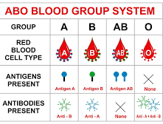
Blood groups are defined in 2 ways
ABO (A,B,O,AB) and Rhesus (C,D,E antigen)
Major difference from ABO system is antibodies don’t form spontaneously
Rh blood system is important in blood transfusion

Slide 10
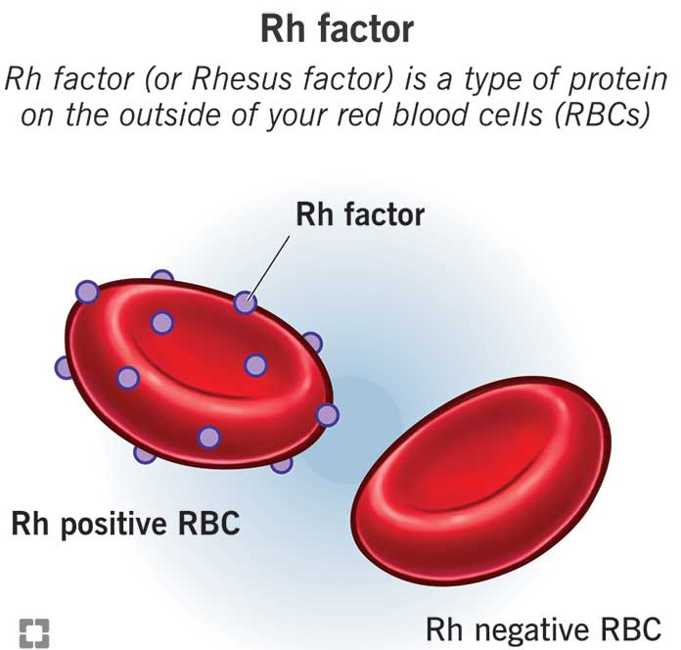
What is Rh factor?
A type of protein on the outside or surface of your red blood cells.
You inherit the protein, which means you get your Rh factor from your biological parents.
If you have the protein, you’re Rh-positive.
If you don’t have the protein, you’re Rh-negative.
The majority of people, about 85%, are Rh-positive.

Slide 11
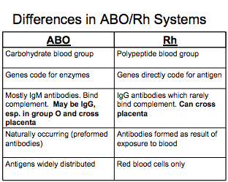

Slide 12
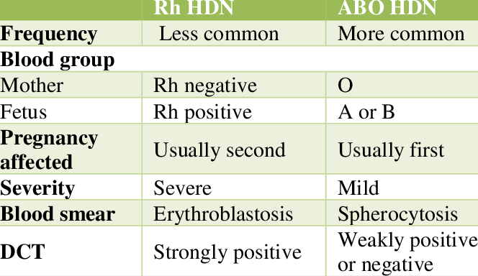

Slide 13
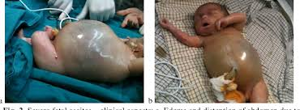
DEFINITION (Rh incompatibility)
Also known as erythroblastosis fetalis/ haemolytic disease of newborn
Disease of newborn or foetus characterised by agglutination and phagocytosis of fetus red blood cells

Slide 14
INCIDENCE
Chinese and Japanese 1 %
Basque 30-35%
In north American blacks 15% and in whites 7-8%
African American 4-8%
Caucasian 15-16%
In Pakistan 7.5%

Slide 15
Hemolytic Disease of Newborn
Mother is Rh negative and father is Rh positive
The baby inherits Rh positive antigen from father
Mother develops anti rh antibodies when exposed to fatal Rh antigen
Mothers antibodies diffuse through placenta and into foetus and cause fatal red cell agglutination

Slide 16
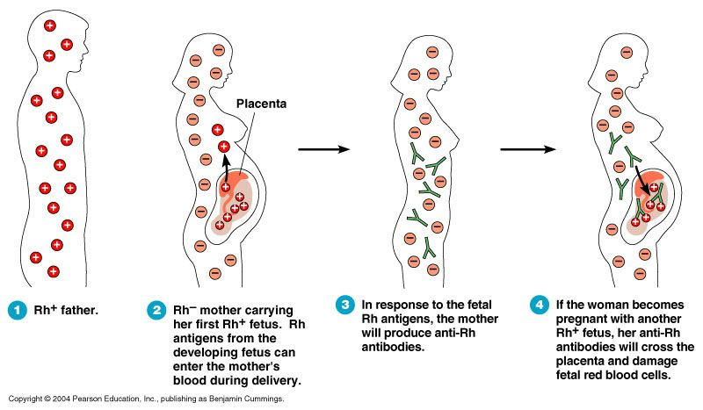

Slide 17
Risks of Rh Incompatibility Effect
Rh+ve father Rh-ve mother
Rhesus antibodies
Rh+ve cells
Miscarriage/ Termination of pregnancy
Ectopic pregnancy Amniocentesis Antepartum haemorrhage Delivery of placenta
Pass to 2nd Rh+ve baby
Hemolysis of Rh +ve cells
1st Rh+ve baby Usually unaffected
Fetal Anemia
Intrauterine transfusion Postnatal exchange transfusion
Hydrops fetalis
Treatment
Oct-15
Rhesus Incompatibility
17

Slide 18
AMOUNT NEEDED FOR SENSITISATION
EXPOSURE TO ML OF RH POSITIVE ERTHROCYTES | SENSITIZATION %
1 ml | 15%
40 ml | 30 %
250 ml | 65%

Slide 19
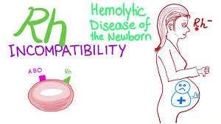
RH ISO IMMUNIZATION CAUSES
Mismatch blood transfusion
Rh negative mother bearing Rh positive baby with fetomaternal hemorrhage

Slide 20
CAUSES OF FETO MATERNAL HEMORRHAGE
Miscarraige
APH
Ectopic pregnancy
Molar pregnancy
Termination of pregnancy
Invasive prenatal testing (CVS ,Amniocentesis ,ands cordocentesis)
E.C.V
Delivery

Slide 21
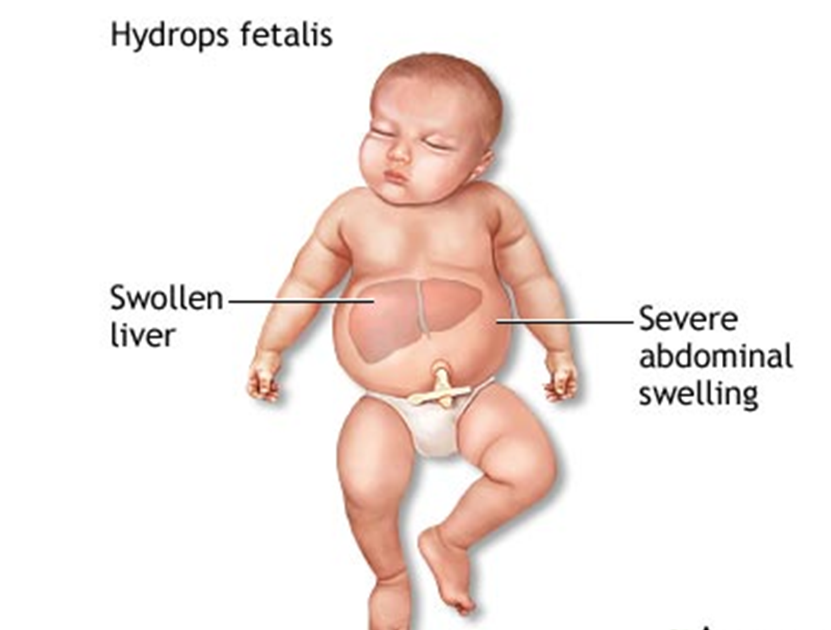
Complications
Hydrops fetalis and stillbirth
Neonatal jaundice
Complications of neonatal kernicterus (lethargy, hypertonicity, hearing loss, cerebral palsy, and learning disability)
Congenital anemia of new born`

Slide 22
Prevention
Prophylactic anti-D at 28 weeks,34 weeks
Prophylactic anti-D 250 IU after any sensitizing event before 20 weeks
Prophylactic anti-D 500 IU after any sensitizing event after 20 weeks
Prophylactic anti-D 500 IU after delivery within72hrs (max 10 days)

Slide 23
Screening and Diagnosis
Maternal blood grouping at their 1st antenatal visit
Presence of anti –D antibodies in serum is diagnostic of maternal rh isoimmunization

Slide 24

Investigations:
Anti-D level | Outcome
<4IU/mL | HDFN unlikely
4-15IU/mL | Moderate risk of HDFN
>15IU/mL | High risk of hydrops fetalis
If antibody levels rise, the baby should be examined for signs of anemia.
Fetal middle cerebral artery (MCA) blood flow is measured at intervals of 1 to 2 weeks depending on titers and patient history.
The purpose is to detect high-output heart failure and fetal anemia.

Slide 25
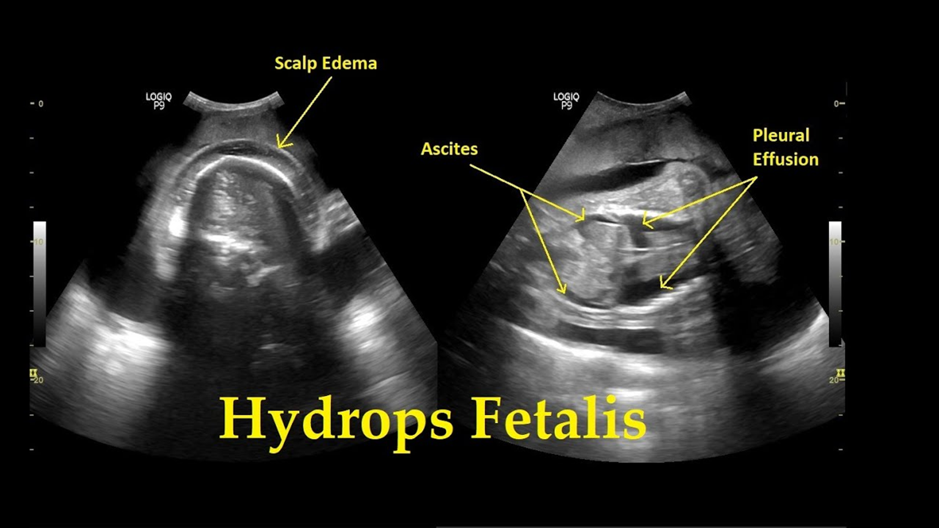
Ultrasound findings

Slide 26
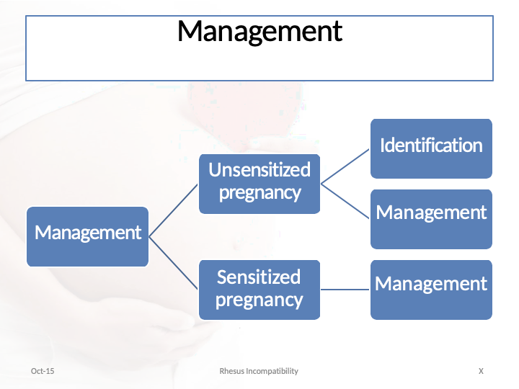

Slide 27
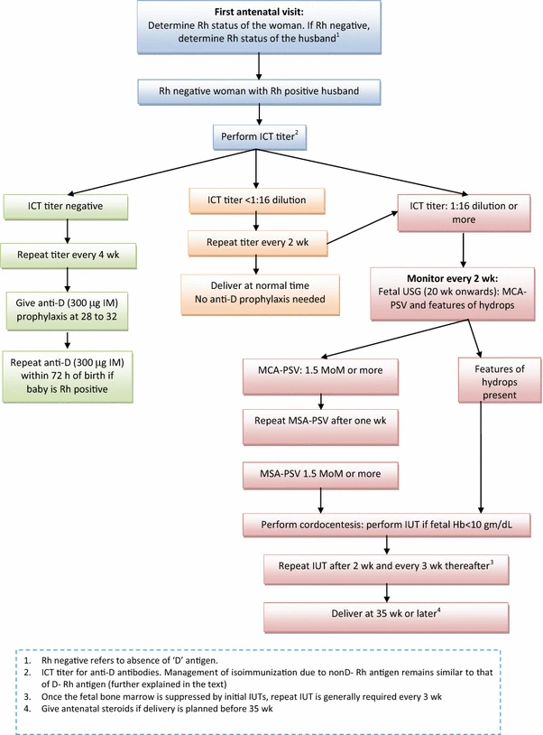

Slide 28
Management of Sensitized Mother
Measurement of antibody levels in titers at regular intervals,
Amniocentesis for bilirubin levels
Serial ultrasound for detection of hydrops and management of neonatal anemia and hyperbilirubinemia. MCA doppler
Referral of these women is the correct approach at fetal medicine center.

Slide 29
Treatment
Intrauterine transfusion
Decide mode and time of delivery
Exchange transfusion after delivery
Phototherapy after delivery
Top-up transfusion
(Hb falls below 7g/dl, prophylactic :oral folate)
29

Slide 30
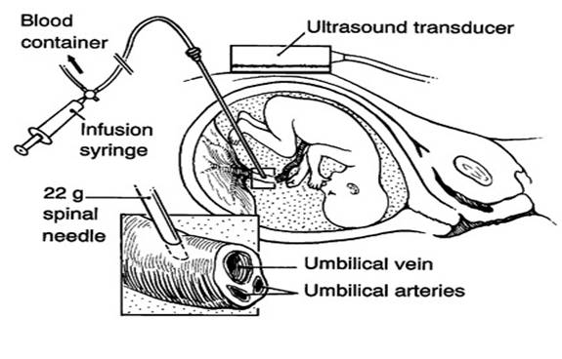

Slide 31
RESEARCH
Costumbrado J, Mansour T, Ghassemzadeh S. Rh Incompatibility. 2022 Dec 11. In: StatPearls [Internet]. Treasure Island (FL): StatPearls Publishing; 2023 Jan–. PMID: 29083656.
Pegoraro V, Urbinati D, Visser GHA, Di Renzo GC, Zipursky A, Stotler BA, Spitalnik SL. Hemolytic disease of the fetus and newborn due to Rh(D) incompatibility: A preventable disease that still produces significant morbidity and mortality in children. PLoS One. 2020 Jul 20;15(7):e0235807. doi: 10.1371/journal.pone.0235807. PMID: 32687543; PMCID: PMC7371205.

Slide 32
BIOMEDICAL ETHICS
All women at risk should be given inj Anti-D
All pregnant women should be screened at first visit

Slide 33
FAMILY MEDICINE
All sensitized pregnant women should be referred to Fetal medicine unit for proper monitoring and early treatment.

Slide 34


Oct-15
Rhesus Incompatibility
34

