Slide 2
Respiratory Module 1st Year MBBS(SGD) Biotin and Pyroxidine
Presenter: Dr Uzma Zafar Date: 01-02-25
Dept of Biochemistry
RMU

Slide 3
Motto, Vision, Dream
To impart evidence based research oriented medical education
To provide best possible patient care
To inculcate the values of mutual respect and ethical practice of medicine
Wisdom
Truth
Service

Slide 4
Professor Umar Model of Integrated Lecture

Slide 5
Learning Objectives
At the end of this session students should be able to
Describe the dietary sources of Pyridoxine and Biotin
Explain the role of Pantothenic Acid and Biotin in the body

Slide 6
Biotin
Core Knowledge
Biotin (also known as vitamin B7 or vitamin H) is one of the B vitamins.
It is involved in a wide range of metabolic processes, both in humans and in other organisms, primarily related to the utilization of fats, carbohydrates, and amino acids.
The name biotin, borrowed from the German Biotin, derives from the Ancient Greek word βίοτος (bíotos; 'life') and the suffix "-in" (a suffix used in chemistry usually to indicate 'forming')

Slide 7
Chemical description
Core Knowledge
Biotin is classified as a heterocyclic compound, with a sulfur-containing tetrahydrothiophene ring fused to a ureido group.
A C5-carboxylic acid side chain is appended to the former ring. The ureido ring, containing the −N−CO−N− group, serves as the carbon dioxide carrier in carboxylation reactions.
Biotin is a coenzyme for five carboxylase enzymes, which are involved in the catabolism of amino acids and fatty acids, synthesis of fatty acids, and gluconeogenesis.
Biotinylation of histone proteins in nuclear chromatin plays a role in chromatin stability and gene expression.

Slide 8
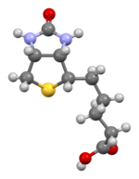
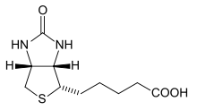
Structure
Core Knowledge

Slide 9
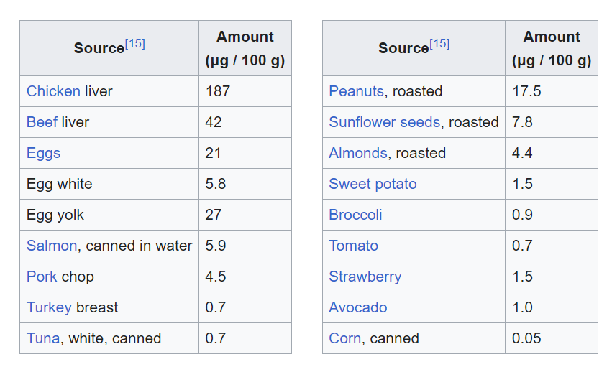
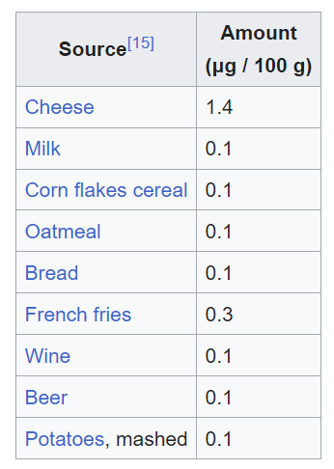
Sources
Core Knowledge

Slide 10
Functions
Core Knowledge
Carbohydrate, Fat, and Protein Metabolism:
Biotin is a coenzyme that plays a critical role in the enzymatic reactions responsible for the breakdown of carbohydrates, fats, and proteins.
Gluconeogenesis:
Biotin is involved in the process of gluconeogenesis, where the body produces glucose from non-carbohydrate sources like amino acids and glycerol.
Fatty Acid Synthesis:
Biotin is a coenzyme for the enzyme acetyl-CoA carboxylase, which is essential for the synthesis of fatty acids.

Slide 11
Core Knowledge
Amino Acid Metabolism:
Biotin is involved in the catabolism (breakdown) of certain amino acids.
It also plays a role in the conversion of amino acids into forms that can be used for energy or for the synthesis of other molecules.
Keratin Production:
Biotin is essential for the health of hair, skin, and nails because it is involved in the synthesis of keratin, a fibrous protein that provides structure and strength to these tissues.
Gene Expression:
Biotin is involved in the regulation of gene expression, particularly genes related to metabolism.

Slide 12
Core Knowledge
Cell Growth and Repair:
Biotin is required for the growth and repair of cells in various tissues throughout the body.
This includes maintaining healthy skin, nerve cells, and muscle tissues.
Immune System Support:
While the exact mechanisms are still under investigation, biotin is believed to play a role in supporting a healthy immune system.
It may contribute to immune function by participating in various metabolic processes that provide energy and building blocks for immune cells.

Slide 13
PYRIDOXINE (VITAMIN B6)
Core Knowledge
Vitamin B6 is a collective term for pyridoxine, pyridoxal, and pyridoxamine, all derivatives of pyridine.
They differ only in the nature of the functional group attached to the ring Pyridoxine occurs primarily in plants, whereas pyridoxal and pyridoxamine are found in foods obtained from animals.
All three compounds can serve as precursors of the biologically active coenzyme, pyridoxal phosphate (PLP).
PLP functions as a coenzyme for a large number of enzymes, particularly those that catalyze reactions involving amino acids, for example, in the transsulfuration of Hcy to cysteine and in the synthesis of dopamine and serotonin. (Note: PLP is also required by glycogen phosphorylase

Slide 14
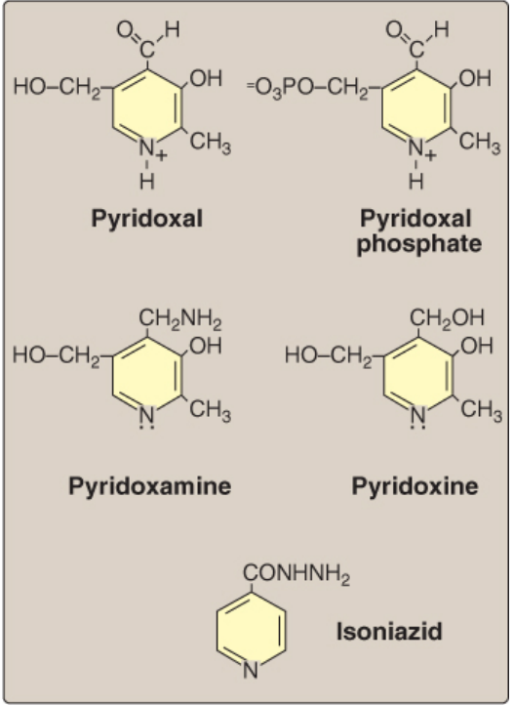
Structure
Core Knowledge

Slide 15
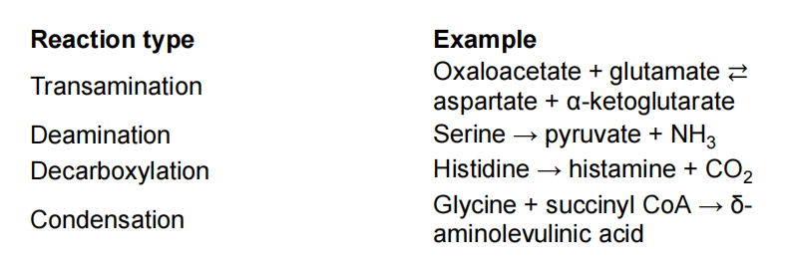
Core Knowledge

Slide 16
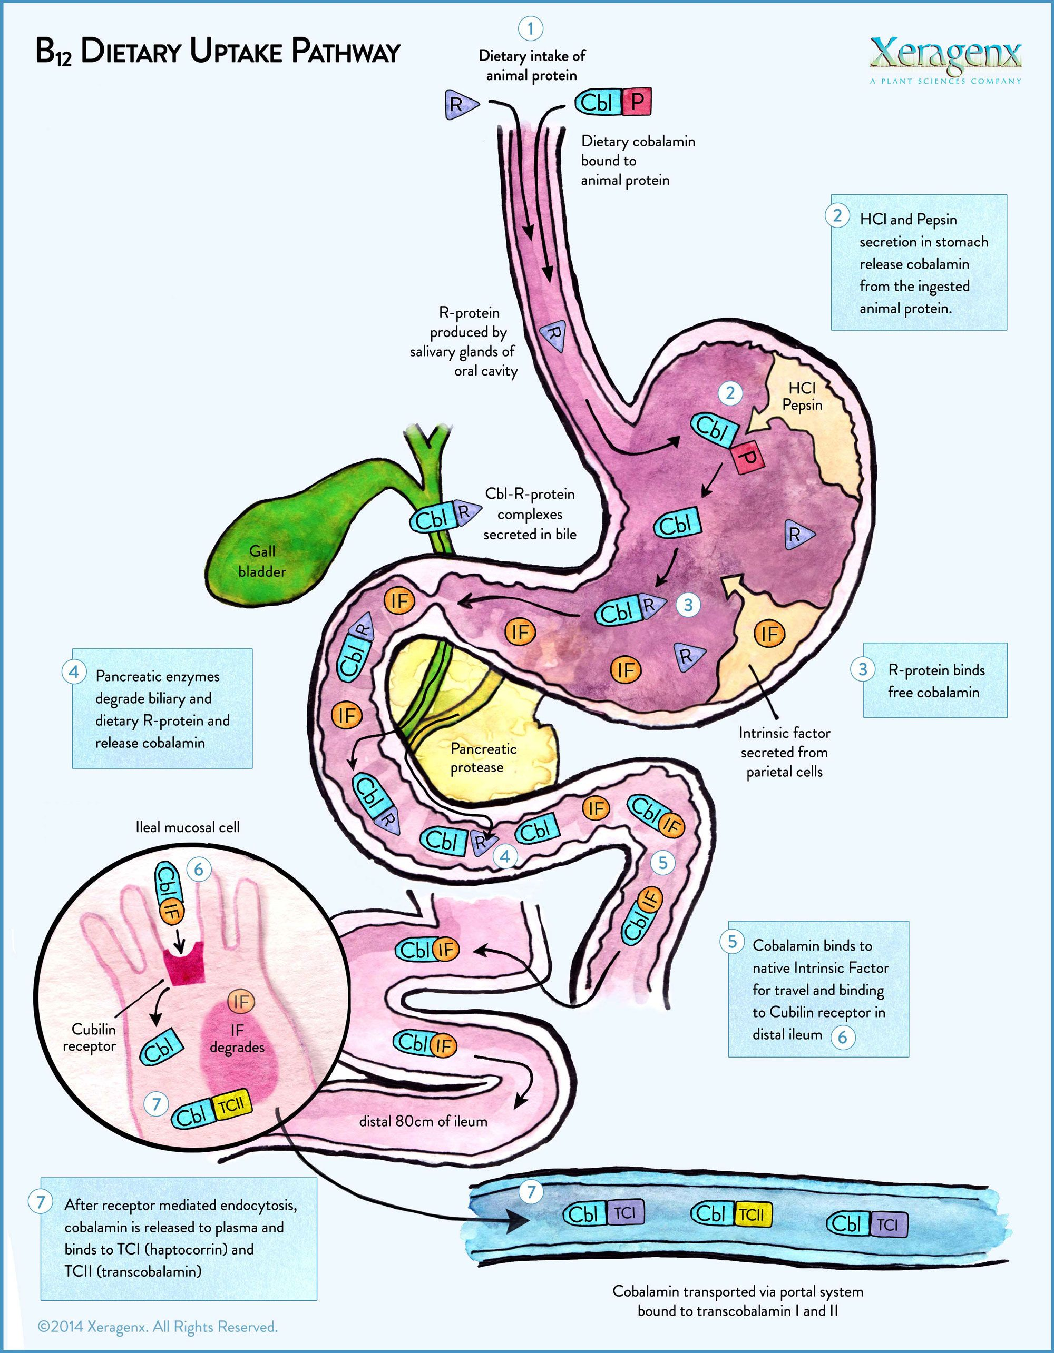
Horizontal Integration

Slide 17
Vertical Integration
Isoniazid, a drug commonly used to treat tuberculosis, can induce a vitamin B6 deficiency by forming an inactive derivative with PLP.
Thus, B6 supplementation is essential for some patients to prevent the development of peripheral neuropathy. Otherwise, dietary deficiencies in pyridoxine are rare but have been observed in newborn infants fed formulas low in B6 , in women taking oral contraceptives, and in those with alcoholism.

Slide 18
Vertical Integration
Dermatitis: Biotin deficiency can cause skin issues such as red, scaly rashes (dermatitis), often around the eyes, nose, mouth, and genitals.
Alopecia (Hair Loss): Hair loss, or alopecia, is a common symptom of biotin deficiency. This can result in thinning hair or complete hair loss.
Brittle Nails: Biotin deficiency can lead to weak and brittle nails, making them prone to breakage and splitting.
Conjunctivitis: Inflammation of the conjunctiva, the clear tissue that covers the white part of the eye, can occur in cases of severe biotin deficiency.

Slide 19
Family Medicine
Spiral Integration
Family Medicine plays important role in following manner:
Diagnosis
Education
Dietary Guidance
Monitoring
Refer to Specialists

Slide 20
Biotin or Pyridoxine Versus Combined Regimen in the Treatment of Onychoschizia
Spiral Integration
Research Article
February 2025 | Volume 24 | Issue 2 | 174 | Copyright © February 2025
doi:10.36849/JDD.7687R1
Avner Shemer MD^{a,b*}, Anna Lyakhovitsky MD^{a,b*}, Vered Hermush MD^{c,d}, Riad Kassem MD^{a,b}, Baruch Kaplan MDe, Eran Galili MD^{a,b}
Abstract
Background: Onychoschizia is characterized by distal nail plate splitting. Several therapeutic approaches exist, most of which are based on case reports or small non-comparative case series.
Objective: To evaluate safety and efficacy of oral biotin and pyridoxine for treating onychoschizia.
Patients and Methods: A retrospective comparative study was conducted among patients with idiopathic fingernail onychoschizia. Patients were prescribed 1 mg/day biotin, or 100 mg/day pyridoxine or both, for 3 months. Complete response (improvement of more than 90%) and partial response (improvement of more than 50%) were assessed after 6 to 9 months.
Results: The study included 61 patients with fingernail onychoschizia (mean age 40.5 years [range 20-68 years]). The average number of affected fingernails was 7.0 (±2.0) per patient. The nail condition lasted 11.6 (±4.7) years on average. The combined treatment regimen achieved significantly higher rates of complete response compared to biotin or pyridoxine alone (69.6% vs 10%, 11.1%, respectively;
P values < .001). Partial response (>50% improvement) was achieved in an additional 30.4%, 45%, and 38.9% of patients treated with combined regimen vs biotin or pyridoxine alone, respectively. No adverse events were recorded.
Conclusions: This study demonstrates that the use of biotin and pyridoxine combination is an effective treatment for fingernail onychoschizia.

Slide 21
Spiral Integration
Bioethics
Ethical Considerations
From an ethical standpoint, the scenario raises considerations regarding patient autonomy, informed consent, and confidentiality
The physician must ensure that patient fully understands her diagnosis, treatment options, and potential implications
Discuss the necessity of a healthy lifestyle & treatment plan. This requires clear communication and understanding of risks and benefits.
Additionally, the physician must respect patient’s privacy and confidentiality throughout the diagnostic and treatment process

Slide 22
Spiral Integration
Artificial Intelligence
Role of AI in Management
AI can potentially aid in enhancing diagnostic accuracy and efficiency.
AI-powered decision support systems can also help clinicians in selecting appropriate treatment modalities
AI-driven predictive models may help anticipate the risk of complications of the Disease in susceptible populations

Slide 23
How To Access Digital Library
Steps to Access HEC Digital Library
Go to the website of HEC National Digital Library
On Home Page, click on the INSTITUTES
A page will appear showing the universities from Public and Private Sector and other Institutes which have access to HEC National Digital Library HNDL
Select your desired Institute
A page will appear showing the resources of the institution
Journals and Researches will appear
You can find a Journal by clicking on JOURNALS AND DATABASE and enter a keyword to search for your desired journal

Slide 24
Learning Resources
Lippincott Illustrated Reviews 8^{th edition}
Harper’s Illustrated Biochemistry 32nd Edition
Google images
Use digital library

Slide 25
THANK YOU

