Slide 2
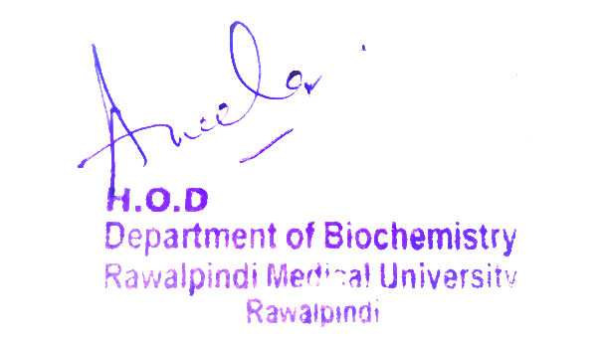
2nd Year MBBS Reproduction Module Large Group Interactive Session (LGIS) Pyrimidine Metabolism
Presenter: Dr Uzma Zafar Date: 01-02-25
Deptt of Biochemistry
RMU

Slide 3
Motto, Vision, Dream
To impart evidence based research oriented medical education
To provide best possible patient care
To inculcate the values of mutual respect and ethical practice of medicine
Wisdom
Truth
Service

Slide 4
Professor Umar Model of Integrated Lecture

Slide 5
Learning Objectives
At the end of this session students should be able to
Pyrimidine metabolism (Core concept)
Related Physiology (Horizontal Integration)
Related clinical/congenital abnormalities (Vertical integration)
Research article related to topic
Ethics
Family Medicine
Artificial Intelligence

Slide 6
Core Knowledge

Slide 7
Core Knowledge
Pyrimidine Synthesis
Unlike the synthesis of the purine ring, which is constructed on a Pre-existing ribose 5-phosphate, the pyrimidine ring is synthesized before being attached to ribose 5-phosphate, which is donated by PRPP.
The sources of the atoms in the pyrimidine ring are glutamine, CO2, and aspartate

Slide 8
Sources of the individual atoms in the pyrimidine ring
Core Knowledge

Slide 9
Core Knowledge
A. Synthesis of carbamoyl phosphate
The regulated step of this pathway in mammalian cells is the synthesis of carbamoyl phosphate from glutamine and CO2, catalysed by carbamoyl phosphate synthetase (CPS) II
CPS II is inhibited by uridine triphosphate (the end product of this pathway, which can be converted into the other pyrimidine nucleotides), and is activated by ATP
Defects in ornithine transcarboxymylase of the urea cycle promote pyrimidine synthesis due to increased availability of carbamoyl phosphate

Slide 10
Core Knowledge
B. Synthesis of orotic acid
The second step in pyrimidine synthesis is the formation of carbamoyl aspartate, catalysed by aspartate transcarbamoylase
The pyrimidine ring is then closed by dihydroorotase. The resulting dihydroorotate is oxidized to produce orotic acid (orotate)
The enzyme that produces orotate, dihydroorotate dehydrogenase, is a flavoprotein associated with the inner mitochondrial membrane
All other enzymes in pyrimidine biosynthesis are cytosolic [Note: The first three enzymic activities in this pathway (CPS II, aspartate transcarbamoylase, and dihydroorotase) are actually three different catalytic domains of a single polypeptide, known as CAD from the first letter in the name of each domain

Slide 11
Core Knowledge
C. Formation of a pyrimidine nucleotide
The completed pyrimidine ring is converted to the nucleotide orotidine monophosphate (OMP) in the second stage of pyrimidine nucleotide synthesis
PRPP is again the ribose 5-phosphate donor
The enzyme orotate phosphoribosyl transferase produces OMP and releases pyrophosphate, thereby making the reaction biologically irreversible
OMP, the parent pyrimidine mononucleotide, is converted to uridine monophosphate (UMP) by orotidylate decarboxylase, which removes the carboxyl group

Slide 12
Core Knowledge
Orotate phosphoribosyl transferase and orotidylate decarboxylase are also catalytic domains of a single polypeptide chain called UMP synthase
Orotic aciduria (a very rare disorder) may be caused by a deficiency of one or both activities of this bifunctional enzyme, resulting in orotic acid in the urine
UMP is sequentially phosphorylated to UDP and UTP
[Note: The UDP is a substrate for ribonucleotide reductase, which generates dUDP. The dUDP is phosphorylated to dUTP, which is rapidly hydrolyzed to dUMP by UTP diphosphatase (dUTPase), dUTPase, then, plays an important role in reducing availability of dUTP as a substrate for DNA synthesis, thereby preventing erroneous incorporation of uracil into DNA]

Slide 13
Synthesis of CTP from UTP
Core Knowledge

Slide 14
Pyrimidine synthesis
Core Knowledge

Slide 15
Differences between CPS I and II
Core Knowledge

Slide 16
Synthesis of CTP from UTP
Core Knowledge

Slide 17
Synthesis of CTP from UTP
Core Knowledge

Slide 18
Core Knowledge
D. Synthesis of cytidine triphosphate
Cytidine triphosphate (CTP) is produced by amination of UTP by CTP synthetase with glutamine providing the nitrogen
[Note: Some CTP is dephosphorylated to cytidine diphosphate (CDP), which is a substrate for ribonucleotide reductase. The dCDP product can be phosphorylated to dCTP for DNA synthesis or dephosphorylated to dCMP that is deaminated to dUMP]

Slide 19
Core Knowledge
E. Synthesis of deoxythymidine monophosphate
dUMP is converted to deoxythymidine monophosphate (dTMP) by thymidylate synthase, which uses N5,N10-methylene tetrahydrofolate as the source of the methyl group
This is an unusual reaction in that tetrahydrofolate (THF) contributes not only a one-carbon unit but also two hydrogen atoms from the pteridine ring, resulting in the oxidation of THF to dihydrofolate (DHF)
Inhibitors of thymidylate synthase include thymine analogs such as 5-fluorouracil, which serve as antitumor agents, (5-Fluorouracil is metabolically converted to 5-fluorodeoxyuridine monophosphate (5-FdUMP), which becomes permanently bound to the inactivated thymidylate synthase, making the drug a “suicide” inhibitor

Slide 20
Core Knowledge
DHF can be reduced to THF by dihydrofolate reductase, an enzyme that is inhibited by folate analogs such as methotrexate
By decreasing the supply of THF, these drugs not only inhibit purine synthesis, but, by preventing methylation of dUMP to dTMP, they also decrease the availability of this essential component of DNA
DNA synthesis is inhibited and cell growth slowed. Thus, these drugs are used to decrease the growth rate of cancer cells

Slide 21
Synthesis of dTMP from dUMP
Core Knowledge

Slide 22
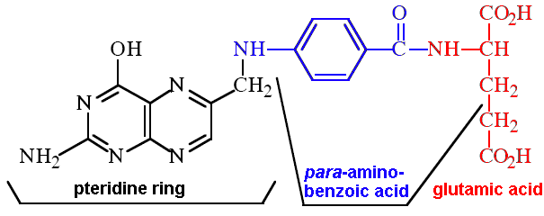
Synthesis of dTMP from dUMP
Core Knowledge

Slide 23
Core Knowledge
Degradation and salvage
of pyrimidines
Unlike the purine ring, which is not cleaved in humans, the pyrimidine ring is opened and degraded to highly soluble products, β-alanine (from the degradation of CMP and UMP) and β-aminoisobutyrate (from TMP degradation), with the production of NH3 and CO2
Pyrimidine bases can be salvaged to nucleosides, which are phosphorylated to nucleotides
However, their high solubility makes pyrimidine salvage less significant clinically than purine salvage
[Note: The salvage of pyrimidine nucleosides is the basis for using uridine in the treatment of hereditary orotic aciduria]

Slide 24
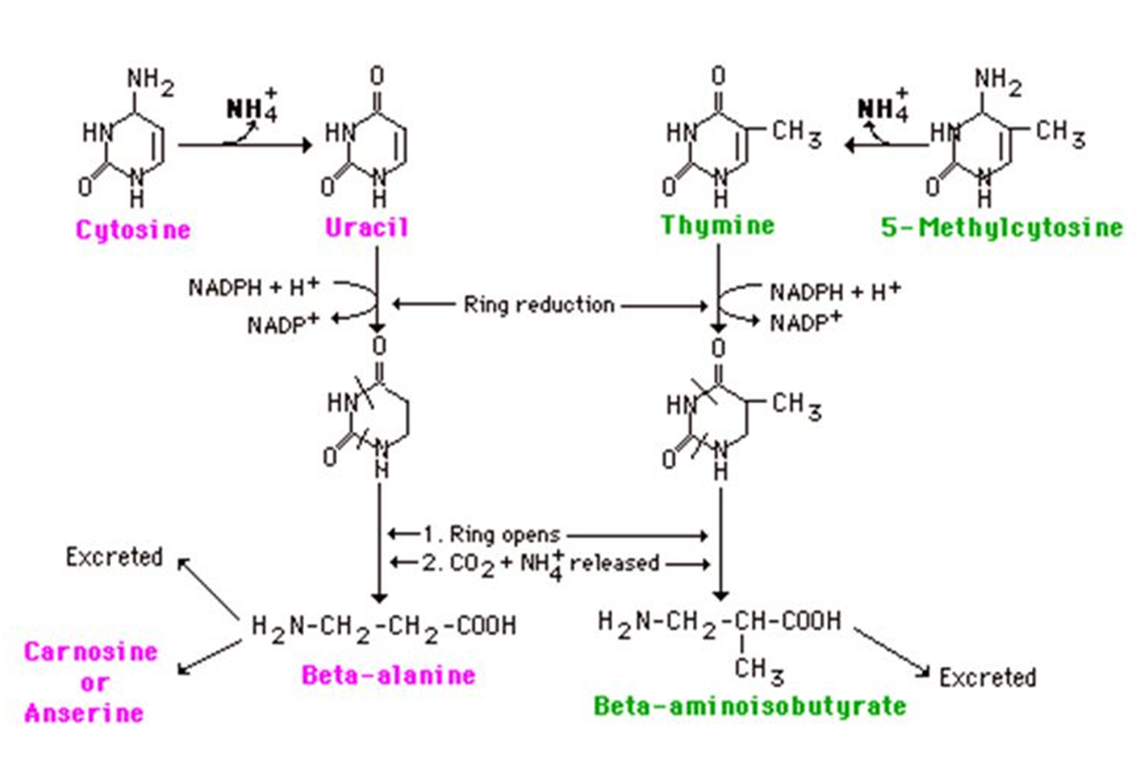
Core Knowledge
Degradation and salvage
of pyrimidines

Slide 25
Vertical Integration
Clinical Correlates
Pharmacological
significance
of pyrimidines

Slide 26
Spiral Integration
Family Medicine
Lifestyle: Maintain a low-salt diet, manage weight and abstain from alcohol.
Medications: Diuretics for ascites, beta-blockers for variceal bleeding, lactulose for hepatic encephalopathy.
Surveillance: Regular screening for varices, liver function, and hepatocellular carcinoma.
Complications: Manage ascites (paracentesis), SBP (antibiotics), and consider liver transplant.
Patient Education: Inform about complication signs and the importance of adherence to treatment.

Slide 27
Spiral Integration
Bioethics
Ethical Considerations
From an ethical standpoint, the scenario raises considerations regarding patient autonomy, informed consent, and confidentiality
The physician must ensure that patient fully understands her diagnosis, treatment options, and potential implications
Discuss the necessity of a healthy lifestyle & treatment plan. This requires clear communication and understanding of risks and benefits.
Additionally, the physician must respect patient’s privacy and confidentiality throughout the diagnostic and treatment process

Slide 28
Spiral Integration
Artificial Intelligence
Role of AI in anagement
AI can potentially aid in enhancing diagnostic accuracy and efficiency.
AI-powered decision support systems can also help clinicians in selecting appropriate treatment modalities
AI-driven predictive models may help anticipate the risk of complications of the Disease in susceptible populations

Slide 29
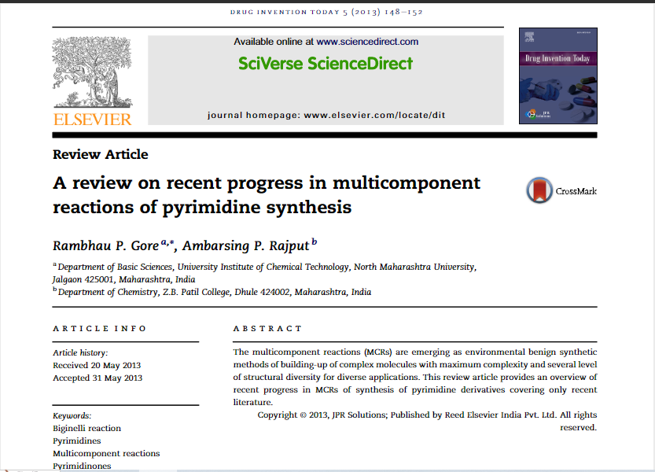
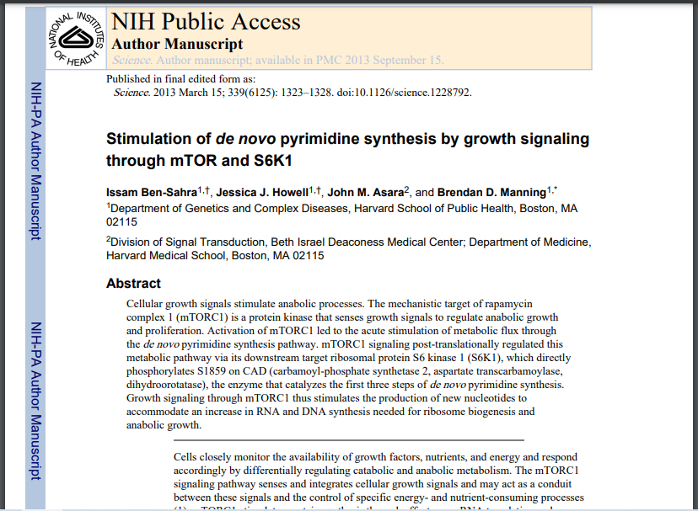
Spiral Integration
Research Article
https://www.sciencedirect.com/science/article/pii/S0975761913000367
https://www.sciencedirect.com/science/article/pii/S0975761913000367

Slide 30
How To Access Digital Library
Steps to Access HEC Digital Library
Go to the website of HEC National Digital Library
On Home Page, click on the INSTITUTES
A page will appear showing the universities from Public and Private Sector and other Institutes which have access to HEC National Digital Library HNDL
Select your desired Institute
A page will appear showing the resources of the institution
Journals and Researches will appear
You can find a Journal by clicking on JOURNALS AND DATABASE and enter a keyword to search for your desired journal

Slide 31
Learning Resources
Lippincott Illustrated Review, Biochemistry, (Eighth edition, chapter 22, pages 302-304)

Slide 32
THANK YOU

