Slide 2
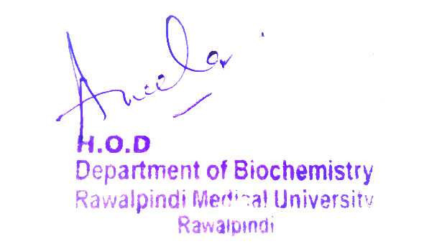
Reproduction Module 2nd Year MBBS(LGIS) Purine Degradation
Presenter: Dr Uzma Zafar Date: 01-02-25
Deptt of Biochemistry
RMU

Slide 3
Motto, Vision, Dream
To impart evidence based research oriented medical education
To provide best possible patient care
To inculcate the values of mutual respect and ethical practice of medicine
Wisdom
Truth
Service

Slide 4
Professor Umar Model of Integrated Lecture

Slide 5
Learning Objectives
At the end of this session students should be able to
Describe the degradation of purine nucleotides to uric acid illustrating some of the genetic diseases associated with this pathway like ADA deficiency, PNP deficiency and gout.
Explain the causes, diagnosis and treatment of these disorders

Slide 6
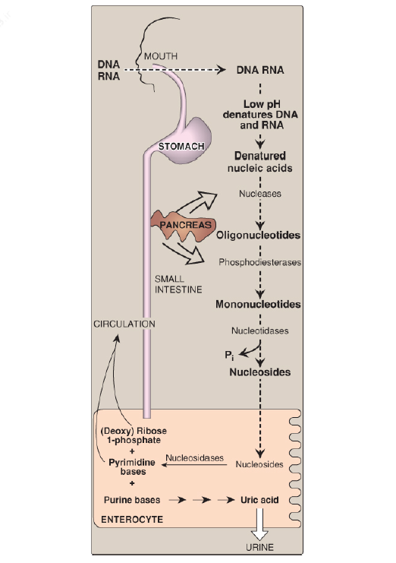
Digestion of Dietary Nucleic ACIDS
Core Knowledge
Digestion of Dietary Nucleic AcidsD

Slide 7
Core Knowledge
Purine Nucleotide Degradation
A summary of the steps in the production of uric acid and the genetic diseases associated with deficiencies of specific degradative enzyme.
An amino group is removed from AMP to produce IMP by AMP (adenylate) deaminase or from adenosine to produce inosine (hypoxanthine-ribose) by ADA.
2. IMP and GMP are converted into their respective nucleoside forms, inosine and guanosine, by the action of 5′-nucleotidase

Slide 8
Core Knowledge
Purine Nucleotide Degradation
A summary of the steps in the production of uric acid and the genetic diseases associated with deficiencies of specific degradative enzyme.
An amino group is removed from AMP to produce IMP by AMP (adenylate) deaminase or from adenosine to produce inosine (hypoxanthine-ribose) by ADA.
2. IMP and GMP are converted into their respective nucleoside forms, inosine and guanosine, by the action of 5′-nucleotidase.

Slide 9
PURINE NUCLEOTIDE DEGRADATION
3. Purine nucleoside phosphorylase converts inosine and guanosine into their respective purine bases, hypoxanthine and Guanosine.
4. Guanosine is deaminated to form xanthine.
5. Hypoxanthine is oxidized by molybdenum-containing xanthine oxidase (XO) to xanthine, which is further oxidized by XO to uric acid, the final product of human purine degradation. Uric acid is excreted primarily in the urine.

Slide 10
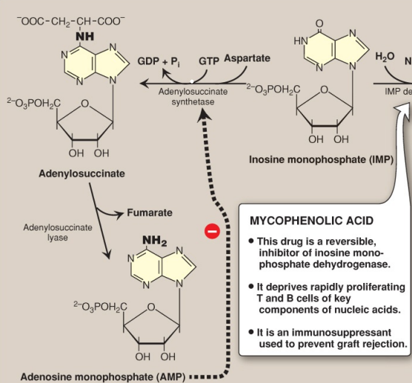
Structure of IMP and AMP
Core Concept

Slide 11
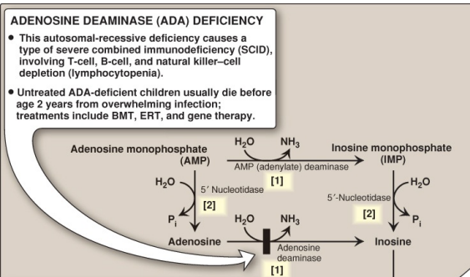
Uric Acid Formation
Core Concept

Slide 12
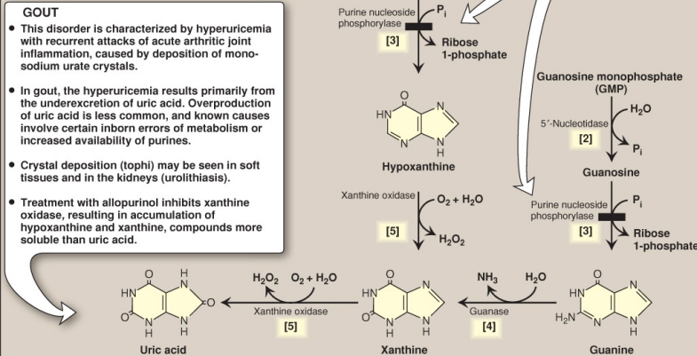
Uric Acid Formation

Slide 13
Diseases associated with purine degradation
Gout:
Gout is a disorder initiated by high levels of uric acid (the end product of purine catabolism) in blood (hyperuricemia), as a result of either the overproduction or under excretion of uric acid.
The hyperuricemia can lead to the deposition of monosodium urate (MSU) crystals in the joints and an inflammatory response to the crystals, causing first acute and then progressing to chronic gouty arthritis.
Nodular masses of MSU crystals (tophi) may be deposited in the soft tissues, resulting in chronic tophaceous gout.

Slide 14
Diseases associated with purine degradation
Diseases associated with purine degradation
Gout:
Formation of uric acid stones in the kidney (urolithiasis) may also be seen.
The definitive diagnosis of gout requires aspiration and examination of synovial fluid from an affected joint (or material from a tophus) using polarized light microscopy to confirm the presence of needle-shaped MSU crystals.
Core Concept

Slide 15
Diseases associated with purine degradation
Diseases associated with purine degradation
Gout:
Uric acid underexcretion:
In >90% of individuals with hyperuricemia, the cause is underexcretion of uric acid.
Underexcretion can be primary, because of as-yet unidentified inherent excretory defects, or secondary to known disease processes that affect how the kidney handles urate (e.g., in lactic acidosis, lactate increases renal urate reabsorption, thereby decreasing its excretion) and to environmental factors such as the use of drugs (e.g., thiazide diuretics) or exposure to lead (saturnine gout).
Core Concept

Slide 16
Gout:
b. Uric acid overproduction:
A less common cause of hyperuricemia is from the overproduction of uric acid.
Primary hyperuricemia is, for the most part, idiopathic (having no known cause).
However, several identified mutations in the gene for X-linked PRPP synthetase result in the enzyme having an increased maximal velocity for the production of PRPP, a lower Km for ribose 5-phosphate, or a decreased sensitivity to purine nucleotides, its allosteric inhibitors.
In each case, increased availability of PRPP increases purine production, resulting in elevated levels of plasma uric acid.

Slide 17
Gout:
c. Treatment
Acute attacks of gout are treated with anti-inflammatory agents. Colchicine, steroidal drugs such as prednisone, and nonsteroidal drugs such as indomethacin are used.
Long-term therapeutic strategies for gout involve lowering the uric acid level below its saturation point (6.5 mg/dl), thereby preventing the deposition of MSU crystals.
Uricosuric agents, such as probenecid or sulfinpyrazone, that increase renal excretion of uric acid, are used in patients who are underexcretors of uric acid.
Core Concept

Slide 18
Gout:
c. Treatment
Allopurinol, a structural analog of hypoxanthine, inhibits uric acid synthesis and is used in patients who are overproducers of uric acid.
Allopurinol is oxidized to oxypurinol, a long-lived inhibitor of XO.
This results in an accumulation of hypoxanthine and xanthine, compounds more soluble than uric acid and, therefore, less likely to initiate an inflammatory response.
In patients with normal levels of HGPRT, the hypoxanthine can be salvaged, reducing the levels of PRPP and, therefore, de novo purine synthesis.
Core Concept

Slide 19
2. Adenosine deaminase deficiency:
ADA is expressed in a variety of tissues, but, in humans, lymphocytes have the highest activity of this cytoplasmic enzyme.
A deficiency of ADA results in an accumulation of adenosine, which is converted to its ribonucleotide or Deoxyribonucleotide forms by cellular kinases.
As dATP levels rise, ribonucleotide reductase is inhibited, thereby preventing the production of all deoxyribose-containing nucleotides.
Consequently, cells cannot make DNA and divide.
Core Concept

Slide 20
2. Adenosine deaminase deficiency:
In its most severe form, this autosomal-recessive disorder causes a type of severe combined immunodeficiency disease (SCID), involving a decrease in T cells, B cells, and natural killer cells.
ADA deficiency accounts for 14% of cases of SCID in the United States.
Treatments include bone marrow transplantation, enzyme replacement therapy, and gene therapy.
Without appropriate treatment, children with this disorder usually die from infection by age 2 years.
Core Concept

Slide 21
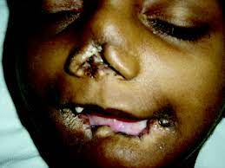
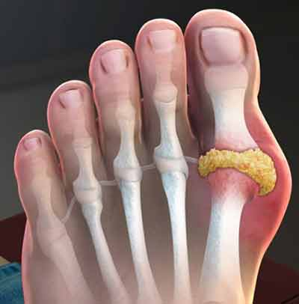
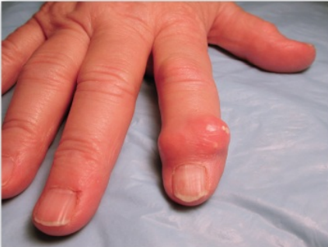
Vertical Integration
Self-mutilation in the Lesch–Nyhan syndrome
Gout in Foot & Hand

Slide 22
Family Medicine
Family Medicine plays important role in following manner:
Diagnosis on the basis of History, physical examination &lab investigations
Education & Counselling of patients regarding life style modifications such healthy weight
Dietary Guidance (low in Purines)
Monitoring and Follow-up of patients to assess effictiveness of treatment
Refer to Specialists

Slide 23
Spiral Integration
Bioethics
Ethical Considerations
From an ethical standpoint, the scenario raises considerations regarding patient autonomy, informed consent, and confidentiality
The physician must ensure that patient fully understands her diagnosis, treatment options, and potential implications
Discuss the necessity of a healthy lifestyle & treatment plan. This requires clear communication and understanding of risks and benefits.
Additionally, the physician must respect patient’s privacy and confidentiality throughout the diagnostic and treatment process

Slide 24
Spiral Integration
Artificial Intelligence
Role of AI in (The Disease) Management
AI can potentially aid in enhancing diagnostic accuracy and efficiency.
AI-powered decision support systems can also help clinicians in selecting appropriate treatment modalities
AI-driven predictive models may help anticipate the risk of complications of the Disease in susceptible populations

Slide 25
Liver cirrhosis: An Overview (Make Changes)
Spiral Integration
Research Article
Nadia Moustafa, Manal Abdul-Hamid Mohamed, Rasha Rashad Ahmed, Rehab Nady
July 2016 Merit Research Journal of Medicine and Medical Sciences 4(7):329-343
Identification and characterization of cell populations contributing to the myofibroblastic pool and production of extracellular matrix (ECM) in liver fibrosis, as well as the increasing knowledge about natural course, many of the intricate cellular and molecular mechanisms underlying liver fibrogenesis and its progression, and contributions of the genetic regulation, inflammatory and immuno-mediators, neuroendocrine factors, and oxidative stress, have provided important data upon which the design of effective and targeted antifibrotic pharmacological strategies, aiming at halting the progression to decompensated cirrhosis or even reversing the liver fibrogenesis, can be based.

Slide 26
How To Access Digital Library
Steps to Access HEC Digital Library
Go to the website of HEC National Digital Library
On Home Page, click on the INSTITUTES
A page will appear showing the universities from Public and Private Sector and other Institutes which have access to HEC National Digital Library HNDL
Select your desired Institute
A page will appear showing the resources of the institution
Journals and Researches will appear
You can find a Journal by clicking on JOURNALS AND DATABASE and enter a keyword to search for your desired journal

Slide 27
Learning Resources
Lippincott Illustrated Reviews 8th Edition, Chap , pages -
Harper’s Illustrated Biochemistry 32nd Edition, Chap , pages –
Google images

Slide 28
THANK YOU

