Slide 1


Slide 2


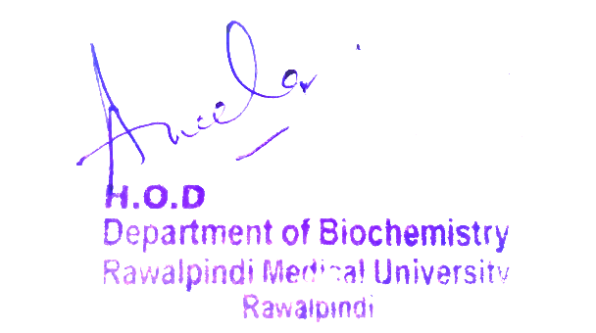
Reproduction Module
2nd Year MBBS(LGIS)
Purine Nucleotide De novo Synthesis and Salvage Pathway
Presenter: Dr Uzma Zafar Date: 01-02-25
Dept of Biochemistry
RMU

Slide 3
Motto, Vision, Dream
To impart evidence based research oriented medical education
To provide best possible patient care
To inculcate the values of mutual respect and ethical practice of medicine
Wisdom
Truth
Service

Slide 4
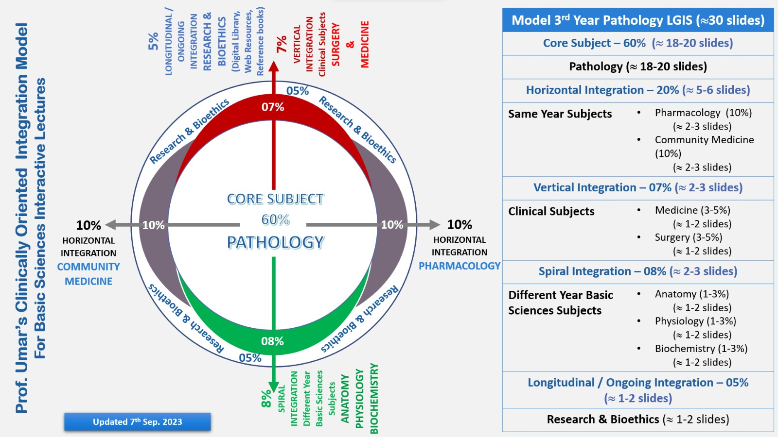
Professor Umar Model of Integrated Lecture

Slide 5
Learning Objectives
At the end of this session, students will be able to:
Learn about the structure of purine and pyrimidine bases, nucleosides and nucleotides.
Describe the de novo synthesis of purine nucleotides.
Explain the salvage pathway for purines and rare X-linked recessive disorder Lesch Nyhan syndrome.

Slide 6
Structure of Nucleotide
Core Knowledge
Nucleotides are composed of a nitrogenous base
a pentose monosaccharide
one, two, or three phosphate groups
The nitrogen-containing bases belong to two families of compounds: the purines and the pyrimidines.

Slide 7
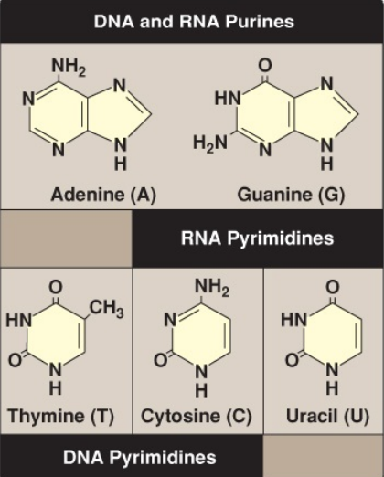
A. Purine and pyrimidine bases
Core Knowledge
Purines are double-ringed structures, whereas pyrimidines have a single ring.
Both DNA and RNA contain the same purine bases: adenine (A) and guanine (G).
Both DNA and RNA contain the pyrimidine cytosine (C), but they differ in their second pyrimidine base: DNA contains thymine (T), whereas RNA contains uracil (U).
T and U differ in that only T has a methyl group

Slide 8
B. Nucleosides
Core Knowledge
The addition of a pentose sugar to a base through an N-glycosidic bond produces a nucleoside.
If the sugar is ribose, a ribonucleoside is produced, and if the sugar is 2-deoxyribose, a deoxyribonucleoside is produced.
The ribonucleosides of A, G, C, and U are named adenosine, guanosine, cytidine, and uridine, respectively.
The deoxyribonucleosides of A, G, C, and T have the added prefix deoxy- (e.g., deoxyadenosine).
The carbon and nitrogen atoms in the rings of the base and the sugar are numbered separately.
Carbons in the pentose are numbered 1′ to 5′.

Slide 9
C. Nucleotides
Core Knowledge
The addition of one or more phosphate groups to a nucleoside produces a nucleotide.
The first phosphate group is attached by an ester linkage to the 5′-OH of the pentose, forming a nucleoside 5′-phosphate or a 5′-nucleotide.
The type of pentose is denoted by the prefix in the names 5′-ribonucleotide and 5′-deoxyribonucleotide.
If one phosphate group is attached to the 5′-carbon of the pentose, the structure is a nucleoside monophosphate, like adenosine monophosphate (AMP, or adenylate).

Slide 10
C. Nucleotides
Core Knowledge
If a second or third phosphate is added to the nucleoside, a nucleoside diphosphate (e.g., adenosine diphosphate [ADP] or triphosphate, e.g., ATP) results.
The second and third phosphates are each connected to the nucleotide by a “high-energy bond” (a bond with a large, negative change in free energy of hydrolysis.

Slide 11
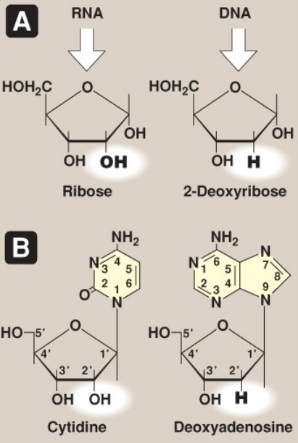
Core Knowledge
A: Pentoses found in nucleic acids.
B: Examples of the numbering systems for purine- and pyrimidine-containing nucleosides.

Slide 12
PURINE NUCLEOTIDE SYNTHESIS
Core Knowledge
The atoms of the purine ring are contributed by a number of compounds, including amino acids (aspartate, glycine, and glutamine), carbon dioxide(CO2), and N10 -formyltetrahydrofolate (N10 - formyl-THF).
The purine ring is constructed primarily in the liver by a series of reactions that add the donated carbons and nitrogens to a preformed ribose 5- phosphate.

Slide 13
A. 5-Phosphoribosyl-1-pyrophosphate synthesis
Core Knowledge
5-Phosphoribosyl-1-pyrophosphate (PRPP) is an activated pentose that participates in the synthesis and salvage of purines and pyrimidines.
Synthesis of PRPP from ATP and ribose 5-phosphate is catalyzed by PRPP synthetase.
This X-linked enzyme is activated by inorganic phosphate and inhibited by purine nucleotides (end product inhibition).
Because the sugar moiety of PRPP is ribose, ribonucleotides are the end products of de novo purine synthesis.
When deoxyribonucleotides are required for DNA synthesis, the ribose sugar moiety is reduced.

Slide 14
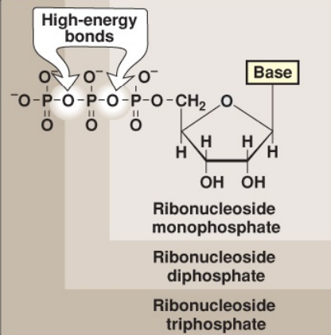
Core Knowledge
Ribonucleoside monophosphate, diphosphate, and triphosphate.

Slide 15
Core Knowledge
PURINE NUCLEOTIDE SYNTHESIS
B. 5-Phosphoribosylamine synthesis
The amide group of glutamine replaces the pyrophosphate group attached to carbon 1 of PRPP.
This is the committed step in purine nucleotide biosynthesis.
The enzyme that catalyzes the reaction, glutamine: phosphoribosyl pyrophosphate amidotransferase (GPAT), is inhibited by the purine 5′-nucleotides AMP and guanosine monophosphate (GMP, or guanylate), the end products of the pathway.
The rate of the reaction is also controlled by the intracellular concentration of PRPP.

Slide 16
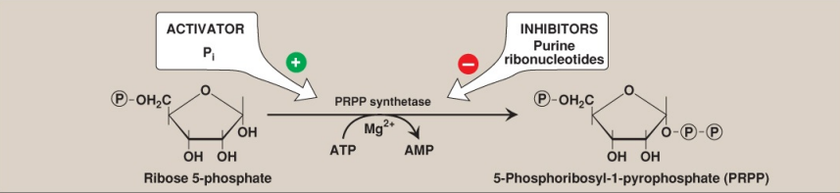
Core Knowledge
Synthesis of PRPP, showing the activator and inhibitors of the reaction. (Note: This is not the committed step of purine synthesis because PRPP is used in other pathways such as salvage.) = phosphate; Pi = inorganic phosphate; AMP = adenosine monophosphate; Mg = magnesium.

Slide 17
Core Knowledge
PURINE NUCLEOTIDE SYNTHESIS
C. Inosine monophosphate synthesis
The next nine steps in purine nucleotide biosynthesis leading to the synthesis of inosine monophosphate ([IMP] whose base is hypoxanthine).
IMP is the parent purine nucleotide for AMP and GMP.
Four steps in this pathway require ATP as an energy source, and two steps in the pathway require N10 -formyl-THF as a one-carbon donor.
Hypoxanthine is found in tRNA.

Slide 18
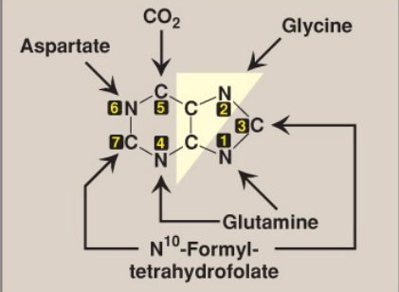
Core Knowledge
Sources of the individual atoms in the purine ring. The order in which the atoms are added is shown by the numbers in the black boxes.

Slide 19
Core Knowledge
PURINE NUCLEOTIDE SYNTHESIS
D. Synthetic inhibitors
Some synthetic inhibitors of purine synthesis (e.g., the sulfonamides) are designed to inhibit the growth of rapidly dividing microorganisms without interfering with human cell functions.
Other purine synthesis inhibitors, such as structural analogs of folic acid (e.g., methotrexate), are used pharmacologically to control the spread of cancer by interfering with the synthesis of nucleotides and, therefore, of DNA and RNA.

Slide 20
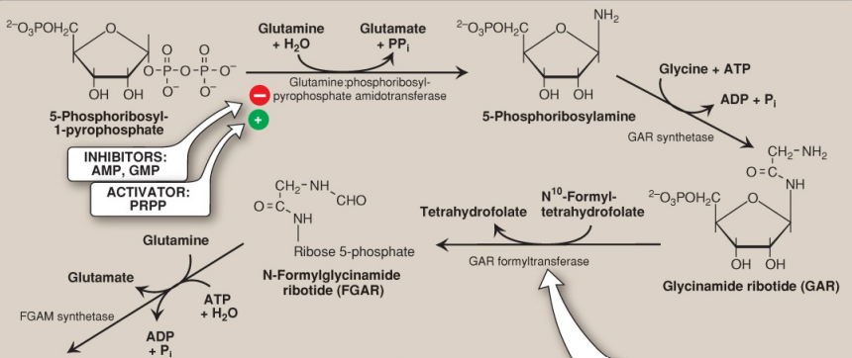
Core Knowledge

Slide 21
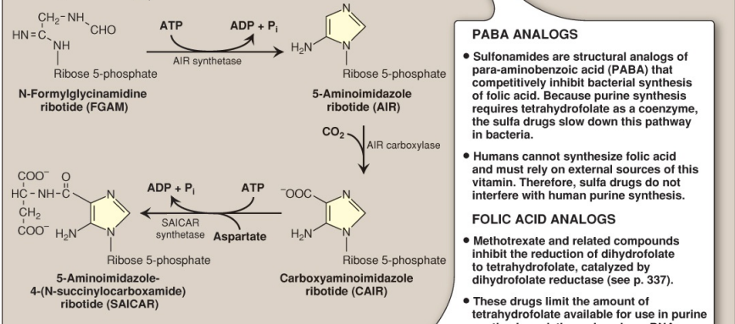
Core Knowledge

Slide 22
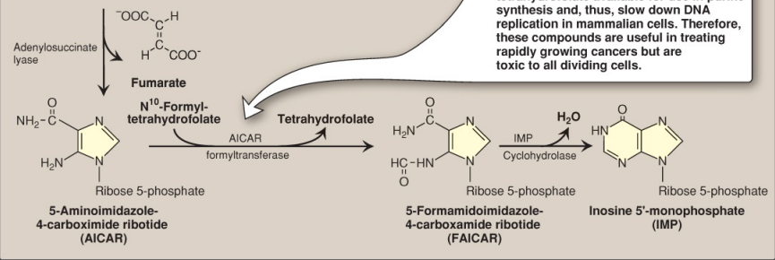
Core Knowledge
Core Concept
De novo synthesis of purine nucleotides, showing the inhibitory effect of some structural analogs. AMP and ADP = adenosine mono- and diphosphates; GMP = guanosine monophosphate; PRPP = 5-phosphoribosyl-1- pyrophosphate; Pi = inorganic phosphate; PPi = pyrophosphate; CO2 = carbon dioxide.

Slide 23
Core Knowledge
PURINE NUCLEOTIDE SYNTHESIS
E. Adenosine and guanosine monophosphate synthesis
The conversion of IMP to either AMP or GMP uses a two-step, energy- and nitrogen requiring pathway.
(Note: AMP synthesis requires guanosine triphosphate [GTP] as an energy source and aspartate as a nitrogen source, whereas GMP synthesis requires ATP and glutamine.)
Also, the first reaction in each pathway is inhibited by the end product of that pathway.
This provides a mechanism for diverting IMP to the synthesis of the purine present in lesser amounts.
If both AMP and GMP are present in adequate amounts, the de novo pathway of purine nucleotide synthesis is inhibited at the GPAT step.

Slide 24
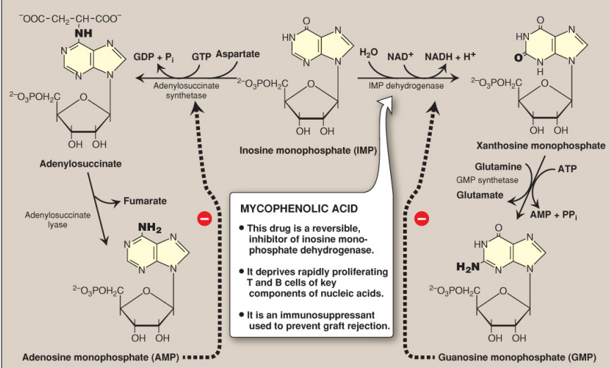
Core Knowledge
Conversion of IMP to AMP (or, adenylate) and GMP (or, guanylate) showing feedback inhibition. NAD(H) = nicotinamide adenine dinucleotide; GDP and GTP = guanosine di- and triphosphates; Pi = inorganic phosphate; PPi = pyrophosphate

Slide 25
Core Knowledge
PURINE NUCLEOTIDE SYNTHESIS
F. Nucleoside di- and triphosphate synthesis
Nucleoside diphosphates are synthesized from the corresponding nucleoside monophosphates by base-specific nucleoside monophosphate kinases.
These kinases do not discriminate between ribose and deoxyribose in the substrate.
ATP is generally the source of the transferred phosphate because it is present in higher concentrations than the other nucleoside triphosphates.

Slide 26
Core Knowledge
PURINE NUCLEOTIDE SYNTHESIS
F. Nucleoside di- and triphosphate synthesis
Adenylate kinase is particularly active in the liver and in muscle, where the turnover of energy from ATP is high.
Its function is to maintain equilibrium among the adenine nucleotides (AMP, ADP, and ATP).
Nucleoside diphosphates and triphosphates are interconverted by nucleoside diphosphate kinase, an enzyme that, unlike the monophosphate kinases, has broad substrate specificity

Slide 27
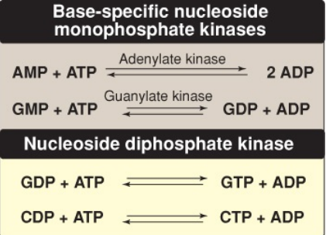
Core Knowledge
Conversion of nucleoside monophosphates to di- and triphosphates. AMP and ADP = adenosine mono- and diphosphates; GMP, GDP, and GTP = guanosine mono-, di-, and triphosphates; CDP and CTP = cytidine diand triphosphates.

Slide 28
Core Knowledge
PURINE NUCLEOTIDE SYNTHESIS
G. Purine salvage pathway
Purines that result from the normal turnover of cellular nucleic acids, or the small amount that is obtained from the diet and not degraded, can be converted to nucleoside triphosphates and used by the body.
This is referred to as the salvage pathway for purines.
(Note: Salvage is particularly important in the brain.)

Slide 29
Core Knowledge
PURINE NUCLEOTIDE SYNTHESIS
G. Purine salvage pathway
1. Purine base salvage to nucleotides: Two enzymes are involved: adenine phosphoribosyl transferase (APRT) and X-linked hypoxanthine–guanine phosphoribosyl transferase (HGPRT).
Both use PRPP as the source of the ribose 5- phosphate group.
The release of pyrophosphate and its subsequent hydrolysis by pyrophosphatase makes these reactions irreversible. (Note: Adenosine is the only purine nucleoside to be salvaged. It is phosphorylated to AMP by adenosine kinase.)

Slide 30
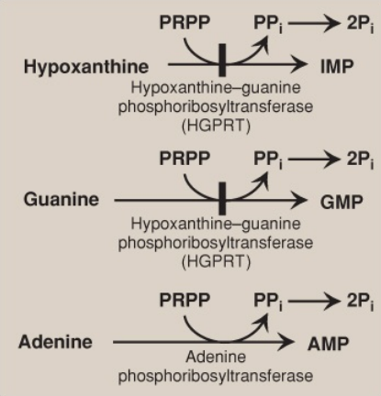
Core Knowledge
Salvage pathways of purine nucleotide synthesis. (Note: Virtually complete deficiency of HGPRT results in Lesch–Nyhan syndrome. Partial deficiencies of HGPRT are known. As the amount of functional enzyme increases, the severity of the symptoms decreases.) IMP, GMP, and AMP = inosine, guanosine, and adenosine monophosphates; PRPP = 5-phosphoribosyl-1- pyrophosphate; PPi = pyrophosphate.

Slide 31
Core Knowledge
PURINE NUCLEOTIDE SYNTHESIS
G. Purine salvage pathway
2. Lesch–Nyhan syndrome:
This is a rare, X-linked recessive disorder associated with a virtually complete deficiency of HGPRT.
The deficiency results in an inability to salvage hypoxanthine or G, from which excessive amounts of uric acid, the end product of purine degradation, are then produced.
In addition, the lack of this salvage pathway causes increased PRPP levels and decreased IMP and GMP levels.
As a result, GPAT (the regulated step in purine synthesis) has excess substrate and decreased inhibitors available, and de novo purine synthesis is increased.

Slide 32
Core Knowledge
PURINE NUCLEOTIDE SYNTHESIS
G. Purine salvage pathway
2. Lesch–Nyhan syndrome:
The combination of decreased purine reutilization and increased purine synthesis results in increased degradation of purines and the production of large amounts of uric acid, making HGPRT deficiency an inherited cause of hyperuricemia.
In patients with Lesch– Nyhan syndrome, the hyperuricemia frequently results in the formation of uric acid stones in the kidneys (urolithiasis) and the deposition of urate crystals in the joints (gouty arthritis) and soft tissues.
In addition, the syndrome is characterized by motor dysfunction, cognitive deficits, and behavioral disturbances that include self-mutilation (e.g., biting of lips and fingers).

Slide 33
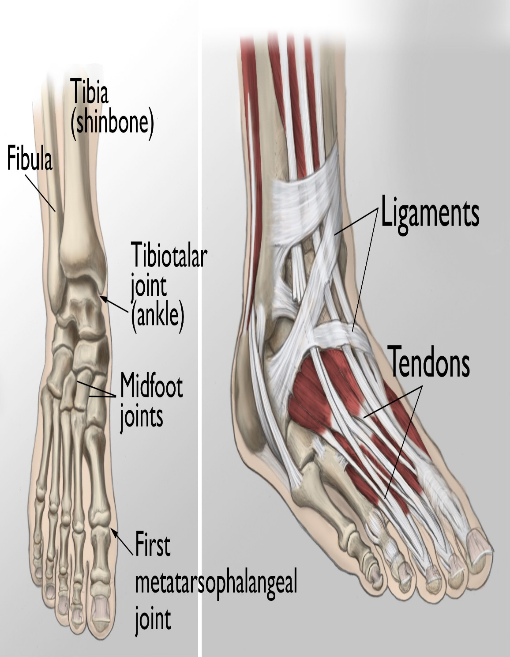
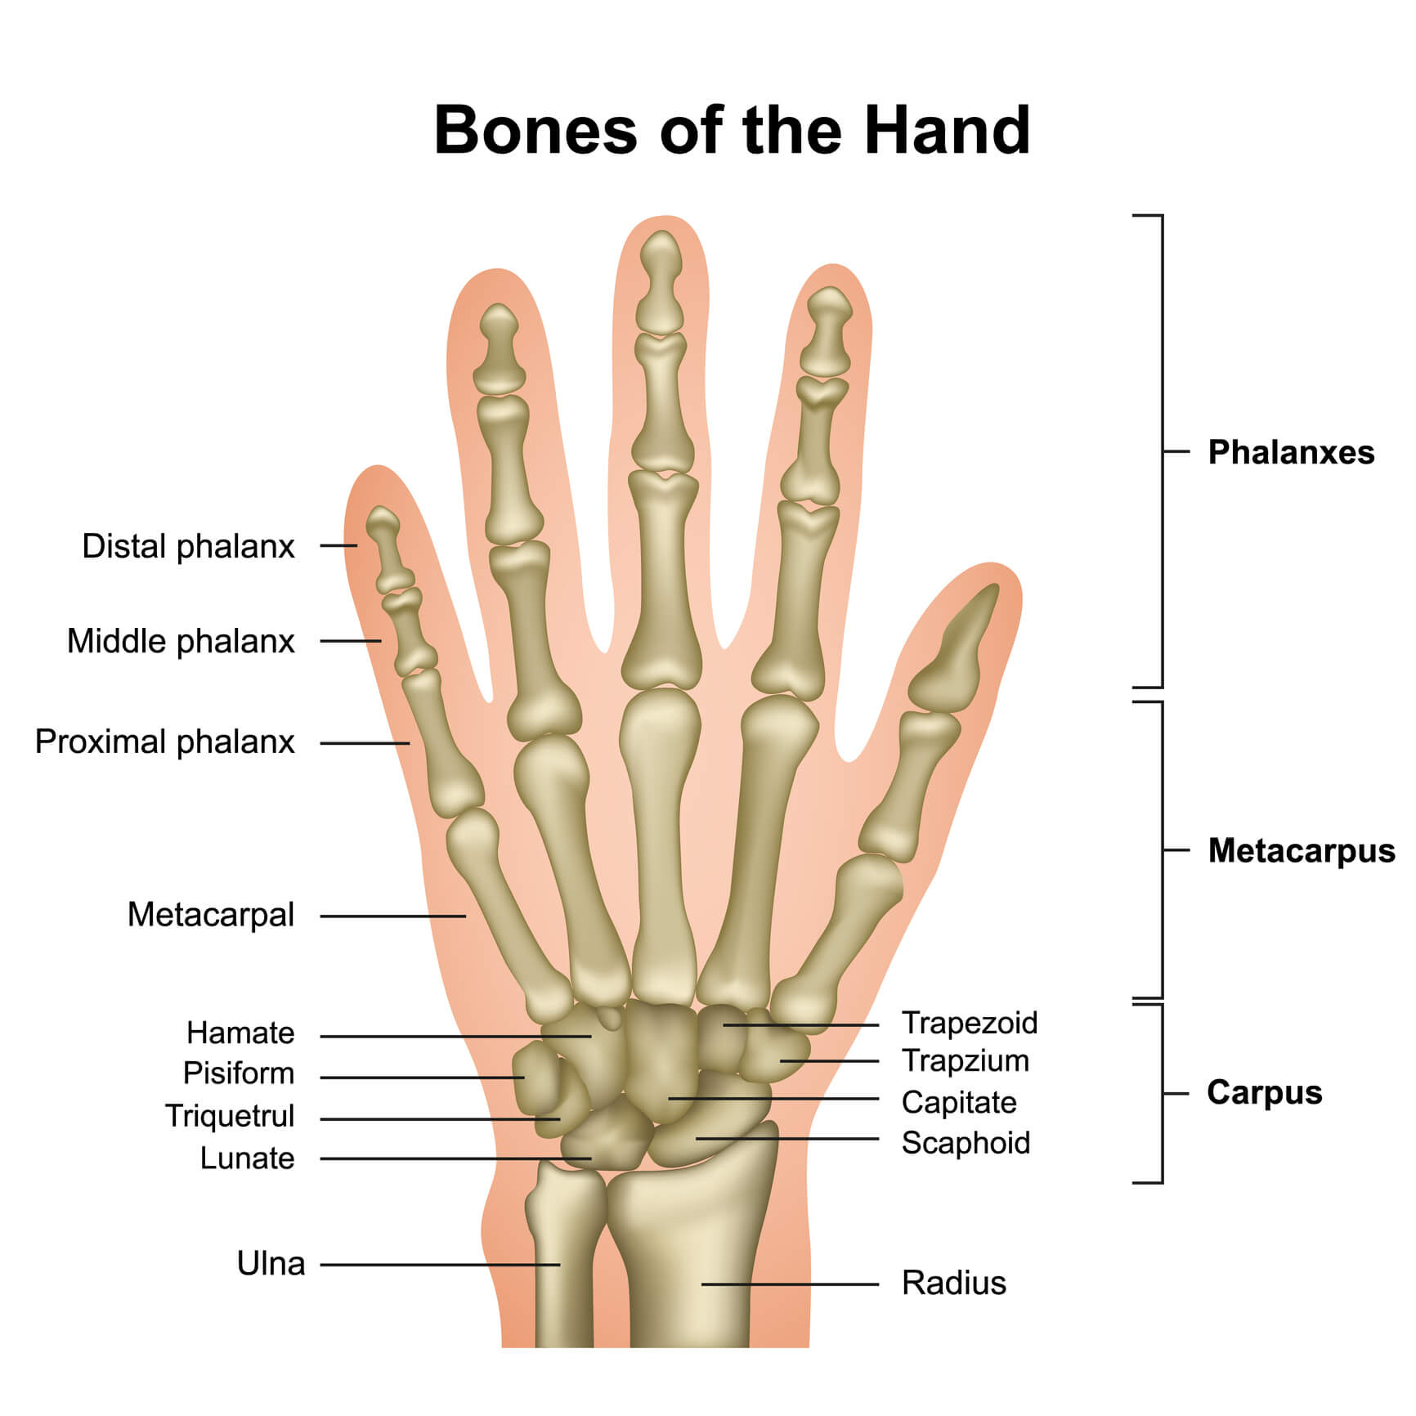
Horizontal Integration

Slide 34
Functions of Nucleotides
Horizontal Integration
Without Ribonucleoside and deoxyribonucleoside phosphates (nucleotides) neither ribonucleic acid (RNA) nor deoxyribonucleic acid (DNA) can be produced
Nucleotides play an important role as energy sources in the cell
Nucleotides are important regulatory compounds for many of the pathways of intermediary metabolism, inhibiting or activating key enzymes

Slide 35
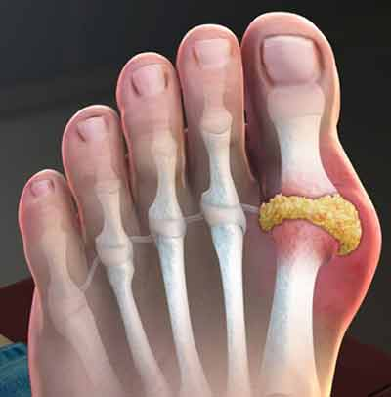
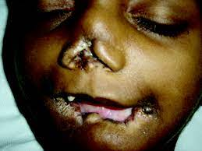
Vertical Integration
Self-mutilation in the Lesch–Nyhan syndrome
Gout in Foot

Slide 36
Family Medicine
Spiral Integration
Family Physician helps the patients in the following manner:
1) After diagnosing, he educates the patient and the family
2) Gives the dietary guidance
3) Monitors the patient’s general health and symptoms
4) Refers to specialists

Slide 37
Spiral Integration
Bioethics
Ethical Considerations
From an ethical standpoint, the scenario raises considerations regarding patient autonomy, informed consent, and confidentiality
The physician must ensure that patient fully understands her diagnosis, treatment options, and potential implications
Discuss the necessity of a healthy lifestyle & treatment plan. This requires clear communication and understanding of risks and benefits.
Additionally, the physician must respect patient’s privacy and confidentiality throughout the diagnostic and treatment process

Slide 38
Spiral Integration
Artificial Intelligence
Role of AI in Management
AI can potentially aid in enhancing diagnostic accuracy and efficiency.
AI-powered decision support systems can also help clinicians in selecting appropriate treatment modalities
AI-driven predictive models may help anticipate the risk of complications of the Disease in susceptible populations

Slide 39
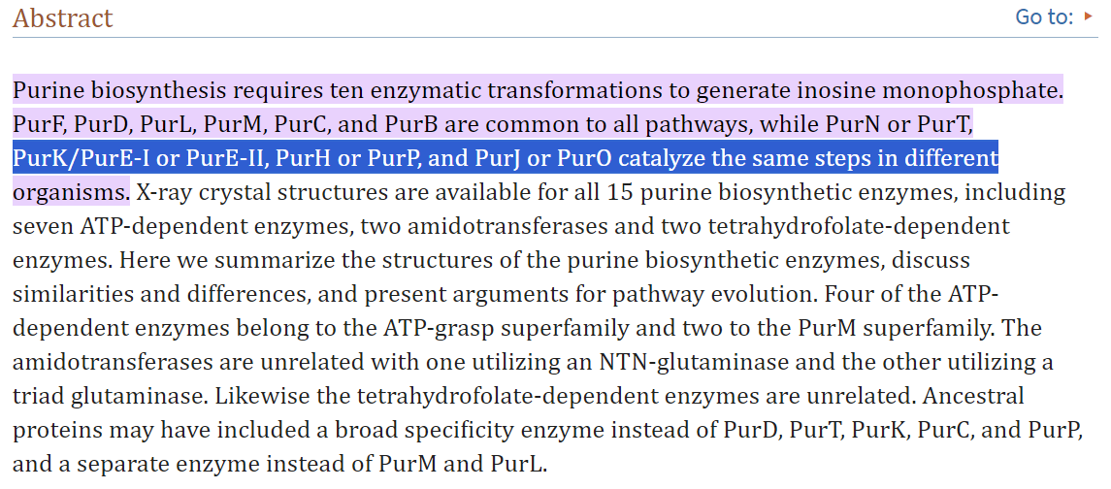
https://www.ncbi.nlm.nih.gov/pmc/articles/PMC2596281/#:~:text=Purine%20biosynthesis%20requires%20ten%20enzyma
Spiral Integration
Research Article

Slide 40
How To Access Digital Library
Steps to Access HEC Digital Library
Go to the website of HEC National Digital Library
On Home Page, click on the INSTITUTES
A page will appear showing the universities from Public and Private Sector and other Institutes which have access to HEC National Digital Library HNDL
Select your desired Institute
A page will appear showing the resources of the institution
Journals and Researches will appear
You can find a Journal by clicking on JOURNALS AND DATABASE and enter a keyword to search for your desired journal

Slide 41
Learning Resources
Lippincott Illustrated Reviews: Biochemistry Chapter#22
Google Images

Slide 42
THANK YOU

