Slide 1
Renal Cell Tumors
Renal Module
4th Year MBBS
Dr Kiran Fatima
Pathology Department
Rawalpindi Medical University

Slide 2


Motto of RMU

Slide 3


Vision of RMU
The Dream/ Tomorrow
To impart evidence based research oriented medical education
To provide best possible patient care
To inculcate the values of mutual respect and ethical practice of
medicine

Slide 4
Learning objectives
To learn about the various renal cell tumours types
To learn regarding the required investigations
To learn regarding the staging system used for renal cell carcinoma
To learn the treatment of renal cell tumours.

Slide 5
Study questions
What is the epidemiology of renal cell tumours?
What are the risk factors for renal cell tumours?
What are familial renal cell syndromes?
How will you diagnose renal cell carcinoma?
What are the histological features of renal cell carcinoma?
What is AJCC staging of renal cell carcinoma?
What is the management of renal cell carcinoma?

Slide 6
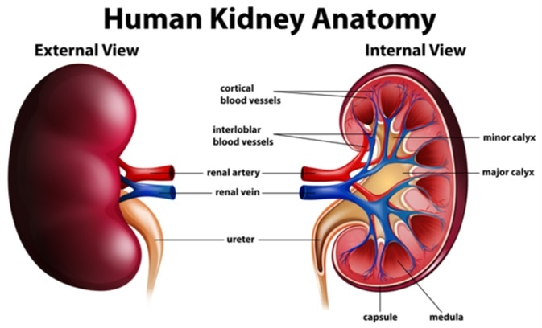
Renal anatomy
spiral

Slide 7
Epidemiology
Core Content
Male predominance (M:F 1.5:1).
Most common in sixth to eighth decades; peak incidence in sixth decade
Metastatic disease in 30% at diagnosis, and eventually in 50% (lung, liver, bone, distant LN, adrenal, brain, opposite kidney, soft tissue)
Most sporadic RCCs are unilateral and unifocal

Slide 8
Core Content
Stage at diagnosis is the most important prognostic factor
Predominant histologic type: adenocarcinoma arising from tubular epithelium
Adenocarcinoma subtypes:
  clear cell (75–85%)
  chromophilic/ papillary (10–15%)
  chromophobe (5–10%)
  oncocytic (rare)
  Sarcomatoid (1–6%; poor prognosis)

Slide 9
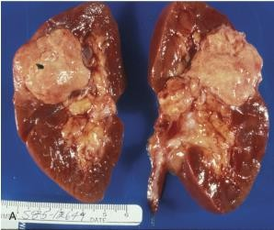
Core Content
Papillary (chromophilic) renal cell carcinoma extending into the collecting
system

Slide 10
Risk factors
Core Content
Tobacco , urban environmental toxins (cadmium/ asbestos/ petrols), obesity, high dietary fat intake, acquired cystic renal disease from renal failure
Association with von Hippel-Lindau disease:
  autosomal dominant
  loss of 3p
  >70% chance developing RCC (almost all clear cell histology) risk of developing multiple other benign and malignant tumors (retinal angiomas, CNS hemangioblastomas, pheochromocytoma , pancreatic cancer)

Slide 11
Histopathological types of renal cell tumours
Core Content
Clear Cell Carcinoma
Papillary Carcinoma (Type 1 and Type 2)
Chromophobic Carcinoma
Collecting Duct Carcinoma
Medullary Carcinoma
Unclassified Carcinoma
Renal Sarcomas

Slide 12
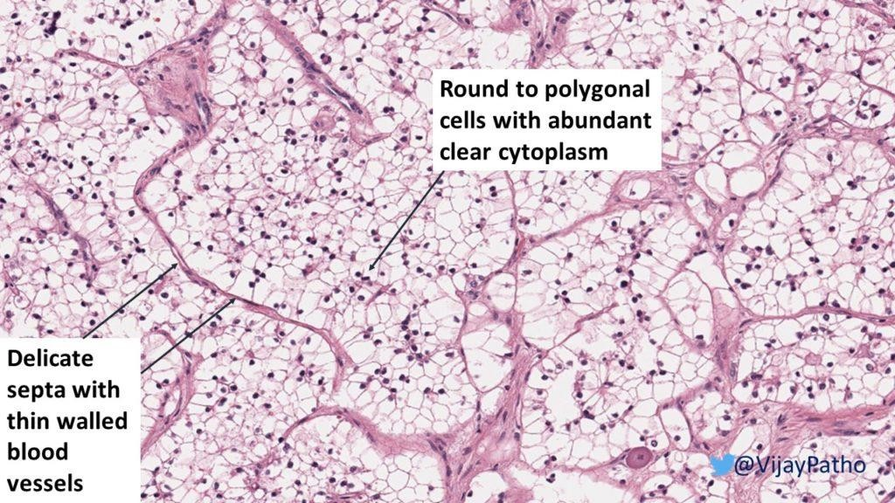

Slide 13
Histopathology
Core Content
Round to ovoid
Circumscribed by a pseudo capsule of compressed parenchyma and fibrous tissue
Nuclear features can be highly variable

Slide 14
Diagnosis
Vertical Integration
Common signs and symptoms:
  Haematuria (80%)
  flank pain (45%)
  flank mass (15%)
  classic triad of prior three only present in 10%
  normocytic/normochromic anemia, fever, weight loss
Less common signs and symptoms:
  hepatic dysfunction without mets
  Polycythemia
  hypercalcemia (occurs in 25% of patients with RCC mets)

Slide 15

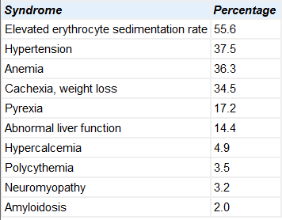
Paraneoplastic syndromes in 20% of patients with RCC
Core Content

Slide 16
Diagnosis
Vertical Integration
Labs: CBC, LFT, BUN/Cr, LDH, urinalysis
Imaging:
  CT abdomen
  MRI abdomen if CT suggests IVC involvement
Metastatic evaluation:
  Chest X ray
  Bone scan or MRI brain only if clinically indicated

Slide 17

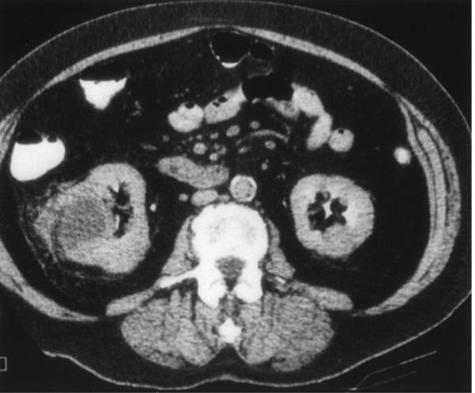
CT scan shows right renal tumor with perinephric stranding suggesting invasion of the
perinephric fat

Slide 18

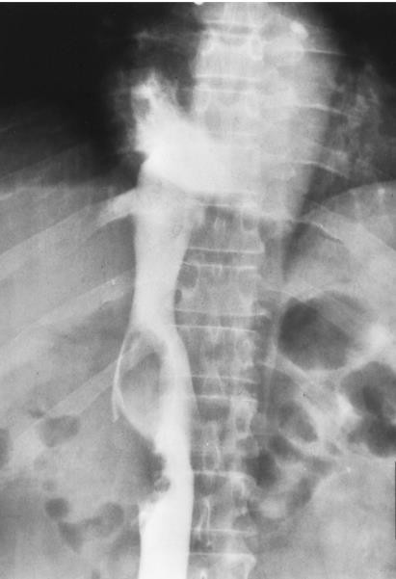
Contrast inferior venacavogram in patient with a right renal tumor shows
involvement of the subdiaphragmatic vena cava

Slide 19
Vertical Integration
PET: equivocal findings on conventional imaging
Percutaneous renal biopsy or aspiration: limited role

Slide 20

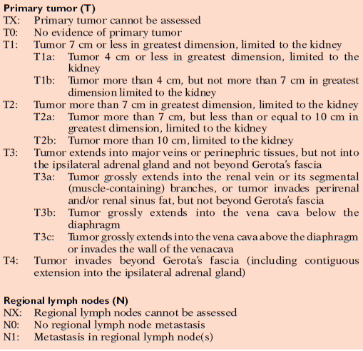
Staging AJCC 7th Edition
Vertical Integration

Slide 21

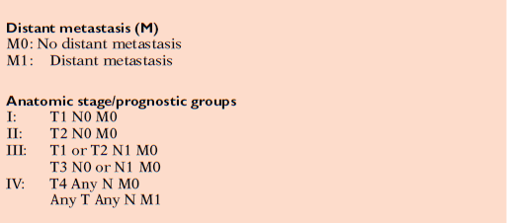
Vertical Integration

Slide 22

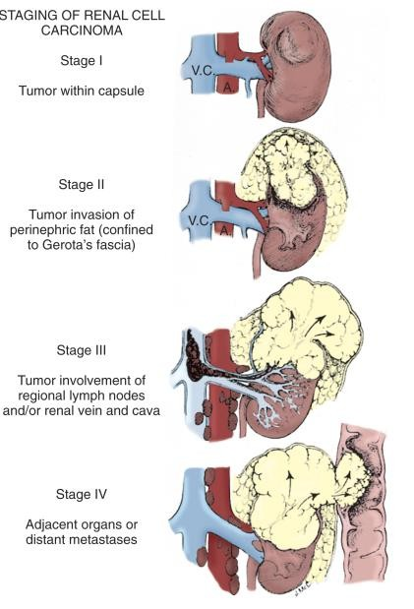

Slide 23

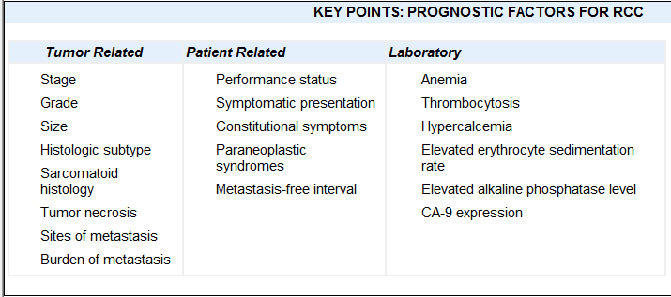
Prognostic factors for RCC
Vertical Integration

Slide 24
Management
Horizontal Integration
Stage I-III
Nephrectomy
Open radical nephrectomy, but laparoscopic gaining popularity
Nephron sparing surgery via partial nephrectomy, if possible (open or laparoscopic)
Possible to spare adrenal gland in ~75% cases
No role for adjuvant chemo/immunotherapy

Slide 25
No widely accepted role for neoadjuvant or adjuvant radiotherapy.
Retrospective data suggest possible utility in select cases:
Horizontal Integration
Positive surgical margins
Locally advanced disease with perinephric fat invasion and adrenal invasion (IVC/renal vein extension alone does not increase local recurrence significantly)
LN+
Unresectable (pre-op RT)

Slide 26
Stage IV
Horizontal Integration
Cytoreductive nephrectomy: improved survival with nephrectomy followed by interferon alpha vs. interferon alpha alone

Slide 27
Horizontal Integration
Systemic therapy
Immunotherapy (IL-2, interferon alpha, or combination)
High dose IL-2 only FDA approved treatment for
Biologic agents show promise in recent trials
  Bevacizumab
  Sorafenib or sunitinib
  Temsirolimus
Consider chemo (gemcitabine ± 5-FU or capecitabine) Focal palliation of metastases
  RT alone
  Metastasectomy
  Combination of both

Slide 28
Family medicine
Screening and Prevention:
Educating about risk factors and promoting healthy lifestyle choices.
Early Detection
Recognizing symptoms and coordinating referrals.
Management:
Supporting patients through treatment, addressing side effects, and providing follow-up care.

Slide 29
Take home message
Renal cell carcinoma (RCC) is the most common kidney cancer in adults. It arises from the kidney's filtering tubules and has several subtypes, with clear cell being the most frequent. Symptoms can include blood in urine, pain, and weight loss, and treatment options vary based on the cancer's stage.

Slide 30
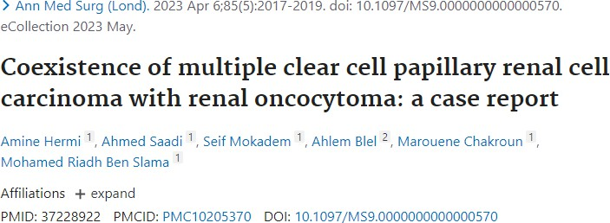
Research

Slide 31


