Slide 2
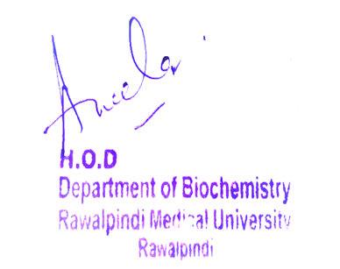
Foundation Module 2nd Year MBBS(LGIS) Metabolism Of Ammonia
Presenter: Dr Uzma Zafar Date: 01-02-25
Deptt of Biochemistry
RMU

Slide 3
Motto, Vision, Dream
To impart evidence based research oriented medical education
To provide best possible patient care
To inculcate the values of mutual respect and ethical practice of medicine
Wisdom
Truth
Service

Slide 4
Professor Umar Model of Integrated Lecture

Slide 5
Introduction to Protein Metabolism
Amino acids are not stored by the body therefore amino acids must be obtained from the diet, synthesized de novo, or produced from the degradation of body protein.
The first phase of catabolism involves the removal of the α-amino groups, forming ammonia and the corresponding α-keto acids, the carbon skeletons of amino acids.
In the second phase of amino acid catabolism, the carbon skeletons of the α-keto acids are converted to common intermediates of energy-producing metabolic pathways.
These compounds can be metabolized to carbon dioxide (CO2 ) and water (H2O), glucose, fatty acids, or ketone bodies

Slide 6
Learning Objectives
At the end of this session students should be able to
Describe chemical Reactions of Amino Acids
Discuss the metabolism of ammonia
Sources of ammonia
Transport of ammonia
Its toxicity and disorders

Slide 7
Biochemical reactions of Amino Acids in the Body 1.Transamination
Amino Acid is deaminated to from a keto acid and NH2 group liberated from amino acid aminates an other keto acid to form another amino acid.
Alanine + α- Ketoglutarate Glutamate + Pyruvate
Oxaloacetate + Glutamate Aspartate + α- Ketoglutarate

Slide 8
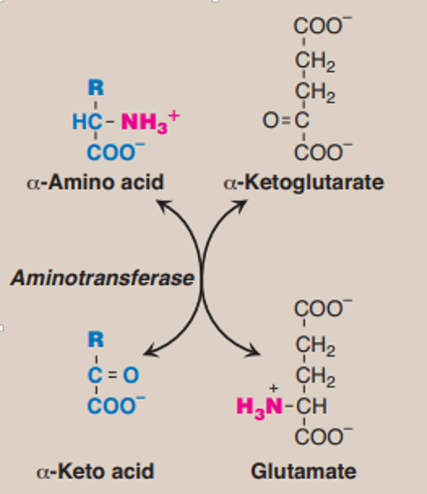

Slide 9
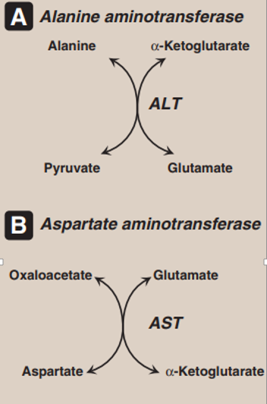

Slide 10
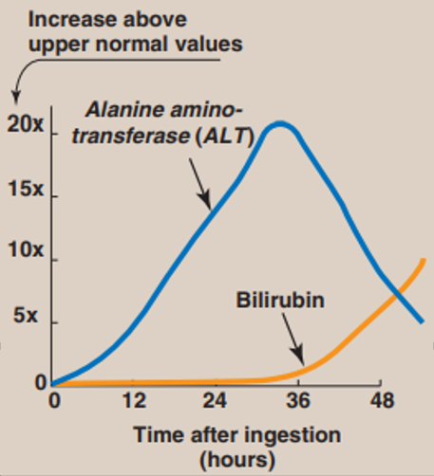
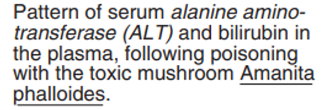

Slide 11
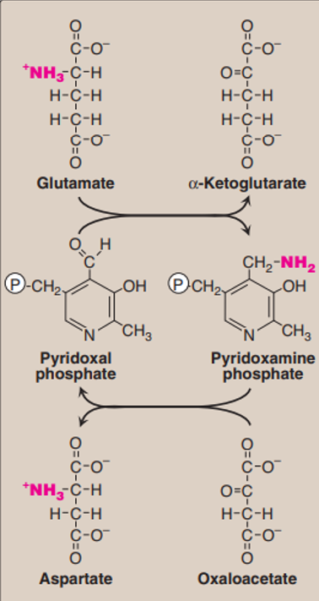

Slide 12
2. Trans methylation
S–Adenosylmethionine act as methyl donor
E.g. In the formation of Adrenaline from Nor–Adrenaline
S–Adenosylmethionine + Nor – Adrenaline Adrenaline + S–Adenosyl homocysteine
Other examples of Trans methylation are:
Formation of Creatine

Slide 13
Synthesis of catecholamines. PLP = pyridoxal phosphate

Slide 14
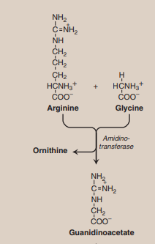
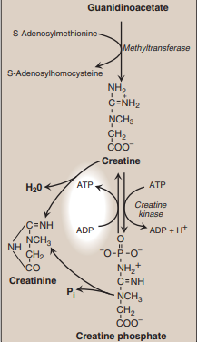
Synthesis of creatine.

Slide 15
3. Deamidation
Glutamine and Asparagine are Amide forms of Glutamic acid and Aspartic acid.
They are hydrolyzed by Glutaminase and Asparaginase to corresponding amino acids.
Ammonia is liberated in these reactions.

Slide 16
3. Deamidation Cont.
(a) Asparagine + H2O Aspartic acid + NH3
(b) Glutamine + H2O Glutamic acid + NH3

Slide 17
4. Deamination
It is removal of NH3 in the free form from an amino acid resulting in the formation of corresponding keto acid
It mainly takes place in Liver
It is of 2 types
(I) Oxidative deamination
(ii) Non oxidative deamination

Slide 18
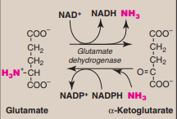
(I) Oxidative Deamination

Slide 19
(I) Oxidative Deamination
Glutamate dehydrogenase:
The amino groups of most amino acids are ultimately funneled to glutamate by means of the transamination with α-ketoglutarate. Glutamate is unique in that it is the only amino acid that undergoes rapid oxidative deamination—a reaction catalyzed by glutamate dehydrogenase.

Slide 20
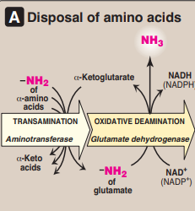
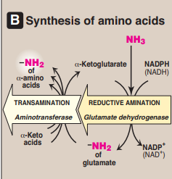
(I) Oxidative Deamination
a. Coenzymes: Glutamate dehydrogenase is unusual in that it can use either NAD+ or NADP+ as a coenzyme NAD+ is used primarily in oxidative deamination (the simultaneous loss of ammonia coupled with the oxidation of the carbon skeleton and NADPH is used in reductive amination.
Combined actions of aminotransferase
and glutamate dehydrogenase reactions.

Slide 21
(I) Oxidative Deamination
b. Direction of reactions: The direction of the reaction depends on the relative concentrations of glutamate, α-keto glutarate, and ammonia, and the ratio of oxidized to reduced co-enzymes
Combined actions of aminotransferase
and glutamate dehydrogenase reactions.

Slide 22
(I) Oxidative Deamination
c. Allosteric regulators: Guanosine triphosphate (GTP) is an allosteric inhibitor of glutamate dehydrogenase, whereas adenosine diphosphate (ADP) is an activator.
Combined actions of aminotransferase
and glutamate dehydrogenase reactions.

Slide 23
Core Concept
2. D-Amino acid oxidase:
D-Amino acid oxidase (DAO) is an FAD-dependent peroxisomal enzyme that catalyzes the oxidative deamination of these amino acid isomers, producing α-keto acids, ammonia, and hydrogen peroxide. The α-keto acids can enter the general pathways of amino acid metabolism, and be reaminated to L-isomers, or catabolized for energy.

Slide 24
Core Concept
2. D-Amino acid oxidase:
In this type of Deamination first there is removal of H2O by Dehydratases resulting in the formation of Imino acid followed by spontaneous Deamination
E.g. Hydoxy amino acids likes Serine and Threonine.

Slide 25
Core Concept
METABOLISM OF AMMONIA
Ammonia is produced by all tissues during the metabolism of a variety of compounds, and it is disposed of by formation of urea in the
Liver However, the level of ammonia in the blood must be kept very low, because even slightly elevated concentrations (hyperammonemia) are toxic to the central nervous system
Sources of ammonia
1. From glutamine
2. From bacterial action in the intestine
3. From amines
4. From purines and pyrimidines

Slide 26
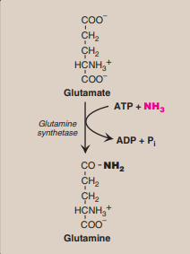
Synthesis of glutamine.

Slide 27
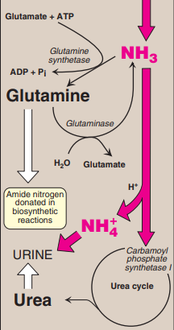
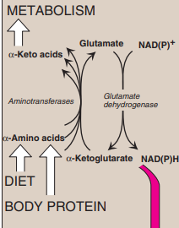
Transport of ammonia in the circulation

Slide 28
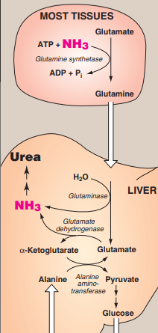
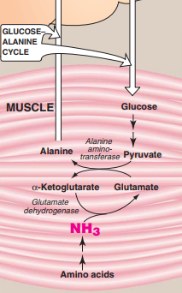
Transport of ammonia from peripheral tissues to the liver.

Slide 29
Hyperammonemia
When liver function is compromised, due either to genetic defects of the urea cycle or liver disease, blood levels can rise above 1,000 μmol/L. Such hyper ammonemia is a medical emergency, because ammonia has a direct neurotoxic effect on the CNS cause the symptoms of ammonia intoxication, which include
tremors, slurring of speech, somnolence, vomiting, cerebral edema,
and blurring of vision. At high concentrations, ammonia can cause
coma and death.

Slide 30
Hyperammonemia
The two major types of hyperammonemia are:
Acquired hyperammonemia:
Liver disease is a common cause of hyperammonemia in adults, and may be due, for example, to viral hepatitis or to hepatotoxins such as alcohol causing Cirrhosis of the liver.
2. Congenital hyperammonemia:
Genetic deficiencies of each of the five enzymes of the urea cycle. Ornithine transcarbamoylase deficiency, which is X-linked, is the most common of these disorders, predominantly affecting males. All of the other urea cycle disorders follow an autosomal recessive inheritance pattern. The failure to synthesize urea leads to hyperammonemia during the first week following birth

Slide 31
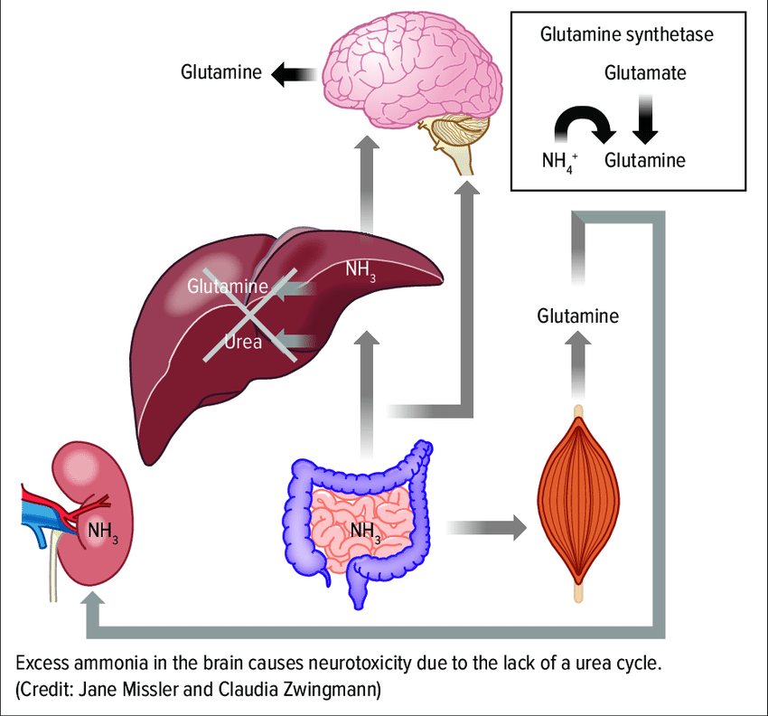
Vertical Integration
Hyperammonemia

Slide 32
Interactive Session
Synthesis of catecholamines. PLP = pyridoxal phosphate

Slide 33
Core Knowledge

Slide 34
Core Knowledge

Slide 35
Core Knowledge

Slide 36
Core Knowledge

Slide 37
Core Knowledge

Slide 38
Core Knowledge

Slide 39
Core Knowledge

Slide 40
Core Knowledge

Slide 41
Core Knowledge

Slide 42
Core
Knowledge

Slide 43
Core
Knowledge

Slide 44
Core Knowledge

Slide 45
Core Knowledge

Slide 46
Horizontal Integration

Slide 47
Vertical Integration
Clinical Correlates

Slide 48
Biochemical changes
Notes:
Thickening of the superficial layer of the epithelium due to increased keratinization.
Destruction or atrophy of the finger-like projections on the dorsal surface of the tongue.
Increased proliferation of epithelial cells in response to the inflammatory process.
Invasion of fungal elements, such as hyphae and spores, within the superficial layers of the epithelium.

Slide 49
Spiral Integration
Family Medicine
Management of (Make Changes)
Lifestyle: Maintain a low-salt diet, manage weight and abstain from alcohol.
Medications: Diuretics for ascites, beta-blockers for variceal bleeding, lactulose for hepatic encephalopathy.
Surveillance: Regular screening for varices, liver function, and hepatocellular carcinoma.
Complications: Manage ascites (paracentesis), SBP (antibiotics), and consider liver transplant.
Patient Education: Inform about complication signs and the importance of adherence to treatment.

Slide 50
Spiral Integration
Bioethics
Ethical Considerations
From an ethical standpoint, the scenario raises considerations regarding patient autonomy, informed consent, and confidentiality
The physician must ensure that patient fully understands her diagnosis, treatment options, and potential implications
Discuss the necessity of a healthy lifestyle & treatment plan. This requires clear communication and understanding of risks and benefits.
Additionally, the physician must respect patient’s privacy and confidentiality throughout the diagnostic and treatment process

Slide 51
Spiral Integration
Artificial Intelligence
Role of AI in (The Disease) Management
AI can potentially aid in enhancing diagnostic accuracy and efficiency.
AI-powered decision support systems can also help clinicians in selecting appropriate treatment modalities
AI-driven predictive models may help anticipate the risk of complications of the Disease in susceptible populations

Slide 52
Liver cirrhosis: An Overview (Make Changes)
Spiral Integration
Research Article
Nadia Moustafa, Manal Abdul-Hamid Mohamed, Rasha Rashad Ahmed, Rehab Nady
July 2016 Merit Research Journal of Medicine and Medical Sciences 4(7):329-343
Identification and characterization of cell populations contributing to the myofibroblastic pool and production of extracellular matrix (ECM) in liver fibrosis, as well as the increasing knowledge about natural course, many of the intricate cellular and molecular mechanisms underlying liver fibrogenesis and its progression, and contributions of the genetic regulation, inflammatory and immuno-mediators, neuroendocrine factors, and oxidative stress, have provided important data upon which the design of effective and targeted antifibrotic pharmacological strategies, aiming at halting the progression to decompensated cirrhosis or even reversing the liver fibrogenesis, can be based.

Slide 53
How To Access Digital Library
Steps to Access HEC Digital Library
Go to the website of HEC National Digital Library
On Home Page, click on the INSTITUTES
A page will appear showing the universities from Public and Private Sector and other Institutes which have access to HEC National Digital Library HNDL
Select your desired Institute
A page will appear showing the resources of the institution
Journals and Researches will appear
You can find a Journal by clicking on JOURNALS AND DATABASE and enter a keyword to search for your desired journal

Slide 54
Learning Resources
Lippincott Illustrated Reviews 8th Edition, Chap , pages -
Harper’s Illustrated Biochemistry 32nd Edition, Chap , pages –
Google images

Slide 55
THANK YOU

