Slide 1
Respiratory viruses
Microbe Module
3rd Year MBBS
Dr Kiran Fatima
Pathology Department
Rawalpindi Medical University

Slide 2


Slide 3
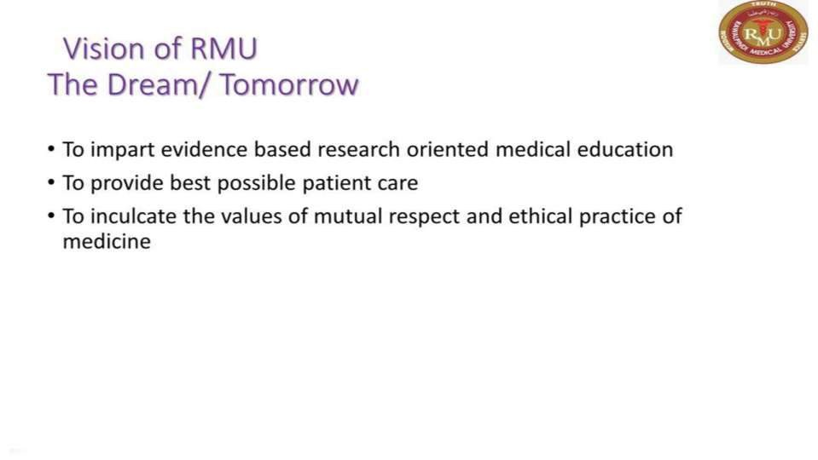

Slide 4
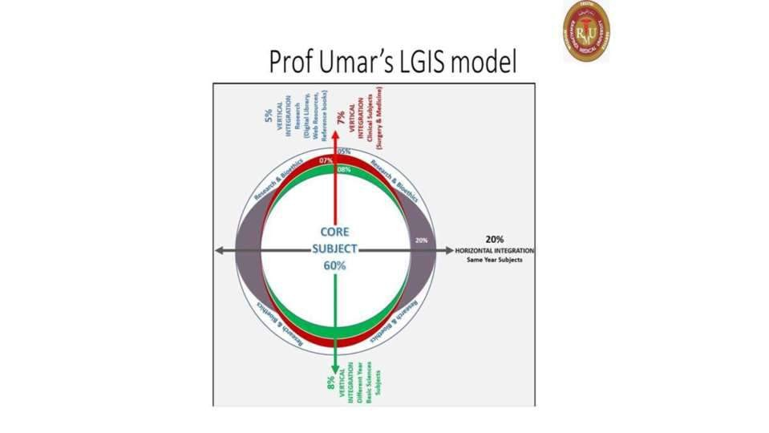

Slide 5
Learning outcomes
By the end of this lecture, you will be able to:
Classification and identification of common respiratory viruses and their associated symptoms.
Explain how respiratory viruses spread and how to prevent their transmission.
Lab diagnosis and practices in preventing respiratory illnesses.
Describe treatment options for various respiratory
viral infections.

Slide 6
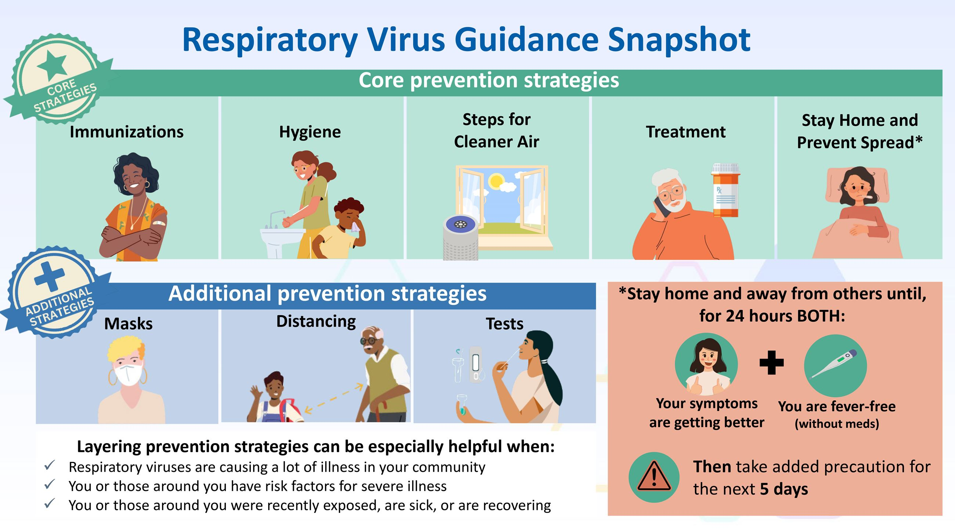
spiral

Slide 7
Pathology
Classification
Core
Orthomyxovirus
🞍 Human influenza virus
🞍 Avian influenza virus
🞍 Swine influenza virus
Paramyxoviruses
Measels virus
Mumps virus
Parainfluenza virus
Rsv
Corona Viruses
Sars VIRUS

Slide 8
Pathology
Core
Influenza virus
​ Term myxo
Human pathogens causing worldwide pandemics
Difference between orthomyxo and para
Myxovirus

Slide 9
Pathology
Core
Influenza virus
​ Diseases
🞍 Influenza A virus
🞍 Influenza B virus
🞍 Influenza C virus
​ Important properties
🞍 Segmented single stranded RNA genome
🞍 Helical nucleocapsid outer lipoprotein
🞍 Negative polarity
🞍 Presence of spikes
🞍 16 antigenically distinct( HA) and9( NA)

Slide 10
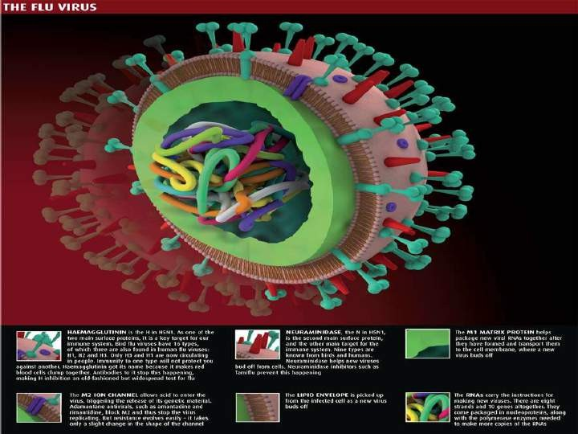
Pathology
Core

Slide 11
Core
Pathology
🞂​Influenza a virus shows changes in antigenicity
Group specific and type specific antigens
​Nonstructural protein ns1
​Species of animals have their own influenzaVi
Influenza b virus does not undergo
Antigenic shift

Slide 12
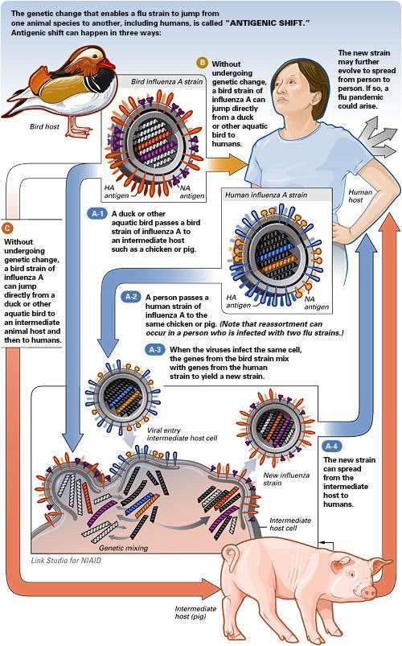
Pathology
Core

Slide 13
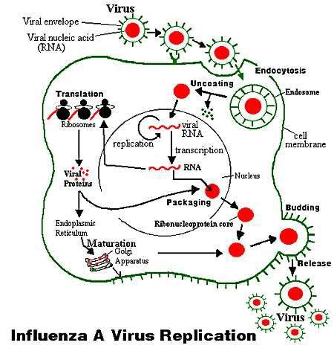
Pathology
Core
Replicative cycle

Slide 14
Pathology
Core
Transmission
Airborne droplets
Primarily in winter
Secondary infections
​ Pathogenesis and immunity
Infection limited to respiratory tract
Viremia rarely occurs

Slide 15
Laboratory diagnosis
Pathology Vertical/horizontal
Direct fluorescent antibody
Pcr
Cell culture
Detection of antigen using monoclonal antibodies
Heamagglutination inhibition test
Complement fixation test
Treatment
M2ion channel blockers
Nuraminidase inhibitors

Slide 16
Prevention
Pathology
longitudinal
Live killed vaccine
Killed vaccine
Who should administered…?
Side effects
Drugs for prevention

Slide 17
Pathology
Core
Swine influenza virus
In april 2009 origin of h1n1virus (soiv)
Uptil dec 2009 millions of cases occurred
​ Who declared a level 6 pandemic
​ Disease affec primarily young
​ Symptoms are mild
​ Eating pork does not transmit virus

Slide 18
Pathology
Core
​ S-oiv is a quadruple reassortant
People do not have protective antibody
​ Human to human transmission
PCR based testis available
​ Both type of vaccines are available

Slide 19
Pathology
Core
Respiratory syncytial virus
​ Diseases
Infants
Children
Elderly
​ Important properties
Rna genome and nucleocapsid
Surface spikes are fusion proteins
Humans are natural host
2 serotypes
Production of antibodies
​ Replicative cycle
Like that of measels virus

Slide 20
Transmission
Pathology
Core
🞍 Via droplets
🞍 Contaminated hands
🞍 Worldwide in every winter
🞍 Hospitalized infants
Pathogenesis and immunity
🞍 Infection in infants is severe
🞍 Viremia does not occur
🞍 Immunopathogenic mechanism
🞍 Immunity is incomplete

Slide 21
Laboratory diagnosis
Pathology
vertical
Enzyme immunoassay
Immuno-flouroscence
Cytopathic effect
Rise in antibody titer
RT-PCR
Treatment
Aerosolized ribavirin
Combination with immunoglobulins
Prevention
No vaccine
Handwashing

Slide 22
Pathology
Core
Parainfluenza virus
​ Diseases
​ Important properties
Rna genome and nucleocapsid
Surface spike are (h), (n) ,and (f) proteins
H and n proteins on the same spike
Both human and animals are infected
4 types
Replicative cycle
Similar to that of measels virus

Slide 23
Pathology
Core
Transmission
Via respiratory droplets
Cause disease worldwide
Pathogenesis
Infection without viremia
Subclinical infection
4 types
Clinical findings
Croup in children
Others

Slide 24
Pathology
Core
Laboratory findings
Diagnosed clinically
Isolation of virus
in antibody titre

Slide 25
Crona virus
Diseases
Pathology
Core
Common cold
Atypical pneumonia
Important properties
RNA genome
Helical nucleocapsid two sero types receptors on ace 2

Slide 26
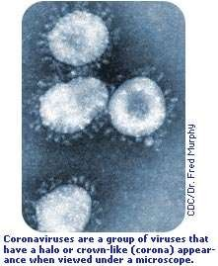
Pathology
Core
Structure

Slide 27
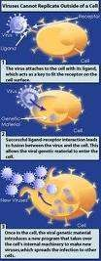
Replicative cycle
Pathology
Core

Slide 28
Pathology
Core
Transmission
Infection occurs worldwide and early in
Life
2-3 year cycle
Originated in china
Fatality 9%
Super-spreaders
Outbreaks in hospitals
Animal reservoir

Slide 29
Pathogenesis and immunity
Pathology
Core
Limited to mucosal cells
50% asymptomatic infection
Binding of virus to ace 2 results in diffuse edema and hypoxia

Slide 30
Pathology
vertical
Clinical findings
  Coryza
  Bronchitis
  Low grade fever
  Sars (atypical pneumonia)
X rays
Leukopenia and thrmbocytopenia
Incubation period
🞍 2-10 days

Slide 31
Laboratory diagnosis
Pathology
vertical
Primarily clinical
PCR based tests
Antibody based test

Slide 32
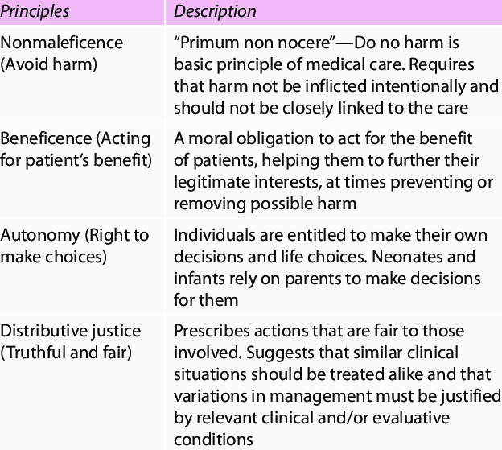
Bioethics
Longitudinal

Slide 33
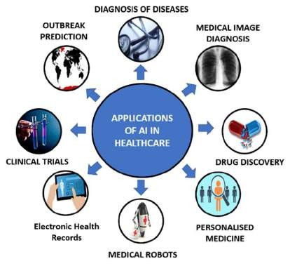
Artificial intelligence
Longitudinal

Slide 34
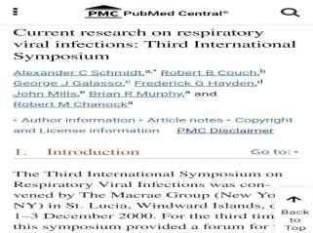
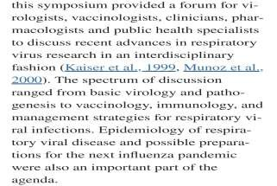
Research
Longitudinal
https://www.ncbi.nlm.nih.gov/pmc/a
rticles/PMC7133842/

Slide 35
Family medicine
Longitudinal
Sarah wakes up feeling achy and with a sore throat. He also has a runny nose and a cough that produces clear mucus.
​ MCQ:
​ Based on the symptoms, what is Sarah most likely
suffering from?
​ a) The flu (usually presents with fever and chills)
​ b) The common cold (often accompanied by runny
nose and mild cough) CORRECT
c) Bronchitis (typically involves a productive cough
with thick mucus)

Slide 36
Take home message
Respiratory viruses are a sneaky bunch. They invade our respiratory system, causing a range of illnesses like the common cold, flu, and even bronchitis. These viruses spread easily through coughs, sneezes, and touching contaminated surfaces.
While most resolve on their own, some can be serious, especially
for young children, older adults, and those with weakened
immune systems.

Slide 37


