Slide 2
WAKE UP CALL

Slide 3
Acute Renal failure
DR.ASAD SHABBIR
RAWALPINDI MEDICAL UNIVERSITY

Slide 4
Motto Vision; The Dream / Tomorrow
To impart evidence based research oriented medical education
To provide best possible patient care
To inculcate the values of mutual respect and ethical practice of medicine

Slide 5
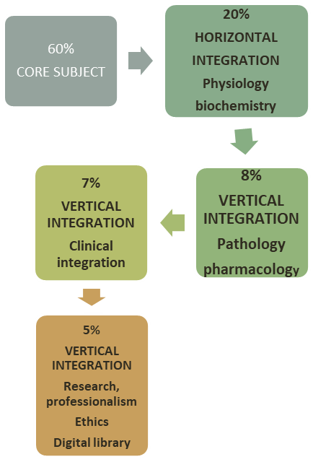
Professor Umar Model of Integrated Lecture
5
Notes:
5

Slide 6
CLINICAL CASE
A 4-year-old girl presents with history of anuria, dysuria and abdominal pain of 24 hours duration. There is now frank hematuria. On examination she is pale. Blood pressure is 120/80 mmHg (hypertension). Plasma sodium is 139 mmol/L (hypernatremia), potassium 6 mmol/L (hyperkalemia), chloride 100 mmol/i, bicarbonate 18 mmol/L (metabolic acidosis), urea and creatinine raised.
Abdominal radiograph reveals calcification in both kidneys. Abdominal ultrasound| shows left-sided hydronephrosis and hydroureter and multiple Stones in both Kidneys causing obstruction.
What is likely diagnosis ?
What are the causes of the condition in children ?
Complications of the disease ?
How will you manage the condition ?

Slide 7
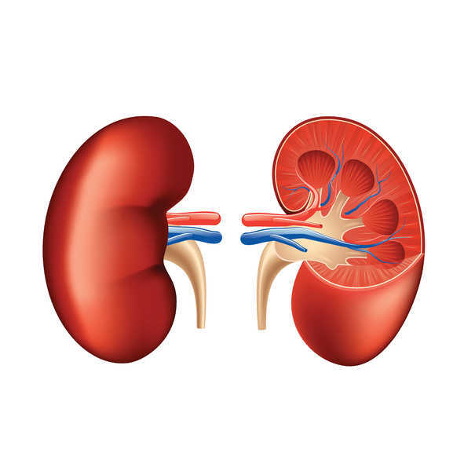
Learning Objectives :
Definition of Renal failure in children
Causes of renal failure
Pathophysiology of renal failure
Clinical features of renal failure
Diagnosis of renal failure
Management of renal failure in children
Bioethical aspects & Research
Post test

Slide 8
Definition of Acute Renal Failure
CORE SUBJECT
Abrupt loss of kidney function
Decline in GFR
Accumulation of waste products (creatinine and Blood urea nitrogen )
Dysregulation of Extra cellular volume & electrolyte balance

Slide 9
CORE SUBJECT
“KDIGO (Kidney Disease Improving Global Outcome) staging of AKI”
Stage | Serum Creatinine | Urine out
1 | >1.5times baseline Or >0.3mg/dL increase | <0.5ml/kg/hour for 6-12 hours
2 | 2 times baseline | <0.5ml/kg/hour for >12 hour
3 | 3 times baseline Or SCr >4mg/dL Or Initiation of renal replacement therapy Or GFR <35ml/min/1.73m² | <0.3ml/kg/hour for >24hours Or Anuria for >12 hours
GFR = K x height in cm
serum creatinine
K=0.45 -1 year age
K=0.55 ->1 year age

Slide 10
Pathogenesis
VERTICAL INTEGRATION
Pre-Renal | Intrinsic | Post Renal
Dehydration | Glomerulonephritis ( post streptococcal GN) | Posterior urethral valve
Hemorrhage | Acute tubular necrosis | Obstruction
Burns | Toxins/drugs | Tumor
Sepsis | Renal vein thrombosis | Urolithiasis

Slide 11
Patho-physiology
VERTICAL INTEGRATION

Slide 12
Clinical features
CORE SUBJECT
Altered mental state
Convulsion
Rapid acidotic breathing
Shortness of breath
Hematuria ,cola coloured urine
Edema
Pallor
Signs of dehydration
Anuria

Slide 13
Diagnosis
CORE SUBJECT
History
Examination
Investigation
Complete blood picture
(Anemia ,thrombocytopenia)
Arterial blood gases
Renal function test
Serum Electrolytes (S. Ca, Phosphorus, Na, K)
(Hyperkalemia , hypocalcemia)
ASO titer , C 3 LEVEL
Xray chest
Urine routine examination ( URINE R/E )
USG KUB
Renal Biopsy

Slide 14
Management
CORE SUBJECT
Avoid nephrotoxic drugs
(Aminoglycosides , NSAIDS)
Bladder palpable ….catheterize
Maintain adequate hydration status
Assess volume status 20ml/kg N/saline over 30 minutes. Severe hypovolemia then repeat rehydration
Diuretics furosemide single I/V dose or infusion.
Restrict i/V fluids
Renal dialysis if needed

Slide 15
Hyperkalemia
CORE SUBJECT
Hyperkalemia >6mEq/L
Kayexalate( K binding resin)
Hyperkalemia >7mEq/L
calcium gluconate, insulin with glucose
Metabolic acidosis
If severe pH <7.15,
intravenous bicarb sodium bicarbonate
Hypocalcemia
Low phosphorus diet
Phosphate binders

Slide 16
Dialysis
CORE SUBJECT
INDICATIONS
Anuria / oliguria
Volume overload
Persistent hyperkalemia
Severe metabolic acidosis
Uremia (encephalopathy, neuropathy)
Refractory Hyperphosphatemia
Types of dialysis
Peritoneal dialysis
Hemo-dialysis
Continuous renal replacement therapy

Slide 17
CLINICAL SCENARIO
A 10-year-old boy presents with growth failure, headache, progressive pallor, lethargy, anorexia, facial puffiness, and bone and joint pain for last one year.
On laboratory serm urea is 40 mg/dl ,creatinine 7 mg/dl,
sodium 146 mEq/L, serum Potassium is 6.5 mEq/L
(hyperkalemia), Ca 8.5 mg/dl
What is likely diagnosis ?
What are the causes of the condition in children ?
Complications of the disease ?
How will you manage the condition ?

Slide 18
CHRONIC KIDNEY DISEASE
CORE SUBJECT
Evidence of renal damage for more than 3 months
OR
Decrease in GFR < 6ml/min/1.73m2 for more than 3 months
OR
Evidence of kidney damage include
Albuminuria > 30mg/24hrs
Microscopic hematuria with abnormal casts
Abnormal imamging aplastic ,dysplastic kidney
Abnormal histology e.g lupus nephritis

Slide 19
STAGING OF CKD
VERTICAL INTEGRATION

Slide 20
CAUSES OF CKD
CORE SUBJECT
CONGENITAL ANOMOLY
Posterior uretral valve
Bilateral pelvi ureteric junction obstruction
Reflux nephropathy
Renal dysplasia
Glomerular disease
Glomerulonephritis
SLE nephritis
HSP nephritis
Alport syndrome
Congenital nephrotic syndrome
Focal segmental glomerulosclerosis

Slide 21
CAUSES OF CKD
CORE SUBJECT
Cystic kidney disease
Autosomal recessive
Autosomal dominant
Follow Acute kidney injury
Hemolytic uremic syndrome
TUBOINTERSTITIAL DISEASE
BARTER SYNDROME
Dent disease
Nephrolithiasis

Slide 22
CLINICAL FEATURES OF CKD
CORE SUBJECT
Clinical features in advanced CKD (stage 3-5) include
Anorexia
Fatigue
Anemia
Growth failure,
Hypertension
Bone disease.

Slide 23
CLINICAL FEATURES OF CKD
CORE SUBJECT
The late feature (when GFR falls <15ml/min/1.73m2)
Itching
Severe acidosis
Left Ventriculuar failure
Hyperkalemia
Pulmonary edema
Pericarditis
Altered sensorium.

Slide 24
DIAGNOSIS
CORE SUBJECT
DEATILED HISTORY
FAMILY HISTORY
EXAMINATION
BLOOD PRESSURE
WEIGHT
HEIGHT
RENAL FUNCTION TEST
SERUM ELECTROLYTES
CALCIUM ,PHOSPHATE,ALBUMIN ,URIC ACID
ATERIAL BLOOD GASES
PARATHYROID HORMONE LEVEL
CHEST XRAY ,ECG,ECHO

Slide 25
SPECIFIC INVESTIGATIONS
CORE SUBJECT
Urine culture and sensitivity
C3, C4, ANA
RENAL BIOPSY
ULTRSOUND ABDOMEN
MCUG
MAG3 SCAN
DTPA SCAN

Slide 26
CKD MANAGEMENT
CORE SUBJECT
The aims of treatment in CKD prior to dialysis are to preserve any remaining renal function and to avoid and treat complications.
Nutritional management
Inadequate caloric intake once renal function falls below 50% is a major cause of growth failure in children.
Protein restriction is important in severe uremia.
High biologic value protein (fish, chicken, eggs)
In growing children 1.0-1.5 g/kg/day of protein is given to protect growth retardation.
Caloric requirements are met by carbohydrates (75%) and fats(20%).
Milk intake can be reduced if there is phosphate overload.
Water-soluble vitamins are recommended to avoid deficiency states

Slide 27
CORE SUBJECT
Fluid balance
Fluid restriction as renal concentrating ability is lost
Fluid restriction ( insensible losses (400 ml/m2/day) plus losses in urine, vomitus, and stools) rarely needed.
Sodium balance
No added salt in food is recommended.
Patients with high blood pressure, edema, or congestive heart failure may need more strict sodium restriction.
Potassium balance
Hyperkalemia can be a potentially life-threatening situation.
Avoid excessive use of high potassium food
(banana, citrus fruits and juices)
Restrict such food in a case of severe renal failure.
Hyperkalemia is managed by potassium binding resin
kayexalate (an oral resin that binds to and removes potassium from the intestine).
It is given in a dose of 1 ¢/kg/dose.

Slide 28
CORE SUBJECT
Acidosis
In all children with CRF
treatment if serum bicarbonate falls below 20 mEq/L.
Sodium bicarbonate (soda mint) tablet may be given 1-2 tablets orally every 6 hours.
Anemia
Inadequate erythropoitin production and Iron deficiency
Severe cases, requires blood transfusion (pack cells) given very slowly. Recombinant erythropoitin is effective treatment for anemia
Blood pressure
Routine treatment of hypertension include
Salt restriction, diuretics, and beta-blockers.
severe hypertension with circulatory overload, 2-4 mg/kg of frusemide

Slide 29
CORE SUBJECT
Drug dosages adjustment
Dosages must be modified in chronic renal failure.
Renal osteodystrophy
The plasma calcium and phosphate level should be normal .
Low-phosphate milk and by giving oral calcium carbonate
Oral calcium supplementation
vit D active form alfacalcidol 0.05-0.10 ug/kg/day.
Infections
Antibiotics are given to control infections especially UTI
Growth retardation
Recombinant human growth hormone therapy.

Slide 30
BIOMEDICAL ETHICS Lesson Of The Day
SPIRAL INTEGRATION
Understanding Biomedical
Ethics
Core biomedical ethical principles are fundamental guidelines that
shape and govern ethical decision-making and behavior.
These principles provide a framework for individuals and organizations to determine what is morally right or wrong in various contexts.
Regarding renal failure patient respect and privacy must be maintained
We must show empathy with patient and family as disease is stressful

Slide 31
MEDICAL ETHICS

Slide 32
How To Access Digital Library
Promoting IT & Research Culture
Steps to Access HEC Digital Library
Go to the website of HEC National Digital Library.
On Home Page, click on the INSTITUTES.
A page will appear showing the universities from Public and Private Sector and other Institutes which have access to HEC National Digital Library HNDL.
Select your desired Institute.
5. A page will appear showing the resources of the institution
6. Journals and Researches will appear
7. You can find a Journal by clicking on JOURNALS AND DATABASE and enter a keyword to search for your desired journal.

Slide 33
RESEARCH
Balestracci, A., Ezquer, M., Elmo, M.E. et al. Ibuprofen-associated acute kidney injury in dehydrated children with acute gastroenteritis.Pediatr Nephrol 30, 1873–1878 (2015). https://doi.org/10.1007/s00467-015-3105-7uprofen-associated acute kidney injury in dehydrated children with acute gastroenteritis
Background
Non-steroidal anti-inflammatory drugs (NSAIDs) induce acute kidney injury (AKI) in volume-depleted patients; however the prevalence of this complication is likely underestimated. We assessed the impact of ibuprofen exposure on renal function among dehydrated children with acute gastroenteritis (AGE) to further characterize NSAID-associated AKI.
iginal Article
Published: 21 April 2015
Volume 30, pages 1873–1878, (2015
in dehydrated children with acute gastroenteritis
Original Article
Published: 21 April 2015
Volume 30, pages 1873–1878, (2015

Slide 34
Methods
Over a 1-year period dehydrated children with AGE (n = 105) were prospectively enrolled and grouped as cases, presenting with AKI (n = 46) or controls, not presenting with AKI (n = 59). AKI was defined by pediatric RIFLE (pRIFLE) criteria.
Results
Among the children enrolled in the study, AKI prevalence was 44 %, and 34 (54 %) of the 63 patients who received ibuprofen developed renal impairment. Relative to the controls, children presenting with AKI were younger (median age 0.66 vs. 1.74 years; p < 0.001) and received ibuprofen more frequently (74 vs. 49 %, p = 0.01). After adjusting for the degree of dehydration, ibuprofen exposure remained an independent risk factor for AKI (p < 0.001, odds ratio 2.47, 95 % confidence interval 1.78–3.42). According to the pRIFLE criteria, 17 patients were at the ‘risk’ stage of AKI severity, 24 were at the ‘injury’ stage, and five were at the ‘failure’ stage; none required dialysis. Distribution of patients within categories was similar regardless of ibuprofen exposure. All cases fulled recovered from AKI.
Conclusions
Ibuprofen-associated AKI was 54 % in our cohort of dehydrated children with AGE. Drug exposure increased the risk for developing AKI by more than twofold, independent of the magnitude of the dehydration.

Slide 35
Clinical case no.1
A 5-year-old boy is brought to the emergency department with a history of diarrhea and vomiting for the past 3 days. On examination, he is lethargic, has sunken eyes, and delayed capillary refill. His blood pressure is 80/50 mmHg, and laboratory tests show elevated blood urea nitrogen (BUN) and creatinine. Urinalysis reveals concentrated urine with high specific gravity.
What is the most likely cause of his acute renal failure?
A) Hemolytic uremic syndrome (HUS) B) Acute post-streptococcal glomerulonephritis (APSGN) C) Prerenal failure due to dehydration D) Acute tubular necrosis (ATN) E) Obstructive uropathy

Slide 36
Case no.2
A previously healthy 7-year-old boy presents with facial puffiness and cola-colored urine 2 weeks after a streptococcal throat infection. His blood pressure is 140/90 mmHg, and laboratory tests show elevated BUN and creatinine, low complement levels (C3), and red blood cell casts in urine.
What is the most likely etiology of his acute renal failure?
A) Acute post-streptococcal glomerulonephritis (APSGN) B) Nephrotic syndrome C) Acute tubular necrosis (ATN) D) Hypercalcemic nephropathy E) Renal artery thrombosis

Slide 37
Clinical case no.3
A 6-month-old infant with a history of recurrent urinary tract infections (UTIs) presents with poor weight gain and irritability. A renal ultrasound shows bilateral hydronephrosis, and a voiding cystourethrogram (VCUG) reveals vesicoureteral reflux with posterior urethral valves.
Which of the following is the most likely cause of his acute renal failure?
a).Obstructive uropathy b).Acute interstitial nephritis (AIN)
c).Minimal change disease d).RhabdomyolysiS e.)Acute tubular necrosis (ATN)

