Slide 1
RENAL CELL CARCINOMA
Dr. M. Ali Shahiman Senior Registrar
Urology Department
Rawalpindi Medical University

Slide 2
University Vision And Mission
Vision
To impart evidence-based research oriented health professional education in order to provide best possible patient care and inculcate the values of mutual respect, ethical practice of healthcare and social accountability.
Mission
Highly recognized and accredited center of excellence in Medical Education, using evidence-based training techniques for development of highly competent health professionals, who are lifelong experiential learner and are socially accountable.

Slide 3
Sequence of LGIS
Learning objectives
Vertical integration with anatomy and physiology
Horizontal integration with pathology
Clinical aspect as core subject
Ethics

Slide 5
VerticalIntegration with Anatomy

Slide 6
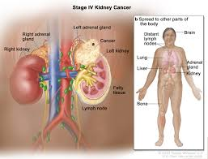

Slide 7
Horizontal Integration with Pathology

Slide 8
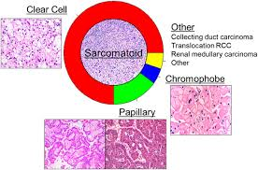

Slide 9
Vertical Integration with Imaging and Staging

Slide 10
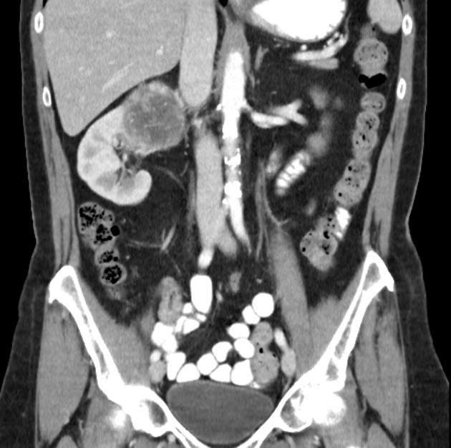

Slide 11
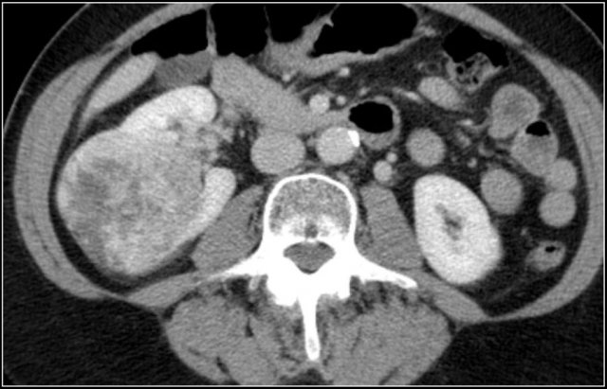

Slide 12
CLINICAL STAGING
Chest X-ray or Chest CT
CT/MRI scan of abdomen or pelvis
Bone scan with plan films (for elevated alkaline phosphatase or bone pain).
Laboratory: CBC, LFT's, alkaline phosphotase, BUN, creatinine.

Slide 13
American Join Committee on Cancer (AJCC) TNM Staging System.
Primary tumor (T)
TX: Primary tumor cannot be assessed (information not available).
T0: No evidence of a primary tumor.
T1a: Tumor is 4 cm in diameter or smaller and is limited to the kidney.
T1b: Tumor is larger than 4 cm but smaller than 7 cm and is limited to the kidney.

Slide 14
T2: Tumor is larger than 7 cm but is still limited to the kidney.
T2a : Tumour size between 7cm to 10cm
T2b : Tumour size greater than 10cm but limited to kidney.
T3a: Tumour extends into renal vein ot tumouor invades the peri-renal / renal sinus fit but not beyond Gerota’s fascia.
T3b: Tumour involving vena cava below the diaphragm.
T3c: Tumour involving vena cava above the diaphragm.

Slide 15
T4: Tumor has spread beyond Gerota’s fascia or ipsilateral adrenal gland.
Regional lymph nodes (N)
NX: Regional lymph nodes cannot be assessed (information not available).
N0: No regional lymph node metastasis.
N1: Metastasis to regional (nearby) lymph node.

Slide 16
Extent of Metastasis (M)
MX: Presence of distant metastasis cannot be assessed (information not available).
M0: No distant metastasis.
M1: Distant metastasis present; includes metastasis to non-regional (not near the kidney) lymph nodes and/or to other organs (such as the lungs, bones, or brain).

Slide 17
Renal Cell Cancer Stage Grouping
Stage I: T1a-T1b, N0, M0. The tumor is 7 cm or smaller and limited to the kidney. There is no spread to lymph nodes or distant organs.
Stage II: T2, N0, M0. The tumor is larger than 7 cm but is still limited to the kidney. There is no spread to lymph nodes or distant organs.
Stage III: T1a-T3b, N1, M0 or T3a-T3c, N0, M0. Several combinations of T and N categories are included in this stage. These include any tumor that has spread to only one nearby lymph node but not to other organs.

Slide 18
Stage IV: T4, N0-N1, M0 or Any T, N2, M0 or Any T, Any N, M1. Several combinations of T, N, and M categories are included in this stage, which includes any cancers that have spread directly through the fatty tissue and beyond Gerota’s fasia.

Slide 19
Core Subject

Slide 20
MANAGEMENT OF RENAL CELL CARCINOMA

Slide 21
INTRODUCTION
Management Overview
Localized disease management
Surgery
Radical Nephrectomy
Nephron Sparing Surgery
Metastatic Disease Management
Palliative Surgery
Radiotherapy
Chemotherapy
Targeted Molecular therapy
Immunotherapy

Slide 22
Management
Localized disease
Metastatic disease

Slide 23
Management of Localized disease
Localized disease
Surgery

Slide 24
Surgery- Radical nephrectomy
Gold standard treatment for localized RCC with contralateral normal kidney, adequate surgical margin.
Principles of Surgery- Early ligation of renal artery and vein , removal of kidney including Gerota’s fascia, removal of ipsilateral adrenal gland.

Slide 25
Nephron Sparing Surgery
Indications
Bilateral RCC
RCC in a solitary functioning kidney
Unilateral RCC with contralateral kidney under threat of its future function (Renal artery stenosis, Chronic pyelonephritis , Hydronephrosis, Ureteral reflux, Calculus disease, Systemic disease such as diabetes).
Tumor less than 4cms with normal opposite kidney.

Slide 26
Management of Metastatic Disease
Metastatic
Disease
Radio
Therapy
Chemo
Therapy
Targeted
Therapy
Immuno
Therapy
Surgery

Slide 27
Surgery
Palliative Nephrectomy – Indicated in patients with
Severe hemorrhage,
Severe pain,
Paraneoplastic syndrome
or compression of adjacent viscera
Solitary metastasis can be resected and may show some survival advantage

Slide 28
Surgery…
Resection of met’s
in pt. not relieved from palliative RT
In solitary mets.
Spontaneous regression of met’s
< 1 % of cases
only 4 (0.8%) of 474 patients in 9 series who underwent nephrectomy experienced regression of metastatic foci

Slide 29
Radio Therapy
Palliation
Used for local or symptomatic metastatic disease, such as painful osseous lesions or brain metastasis.
Higher doses (up to 35-40Gy) may be required to overcome radioresistance.
Symptomatic relief in 64-84% of patients

Slide 30
Chemotherapy
RCC is a chemo resistant tumor. Phenomenon due to presence of multi drug resistant glycoprotein (MDR) in tumor cell - causes extrusion of the drug
Conventional therapy has little to offer.
5-FU alone has a response rate of 10%,
On-going clinical trials of combination chemotherapy including Gemcitabine and 5-FU.
Limited data reveals some response in non-clear cell RCC to Carboplatin, Cisplatin plus Gemcitabine.

Slide 31
RECENT ADVANCES : Targeted Molecular Therapy
New treatment approach that targets only the cancer.
In renal cell carcinoma patients, this type of therapy uses drugs that stop the new blood vessels from growing, and targets certain factors that cause the cells to grow.
Tyrosine kinase (TK) inhibitors block the intracellular domain of the VGEF receptor
Sunitinib (Sutent)
Sorafenib (Nexavar)

Slide 32
Immunotherapy
Systemic type of treatment used to improve the body’s natural defenses.
Boosts the immune system and slows down the cancer growth
Interferon (IFN)
Interleukin (IL -2)

Slide 33
Summary
RCC has increasing incidence
Associated with tobacco and inherited disorders
Surgery is the only curative modality for Stage I, II, and III
RCC is radio resistant, RT’s role in paliation
Stage IV disease holds poor prognosis despite advancements in molecular understanding
IL-2, Sorafenib, Sunitinib, and Temsirolimus are FDA approved treatments for advanced RCC.

Slide 34
Biomedical Ethics
Before doing any medical and surgical treatment informed consent must be taken
Prognosis should be explained to the patient and attendants

Slide 35
THANK YOU

