Slide 1
NORMAL PUERPERIUM

Slide 2
SEQUENCE OF LGIS
Learning objectives
Normal Puerperium
(core concept = 70%)
Related pathophysiology (horizontal integration 15%)
Related clinical findings (vertical integration – 10%)
Research article related to topic (3%)
Ethics (2%)

Slide 3
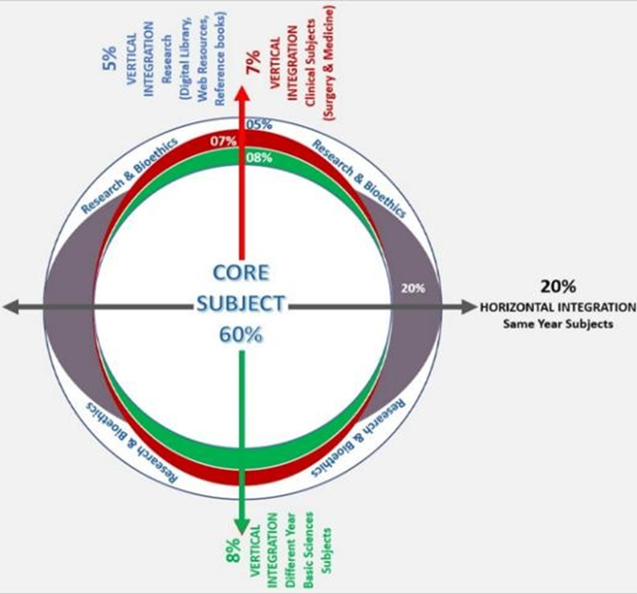
PROF UMER MODEL OF INTEGRATED LECTURE

Slide 4
University Motto, Vision, Values & Goals
MISSION STATEMENT
To impart evidence-based research-oriented health professional education
Best possible patient care
Mutual respect, ethical practice of healthcare and social accountability.
VISION AND VALUES
Highly recognized and accredited centre of excellence in Medical Education, using evidence-based training techniques for development of highly competent health professionals, who are lifelong experiential learner and are socially accountable.
GOALS
The Undergraduate Integrated Learning Program is geared to provide you with quality medical education in an environment designed to.

Slide 5
LEARNING OBJECTIVES
At The End Of This Lecture Students Shall Be Able To Learn:
Normal and abnormal puerperium
Understand physiology of puerperium
Complications in puerperium and their management

Slide 6
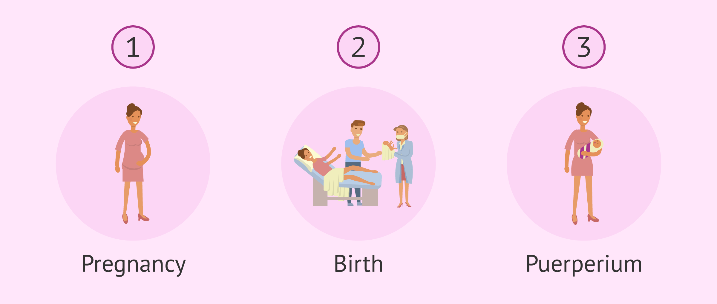
Definition
The puerperium, or postpartum period, generally lasts 6 week
it is the period of adjustment after delivery when the anatomic and physiologic changes of pregnancy are reversed, and the body returns to the normal, nonpregnant state.

Slide 7
Stages of Puerperium
Immediate puerperium: First 24 hours after childbirth.
Early puerperium: which extends until the first week postpartum.
Remote puerperium: until the sixth week postpartum.

Slide 8
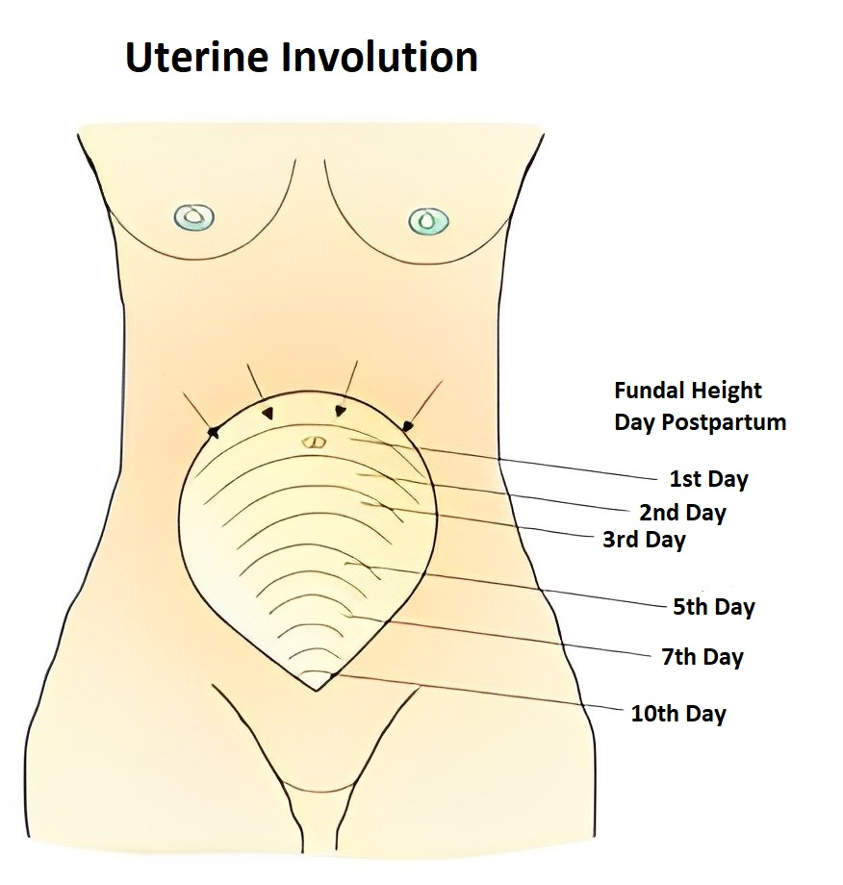
Anatomical Consideration
Uterine involution: immediately after delivery uterus becomes firm and retracts with alternate hardening and softening.
At the end of sixth week uterus measures almost similar to non pregnant state(60gm). Clinically assessed by noting the height of fundus from symphysis pubis.
Cervix: contracts slowly, by the end of first week narrows down to admit tip of finger only.

Slide 9
Signs of Delayed Involution
Artefect
Full bladder
Loaded rectum
Retained product of conception (Clots)
Uterine infection
Fibroids
Broad ligament haematoma

Slide 10
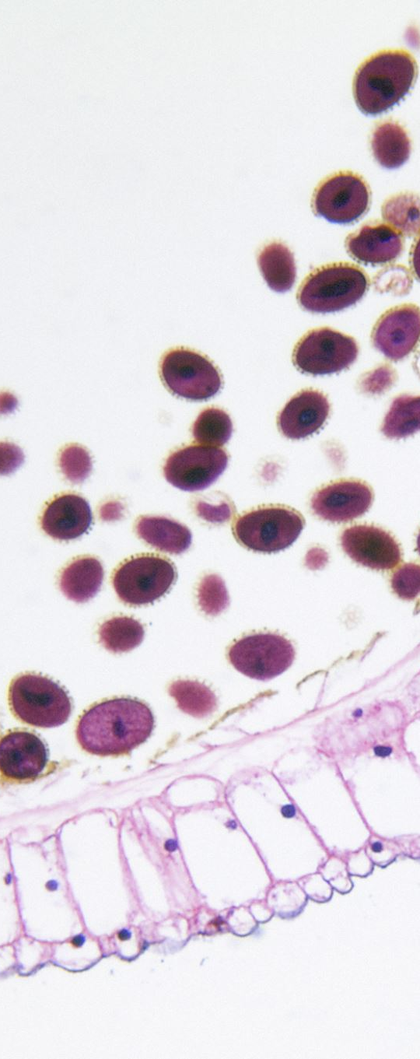
Physiological Consideration
Muscles: Substantial reduction of myometrial cell size
Blood vessels: During the first week arteries undergo thrombosis and hyalinization, new blood vessels grow inside the thrombi.
Endometrium: The superficial part containing the degenerated decidua casts off in lochia. The endometrium left behind varies in thickness 2-3cm. Regeneration completed by 10th day.

Slide 11
Involution of other Pelvic Structures
Vagina: Mucosa remains delicate for the first few weeks, it regains its tone nut never to virginal state.
Broad ligament and round ligament: Requires considerable time to recover from stretching and laxation.
Pelvic floor and pelvic facia: Take a long time to involute from the stretching effect.

Slide 12
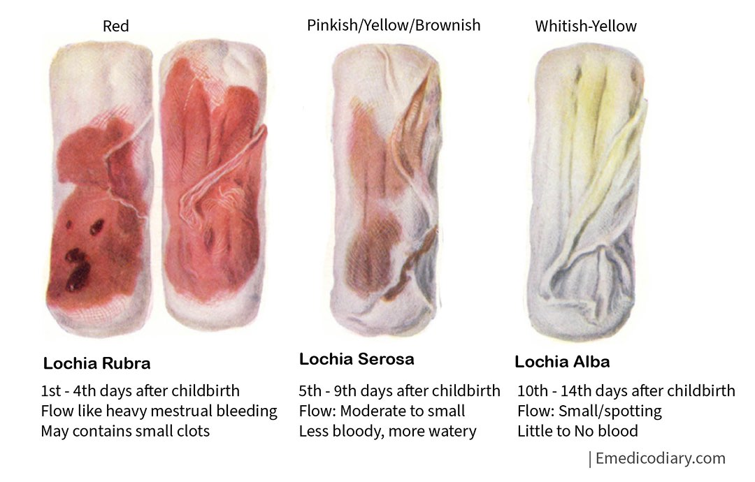
Lochia
Vaginal discharge for the first
fortnight of puerperium.
Lochia rubra; Red, 1-4 days.
Lochia serosa; Yellowish or pink,
          5-9 days.
Lochia alba; Pale white,10-15days.

Slide 13
General Physiological Changes
Pulse: For a few hours pulse rate increases, settles down to normal on second day.
Temperature: Reactionary rise by 0.5F but settles down in 12 hours.
Urinary tract: Bladder capacity increased, risk of UTI.
Gasrtrointestinal tract: increased thirst, constipation, anal incontinence.

Slide 14
ABNORMAL PUERPERIUM

Slide 15
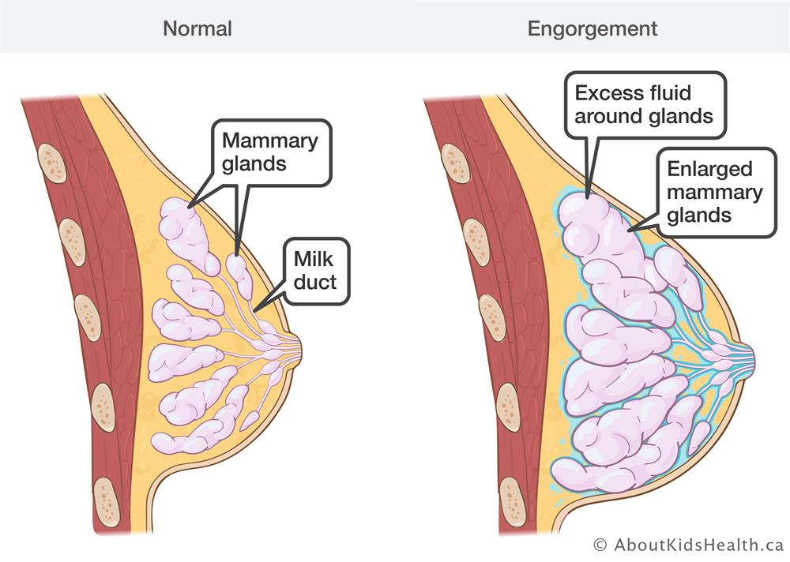
Breast Engorgement
Breast Disorders in Puerperium
For the first 24 hours after development of lacteal secretion, breasts become distended, firm, & nodular exaggeration of normal venous & lymphatic drainage of the breast
. Puerperal fever from breast engorgement is common.
37.8 – 39 C, seldom persists for longer than 4 - 16 hours
Other causes (especially infection) of fever must be excluded
Treatment
  Binder , ice bag, analgesics, pumping or manual expression

Slide 16
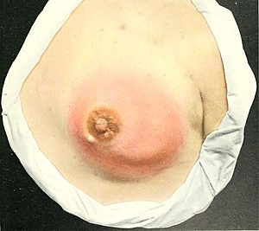
Mastitis
Parenchymatous infection of mammary glands
3rd or 4th week.
Unilateral, breast becomes hard, reddened and painful
Signs : chills (1st), rigor, fever, tachycardia
Etiology
  Staphylococcus aureus (most common)
  Breast abscess : caused by group B streptococcus almost always from nursing infant's nose & throat the organism enters the breast through the nipple at the site of a fissure or abrasion

Slide 17

Mastitis ------- cont
Treatment
  Swab and cultures
  Antibiotic therapy
  Penicillin or cephalosporin
MRSA →vancomycin continued for about 7-10 days
Continue Breast Feeding
  Early Tx & continued lactation is successful in avoiding abscess formation
Breast abscess
Surgical drainage (essential) under general anesthesia

Slide 18
Cracked Nipples
Causes:
Loss of Epithelium of the nipple
Small deep fissure at the base or the tip of the nipple
Treatment:
Rest, manual expression of milk, use of breast pump, local applications

Slide 19

PUERPERAL PYREXIA
A temperature rise above 100.0 °F maintained over 24 hours or recurring during the period from the end of the 1st to the end of the 10th day after childbirth or abortion
The specific target of infection:
Endometritis
Metrophlebitis(veins of the uterus),
Peritonitis

Slide 20
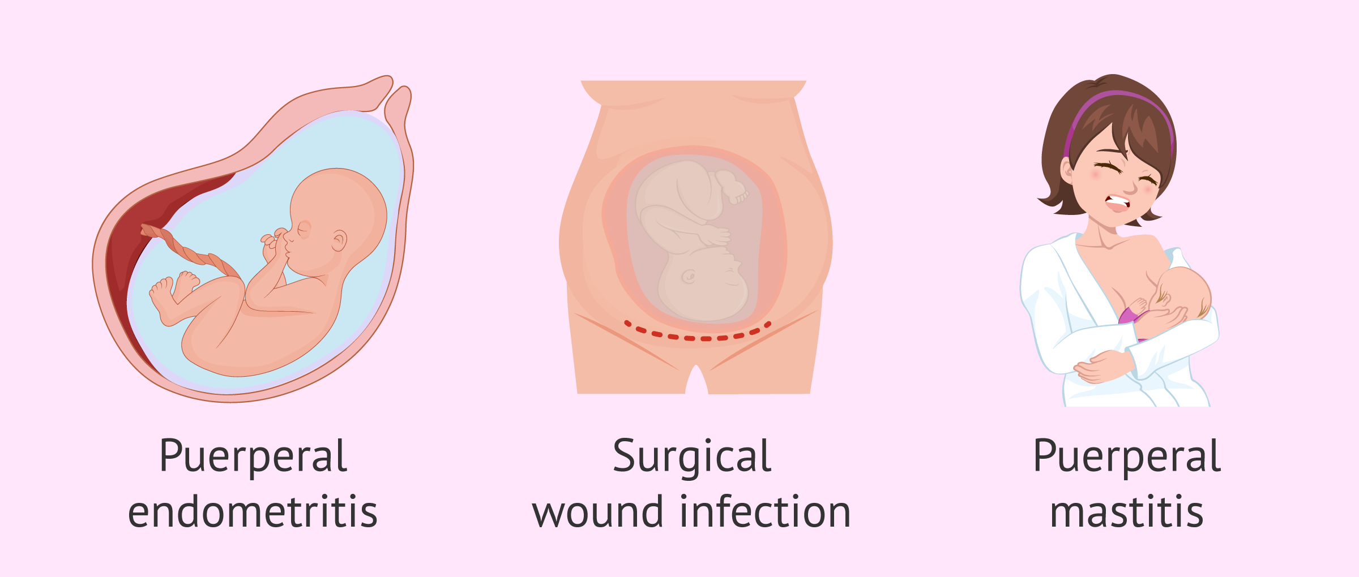
PUERPERAL PYREXIA
    Causes
Genital Tract Infection
Urinary Tract Infection
Breast Infection
Thrombophlebitis
Wound Infection
Respiratory Tract Infection
Intercurrent Febrile Illness

Slide 21

Genital Tract Infection
Aetiology
Home birth in unhygienic conditions,
Low socioeconomic status,
Poor nutrition,
Primiparity
Anemia
Prolonged rupture of membranes,
Prolonged labor with multiple vaginal examinations in labor,
Cesarean section,
Obstetrical maneuvers,
Retained placental tissues within the uterus leading to postpartum hemorrhage

Slide 22
Maternal Complications
Septicemia,
Peritonitis or abscess formation leading to compromised future fertility
Endotoxic shock

Slide 23
Transmissions of Infecting Organisms
Are typically categorized into
Nosocomial,
Exogenous,
Endogenous.

Slide 24
Nosocomial Infections:
May come from the hospital environment or from the patient's own flora.
Exogenous Infections:
Come from external contamination, especially when deliveries take place under unhygienic conditions.
Endogenous Organisms:
Consisting of mixed flora colonizing the woman's own genital tract, are also a source of infection in puerperal period.

Slide 25

CAUSATIVE ORGANISMS
Endogenous
Coliform organisms
Enterococci
Anaerobic Streptococci
Gonococci
Chlamydia
Less commonly streptococci Groups B,C,D & G
Exogenous
Haemolytic Streptococcus, Group A
Staphylococcus aureus

Slide 26

Signs and Symptoms
Fever (3rd Postpartum day)
Rigors
Rapid Pulse rate
Headache & Backache
Lower abdominal pain & Tenderness ( Pelvic Peritonitis)

Slide 27
Lower Abdominal Mass
(cellulitis of pelvic peritoneum and abscess formation in pelvic cavity)
General Peritonitis:
Severely ill patient
Rapid thready pulse
Abdominal pain and distention
Vomiting and Diarrhoea
Absent Bowel Sounds
High grade fever
Terminally sick patient in Septicaemic shock HYPOPYREXIA

Slide 28
DIAGNOSIS
Pyrexia following labour or miscarriage for more than 24 hours
Delayed involution of uterus and tenderness
Offensive Lochia
Inflamed and infected episiotomy or abdominal wound

Slide 29
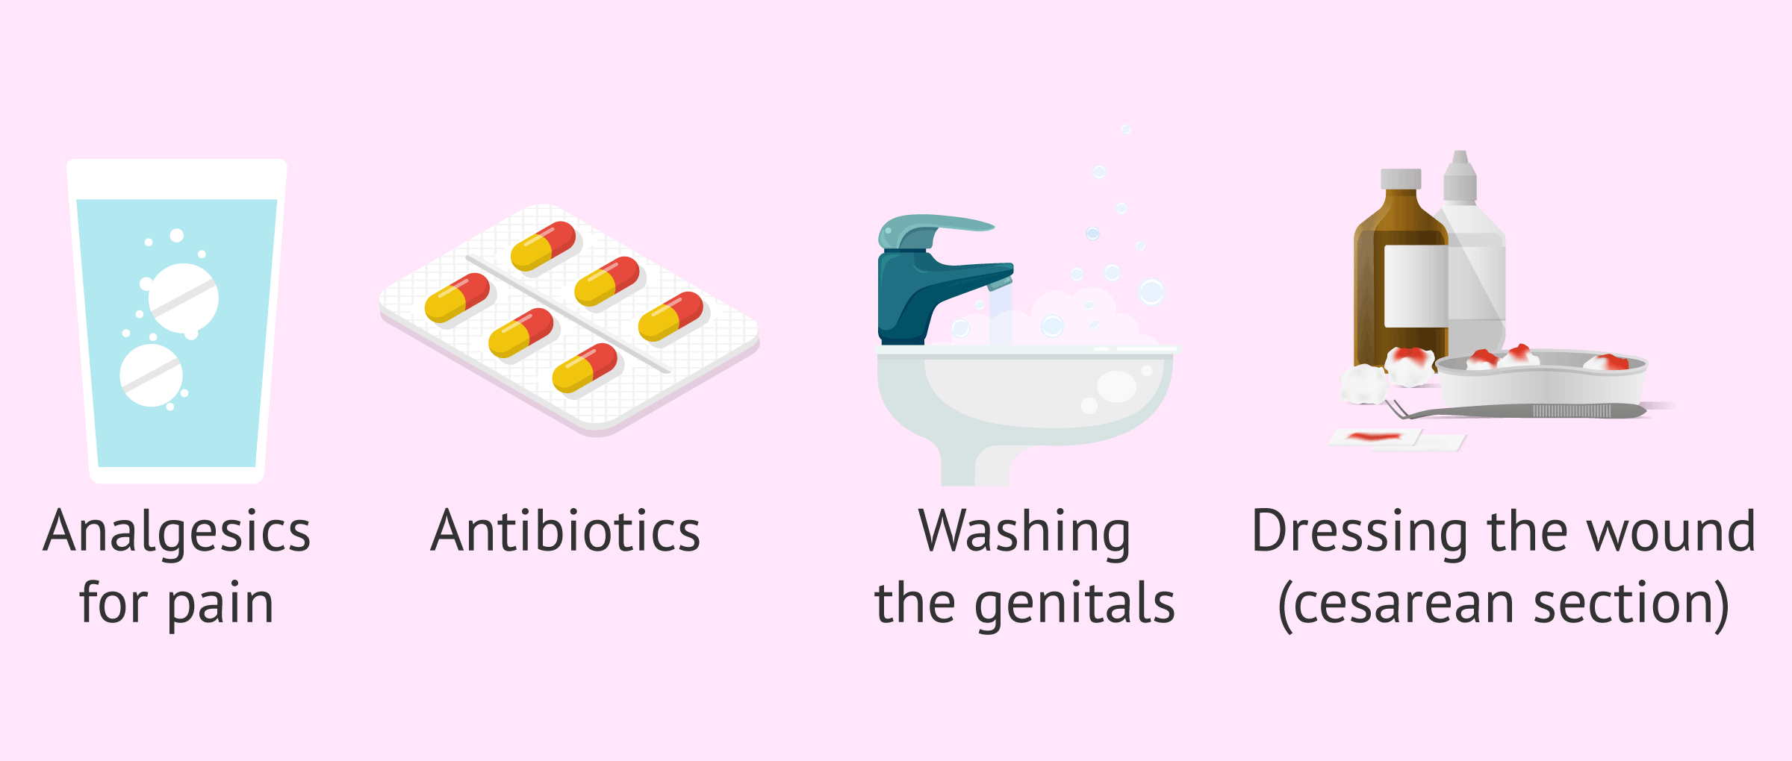
Management
Good nursing care
Analgesics
Adequate fluid intake
Anaemia correction
Antibiotics (broad spectrum such as ampicillin or cephalexin)
Exploration of uterine cavity to remove retained pieces of placenta

Slide 30
Urinary Tract Infection
Causative organism – E.Coli
Causes
- Catheterization
- Bruising of the tissues during delivery
Diagnosis
- Midstream urine examination
Treatment
- Fluid Intake – 3 lit. in 24 hours
- Antibiotic therapy

Slide 31
Bioethics
Consideration of maternal health
Consideration of mental health
Encouragement and support for breastfeeding, and the rights of new mothers.

Slide 32
Future Research
Aisien AO. The puerperium. Contemporary Obstetrics and Gynecology for Developing Countries. 2021:257-62.
Guzmán-Delgado NE, Velázquez-Sotelo CE, Fernández-Gómez MJ, González-Barrera LG, Muñiz-García A, Sánchez-Sotelo VM, Carranza-Rosales P, Hernández-Juárez A, Morán-Martínez J, Martínez-Gaytan V. Adverse cardiovascular, obstetric and perinatal events during pregnancy and puerperium in patients with heart disease. Revista Clínica Española (English Edition). 2024 Jun 1;224(6):337-45.

Slide 33
Family Medicine
Monitor hemoglobin levels in symptomatic patients.
Advise on iron supplementation and balanced nutrition.
Educate on signs of abnormal bleeding and when to seek care
  Early diagnosis and antibiotic treatment for infections when needed.
  Encourage frequent breastfeeding or pumping to prevent mastitis.
  Teach proper perineal care and hygiene.
  Assess risk factors (history of clots, obesity, immobility).
  Encourage early ambulation and hydration.
  Consider low-molecular-weight heparin (LMWH) for high-risk cases.
  Routine screening at 2–6 weeks using the Edinburgh Postnatal Depression Scale (EPDS).
  Encourage social support, counseling, and consider SSRIs if moderate to severe (e.g., sertraline, safe for breastfeeding).

Slide 34
ThankYou

