Slide 2
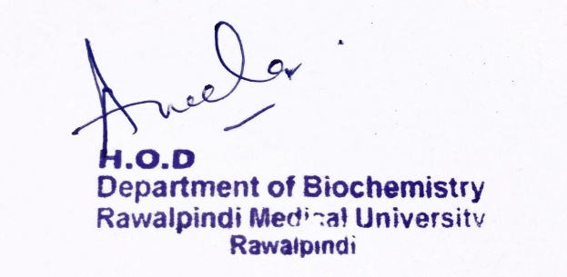
Renal Module 2nd Year MBBS(LGIS) Protein Metabolism
Presenter: Dr Uzma Zafar Date: 01-02-25
Deptt of Biochemistry
RMU

Slide 3
Motto, Vision, Dream
To impart evidence based research oriented medical education
To provide best possible patient care
To inculcate the values of mutual respect and ethical practice of medicine
Wisdom
Truth
Service

Slide 4
Professor Umar Model of Integrated Lecture

Slide 5
Learning Objectives
At the end of the lecture, students will be able to:
Describe amino acid pool
Elaborate protein turn over
Describe transport of amino acids along its absorption

Slide 6
Introduction to Protein Metabolism:
Core Knowledge
Amino acids are not stored by the body therefore amino acids must be obtained from the diet, synthesized de novo, or produced from the degradation of body protein.
The first phase of catabolism involves the removal of the α-amino groups, forming ammonia and the corresponding α-keto acids, the carbon skeletons of amino acids.
In the second phase of amino acid catabolism, the carbon skeletons of the α-keto acids are converted to common intermediates of energy-producing metabolic pathways.
These compounds can be metabolized to carbon dioxide (CO2 ) and water (H2O), glucose, fatty acids, or ketone bodies.

Slide 7
Core Knowledge
Amino Acid Pool
This pool is supplied by 3 sources:
Amino acids provided by degradation of body proteins
Amino acids derived from dietary protein
Synthesis of non essential amino acids from simple intermediates of metabolism
And it is depleted by three routes :
Synthesis of body proteins
Amino acids consumed as precursor of essential nitrogen containing molecules
Conversion of amino acids to glucose, glycogen, fatty acid ,ketone bodies or carbon dioxide and water

Slide 8
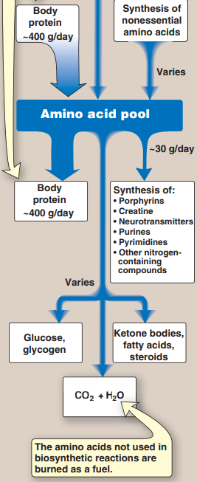
Core Knowledge
Sources and fates of amino acids

Slide 9
Core Knowledge
Protein Turnover
This process, called protein turnover, leads to the hydrolysis and resynthesis of 300–400 g of body protein each day
Most proteins in the body are constantly being synthesized and then degraded (turned over), permitting the removal of abnormal or unneeded proteins.
Regulation of synthesis determines the concentration of protein in the cell.

Slide 10
Core Knowledge
Protein Turnover Cont…
The rate of protein turnover varies widely for individual proteins.
Short-lived proteins (for example, many regulatory proteins and misfolded proteins) are rapidly degraded, having half-lives measured in minutes or hours.
Long-lived proteins, with half-lives of days to weeks, constitute the majority of proteins in the cell.
Structural proteins, such as collagen, are metabolically stable, and have half-lives measured in months or years.

Slide 11
Core Knowledge
Protein degradation :
There are two major enzyme systems responsible for degrading damaged or unneeded proteins:
The ATP-dependent ubiquitin-proteasome system of the cytosol
Proteasomes degrade mainly endogenous proteins, that is, proteins that were synthesized within the cell.
The ATP-independent degradative enzyme system of the lysosomes
Lysosomal enzymes degrade primarily extracellular proteins, such as plasma proteins that are taken into the cell by endocytosis, and cell-surface membrane proteins that are used in receptor-mediated endocytosis

Slide 12
Core Knowledge
Ubiquitin-proteasome proteolytic pathway:
Proteins selected for degradation by the ubiquitin-proteasome system are first covalently attached to ubiquitin, a small, globular, non-enzymatic protein.
Ubiquitination of the target substrate occurs through linkage of the α-carboxyl group of the C-terminal glycine of ubiquitin to the ε-amino group of a lysine on the protein substrate by a three-step, enzyme-catalyzed, ATP-dependent process.

Slide 13
Core Knowledge
Ubiquitin-proteasome proteolytic pathway
Cont.:
The consecutive addition of ubiquitin moieties generates a polyubiquitin chain. Proteins tagged with ubiquitin are then recognized by a large, barrel-shaped, macromolecular, proteolytic complex called a proteasome, which functions like a garbage disposal).
The proteasome unfolds, deubiquitinates, and cuts the target protein into fragments that are then further degraded to amino acids, which enter the amino acid pool.

Slide 14
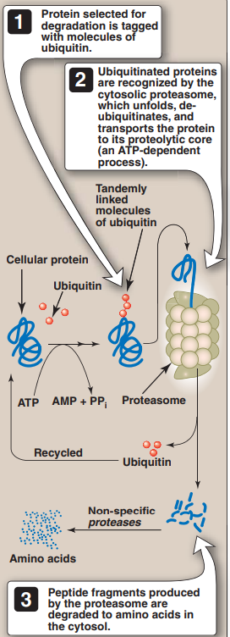
Core Knowledge
Chemical signals for protein
degradation:
The half-life of a protein is influenced by the nature of the N-terminal residue. For example, proteins that have serine as the N-terminal amino acid are long-lived, with a half-life of more than 20 hours.
In contrast, proteins with aspartate as the N-terminal amino acid have a half-life of only 3 minutes.
Proteins rich in sequences containing proline, glutamate, serine, and threonine (called PEST sequences after the one-letter designations for these amino acids) are rapidly degraded and, therefore, exhibit short intracellular half-lives.

Slide 15
Core Knowledge
Absorption of amino acids
and small peptides
Free amino acids are taken into the enterocytes by a Na+-linked secondary transport system of the apical membrane. Di- and tri - peptides, however, are taken up by a H+-linked transport system.
The peptides are hydrolyzed in the cytosol to amino acids that are released into the portal system by facilitated diffusion. Thus, only free amino acids are found in the portal vein after a meal containing protein. These amino acids are either metabolized by the liver or released into the general circulation.

Slide 16
Core Knowledge
TRANSPORT OF AMINO ACIDS INTO CELLS
The concentration of free amino acids in the extracellular fluids is significantly lower than that within the cells of the body.
At least seven different transport systems are specific for different amino acids. The small intestine and the proximal tubule of the kidney have common transport systems for amino acid uptake; therefore, a defect in any one of these systems results in an inability to absorb particular amino acids into the gut and into the kidney tubules.
For the Example, see the next slide

Slide 17
Core Knowledge
TRANSPORT OF AMINO ACIDS
INTO CELLS CONT.
For example, one system is responsible for the uptake of cysteine and the dibasic amino acids, ornithine, arginine, and lysine (represented as “COAL”). In the inherited disorder cystinuria, this carrier system is defective, and all four amino acids appear in the urine
Defects in the transport of tryptophan (and other neutral amino acids) can result in Hartnup disorder and pellagra-like (see p. 380) dermatologic and neurologic symptoms.

Slide 18
Core
Knowledge
Nitrogen Balance
Nitrogen -Ingested in food chiefly as proteins.
Eliminated from body mostly as urea and other nitrogen compounds such as
Creatinine
Uric acid
Ammonia
Amino acids

Slide 19
Core
Knowledge
Nitrogen Balance Cont.
Nitrogen Balance is defined as balance between the amount of Nitrogen ingested and eliminated from the body over a certain length of time.
A person may be in any of three phases of nitrogen balance.
i) Equilibrium
ii) Positive Nitrogen balance
ii) Negative Nitrogen balance

Slide 20
Core
Knowledge
Equilibrium
In this state, the amount of nitrogen ingested is equal to the amount of nitrogen eliminated from the body. E.g. In Normal adult

Slide 21
Core
Knowledge
Positive Nitrogen Balance
In this state more nitrogen is ingested than eliminated from the body. For example,
During growth
Pregnancy
Convalescence from wasting illness
Hormones like Insulin
Male sex hormones
Growth hormone

Slide 22
Core
Knowledge
Negative Nitrogen Balance
In this state less nitrogen is ingested than eliminated from the body. For example,
Starvation
Wasting illness
Fever
After Burns and surgical operations
Diet deficient in Proteins
Essential Amino acids
Excessive administration of Hormones like Thyroid hormone, ACTH and Corticosteroids

Slide 23
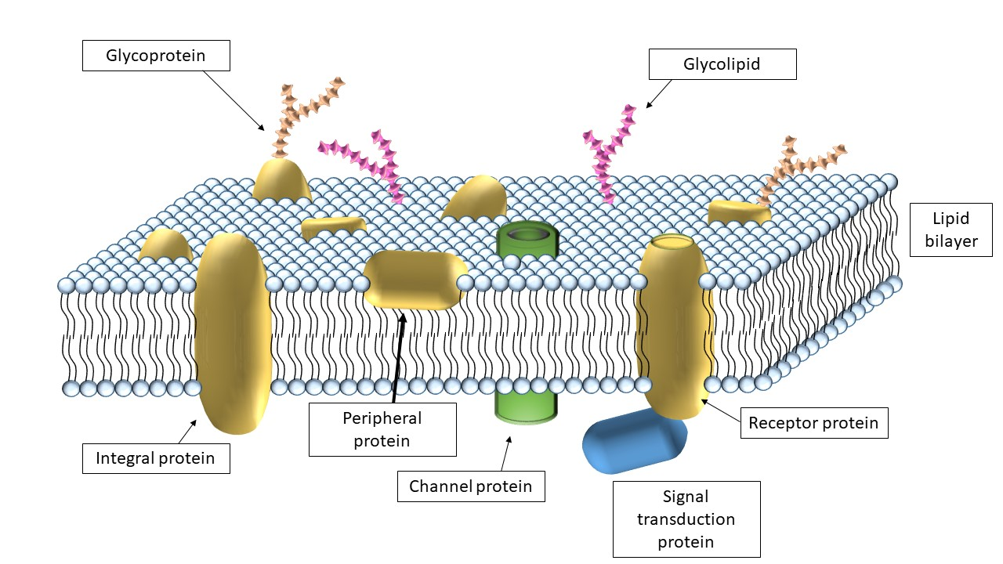
Horizontal Integration

Slide 24
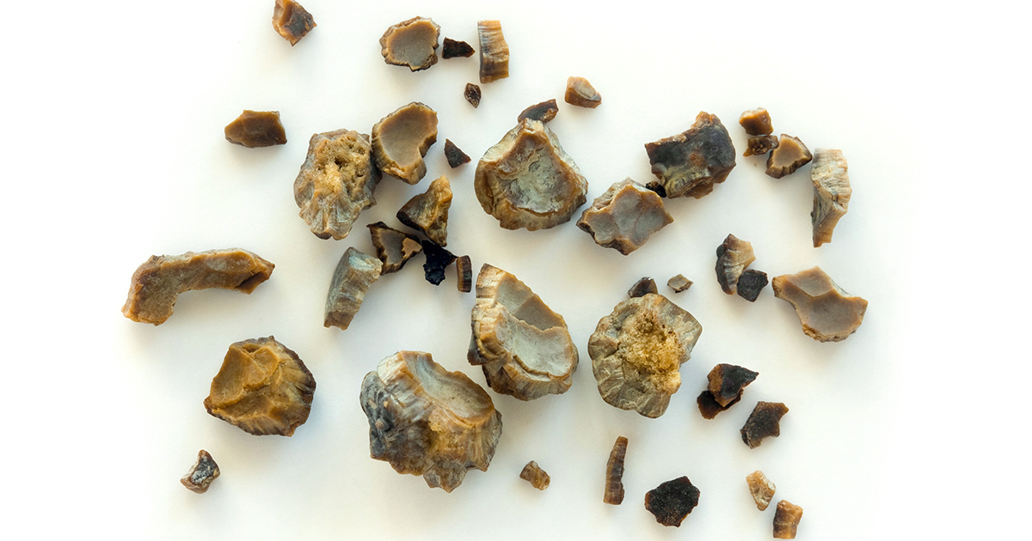
Vertical Integration
Cystine Stones

Slide 25
Spiral Integration
Family Medicine
Lifestyle: Maintain a low-salt diet, manage weight and abstain from alcohol.
Medications: Diuretics for ascites, beta-blockers for variceal bleeding, lactulose for hepatic encephalopathy.
Surveillance: Regular screening for varices, liver function, and hepatocellular carcinoma.
Complications: Manage ascites (paracentesis), SBP (antibiotics), and consider liver transplant.
Patient Education: Inform about complication signs and the importance of adherence to treatment.

Slide 26
Spiral Integration
Bioethics
Ethical Considerations
From an ethical standpoint, the scenario raises considerations regarding patient autonomy, informed consent, and confidentiality
The physician must ensure that patient fully understands her diagnosis, treatment options, and potential implications
Discuss the necessity of a healthy lifestyle & treatment plan. This requires clear communication and understanding of risks and benefits.
Additionally, the physician must respect patient’s privacy and confidentiality throughout the diagnostic and treatment process

Slide 27
Spiral Integration
Artificial Intelligence
Role of AI in (The Disease) Management
AI can potentially aid in enhancing diagnostic accuracy and efficiency.
AI-powered decision support systems can also help clinicians in selecting appropriate treatment modalities
AI-driven predictive models may help anticipate the risk of complications of the Disease in susceptible populations

Slide 28
https://www.sciencedirect.com/topics/medicine-and-dentistry/protein-metabolism
Spiral Integration
Research Article

Slide 29
How To Access Digital Library
Steps to Access HEC Digital Library
Go to the website of HEC National Digital Library
On Home Page, click on the INSTITUTES
A page will appear showing the universities from Public and Private Sector and other Institutes which have access to HEC National Digital Library HNDL
Select your desired Institute
A page will appear showing the resources of the institution
Journals and Researches will appear
You can find a Journal by clicking on JOURNALS AND DATABASE and enter a keyword to search for your desired journal

Slide 30
Learning Resources
Lippincott Illustrated Reviews: Biochemistry Chapter#19 Page no. 245

Slide 31
THANK YOU

