Slide 1
Primary Amenorrhea
Dr. Humera Noreen
Associate Professor
OB/GYN HFH

Slide 2
SEQUENCE OF LGIS
Learning objectives
Primary Amenorrhea
(core concept = 70%)
Related pathophysiology (horizontal integration 15%)
Related clinical findings (vertical integration – 10%)
Research article related to topic (3%)
Ethics (2%)

Slide 3
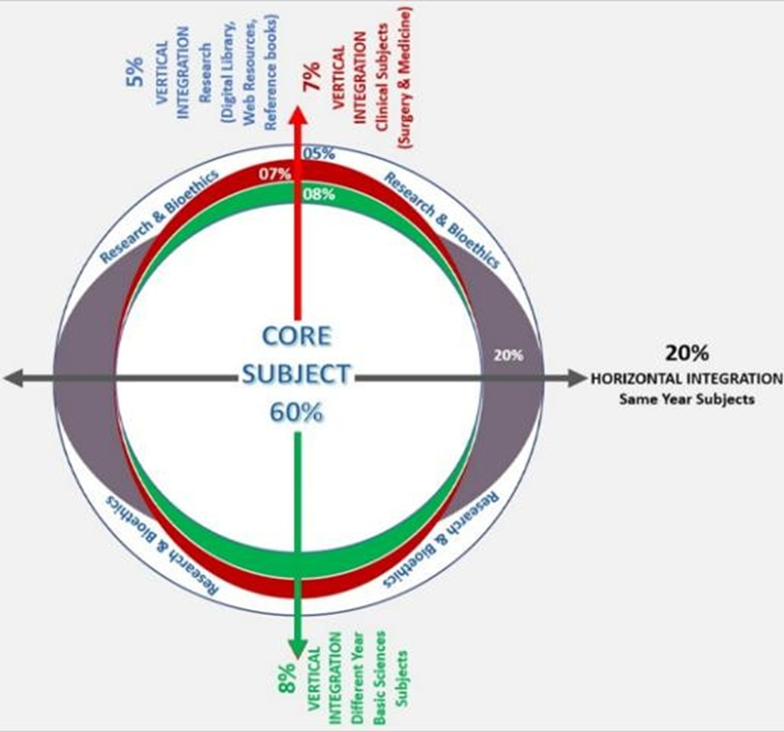
PROF UMER MODEL OF INTEGRATED LECTURE

Slide 4
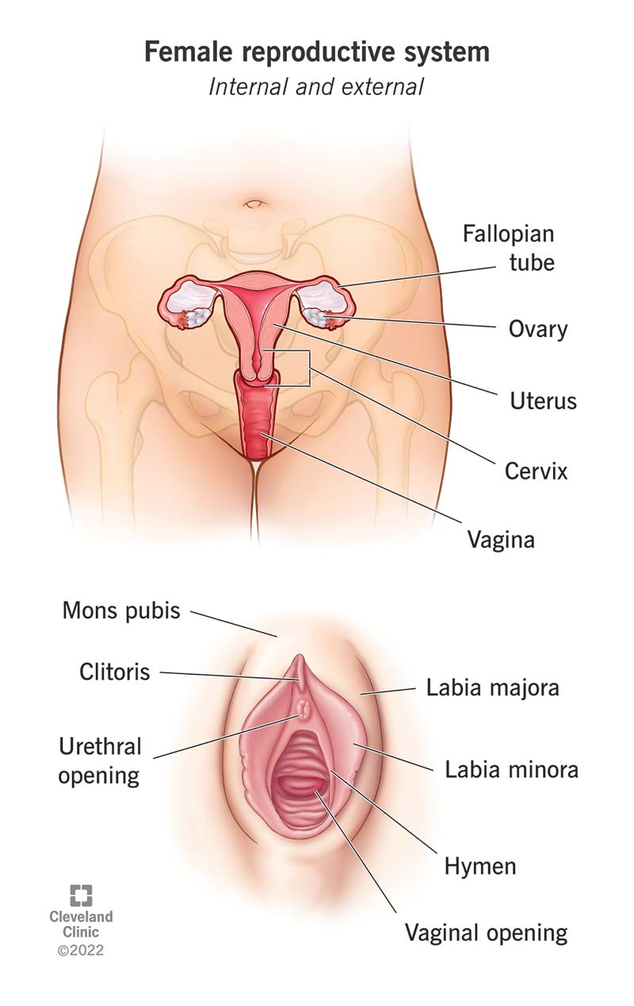

Female Reproductive System
Internal organs
External organs

Slide 5
Sexual Differentiation
Normal embryo
46 chromosomes
46 XY
Male
Female
46 XX
The presence or absence of Y chromosome which determines whether the undifferentiated gonad becomes a testis or ovary

Slide 6
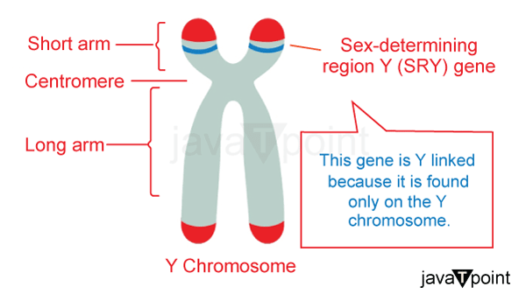
SRY-sex determining region of Y chromosome

Slide 7
Ovarian Differentiation
XX chromosome
DAX1
(gene which determine the gonad to become an ovary)

Slide 8
Absence of Y chromosome or SRY region of Y chromosome
Indifferent gonads do not produce testis determining factor (TDF)
Gonads do not differentiate into testis and AMH and testosterone not produced
Indifferent gonad develop into ovary and female duct system form
Mesonephric duct regress in female due to absence of AMH
Cranial portion of paramesonephric duct remain open as ostium of oviduct and caudal part forms oviducts, uterus and upper part of vagina

Slide 9
The Gonads-Indifferent Stage

Slide 10
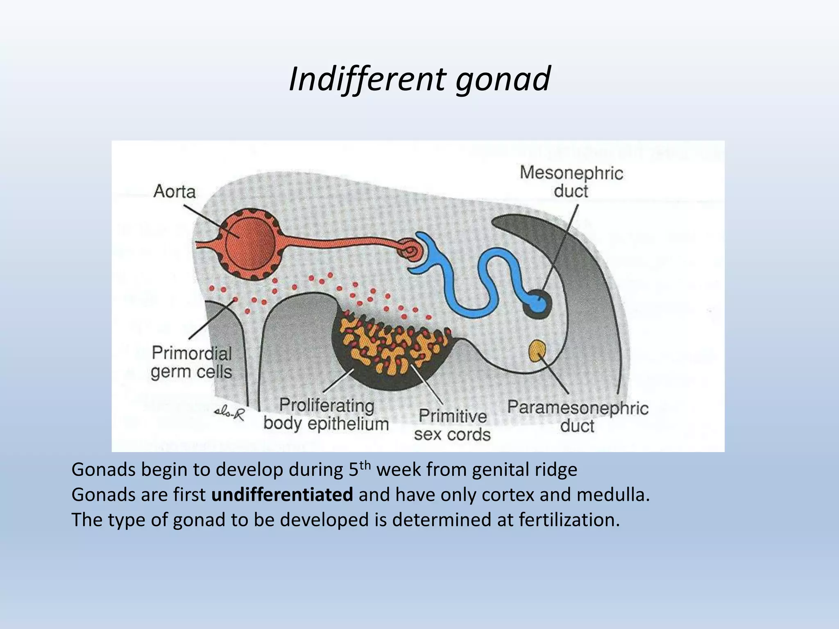

Slide 11
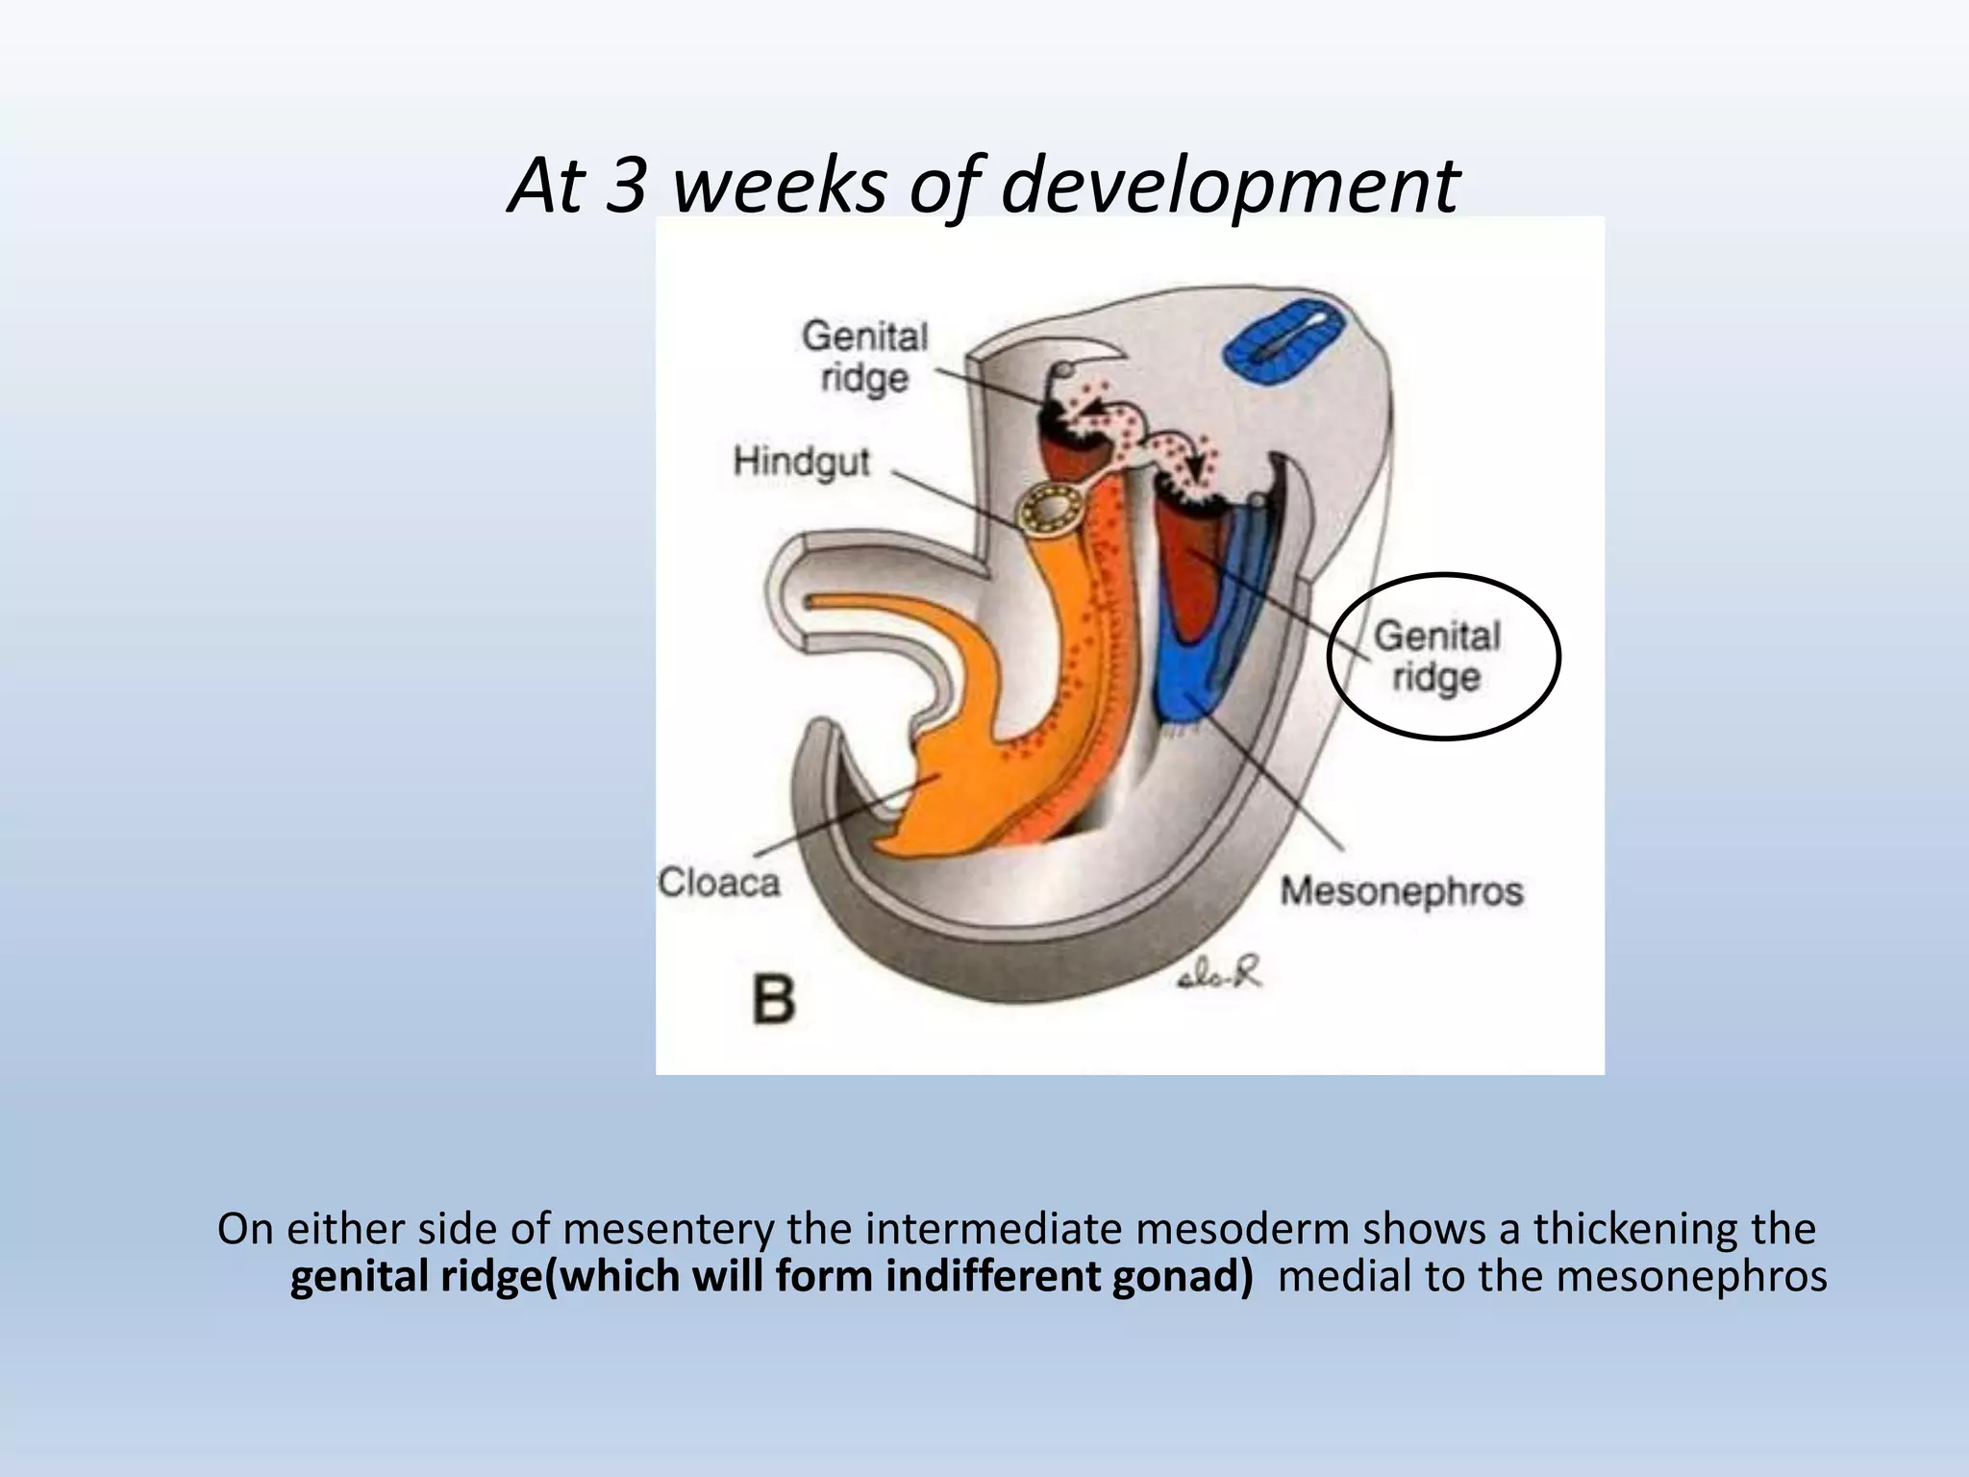

Slide 12
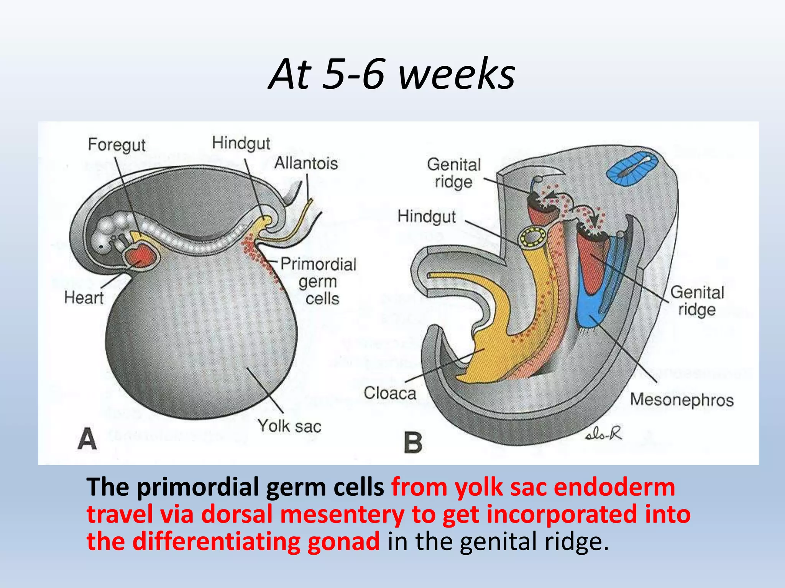

Slide 13
Paramesonephric ducts or Mullerian ducts
Development of genital organs

Slide 14
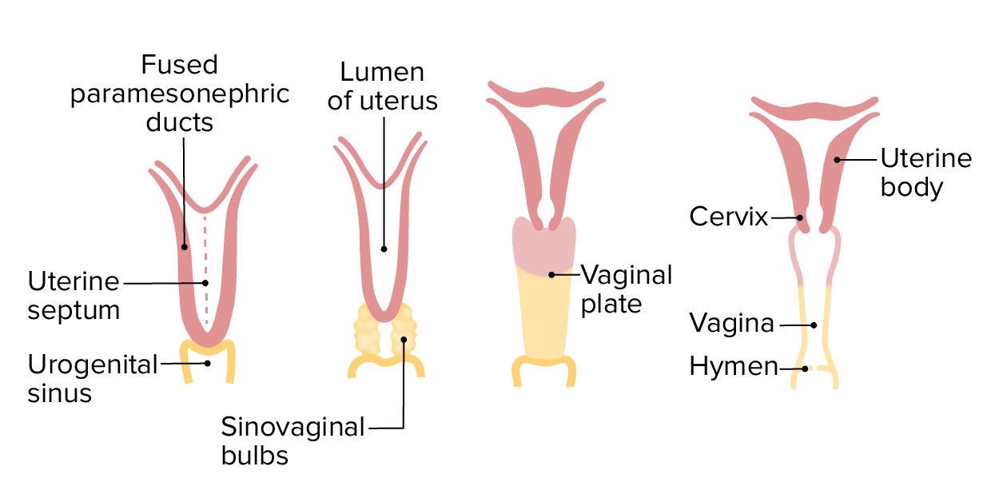
Uterus, fallopian tubes and upper1/3rd of vagina develop from para-mesonephric ducts.
Lower 2/3rd of vagina develop from urogenital sinus.

Slide 15
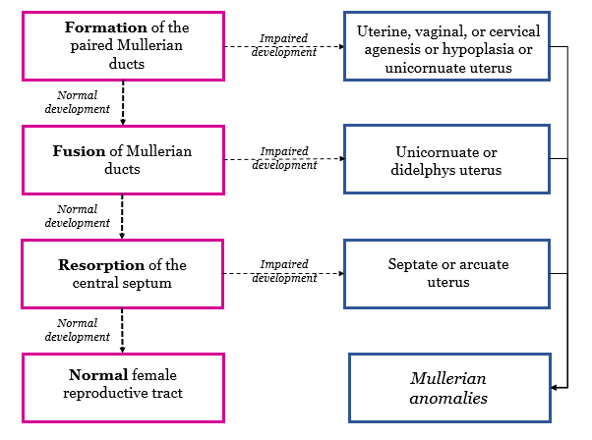

Slide 16
Puberty
“The process of reproductive and sexual development and maturation that changes a child into an adult”.

Slide 17
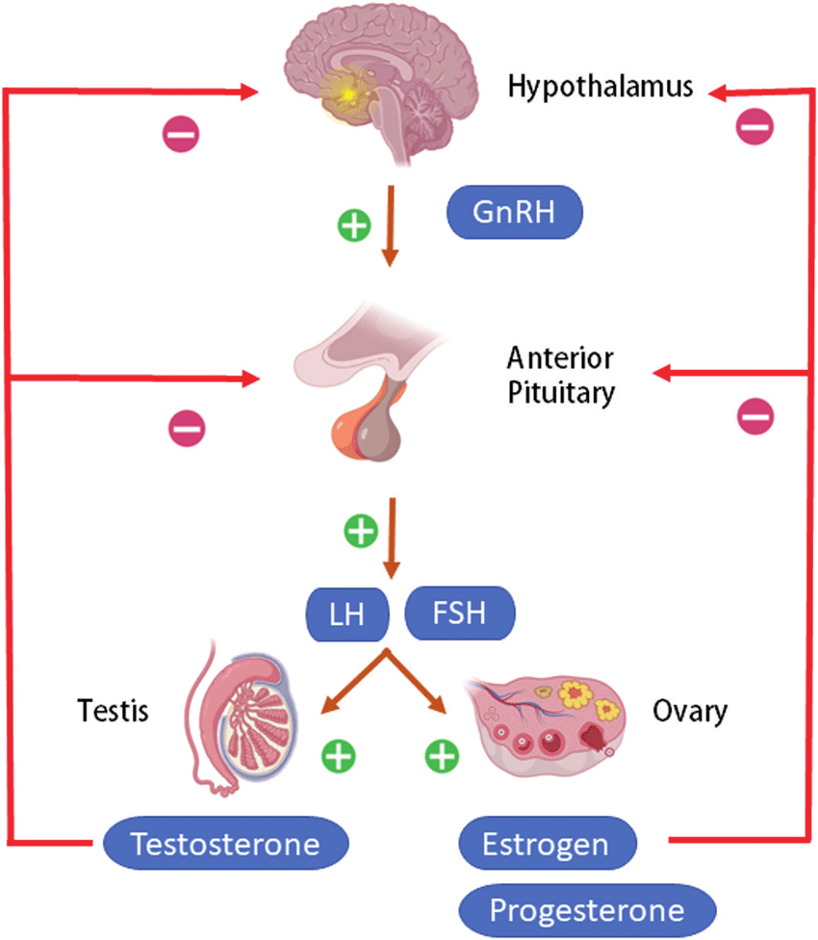
HPO Axis
Notes:
Active during fetal life and quiescent during childhood. Reactivation leads to sexual maturation

Slide 18
Sequence of pubertal development
Growth spurt
Thelarche
Pubarche
Peak growth spurt
Menarche

Slide 19
Maintenance of normal menstrual cycle
Normal chromosomal pattern
Co ordinated HPO axis
Active thyroid and adrenal glands
Responsive endometrium.
Anatomical presence and patency of outflow tract

Slide 20
Primary Amenorrhea
Absence of menstrual cycle by age of 16 years irrespective of secondary sexual characteristics
or
Absence of menstrual cycle by age of 14 years with no secondary sexual characteristics.

Slide 21
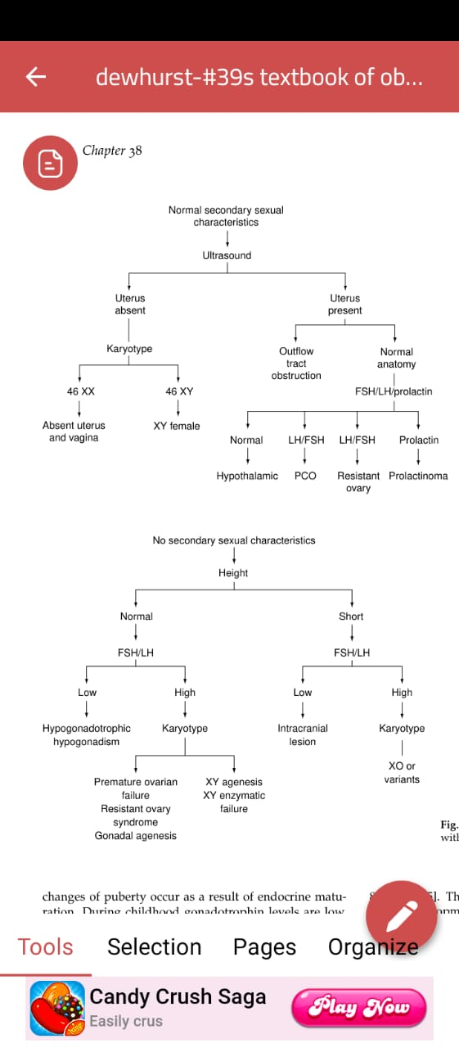

Slide 23
uterus present
1. Normal secondary sexual characteristics

Slide 25
Outflow tract obstruction
Imperforate hymen
Transverse vaginal septum
Vaginal atresia
Cervical stenosis
Mullerian agenesis

Slide 26
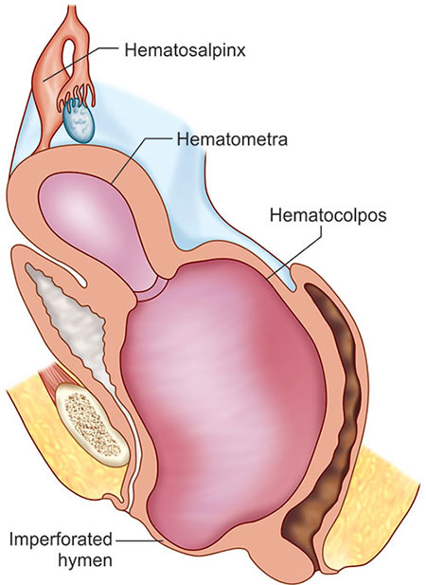
Imperforate hymen
Sign and symptoms
Amenorrhea
Cyclical lower abdominal pain
Abdominal lump
Retention of urine
Bulging bluish membrane at the introitus
Treatment : Cruciate incision over bulging hymen

Slide 27
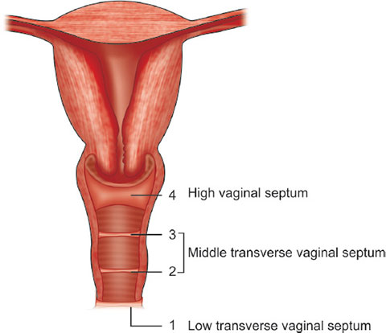
Transverse vaginal septum
Vagina fails to cannulate the upper and lower parts of the vagina are separate.
Abdominal mass with blind ending vagina bulging pink not blue membrane.
Hymenal remnants are often seen separately.
Treatment: Excision of septum or hysterectomy (high vaginal septum)

Slide 28
uterus present ( normal anatomy)
1. Normal secondary sexual characteristics

Slide 30
Hypothalamic
Pituitary (Hypogonadotrophichypogonadism)
Ovarian (Hyper gonadotrophic hypogonadism)

Slide 31
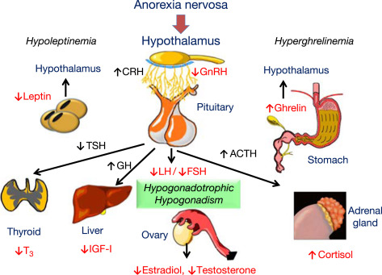
Hypothalamic
Excessive exercise, weight loss and stress.
Hypothalamic lesions (craniopharyngioma, glioma)
Head injuries.
Kallman’s syndrome.
Systemic disorder i.e, sarcoidosis , TB
Drugs: HRT or dopamine antagonists.
Constitutional delay .
Notes:
Kallman’s syndrome (X-linked recessive condition resulting in deficiency in GnRH causing underdeveloped genitalia).

Slide 32
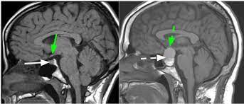
Pituitary
Adenomas (prolactinoma is most common)
Iatrogenic damage (surgery or radiotherapy).
Congenital failure of development.
Pituitary adenoma

Slide 33
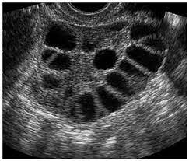
Ovarian
Polycystic ovary syndrome (PCOS)
Premature ovarian failure (POF)
Gonadal dysgenesis
Polycystic ovary

Slide 34
uterus absent
1. Normal secondary sexual characteristics

Slide 36
46 XX
Meyer-Rokitansky Kuster-Hauser syndrome
46XY and female phenotype
Failure of testicular development
Enzymatic failure to produce androgen
Androgen receptor absence or failure to function

Slide 37
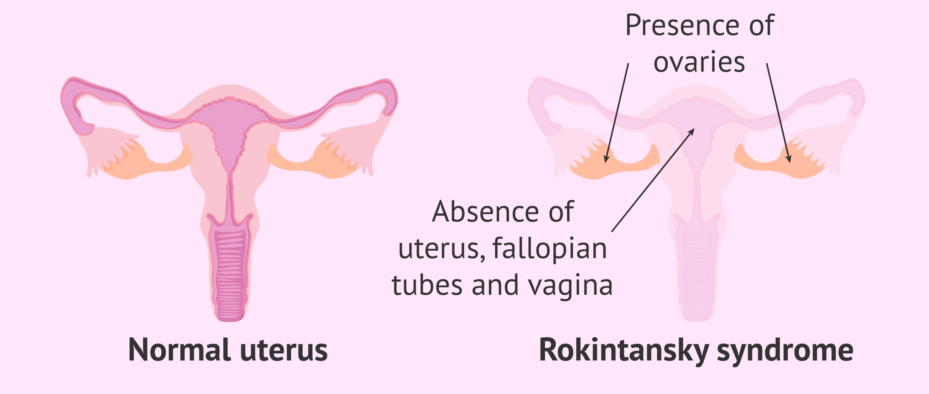
Meyer-RokitanskyKuster-Hauser syndrome
Second most common cause
Ovaries normal
Normal female external genitalia but a blind ending vaginal dimple which is usually not more than 1.5 cm in depth.
uterine development is rudimentary
Associated with renal and skeletal abnormalities.
Notes:
Secondary sexual characteristics are normal as would be expected as ovarian function is unaffected

Slide 38
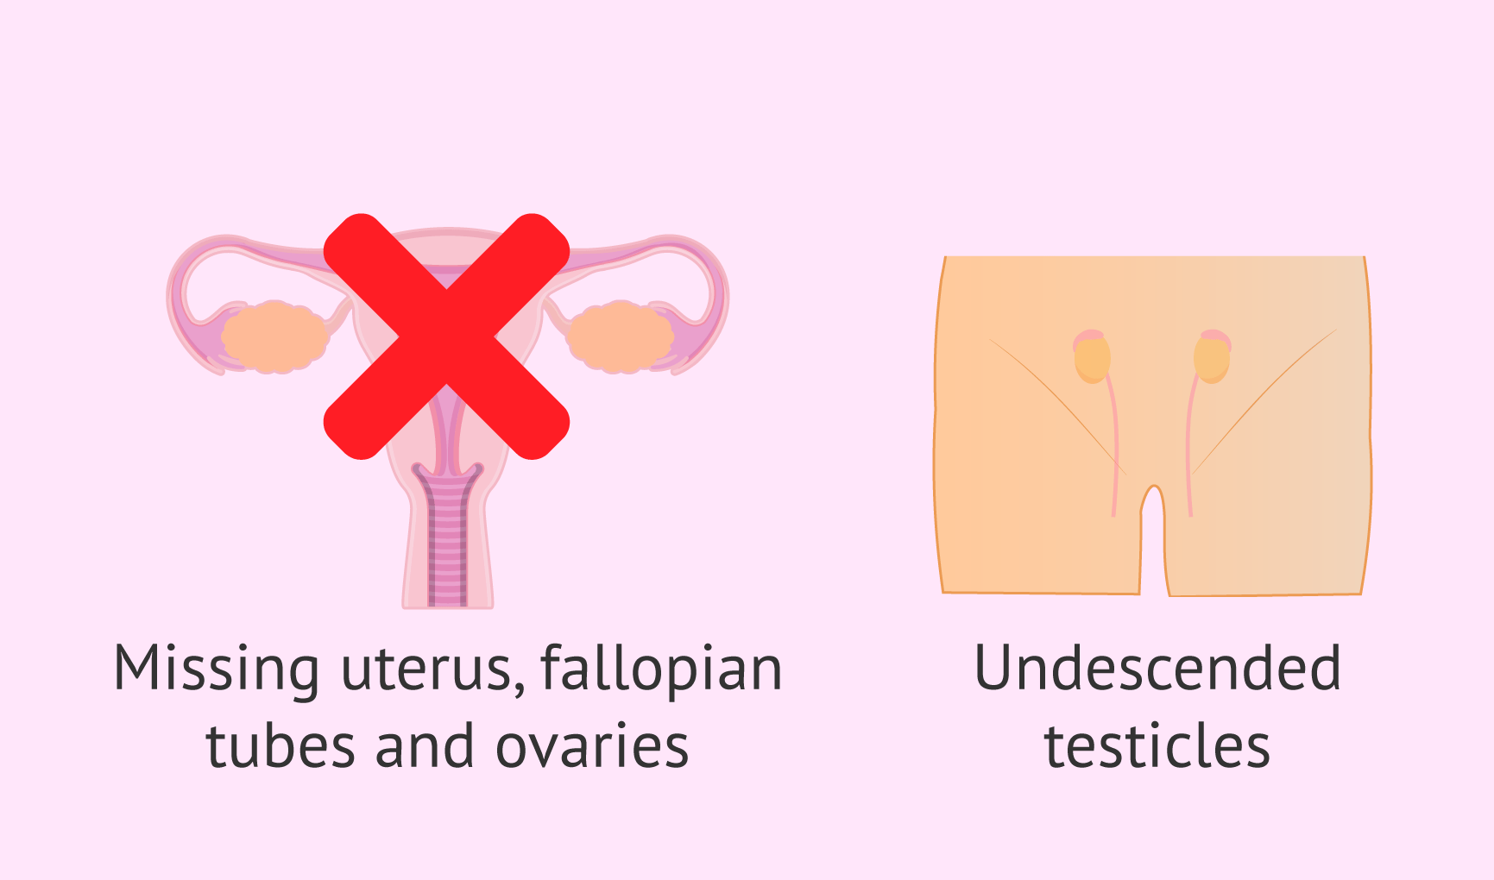
Androgen insensitivity syndrome (46XY)
Phenotypically female with normal breast development (peripheral conversion of androgen to estrogen)
Scanty pubic hair.
Vulva is normal and the vagina is usually short.
Uterus and tubes are absent.
Testes are usually found in the lower abdomen
Notes:
Structural abnormality of androgen receptor
the masculinizing effect of testosterone during normal development is prevented and patients are phenotypically female with normal breastdevelopment

Slide 39
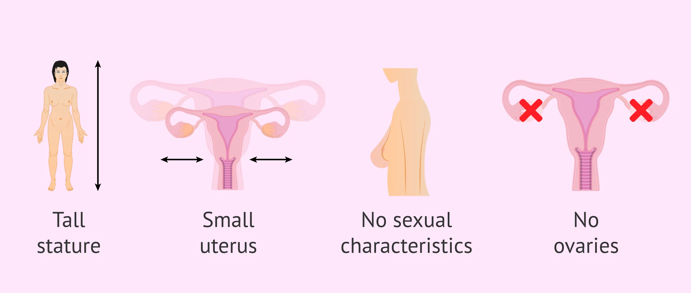
Androgen insensitivity syndrome (46XY)
Treatment
Reared as female and treatment is removal of gonads and HRT with CEE 0.625mg for secondary sexual characteristics.

Slide 40

Constitutional delay
Normal secondary sexual characteristics.
No anatomical or endocrine anomaly
Immature pulsatile release of GnRH
These women eventually menstruate spontaneously as the maturation

Slide 41
normal height
2. Secondary sexual characteristics absent

Slide 43
Causes
Isolated GnRH deficiency ( Olfactogenital syndrome ,Kallman’s syndrome)
Weight loss, anorexia, excessive exercise
Hyper prolactinemia
Gonadal agenesis
Gonadal dysgenesis
Ovarian failure
XY enzymatic failure
Galactosemia

Slide 44
short height
2B.Secondary sexual characteristics absent

Slide 46
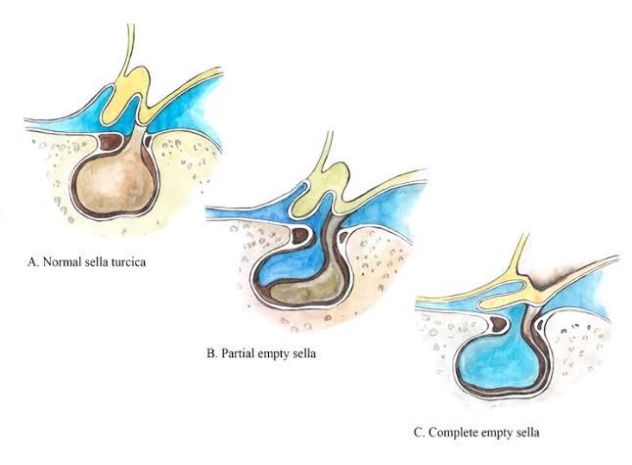
Congenital infections
Turner syndrome
Empty sella syndrome
Trauma ( head injury)
Tumors

Slide 47
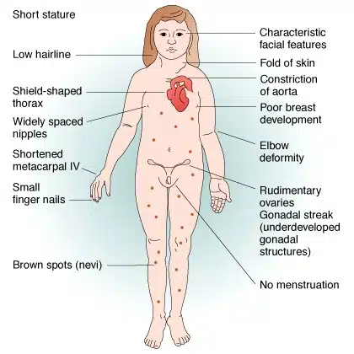
Turner syndrome
Loss of X chromosome at 23rd pair (45XO)
Incidence 3 in 10000 full term births
Vagina and uterus are present
Poor breast development
Little or no pubic and axillary hair
Treatment short course of estrogen and progesterone

Slide 48
3.Heterosexual development

Slide 49
Congenital adrenal hyperplasia
Androgen secreting tumors
True hermaphrodite

Slide 50
Congenital adrenal hyperplasia(46XX)
21 alpha hydroxylase deficiency> > decreased cortisol production
Adrenal enlargement
Increased androgen production
Female infants with ambiguous genetalia
Vagina and uterus present
Ovaries are polycystic and enlarged and an ovulatory, clitoris enlarged and labias fused together.
Treatment : steroid replacement

Slide 51
How to approach
History
Examination
Investigations
Management

Slide 52
History
Childhood growth and development, Head injury
Age at menarche of the patient's mother and sisters
Pubic and axillary hair, breast development
Excessive weight gain or loss, exercise, headache, galactorrhea, heat and cold intolerance, visual disturbances
Cyclical abdominal pain
Loss of sense of smell (Kallman syndrome)
Chronic illness, trauma, surgery, and medications
Sexual history, Drug history, Chemotherapy, Radiotherapy,

Slide 53
Examination
GPE
Height , weight, secondary sexual characteristics , galactorrhea , thyroid
Abdominal examination
Palpable mass in case of outflow obstruction

Slide 54
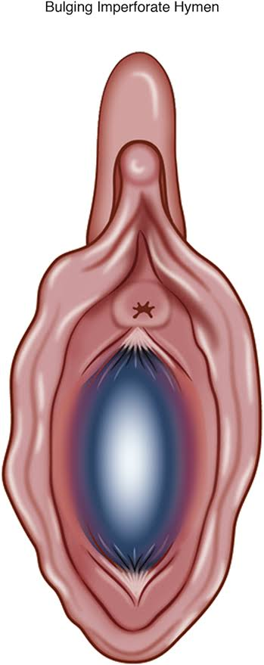
Local examination
Imperforate hymen : blue membrane
Low vaginal septum: Thick, pink septum
Absent vagina: No vaginal opening or dimple
Short vagina
Imperforate hymen

Slide 55
Investigations
Hormonal profile
LH ,FSH
Estrogen
TFTs
Prolactin,
Testosterone
USG
Size of ovaries
Ovulation status
Uterus size

Slide 56
MRI pelvis
karyotyping
Buccal smear and polymorph leucocytes for chromatin positive (XX) or chromatin negative (XO).

Slide 57
Family medicine
Detailed history and thorough examination help in reaching the cause of primary amenorrhea.
Avoid unnecessary expensive investigations.
When constitutional delay is the cause of primary amenorrhea, parents n patient should be reassured and unnecessary investigations and interventions should be avoided.

Slide 58
Bioethics
Cases of primary Amenorrhea should be dealt with extreme care.
Parents should be counseled in detail regarding the impact of this condition on future sexual life and fertility especially in cases of Mullerian agenesis and androgen insensitivity syndrome.
Timely treatment of outflow obstruction can prevent retrograde menstruation causing endometriosis and pelvic adhesions.

Slide 59


