Slide 1
Dr Gulzaib & Dr Naila
Forensic Medicine & Toxicology

Slide 2
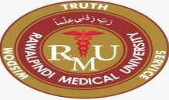

Slide 3
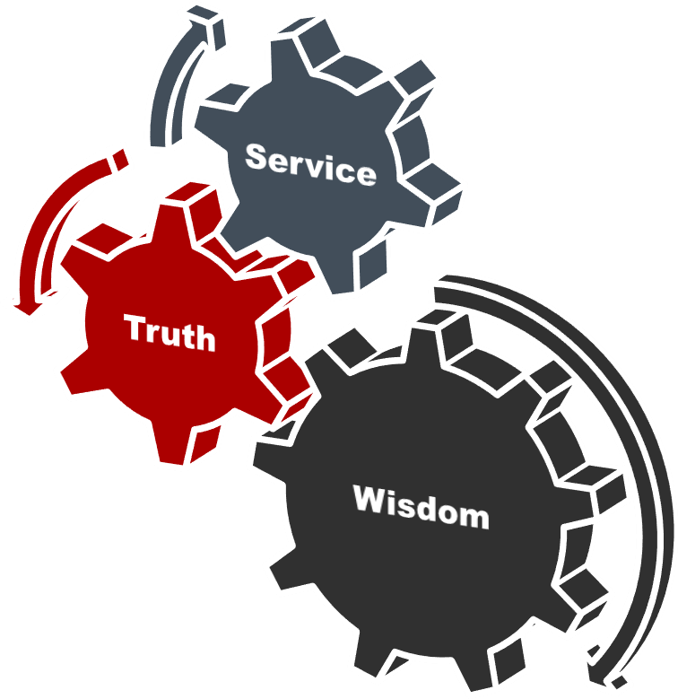

Slide 4
Vision of RMU The Dream/ Tomorrow
To impart evidence based research oriented medical education
To provide best possible patient care
To inculcate the values of mutual respect and ethical practice of medicine

Slide 5
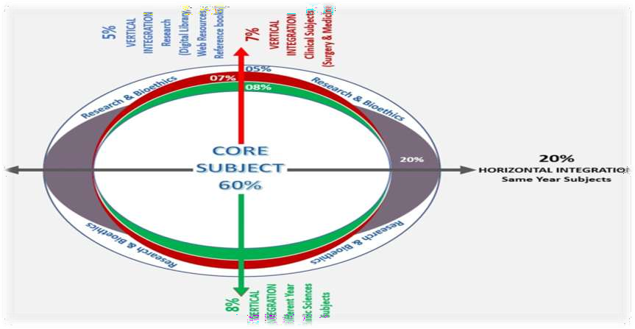

Slide 6
SEQUENCE OF LGIS
Learning Objectives
Core concept 70 %
Horizontal integration related to Pathology and Pharmacology 15 %
Relevant clinical concepts and medico legal application of core knowledge / Vertical integration 10%
Research article relevant to the topic 3%
Ethics and family medicine 2%

Slide 7
🞂​Define DNA finger printing and state the objectives of DNA finger profiling in forensic Medicine
🞂 ​ Classify different types of methods used for DNA analysis.
🞂​ Briefly describe the method of collection preservation and dispatch of samples.
🞂​Enlist the sources of DNA.
🞂Enumerate the uses of DNA finger printing.

Slide 8
Core Concept
🞂​Definition: “It is a technique that is capable of distinguishing every individual, with the exception of identical twins and clones.”
🞂​It is also called DNA fingerprinting ,DNA typing, DNA identification, DNA profiling or Genetic typing.
🞂​DNA is a sturdy molecule which can tolerate wide range of temperature, pH and other factors.
🞂​DNA mixed with detergents, oil, gasoline and other adulterants does not alter its typing characteristics.

Slide 9
Core Concept
Objectives:
🞂​ The main objective in fingerprinting techniques is to cluster data in meaningful groups.
🞂​ It is used to identify prospective criminal suspects.
🞂​ In cases where a suspect is identified, a sample of that person's DNA can be compared to evidence from the crime scene. The results of this comparison may help establish whether the suspect committed the crime.
🞂​To prove paternity and establish familial ties.

Slide 10
Core Concept
🞂​ Two methods of DNA analysis are in common use:
i.
RFLP (restriction fragment length polymorphism) PCR (polymerase chain reaction)
ii.
Feature | RFLP | PCR
Amount of DNA sample required | Large (300–500 ng) | Small (25 ng)
Sensitivity | Less | More
DNA degradation | Useless when degradation is present | useful
Decomposed sample | Not useful | useful
Time required | More | Less
Labor intensive | More | Less
Sensitivity to contamination with other samples | Less sensitive | More sensitive
Result of the test | Non-discrete | Discrete

Slide 11
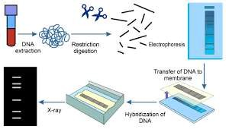
Core Concept

Slide 12
Core Concept
🞂​Procedure: The most common method of DNA typing is RFLP. It involves the following steps.
Isolation/extraction of DNA
Cutting and sizing
Sorting by gel electrophoresis
Transfer of DNA to nylon (Southern blotting)
Hybridization
Washing
DNA fingerprint

Slide 13
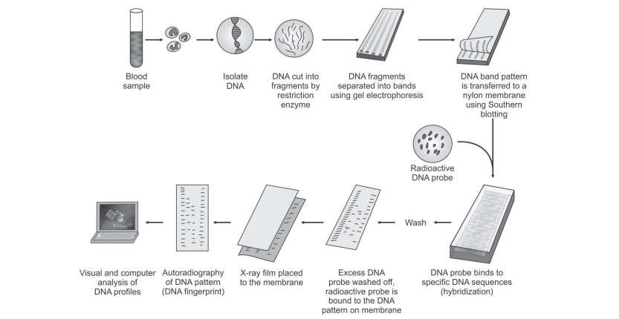
Core Concept

Slide 14
Core Concept
🞂​ Limitations:
It takes few weeks to perform.
„For every probing, the membrane is stripped off the previous probe and rehybridized and autoradiography performed again.
It is not useful where DNA is degraded— limited value in testing cadaveric tissue for identification of human remains, unless fresh.

Slide 15
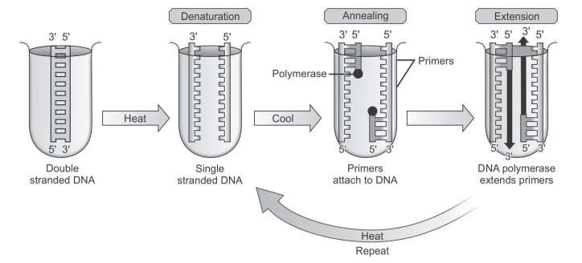
PCR is a technique used for amplifying sample of DNA fragments in vitro. This process is also called DNA amplification.
Core Concept
🞂​ Procedure: It involves the following steps.
Denaturation
Annealing
Extension

Slide 16
Core Concept
🞂​ Limitations:
It is too sensitive; a tiny amount of contaminant
DNA in a sample may alter the results.
It can only be used to identify the presence or absence of a known pathogen or gene.
Its specificity is potentially lower than culturing and staining, which leads to an increased risk for false positives.

Slide 17
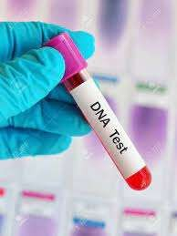
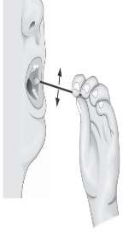
Horizontal Integration
🞂​ Samples Collected from Living:
Blood: (most common sample)5 ml of venous blood is collected in a EDTA tube)and mixed thoroughly without shaking.
Heparin is not used as an anticoagulant since it interferes with PCR. Sample can be preserved at 2–8°C (not frozen).
Buccal epithelial cells: (buccal swabs) are considered a convenient alternative for collecting genetic material, as they are relatively easy to collect, inexpensive and non-invasive.
The swab is removed from the packing and without handling the tip, immediately swabbed the subject’s mouth for 10 seconds. After swabbing, it placed directly into the receptacle (packaging) to dry
i.

Slide 18
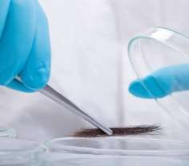
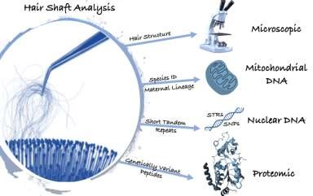
iii.Hair follicles: with roots (plucked hair), about 10–20, from the head is used as a reference standard.
Horizontal Integration
The root of the hair contains nuclear DNA, and the shaft contains mitochondrial DNA.
The root contains keratinocytes which are ideal for the extraction of nuclear DNA.
Cut or naturally shed hairs (without follicle) may not be entirely unhelpful.

Slide 19
Core Concept
Samples Collected from Dead Bodies
🞂​: DNA can be isolated and tested from practically any postmortem tissue, DNA is broken down into fragments by autolytic and bacterial enzymes, especially DNases.
In relatively fresh dead bodies, unclotted 10 ml of blood (EDTA anticoagulated in a sterile tube) is the preferable source of
Brain tissue is a good source of DNA in intermediate
postmortem intervals.
Hard tissue (bone and vascular pulp of teeth) is the best source of DNA in cases of advanced decomposition.
iv. Best material is said to be muscle or spleen if decomposition is
establishing.
Bone marrow (from femur) and teeth (usually molars) are also recommended.
i.
ii.
iii.
v.

Slide 20
Samples Encountered in Forensic Practice: „
Core Concept
🞂​ Blood (EDTA/heparinized/clotted/stain on cloth, newspaper,
wood or tiles).
🞂​ „Semen (stain on cloth/paper/floor). „
🞂​ Hair (head/body/pubic). „
🞂​ Tissue (bone marrow/muscle/spleen/fingernail scrapings). „
🞂​Mouth swabs, and saliva stain on cigarette buds/ licked envelope/glass.

Slide 21
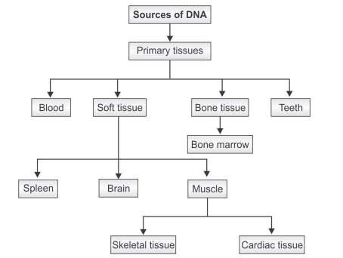
Core Concept

Slide 22
Core Concept
Identification: It is used to link suspects to biological evidence—blood or semen stains, hair or items of clothing—found at the scene of a crime. It is used to establish identity of an assailant in sexual assaults.
ii. Diagnosis of inherited disorders :in adults, children, newborn and prenatal babies. It includes cystic fibrosis, hemophilia, Huntington’s disease, familial Alzheimer’s, sickle cell anemia and thalassemia.
i.

Slide 23
Developing cures for inherited disorders: By studying the DNA fingerprints of relatives who have a history of some particular disorder or by comparing large groups of people with and without the disorder.
Core Concept
iii.
iv. Establish paternity: in custody and child support litigation. In these applications, DNA fingerprints bring a nearly perfect accuracy to the determination..
Identification of endangered species: Biologists routinely use it, particularly to protect endangered species.
vi. Accidents/mass disaster investigations: and postmortem identification of skeletal remains/ mutilated bodies.
v.

Slide 24
Core Concept
🞂​Uniqueness of DNA fingerprinting: DNA segments rather
than complete DNA strands are ‘fingerprinted’, a DNA fingerprint
may not be unique.
🞂​Time constraints: The process is lengthy, with each of four or five loci exposed sequentially, it usually takes 10 weeks.
🞂​Accuracy of the results: Tests are often performed in private laboratories that may not follow uniform testing standards and quality controls.
🞂​ Cost: Testing is expensive.
🞂​ Invasion of privacy and ethical concerns:
🞂​Difficult to defend in court: Suspects who are unable to provide their own DNA experts may not be able to adequately defend themselves against charges based on DNA evidence.
🞂​Unlike fingerprints DNA profile cannot be enlarged and shown in the court of law.

Slide 25
Research
🞂​https://www.rpsbs.com.au/wp- content/uploads/2016/08/Instructions-for- Collecting-Hair-Samples-for-DNA-Testing- V1.1.pdf
🞂​https://investigativegenetics.biomedcentral.c om/articles/10.1186/2041-2223-4-22
🞂​https://www.britannica.com/science/DNA- fingerprinting
🞂​https://www.nature.com/articles/s41598- 020-64582-4

Slide 26
Ethics
🞂​ A dignified handling of corpses should be central in daily practice of forensic medicine and forensic staff should always have in mind the ethical dimension of human corpses in spite of their regular confrontation with the dead.
🞂​https://jfse-ojs- tamu.tdl.org/jfse/article/view/70
🞂​https://link.springer.com/book/10.1007/978- 3-319-56869-0
🞂​ https://pubmed.ncbi.nlm.nih.gov/19438443/

Slide 27
Family Medicine
🞂​Family medicine is the speciality that is responsible for providing comprehensive and continuing care to all individuals seeking medical advice, irrespective of gender, age and illness.
🞂​Medical expertise of a family physician is crucial in death investigations.
🞂​ It begins with body examination and evidence collection at the scene and proceeds through history, physical examination, laboratory tests, and diagnosis – in short, the broad ingredients of a doctor’s treatment of a living patient.
🞂​The key goal is to provide objective evidence of cause, timing, and manner of death for adjudication by the criminal justice system.

Slide 28
How to use HEC Digital Library
Go to the website of HEC National Digital Library
http://www.digitallibrary.edu.pk
On Home Page, click on the INSTITUTES.
A page will appear showing the universities from Public and Private Sector and other Institutes which have access to HEC National Digital Library (HNDL).
Select your desired Institute.
A page will appear showing the resources of the institution
Journals and Researches will appear
You can find a Journal by clicking on JOURNALS AND DATABASE and enter a keyword to search for your desired journal

Slide 29
Learning Resources
Principles & Practice of Forensic Medicine.
by Nasib R. Awan
Parikh’s Textbook of Medical Jurisprudence,
Forensic Medicine & Toxicology.

Slide 30
THANK YOU

