Slide 1
Dr Sharukh & Dr Urooj
Forensic Medicine & Toxicology

Slide 4
🞂​To impart evidence based research oriented medical education
🞂​ To provide best possible patient care
🞂​To inculcate the values of mutual respect and ethical practice of medicine

Slide 5
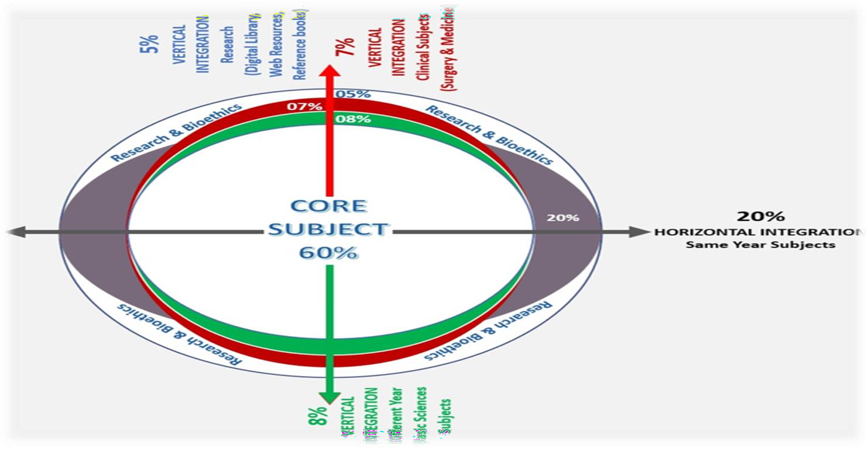

Slide 6
SEQUENCE OF LGIS
Learning Objectives
Core concept 70 %
Horizontal integration related to Pathology and Pharmacology 15 % (If Applicable)
Relevant clinical concepts and medico legal application of core knowledge / Vertical integration 10%
Research article relevant to the topic 3%
Ethics and family medicine 2%

Slide 7
🞂​Define mass disaster & Classify it.
🞂​Mention the objectives of Forensic investigation in
mass disaster.
🞂​ Outline briefly special techniques for identification in mass disaster.
🞂​Enlist different parameters used for identification
in mass disaster.
🞂​ Define Decomposed, mutilated bodies and fragmentary remain and state their medicolegal importance.
🞂​Define superimposition and enumerate the role of
photography in mass disaster.

Slide 8
Core Concept
🞂​Every accidental death is a disaster to the individual family involved and (to them) is of the same dimension irrespective of how many others were similarly affected at the same time.
🞂​WHO has defined disaster as “an occurrence that causes damage, ecological disruption, loss of human life or deterioration of health and health services on a scale sufficient to warrant an extraordinary response from outside the affected community or area.”

Slide 9
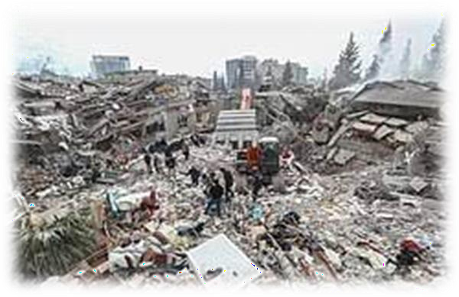
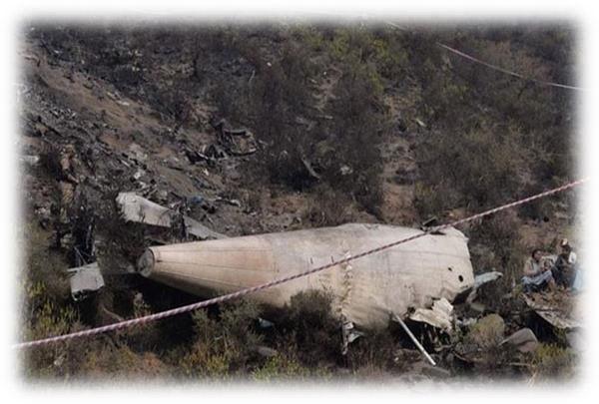
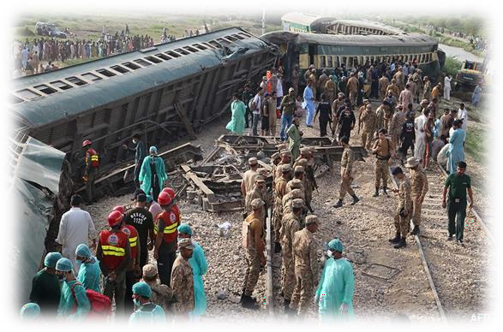
Core Concept
🞂​A ‘Mass Disaster’ is considered to have occurred when the number of casualties occurring in a single event exceeds 12.

Slide 10
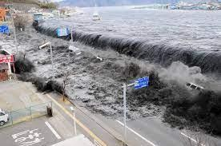
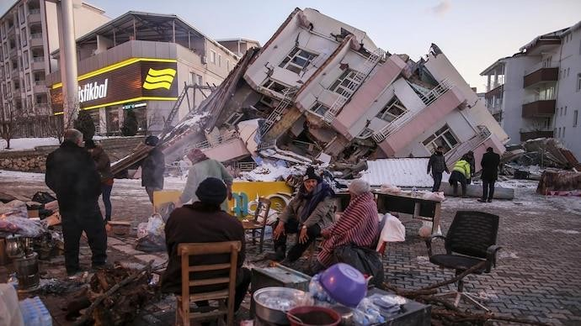
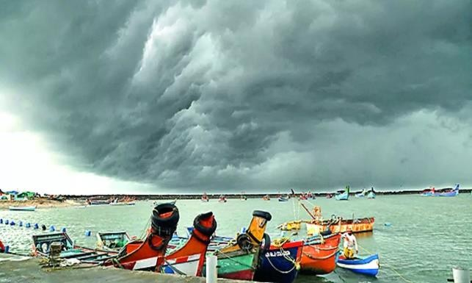
Core Concept
Natural:
Non-biological: Earthquake, cyclone, flood, drought, heat wave, volcanic eruption, landslide, and most recently, ‘the tsunami’.
Biological: Disease epidemic, mass poisoning (food/ liquor).

Slide 11
B. Man made:
Core Concept
i.
Accidental:
Transportation (road, rail, sea, river, and air),
Building collapse
Mining accidents
Dam bursts
Food poisoning, fires, football tragedies crush tragedies
Industrial:
Fires, explosions, leakage of toxic substances/ gases. Civil disturbances:
Riots and demonstrations.
Warfare:
Conventional (bombardment, exchange of fire, shelling)
Non-Conventional (nuclear, biological and chemical warfare, terrorism).
ii.
iii.
iii.

Slide 12
Core Concept

Slide 13
Core Concept
🞂​ The Objectives of Forensic Investigation in mass disaster are following:
🞂​ Retrieval & Reconstruction: Examination and early disposal of the bodies
🞂​Establishing identity:
🞂​Cause of death: Conducting autopsy, wherein practicable, and to establish the cause of death [all necessary factual evidence needs to be obtained at the time of autopsy, including samples for histology, toxicology, odontology, radiology and DNA analysis (depending upon the case).
🞂​ Seeking evidence: In the form of some foreign material/ fragment (of bomb or detonator) that may be embedded in the bodies.

Slide 14
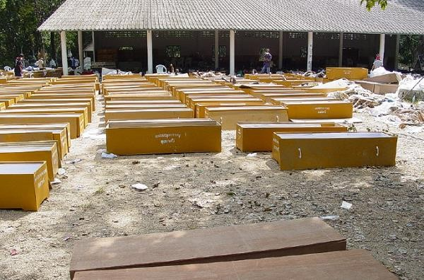
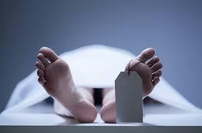
There are some special techniques for
identification in mass disaster.
Core Concept
🞂​Visual recognition: may not be helpful because of severe disfigurement (due to trauma, burning or decomposition, etc.). Further, the emotional factors involved in visual recognition make it unwise to accept either a positive or negative response in such circumstance.
🞂​Belongings: can be helpful and may include clothing, jewellery, and personal documentation. Clothing found on a body can be of great value in establishing identity but must not be accepted as a positive proof in isolation.

Slide 15
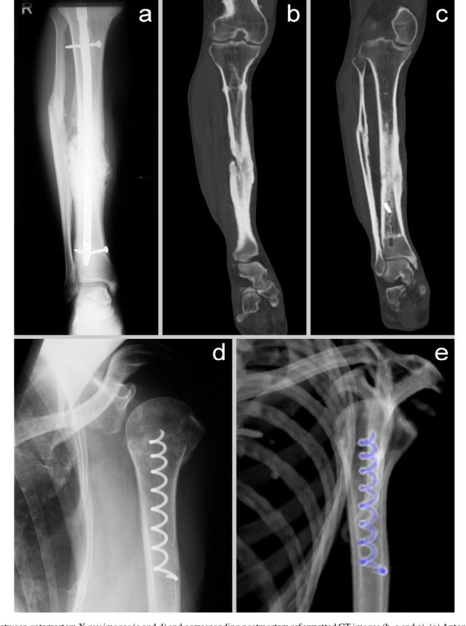
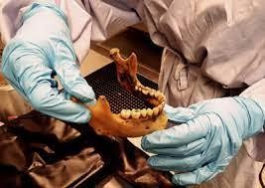
Core Concept
🞂​Medical and X-ray evidence: may contribute or confirm identification. Comparison of X- rays taken in life may be used when there is some abnormality.
🞂​Odontology: has proven to be very helpful, especially when fire or putrefaction has destroyed the soft tissues. Obviously, the method needs obtainable dental records.

Slide 16
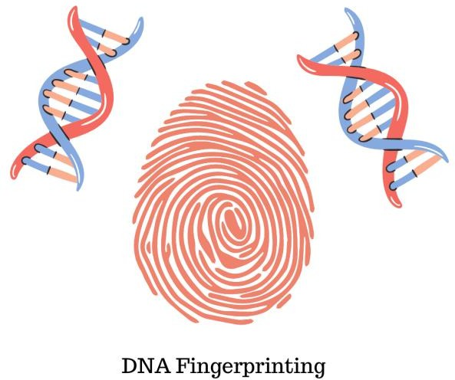
Core Concept
🞂​Fingerprinting: is another method of personal identification with well-established criteria for reliability. Obviously, fingers or fingerprints may be destroyed in the event of fire or severe mutilation. It is for this reason that some recommend retaining of heel print records too as they are better protected by boots.
🞂​DNA-profiling: has been shown to be of great value in identifying a wide range of human fluids and tissues.

Slide 17
Core Concept
Identification from remains begins at the scene of death, it should be in orderly manner and should be documented by photographs and diagrams. It is achieved by building up a description for each person as regards:
Appearance
Clothing(Pocket contents)
Deformities(Birth marks, scars, tattoos, occupational marks)
Race (Clothing, complexion, eyes,hairs,skull & bones)
Sex (Clothes, Physical morphology, Nuclear sexing)
Age (Teeth, physical characteristics, Bones)

Slide 18
Core Concept
Stature(usually from available skeleton & bones)
Fingerprints (From available fingers>epidermis &
dermis)
Footprints
Dental status(Age, sex,etc)
Miscellaneous Data (CNIC, Driving license,bank
cards)
Data from specialized techniques (Blood grouping, DNA profiling)

Slide 19
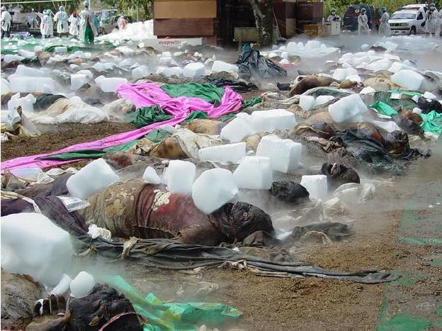
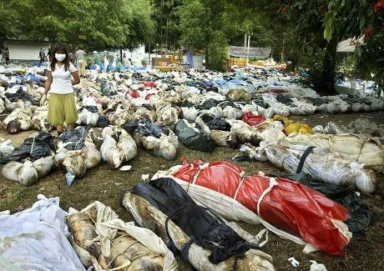
Decomposed Bodies:
Core Concept
These are bodies which shows putrefactive changes in varying degrees depending upon the time lapsed since death.
Medicolegal Importance:
Identification
Cause of death
Time since death
Mutilated Bodies:
The bodies which are disfigured, deprived of a limb or a part of a body . In this condition the soft tissues, muscles and skin are still attached to the bones.

Slide 20
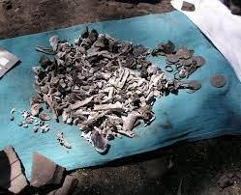
trunk or limb.
Medicolegal importance:
Core Concept
It includes only fragments of the body such as head,
Source (Whether human or animal)
Parts If parts belong to the same or different individual
Age (Teeth,bones ,ossification center through radiographs)
Sex (Nature & characteristics of soft parts, configuration of pelvis, nuclear sexing)

Slide 21
Core Concept
Stature (Usually from available bones)
Race (Clothing, hairs,eyes,complexion,skull –
index)
Identity (Clothing,personal articles,teeth,finger printsand DNA profiling)
Special features (Mutilation may be the work of a personwith anatomical knowledge)
Cause of death (Signs of antemortem violence
,injury to the vital organs,recovery of a bullet,f ractures & toxicological analysis)
Time since death (condition of soft parts in relation to the putrefactive changes)

Slide 22
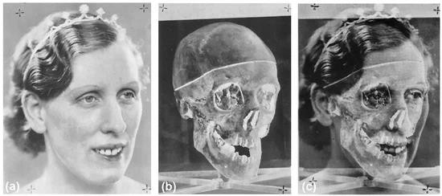
Core Concept
🞂​ Definition: “Craniofacial superimposition is a technique used in the field of forensic anthropology to assist in the analysis of an unknown skull. The process involves superimposing an image of the recovered skull over an ante mortem image of the suspected individual.”

Slide 23
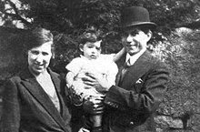
Interactive session
What is Buck’s Ruxton murder case ???

Slide 24
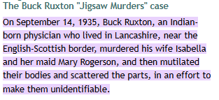

Slide 25
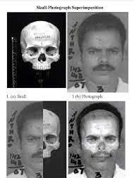
Core Concept
🞂​Method: In graphics, superimposition is
the placement of an image or video on top of an already- existing image or video, usually to add to the overall image effect, but also
sometimes to conceal something (such as when a different face is superimposed over the original face in a
photograph).

Slide 26
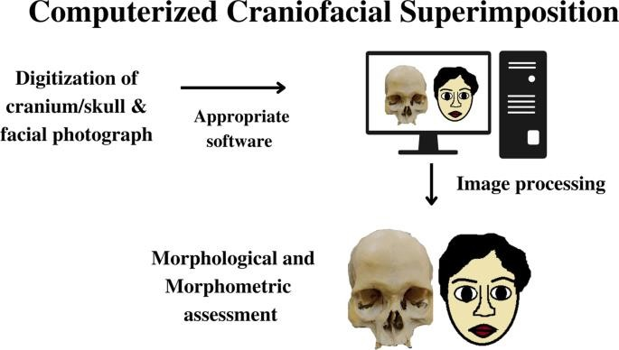
Core Concept

Slide 27
Core Concept
🞂​The purpose of mass disaster photography is to provide a true and accurate record of the scene and physical evidence present by recording the original scene and related areas.It helps in the following areas:
🞂​ Identification
🞂​ Cause of death
🞂​ Manner of death
🞂​ Time since death

Slide 28
Research
🞂​https://systematicreviewsjournal.biomedcentral.c om/articles/10.1186/s13643-021-01879-z
🞂​https://www.longdom.org/open- access/personal-identification-in-forensic- examinations- 33481.html#:~:text=The%20'big%20fours'%20of% 20personal,%2C%20sex%2C%20stature%20and%2 0ethnicity.
🞂​https://www.researchgate.net/publication/2818 07738_I_Identify_with_Her_I_Identify_with_Him_U npacking_the_Dynamics_of_Personal_Identificatio n_in_Organizations

Slide 29
Ethics
🞂​ A dignified handling of corpses should be central in daily practice of forensic medicine and forensic staff should always have in mind the ethical dimension of human corpses in spite of their regular confrontation with the dead.
🞂​https://jfse-ojs- tamu.tdl.org/jfse/article/view/70
🞂​https://link.springer.com/book/10.1007/978- 3-319-56869-0
🞂​ https://pubmed.ncbi.nlm.nih.gov/19438443/

Slide 30
Family Medicine
🞂​Family medicine is the speciality that is responsible for providing comprehensive and continuing care to all individuals seeking medical advice, irrespective of gender, age and illness.
🞂​Medical expertise of a family physician is crucial in death investigations.
🞂​ It begins with body examination and evidence collection at the scene and proceeds through history, physical examination, laboratory tests, and diagnosis – in short, the broad ingredients of a doctor’s treatment of a living patient.
🞂​The key goal is to provide objective evidence of cause, timing, and manner of death for adjudication by the criminal justice system.

Slide 31
How to use HEC Digital Library
Go to the website of HEC National Digital Library
http://www.digitallibrary.edu.pk
On Home Page, click on the INSTITUTES.
A page will appear showing the universities from Public and Private Sector and other Institutes which have access to HEC National Digital Library (HNDL).
Select your desired Institute.
A page will appear showing the resources of the institution
Journals and Researches will appear
You can find a Journal by clicking on JOURNALS AND DATABASE and enter a keyword to search for your desired journal

Slide 32
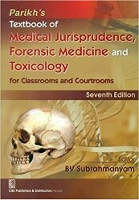
TEXT BOOKS & PRACTICAL NOTEBOOK:
Principles & Practice of Forensic Medicine. by Nasib R. Awan
Parikh’s Textbook of Medical Jurisprudence,Forensic Medicine & Toxicology.
Practical Manual Of Forensic Medicine & Toxicology

Slide 33
THANK YOU

