Slide 2
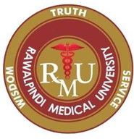
Patterns of Injury in Nervous System Physical Traumatic Head Injury
CNS & Psychiatry II 4th year MBBS
Department of Pathology
Rawalpindi Medical University

Slide 3
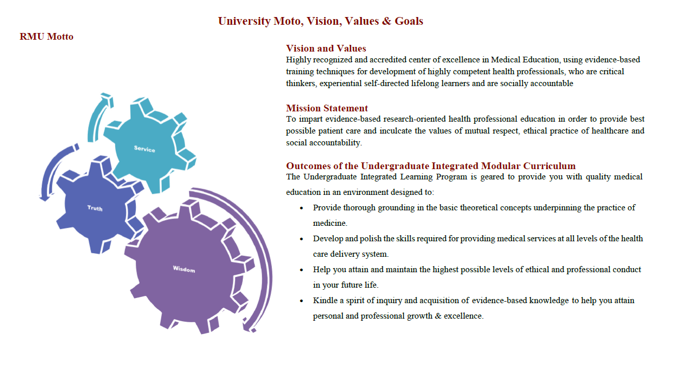

Slide 4
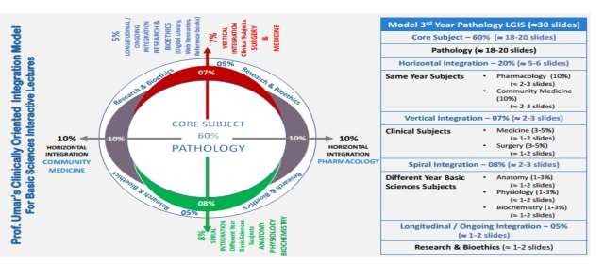

Slide 5
Learning Objectives
Students should be able to:
Describe edema, herniation, and hydrocephalus.
Classify cerebrovascular diseases.
Explain CNS trauma.
Learning Resources: Robbins & Cotran Pathologic Basis Of Disease 10th Edition

Slide 6
Cerebrovascular Diseases
Brain disorders caused by pathologic processes involving blood vessels.
The three main pathogenic mechanisms are:
Thrombotic occlusion
Embolic occlusion
Vascular rupture.

Slide 7
Cerebrovascular Diseases
CORE PATHOLOGY
Thrombosis
Embolism
Localized effect
Hypoxia
Infarction /ischemia
Hypovolemic Shock
Sever Hypoglycemia
Global effect
Hypoxia
Infarction / Ischemia
Hemorrhage by rupture of vessel
Direct tissue damage
Ischemic injury

Slide 8
The Brain And Cerebral Blood Supply
VERTICAL INTEGRATION
Cerebral Blood Flow
Highly oxygen-dependent tissue
Requires a continual supply of glucose and oxygen
Receives 15% of the resting cardiac output and is responsible for 20% of total body oxygen consumption
Cerebral blood flow normally remains stable over a wide range of blood pressure and intracranial pressure due to autoregulation of vascular resistance.

Slide 9
Hypoxia, Ischemia, and Infarction
VERTICAL INTEGRATION
Brain Hypoxia Occurs By Following:
Functional Hypoxia
Low partial pressure of oxygen (e.g., high altitude)
Impaired oxygen-carrying capacity (e.g., severe anemia, carbon monoxide poisoning)
Toxins that interfere with oxygen use (e.g., cyanide poisoning)
Ischemia
Transient or permanent tissue hypoperfusion
Severe hypotension
Vascular obstruction
Both.
NO AIR
NO BLOOD

Slide 10
The Brain And Cerebral Blood Supply
VERTICAL INTEGRATION
Global Cerebral Ischemia
Widespread ischemic-hypoxic injury due to severe systemic hypotension, usually systolic pressures below 50 mm Hg, as in cardiac arrest and shock.
Outcome depends on the severity and duration of the insult.
Mild Severity and Transient Outcomes:
Transient post-ischemic confusional state
Complete recovery
Neuronal Vulnerability:
Neurons are more susceptible to hypoxic injury than glial cells.
Among the most vulnerable neurons are the pyramidal cells of the hippocampus and neocortex, and Purkinje cells of the cerebellum.
Note: Even mild or transient global ischemic insults may cause damage to these vulnerable areas in some individuals.

Slide 11
Global Cerebral Ischemia
CORE PATHOLOGY
Severe Global Cerebral Ischemia
Widespread neuronal death occurs irrespective of regional vulnerability.
Patients who survive often remain severely impaired neurologically and in a persistent vegetative state.
Other patients meet the clinical criteria for brain death, with no voluntary or reflex brain and brain stem function, including respiratory drive.

Slide 12
Morphology
CORE PATHOLOGY
Gross Changes in Global Ischemia
Brain swelling
Wide gyri and narrowed sulci
Compression with effacement of lateral ventricles
Flattening of gyri from extensive bilateral cerebral edema.
The cut surface shows poor demarcation between gray matter and white matter.

Slide 13
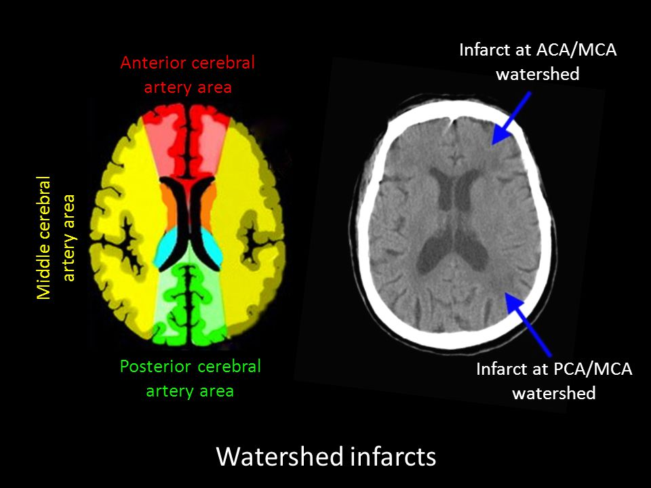
Morphology
CORE PATHOLOGY
Border zone ("watershed") infarcts: Regions of the brain and spinal cord that lie at the most distal portions of arterial territories.
Border zone between the anterior and middle cerebral artery distributions.

Slide 14
Focal Cerebral Ischemia
CORE PATHOLOGY
Ischemia Localized to a Distribution of an Artery
The effect is modified by collateral blood supply.
Can be caused by:
Embolic infarcts (more common)
Thrombotic occlusions.

Slide 15
Focal Cerebral Ischemia
CORE PATHOLOGY
Embolic Infarcts Sources:
Cardiac mural thrombi
Atheromatous plaques
Emboli of venous origin – cross over to the arterial circulation through a patent foramen ovale (paradoxical embolism)
The territory of the middle cerebral artery, a direct extension of the internal carotid artery, is most frequently affected.
Emboli tend to lodge where vessels branch or in areas of stenosis caused by atherosclerosis.

Slide 16
Focal Cerebral Ischemia
CORE PATHOLOGY
Thrombotic Occlusions
Occur superimposed on atherosclerotic plaques.
Common sites:
Carotid bifurcation
Origin of the middle cerebral artery
Both ends of the basilar artery.
Anterograde extension, thrombus fragmentation, and distal embolization.
Thrombotic occlusions of small penetrating arteries lead to lacunar infarcts.

Slide 17
Cerebral Amyloid Angiopathy
CORE PATHOLOGY
Amyloid Deposition and Hemorrhages
Amyloid deposition weakens vessel walls, increasing the risk of hemorrhages.
Hemorrhage distribution is different from those associated with hypertension.
CAA-associated hemorrhages often occur in the lobes of the cerebral cortex (lobar hemorrhages).
Small (<1mm) cortical hemorrhages are referred to as microhemorrhages.

Slide 18
Intracranial Hemorrhage
CORE PATHOLOGY
Hemorrhages Within the Brain Are Caused By
Diseases That Cause Vessel Wall Injury:
Primary brain parenchymal injury
Hypertension
Vasculitis
Cerebral amyloid angiopathy
Structural Lesions:
Arteriovenous malformation
Cavernous malformations
Capillary telangiectasias
Saccular aneurysms
Tumors

Slide 19
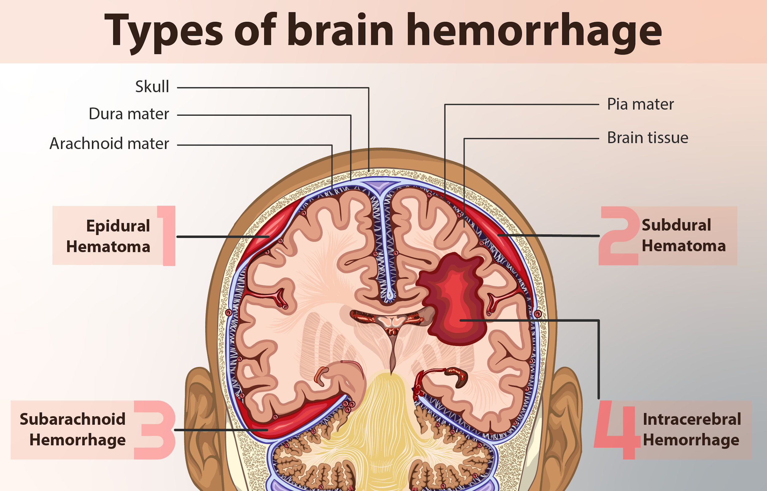
VERTICAL INTEGRATION

Slide 20
Subarachnoid Hemorrhage And Saccular Aneurysms
CORE PATHOLOGY
The Most Frequent Cause of Clinically Significant Non-Traumatic Subarachnoid Hemorrhage:
Rupture of a saccular (berry) aneurysm.
Other Causes:
Vascular malformations
Trauma
Rupture of intracranial hemorrhage into the ventricles
Coagulopathies
Tumors.

Slide 21
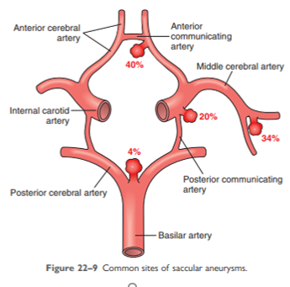
Common Sites of Saccular Aneurysms
CORE PATHOLOGY
Increased intracranial pressure e.g.
Straining at defecation
Rupture of saccular aneurysm
Thunderclap headache
Loss of consciousness
Death recovery
Recurrent bleed

Slide 22
Clinical Patterns Of Vascular Injury In The Cns
VERTICAL INTEGRATION
LOCATION | ETIOLOGY
Epidural space | Trauma
Subdural space | Trauma
Subarachnoid space | Vascular abnormalities (arteriovenous malformations/ aneurysms Trauma
Intraparenchymal | Trauma Hemorrhagic conversion of an infarction Cerebral amyloid angiopathy Hypertension Tumors

Slide 23
VERTICAL INTEGRATION
SPIRAL INTEGRATION

Slide 24
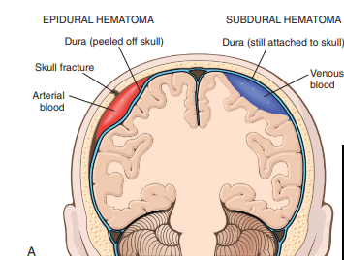
Epidural Hematoma
VERTICAL INTEGRATION
Most Common Site:
Middle meningeal artery
Skull Fractures:
In infants, skull fractures may be absent.
In children and adults, skull fractures almost always present.
Clinical Presentation:
Patients can be lucid for several hours between the moment of trauma and the development of neurological signs.
An epidural hematoma may expand rapidly and constitutes a neurosurgical emergency, necessitating prompt drainage and repair to prevent death.

Slide 25
Epidural Hematoma
CORE PATHOLOGY
Tearing of a vessel
blood accumulation
Dissection of tightly applied dura away from the inner skull surface
compression of the brain surface
hematoma formation

Slide 26
Subdural Hematoma
CORE PATHOLOGY
Rapid Movement of the Brain During Trauma
Occurs mainly in settings of brain atrophy (e.g., elderly persons).
In infants, bridging veins are thin-walled, making them more vulnerable.
Most Common Site: Over the lateral aspects of the cerebral hemispheres, and may be bilateral.
Manifestation: Symptoms typically manifest within the first 48 hours after injury.
Neurologic Signs: Neurologic signs are attributable to the pressure exerted on the adjacent brain.
Symptoms may be localizing, but are more often nonlocalizing, taking the form of headache, confusion, and slowly progressive neurologic deterioration.

Slide 27
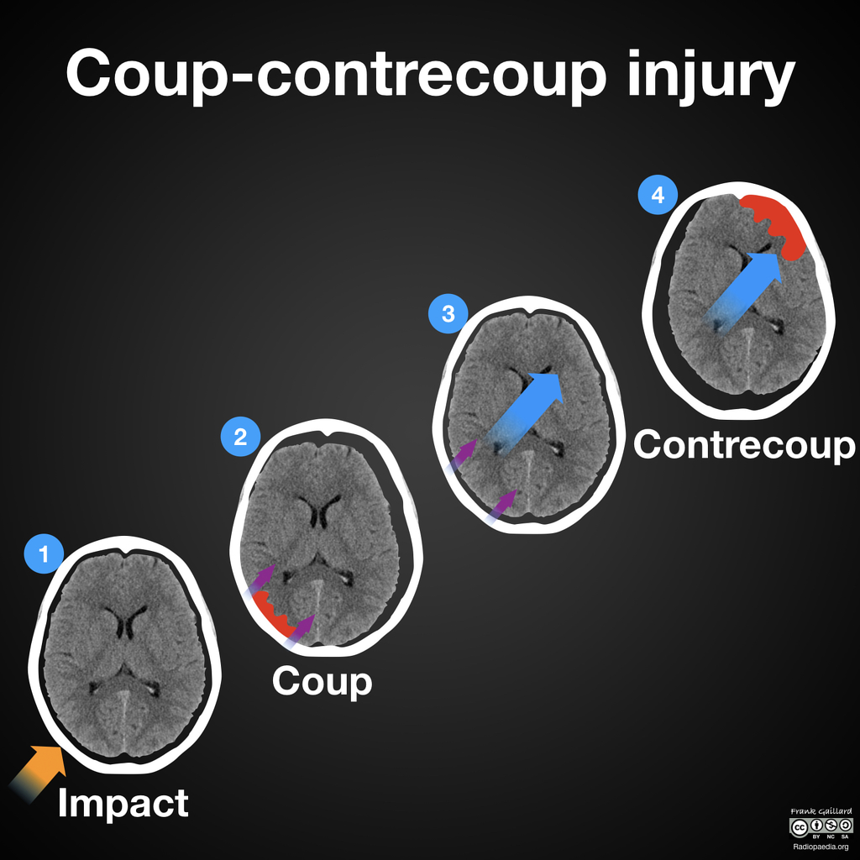
Traumatic Parenchymal Injuries
HORIZONTAL INTEGRATION
Head Collision:
Brain injury may occur at the site of impact—coup injury—or opposite the site of impact on the other side of the brain—contrecoup injury.
Both coup and contrecoup lesions are contusions.

Slide 28
Traumatic Parenchymal Injuries
CORE PATHOLOGY
Contusion:
A contusion is caused by rapid tissue displacement, disruption of vascular channels, and subsequent hemorrhage, tissue injury, and edema.
Site:
The crests of the gyri are the part of the brain most susceptible to traumatic injury.
The brain overlying rough and irregular inner skull surfaces, such as the orbitofrontal regions and the temporal lobe tips, is also vulnerable.

Slide 29
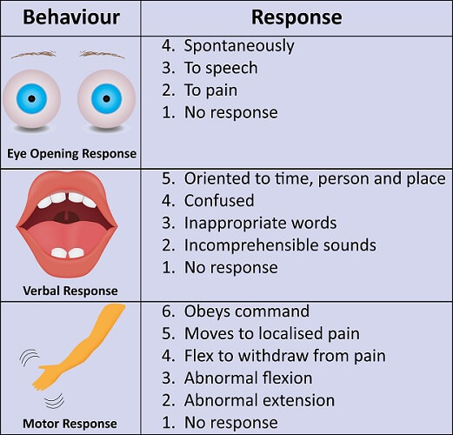
Glasgow Coma Scale
VERTICAL INTEGRATION

Slide 30
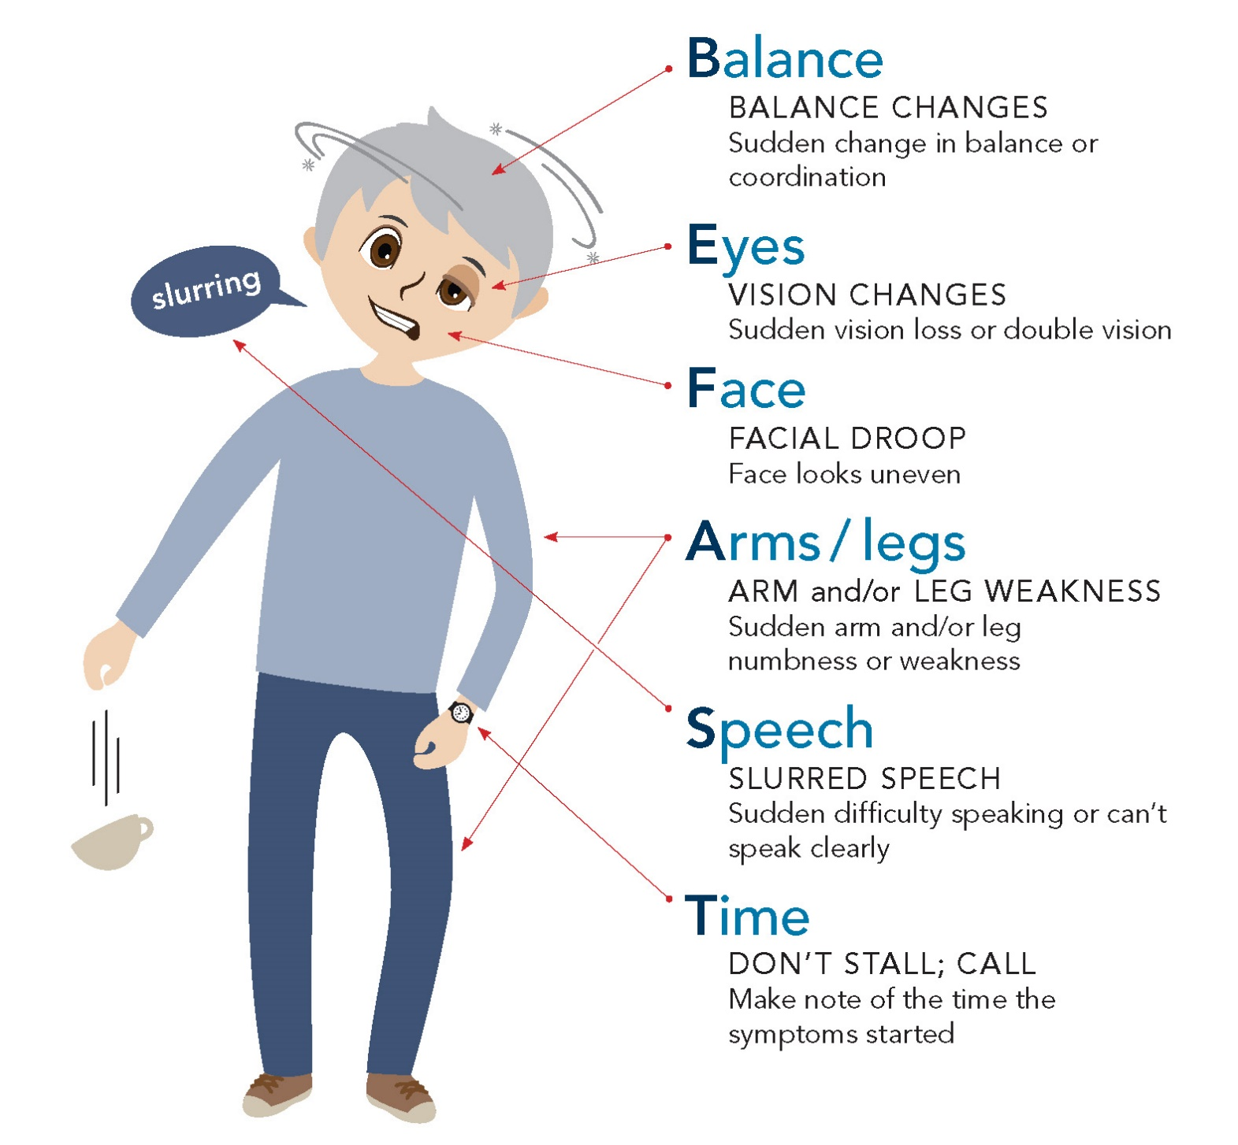
VERTICAL INTEGRATION
STROKE!
BE FAST

Slide 31
Therapeutics In Brain Ischemia
HORIZONTAL INTEGRATION
Thrombolytic Therapy: IV alteplase (tPA) within the golden window (≤4.5 hours) for clot dissolution and reperfusion.
Neuroprotective Agents: Investigational drugs targeting oxidative stress, inflammation, and apoptosis to limit neuronal damage.
Antiplatelet & Anticoagulation Therapy: Aspirin, clopidogrel, and heparin prevent secondary strokes in high-risk patients.
Vascular Risk Management: Statins, antihypertensives, and glucose control optimize cerebrovascular health and prevent recurrence.

Slide 32
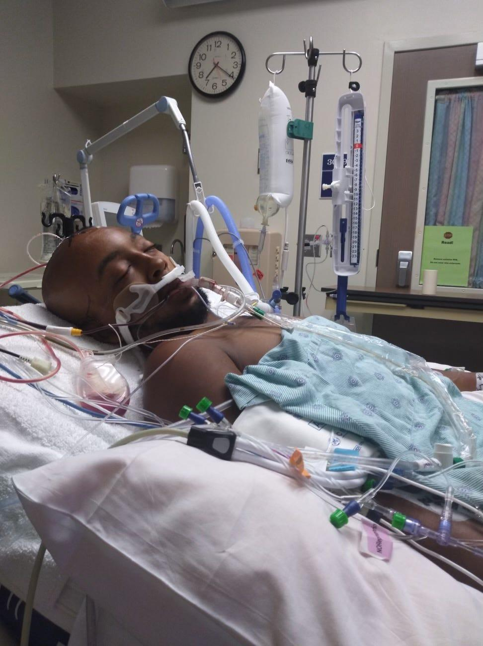
Informed Decision Capability
Decision making rights at different ages

Slide 33
Ethical Issues in Ventilator-Supported Persons
Autonomy & Informed Decision-Making: Respect patient or surrogate choices regarding continuation or withdrawal of ventilatory support.
Beneficence vs. Non-Maleficence: Balance prolonging life with avoiding unnecessary suffering in terminal conditions.
Advance Directives & Palliative Care: Consider living wills, DNR orders, and transition to comfort-focused care.
Family & Multidisciplinary Communication: Ensure transparent discussions among healthcare providers, patients, and families for ethical decision-making.

