Slide 1
Patient with Fever
Dr. Muhammad Mujeeb Khan
FCPS (Medicine)
Dip. DM (UK), Dip. Nutrition (Pak),
MSc. Infectious Diseases (UK)
Associate Professor
Rawalpindi Medical University, Rawalpindi

Slide 2
University Motto, Vision, Values & Goals
Mission Statement
To impart evidence-based research-oriented health professional education
Best possible patient care
Mutual respect, ethical practice of healthcare and social accountability.
Vision and Values
Highly recognized and accredited centre of excellence in medical education, using evidence-based training techniques for development of highly competent health professionals, who are lifelong experiential learner and are socially accountable.
Goals
The Undergraduate Integrated Learning Program is geared to provide you with quality medical education in an environment designed.

Slide 3
SEQUENCE OF LGIS
Learning objectives
What is Pyrexia of Unknown Origin and how to diagnose it?(core concept = 70%)
Related pathology and pharmacology (horizontal integration 15%)
Recent advances and developments. (vertical integration – 10%)
Research article related to topic (3%) Ethics (2%)

Slide 4
LEARNING OBJECTIVES
By the end of this lecture, students will have learnt about:
Define Fever and Hyperthermia
Classify and Identify Fever Types –
Recognize infectious and non-infectious causes of fever
Discuss Pyrogens and Fever Mechanism
Define FUO, its classification, common causes, diagnostic approach, and management strategies.
Recognize Fever-Related Emergencies
Outline Diagnostic Approaches
Describe Management and Treatment
Evaluate the Role of Infectious Disease Consultation
Understand ethical concerns in fever management

Slide 5
PROF UMER MODEL OF INTEGRATED LECTURE

Slide 6
INTRODUCTION
FEVER(Pyrexia): Elevation in core body temperature above the daily range for an individual
Range of normal temperature: 35.3 – 37.3ºC ( 95.5 – 99.9⁰F)
Average body temperature: 36.7ºC (98⁰F)
Hyperthermia:
Hyperthermia is an uncontrolled increase in body temperature that exceeds the body's ability to lose heat, without a change in the hypothalamic set point.
Examples: Heat stroke, Drugs like atropine, ecstasy
Hyperpyrexia
Hyperpyrexia is the term for an extraordinarily high fever (>41.5°C), It may be due to severe infections or non infective cause like central nervous system pathology

Slide 7
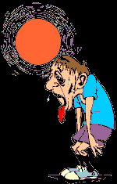
HYPERTHERMIA IS ALWAYS PATHOLOGICAL
Hypothalamic Set point is unchanged
Mechanism: Exogenous Heat exposure and/or endogenous heat production.
Examples:
Heat stroke: Excessive heat exposure + dehydration + impaired heat dissipation
Malignant hyperthermia: Genetic disorder triggered by anesthetic drug (halothane) leads to excessive muscle contraction & heat production
Neuroleptic malignant syndrome: Excessive muscle contractions and excessive heat production due to dopamine receptor blockade

Slide 8
TREATMENT OF FEVER, HYPERPYREXIA AND HYPERTHERMIA
Fever: Supportive + antipyretics
Hyperpyrexia: Excessive cooling + Antipyretics + Treat underling cause
Hyperthermia: Excessive cooling + Treat underling cause

Slide 9
PATHOPHYSIOLOGY OF FEVER
Pyrogens: “any substance that causes fever” . Pyrogens are either
exogenous : Toxins, Viral protein, Microbial components
endogenous: Proinflammatory cytokines (IL-1, IL-6, TNF-α)
Pyrogens (Exogenous or Endogenous) → Cytokine Release (IL-1, IL-6, TNF-α)
Cytokines acts on hypothalamus → Stimulats COX → PGE2 production
PGE2 production → binds with hypoyhalmus → Increases Setpoint
Thermoregulatory Response (Vasoconstriction, Shivering, Increased Metabolism)
Fever

Slide 10
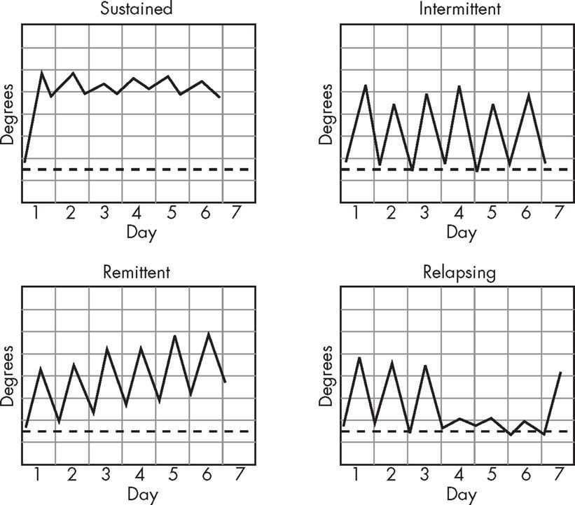
TYPES OF FEVER
Continuous/sustained fever: Temperature remains above normal throughout the day and does not fluctuate more than 1 °C in 24 hours, e.g. Typhoid fever, Brucellosis,
Intermittent fever: Fever spikes but returns to normal between episodes e.g. pyaemia, or septicemia.
Remittent fever: Temperature remains above normal throughout the day and
fluctuates more than 1 °C in 24 hours, e.g., infective endocarditis.

Slide 11
TYPES OF FEVER
Relapsing fever: Periods of fever alternating with afebrile periods: e.g. Malaria
Pel-Ebstein fever: Fever for days (e.g. 3–10 days) followed by an afebrile period of the same duration. It is associated with Hodgkin’s lymphoma

Slide 12
TREATMENT OF FEVER
Anti Pyretics:
Paracetamol (Acetaminophen):
It acts by Inhibition of Prostaglandin synthesis in hypothalamus
NSAIDs (Ibuprofen, Aspirin)
Its Acts by COX inhibition which reduces prostaglandin synthesis
Corticosteroids:
It acts at 2 levels. It blocks the cytokines + COX inhibition
Supportive measures:
Hydration: Encourage Fluids to prevent dehydration
Rest: Reduces metabolic demand
Cooling Measures: tepid sponging, light clothing, cool enviornment

Slide 13
SITE OF ACTION OF ANTIPYRETIC DRUGS
Pyrogens (Exogenous or Endogenous) → Cytokine Release (IL-1, IL-6, TNF-α)
Cytokines acts on hypothalamus → Stimulats COX → PGE2 production
PGE2 production → binds with hypoyhalmus → Increases Setpoint
Thermoregulatory Response (Vasoconstriction, Shivering, Increased Metabolism)
Fever
NSAIDS + Paracetamol
Steroids

Slide 14
WHAT WENT WRONG IN MANAGEMENT OF FEVER ?
A 6 year old child had history of fever and sore throat a week ago and took aspirin for fever. Now presented with vomiting, confusion and lethargy. On examination, The child is disoriented with altered mental status hepatomegaly and hyper reflexia.
What went wrong?
What is the diagnosis?
Can we use aspirin in children?

Slide 15
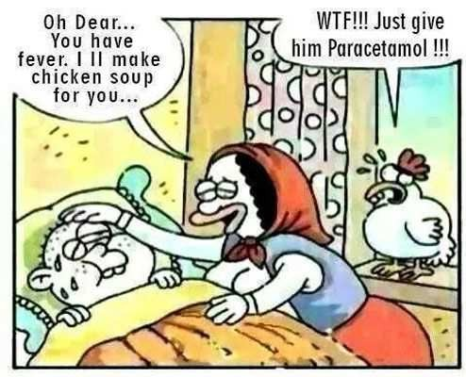
FACTITIOUS FEVER
Self induced fever by the patient
Common methods used by patients
Manipulation of thermometer
Self injected drugs: thyroxine, atropine
Clue to diagnosis:
Temperature pulse dissociation
Normal inflammatory markers
Unusual fever patterns

Slide 16
PYREXIA OF UNKNOWN ORIGIN (PUO)
A fever ≥ 38.3°C (101°F) on multiple occasions, lasting for more than 3 weeks, with no clear diagnosis despite at least 1 week of inpatient investigation (or extensive outpatient evaluation)
Common caues of PUO
Infections (30%) | Tuberculosis, HIV, endocarditis, depp abscess, brucellosis, psitacosis
Neoplasm (15%) | Lymphoma, leukemia, solid tumors
Autoimmune diseases (25%) | SLE, Vasculitis, Adult onset still’s disease, Granulamtous diseases (Sarcoidosis, crohn’s)
Miscellaneous (~20%) | Thromboembolic disease, drug fever, Endocrine disease (hyperthyroidism, thyroiditis,)

Slide 17
Fever is not an illness in itself but a sign of the body's battle against infection or disease
Hippocrates

Slide 18
HISTORY OF FEVER
Duration:
Acute & shorter duration: Usually infectious, self limiting
Chronic (Prolong Duration): Usually > 14 days, indicates malignancy, chronic infection, systtemic disease
Mode of onset:
Sudden onset: Develops over the hours (e.g. Dengue, influenza, UTI, Pneumonia)
Gradual onset: Develops slowly over the days or weeks (e.g TB, endocarditis, SLE)

Slide 19
HISTORY OF FEVER
Progression: Continoue, intermittent, remitent or relapsing
Severity: Assess by quality of life, temerautre charting
Treatment received and outcome
Associated symptoms: These localizes to source of infection

Slide 20
FEVER AND RESPIRATORY DISEASES
Associated symptoms: Cough, sputum production, shortness of breath, chest pain
Upper respiratory tract infections: pharyngitis, sinusitis, common cold
Lower respiratory tract infections: Pneumonia, Bronchitis, Bronchiolitis
Tuberculosis:
Covid 19 and influenza
Lung abscess or empyema:

Slide 21
FEVER AND CARDIAC DISEASES
Associated sign and symptoms : Chest pain, shortness of breath, edema, weight loss, fatigue , murmur
Infective endocarditis:
Myocarditis:
Pericarditis:

Slide 22
FEVER AND NEUROLOGICAL DISEASES
Localizing symptoms: Headache, neck stiffness, loss of consciousness, Focal neurological deficits
Meningitis
Encephalitis:
Brain abscess:
Central fever: Fever due to hypothalamic dysfunction (After stroke or brain injury)
Neuroleptic malignant syndrome: Drug induced fever

Slide 23
FEVER IN GASTROINSTINAL DISEASES
Abdominal ,vomiting, diarrhea, jaundice, change in bowel habits, per rectal bleeding
Infectious gastroenteritis:
Appendicitis
Inflammatory Bowel Diseases:
Hepatitis/liver abscess:
Peritonitis:

Slide 24
FEVER IN GENITOURINARY DISEASES
Localizing symptoms: Dysurea,frequency/urgency flank pain, perineal or suprapubic discomfort
Urinary tract infection:
Prostatitis
Epididymitis/orchitis
Pelvic inflammatory disease
Renal abscess/perinephric abscess

Slide 25
FEVER IN ENDOCRINE DISEASES
Localizing smptoms: Palpitations, heat intolerance, sweating, Skin hyperpigmentation,
goiter, ophthalmopathy, tremors
Thyroid storm
Adrenla insufficiency
Pheochromocytoma
Graves disease
Thyroiditis

Slide 26
FEVER IN HEMATOLOGY & ONCOLOGY
Neutropenic fever: Fever in presence of neutropenia (ANC < 500/µL)
Fever, night sweats, weight loss: Lymphoma, tuberculosis, brucellosis
Fever with bone pain: Leukaemia, multiple myeloma, bone metastasis
Fever with hepatosplenomegaly: Leukaemia, lymphoma, malaria, leishmaniasis

Slide 27
FEVER IN DERMATOLOGY
Pattern of the skin rash is the major localizing sign
Bacterial:
Celuulitis
Necrotizing Fascitis
Scarlet fever
Viral:
Varicella (chicken pox)
Measles
Rubella
Hand, foot and mouth disease
Drug induced :
DRESS syndrome
Steven-Johnson syndrome
Toxic eidermal Necrolysis

Slide 28
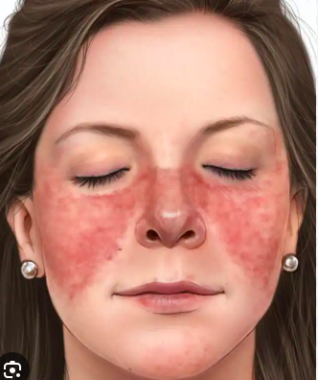
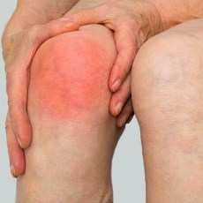
FEVER & MUSCULOSKELETAL SYSTEM
Localizing sign and symptoms: Pattern of arthritis, Rash ,
Bone pain, Myopathy
SLE:
Rheumatic fever
Vasculitis (giant cell arteritis, Polyarteeritis nodosa
Adult onset still’s disease:
Septic arthritis:
Osteomyelitis:

Slide 29
HISTORY OF PAST ILLNESS
History of immunosuppression: HIV, Chemotherapeutic drugs, Malignancy,
Chronic illness: Diabetes mellitus, CKD, Autoimmune diseases
Surgical or procedure history: Prosthetic heart valves
Trauma/accidents
History of bllod transfusion

Slide 30
DRUG HISTORY IMMUNIZATION HISTORY
Drug induced fever:
Antibiotics: Beta-lactams, Sulfonamide, vancomycin
Anticonvolsants: Phenytoin, carbamazepine, valproate
Biologics: TNF inhibitors
Vaccination and fever: Fever may be due to vaccination or missed vaccination
Vaccination induced fever: 24-48 hours vaccine

Slide 31
IMMUNIZATION HISTORY
Fever may be due to vaccination or missed vaccination
Post vaccination fever: Mild and self limiting,
Missed Vaccinations: Specially in splenectomized patients
No Pneumococcal vaccine: Pneumonia risk
No Meningococcal vaccine: Meningitis risk
No childhood vaccine: Measles, mumps and rubella risk
Any fever (>38.5⁰) in a splenectomized patient is medical emergency as patient is at the risk of fulminant sepsis

Slide 32
TRAVEL HISTORY
Name of the area, Duration of stay
Short incubation period (< 7 days): Dengue, Leptospirosis, typhoid
Medium incubation period (1-3 weeks): malaria, typhoid, rickettsial fever
Long incubation period: (> 3 weeks): TB, Leishmaniais
Mosquito bite: Malaria, dengue, chickungunya
Fresh water exposure: Leptospirosis, Schistosomiasis
Animal contact: Rabies, Brucellosis
Uncooked food/water: Typoi, Hepatitis A/E

Slide 33
PERSONAL AND SOCIAL HISTORY
Drinking water source:
Sanitation status of home and surrounding area:
Animal/pets at home:
Consumption of unpasteurized milk:
Sexual history:
Illicit drug use and injection and sharing of needle

Slide 34
INVESTIGATIONS
Initial basic investigations:
CBC
Urine analysis
Chest X-ray
ESR and CRP
Blood Cultures before starting antibiotics. 2-3 sets from different sites
Urine Cultures
Liver functions, Renal functions

Slide 35
TARGETED INVESTIGATIONS
Lymph node biopsy
Bone Marrow Biopsy
ANA, RA factor
Sputum studies:
Viral serology
CT scan/MRI

Slide 36
RED FLAGS
The following are of particular concern:
• Immunocompromise
• Heart murmur
• Presence of inserted devices (eg, IV lines, pacemakers, joint prostheses)
• Recent travel to endemic areas

Slide 37
WHEN TO OBTAIN AN INFECTIOUS DISEASE CONSULT?
(1) difficult-to diagnose patients with presumed infections,
(2) patients who are not responding to treatment as expected,
(3) patients with a complicated medical history (e.g., organ transplant recipients, patients immunosuppressed due to autoimmune or inflammatory conditions), and
(4) patients with “exotic” diseases (i.e., diseases that are not typically seen within the region).

Slide 38
REFRENCES
Roth AR, Basello GM. Approach to the adult patient with fever of unknown origin. Am Fam Physician. 2003;68(11):2223-8.
Cunha BA. Fever of unknown origin: focused diagnostic approach based on clinical clues from the history, physical examination, and laboratory tests. Infect Dis Clin North Am. 2007;21(4):1137-87.
Dinarello CA. Infection, fever, and exogenous and endogenous pyrogens: some concepts have changed. J Endotoxin Res. 2004;10(4):201-22.
World Health Organization (WHO). Fever in children: assessment and initial management in children younger than 5 years. Geneva: World Health Organization; 2013.
Mackowiak PA, Wasserman SS, Levine MM. A critical appraisal of 98.6°F, the upper limit of the normal body temperature, and other legacies of Carl Reinhold August Wunderlich. JAMA. 1992;268(12):1578-80.
Hayakawa K, Ramasamy B, Chandrasekar PH. Fever of unknown origin: an evidence-based review. Am J Med Sci. 2012;344(4):307-16.
World Health Organization (WHO). Fever in children: assessment and initial management in children younger than 5 years. Geneva: World Health Organization; 2013.

Slide 39
Thank You

