Slide 1
HEMATEMESIS
DR WAQAS RAZA
PROF OF SURGERY
RTH HOSPITAL RAWALPINDI

Slide 2
Learning Objectives:
Understand the pathophysiology behind hematemesis.
Identify the common causes and their mechanisms.
Discuss the principles of initial assessment and management.

Slide 3
Imagine you're in the ER and a patient comes in with a complaint of sudden onset of blood in vomitus. Before we discuss the potential causes and the pathophysiology behind this complaint ,
1. I want you to tell about the initial steps you would take in assessing this patient.
2. What questions would you ask.
3. What immediate interventions might be necessary.

Slide 4
INTRODUCTION
Definition:
"Hematemesis refers to the vomiting of blood, indicating bleeding somewhere in the gastrointestinal (GI) tract."

Slide 7
CAUSES

Slide 8
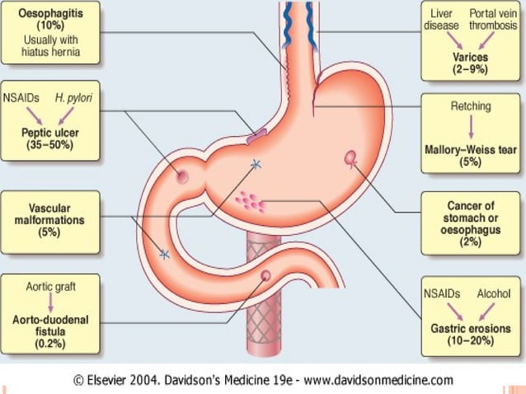

Slide 9
SIGN AND SYMPTOMS

Slide 10
PRESENTATION

Slide 11
APPROACH TO PATIENT

Slide 15
LAB DIAGNOSIS

Slide 18
ENDOSCOPY

Slide 19
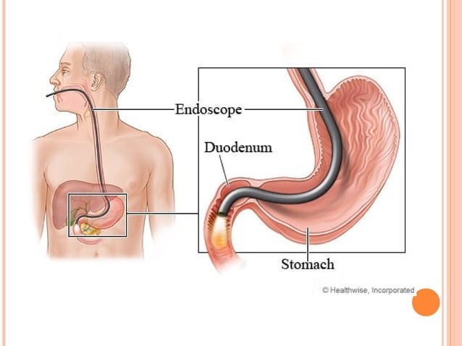

Slide 20
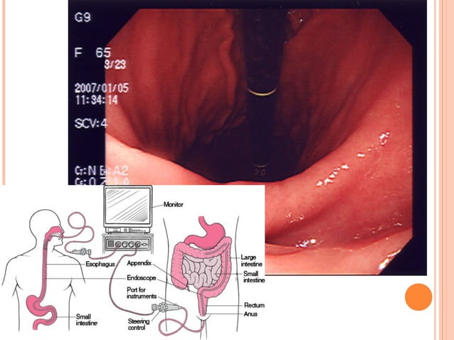

Slide 21
IMAGING

Slide 23
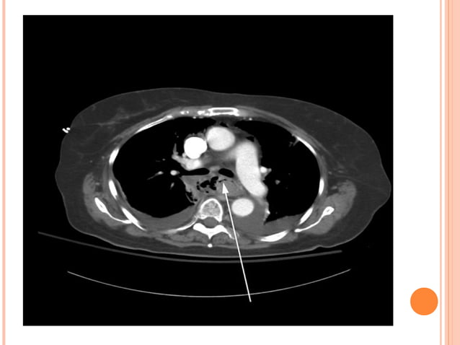

Slide 24
ANGIOGRAPHY

Slide 25
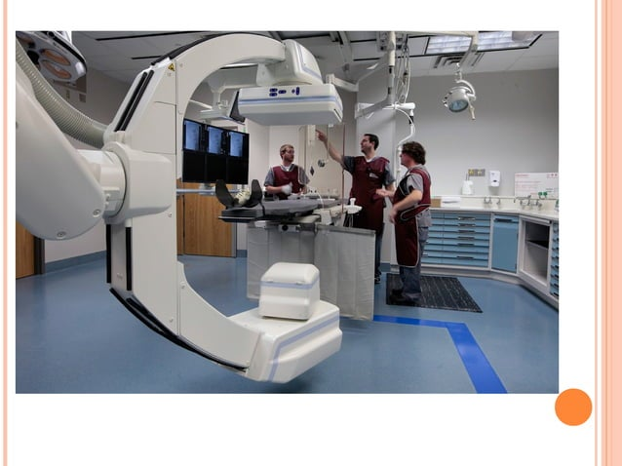

Slide 27
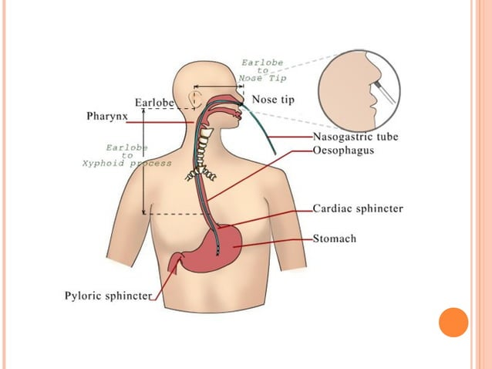

Slide 36
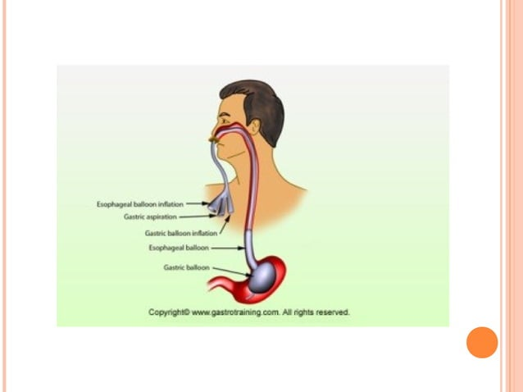

Slide 37
TREATMENT FOR VARICEAL BLEED

Slide 38
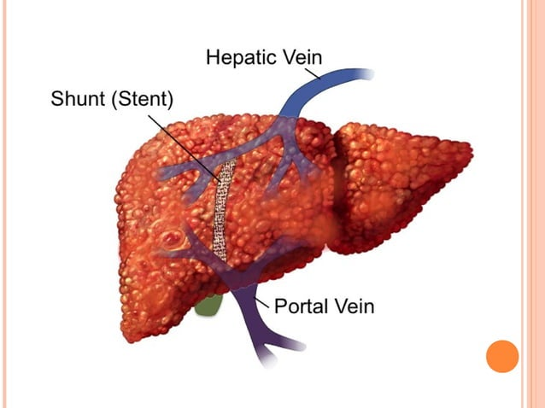

Slide 39
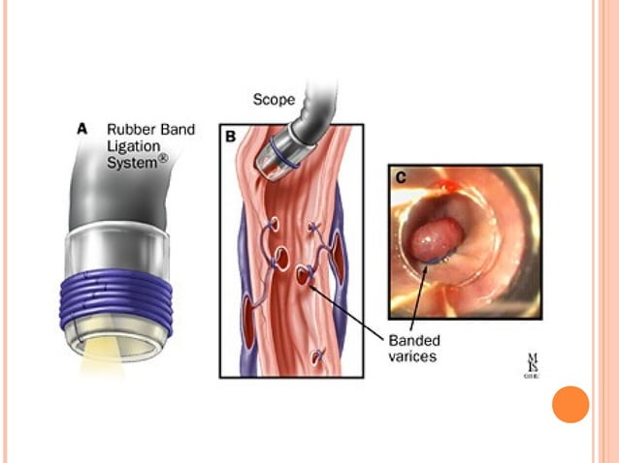

Slide 40
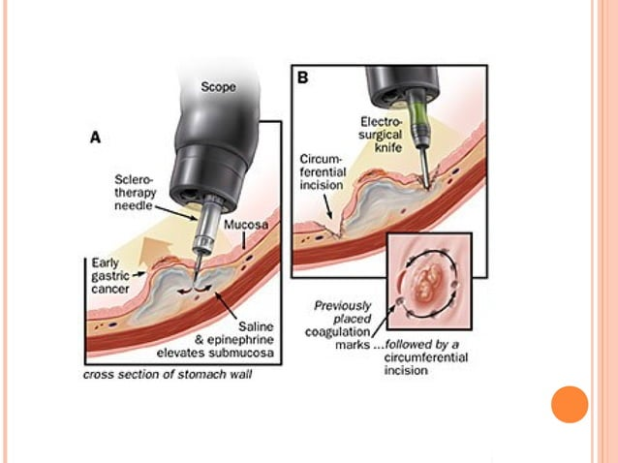

Slide 41
TREATMENT FOR NONVARICEAL BLEED

Slide 42
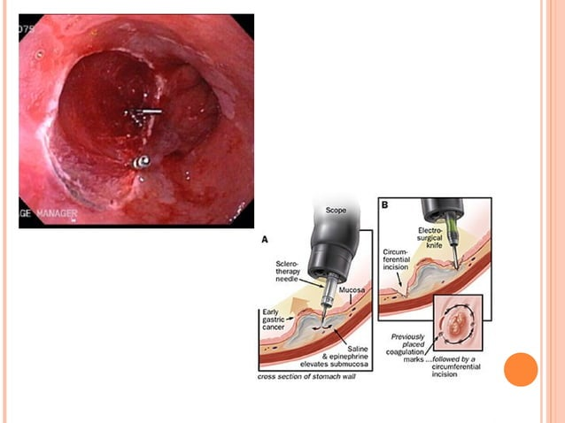

Slide 43
INDICATIONS FOR SURGERY

Slide 45
COMPLICATIONS

