Slide 2
PLEURAL EFFUSION & EMPYMA
DR ABRAR AKBAR
ASSISTANT PROF
MICU/HFH

Slide 3
UNIVERSITY MOTTO, VISION, VALUES & GOALS
MISSION STATEMENT
To impart evidence-based research-oriented health professional education
Best possible patient care
Mutual respect, ethical practice of healthcare and social accountability.
VISION AND VALUES
Highly recognized and accredited centre of excellence in Medical Education, Using evidence-based training techniques for development of highly Competent health professionals, who are lifelong experiential learner and are Socially accountable.

Slide 4
GOALS
The Undergraduate Integrated Learning Program is geared
to Provide you with quality medical education.
Provide thorough grounding in the basic theoretical
concepts underpinning the practice of medicine.
Develop and polish the skills required for providing medical
services at all levels of the Health care delivery system.
Help you attain and maintain the highest possible levels of
ethical and professional conduct in your future life.
Kindle a spirit of inquiry and acquisition of knowledge to help
you attain personal and professional growth & excellence.

Slide 5
SEQUENCE OF LGIS
Learning objectives
Definition
Integration with pathophysiology
Types of Pleural Effusion
Related Clinical Features
Complications
Investigations
Management
Research articles related to topic
Ethics

Slide 6
LEARNING OBJECTIVES
AT THE END OF THIS LECTURE STUDENTS SHALL BE ABLE TO LEARN:
Definition and causes Pleural Effusion
Classification of Pleural Effusion
Pathophysiology of Pleural Effusion
Signs and symptoms of Pleural Effusion
Investigations
Medical and Surgical management
Recent advances
Ethics

Slide 8
SCENARIO
A 40 year old laborer living in joint family presents with history of cough for 5 days with high grade fever.
He only took paracetamol for fever with no improvement.
Now he has developed Shortness of breath with chest pain increased on deep breathing.
His labs show TLC of 15,000 and positive CRP.
His Physician advised Chest X-ray which is as follows.

Slide 9
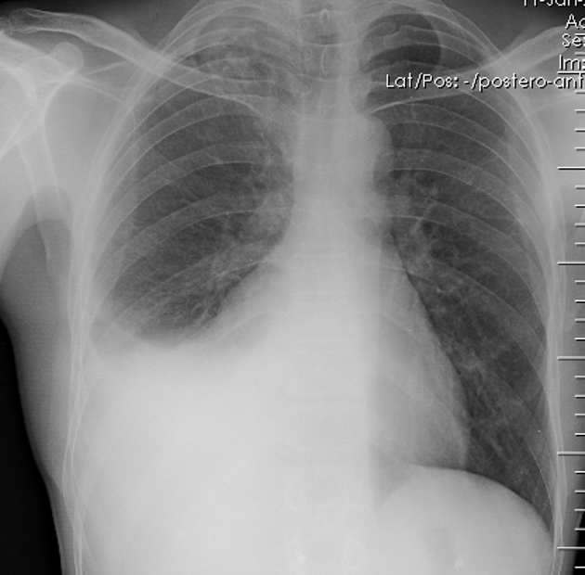
Right Side homogeneous opacity with blunting of cardiophrenic and costophrenic angle
DIAGNOSIS:
Right sided Pleural Effusion

Slide 10
Symptoms of Pleural effusion
Chest pain.
Dry, nonproductive cough.
Dyspnea (shortness of breath, or difficult, labored breathing)
Orthopnea (the inability to breathe easily unless the person is sitting up straight or standing erect)

Slide 11
Signs of Pleural effusion
Physical examination reveals
Absent tactile fremitus
Dullness to percussion
Decreased breath sounds on the side of the effusion
Pleural friction rub

Slide 12
INVESTIGATIONS
Chest x-ray
Pleural fluid analysis and PH
Sometimes CT angiography
Sputum C/S

Slide 13
PATHOGENESIS

Slide 14
In the normal pleural space, there is a steady state in which there is a roughly equal rate of the formation (entry) and absorption (exit) of liquid. This balance must be disturbed in order to produce a pleural effusion. Thus, there must be an increase in entry rate and/or a reduction in exit rate.

Slide 15
Mechanisms of fluid accumulation
1) Increased fluid entry
2) Decreased exit of fluid

Slide 16
Mechanism of increased fluid entry
Increase in permeability
due to infection
2. Increase in microvascular pressure
Elevations in either systemic venous pressure (affecting the parietal pleura) or pulmonary venous pressure (affecting the visceral pleura) can lead to an increase in pleural liquid formation
3. Decrease In pleural pressure
seen with significant atelectasis
4. Decrease in plasma osmotic pressure
Hypoproteinemia (due to hypoalbuminemia) will decrease the plasma oncotic pressure

Slide 17
Mechanism of decreased fluid exit
A decrease in exit rate reflects a reduction in lymphatic function.
Intrinsic factors
A number of factors can interfere with or inhibit the ability of lymphatics to contract, including:
Cytokines and products of inflammation (eg, endotoxins)
Endocrine abnormalities (eg, hypothyroidism)
Injury due to radiation or drugs (eg, chemotherapeutic agents)
Infiltration of lymphatics by cancer
Anatomic abnormalities (eg, yellow nail syndrome)

Slide 18
Mechanism of decreased fluid exit
Extrinsic factors
Multiple extrinsic factors can inhibit lymphatic function although the lymphatics themselves are normal. These include:
Limitation of respiratory motion (eg, diaphragm paralysis, lung collapse, pneumothorax)
Extrinsic compression of lymphatics (eg, pleural fibrosis, pleural granulomas)
Blockage of lymphatic stomata (eg, fibrin deposition on pleural surface, pleural malignancy)
Decreased intrapleural pressure (eg, trapped lung caused by a fibrous rind on the visceral pleura)
Increased systemic venous pressure - Acutely, increases in venous pressure may decrease lymphatic flow because of the higher downstream pressures; chronically, the lymphatics may be able to adapt.
Decreased liquid availability - After pneumothorax, for example, liquid will be in contact with fewer lymphatic stomata and may accumulate in the pleural space.

Slide 19
CAUSE OF PLERAL EFFUSION
Determining the cause of a pleural effusion is greatly facilitated by analysis of the pleural fluid. Thoracentesis is a simple bedside procedure that permits fluid to be rapidly sampled, visualized, examined microscopically, and quantified.

Slide 20
TYPES OF PLEURAL EFFUSION
Gross appearance — Initial diagnostic clues can be obtained by gross inspection of pleural fluid as it is being aspirated from the patient's chest .
Characterization — The pleural fluid is next characterized as either a transudate or an exudatative.

Slide 21
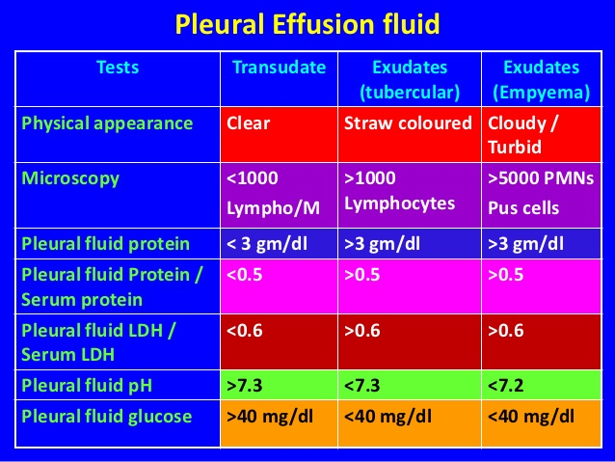

Slide 22
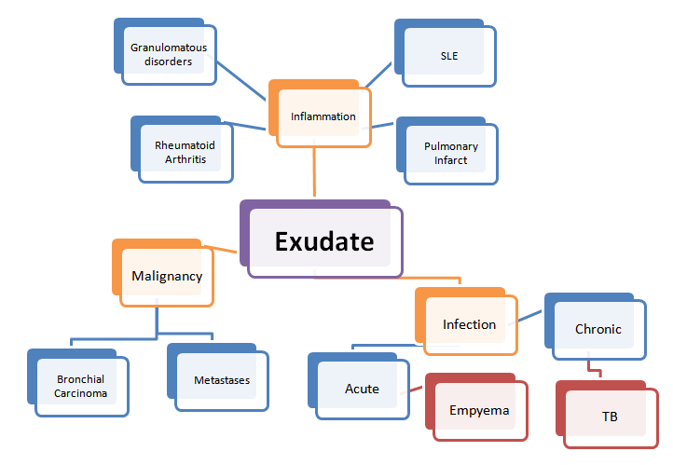

Slide 23
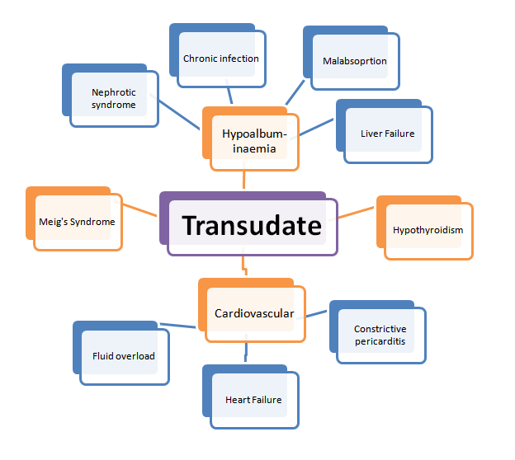

Slide 24
PLEURAL EFFUSION STAGES
UNCOMPLICATED (exudative/neutrophilic )
COMPLICATED ( persistent bacterial invasion/ LDH >1000)
EMPYEMA (+ve Gram stain and/or the aspiration of pus)

Slide 25
TREATMENT
According to Cause
For infective Exudative : antibiotics
For inflammatory Exudative: Treat underlying disorder
For Transudative : treat cause
Consider Diuretics and albumin where indicated

Slide 26
EMPYEMA
Sterilization of the empyema cavity with appropriate systemic antibiotics; at least 4 to 6 weeks of therapy are required, and a longer course may be necessary unless there is prompt resolution of fever and leukocytosis.
Complete pleural fluid drainage, as evidenced by minimal chest tube output and CT documentation that no residual loculations persist.
Obliteration of the empyema cavity by adequate lung expansion.

Slide 27
RESEARCH
Beaudoin S, Gonzalez AV. Evaluation of the patient with pleural effusion. Cmaj. 2018 Mar 12;190(10):E291-5.

Slide 28
ETHICS
Before doing any medical or surgical treatment, informed consent must be taken
Prognosis should be explained to patients
and attendants

Slide 29
THANKYOU

