Slide 2
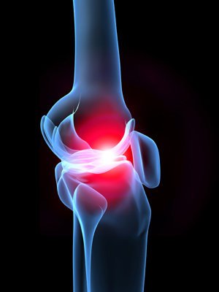
RHEUMATOLOGY

Slide 3
Motto Vision
To impart evidence based research oriented medical education
To provide best possible patient care
To inculcate the values of mutual respect and ethical practice of medicine
Wisdom
Truth
Service

Slide 4
Professor Umar Model of Integrated Lecture
60%
CORE SUBJECT
20%
HORIZONTAL
INTEGRATION
Physiology
biochemistry
8%
VERTICAL INTEGRATION
Pathology
pharmacology
7%
VERTICAL INTEGRATION
Clinical integration
5%
VERTICAL INTEGRATION
Research, professionalism
Ethics
Digital library

Slide 5
RHEUMATOLOGY LECTURE:1

Slide 6
“Overview of Rheumatological Disorders”
Dr Shamaila Mumtaz
FCPS (Medicine), FCPS (Rheumatology)
Rheumatologist, Rawalpindi Medical University

Slide 7
Learning Objectives
At the end of this session students will be able to learn:
How to diagnose rheumatological disorders on the basis of history and examination
Rheumatological Investigations
Guidelines and recent advances

Slide 8
Rheumatological Diseases
Joint Diseases (Arthritis)
Soft tissue Rheumatism
Systemic Diseases (Auto-immune/Vasculitis)
Bone Disorders

Slide 9
Core Concept

Slide 10
History
Is it Arthralgia or Arthritis ?

Slide 11
History
Pain
Swelling
Stiffness

Slide 12
History
Is it Monoarthritis/Oligoarthritis/Polyarthritis ?

Slide 13
History
Is it Mechanical or Inflammatory pain ?

Slide 14
Examination
Look (swelling, redness, deformity)
Feel (painful, fluid )
Move (restricted range of motion)

Slide 15
Examination

Slide 16
Examination

Slide 17
Examination

Slide 18
Systemic Examination
RA (ILD, amyloidosis, felty’s syndrome, mononeuritis)
SPA (uveitis, psoriasis)
SLE (multi-system)

Slide 19
Investigations
Imaging modalities (x-rays, MRI, MSUS)
Synovial fluid analysis
Serological tests

Slide 20
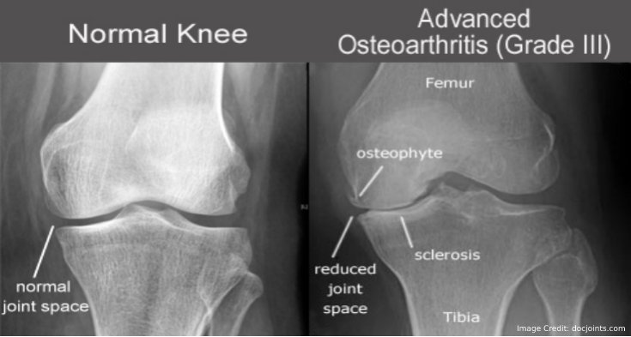
Radiographs

Slide 21
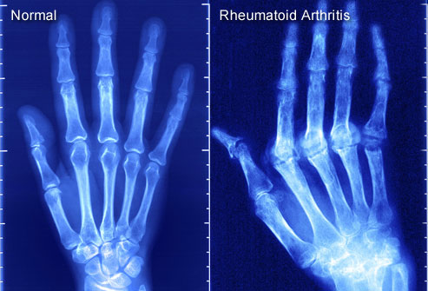
Radiographs

Slide 22
Radiographs

Slide 23
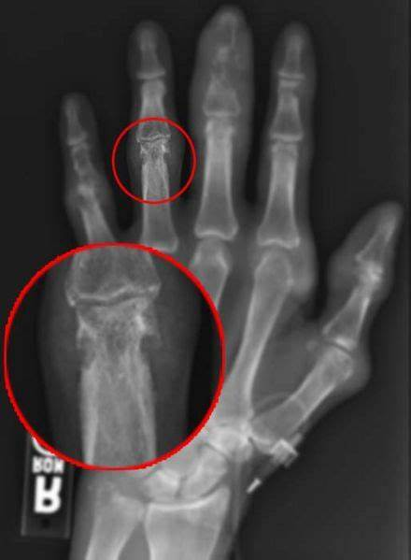
Radiographs

Slide 24
MRI
Assessment of inflammatory lesions of joints(synovial thickening, effusion, cartilage)
Assessment of bone lesions (bone edema, erosions)

Slide 25
MSUS
Diagnostic and monitoring tool

Slide 26
MSUS

Slide 27
Investigations
Synovial Fluid Analysis

Slide 28
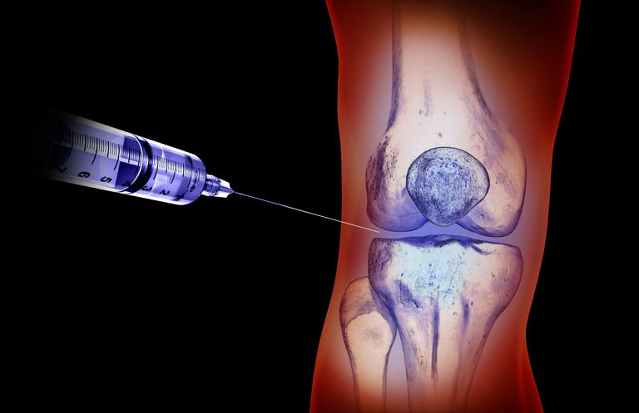
Investigations

Slide 29
Investigations

Slide 30
Synovial Fluid Analysis

Slide 31
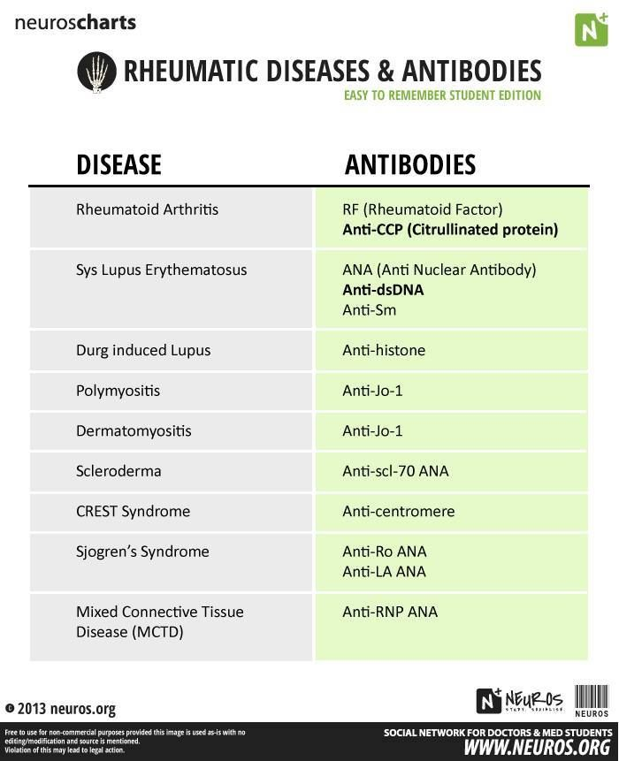
Serological Tests

Slide 32
Serological Tests

Slide 33
Take home message
Focussed history and examination
Appropriate use of investigations
help in establishing diagnosis of “rheumatological disorders”

