Slide 1
OSTEOPOROSIS
Dr Saad Riaz

Slide 3
LEARNING OBJECTIVES
▶Describe osteoporosis
▶Describe pathophysiology of postmenopausal and
senile osteoporosis
▶Outline morphological features of osteoporosis
▶Enumerate lab tests for diagnosis

Slide 4
OSTEOPOROSIS
Osteo – bone, Porosis- porous
▶Osteoporosis is reduced bone density, which causes a micro architectural deterioration of bone tissue and leads to an increase risk of fracture
▶Prevalence of osteoporosis increases with the age

Slide 5
OSTEOPOROSIS
DISEASES ASSOCIATED WITH DECREASED BONE MASS
“PEAK” bone mass is early adulthood
Normal decline, slow
Osteoporosis is accelerated bone loss
At least 2.5 standard deviation below peak bone mass
Age related bone loss is 0.7%/year

Slide 6
Osteoporosis is a disease characterized by porous bones and a reduced bone mass.
Localized (disuse osteoporosis)
Generalized osteoporosis
– primary or secondary

Slide 7
Categories of Generalized Osteoporosis
PRIMARY
Postmenopausal
Senile
Idiopathic
SECONDARY
Endocrine
Neoplasia
Gastrointestinal
Drugs
Miscellaneous

Slide 8
PATHOPHYSIOLOGY

Slide 9
Pathogenesis.
Age-related changes in bone cells and matrix
Reduced physical activity
Genetic factors are also important
The body's calcium nutritional state is important
Hormonal influences.

Slide 10
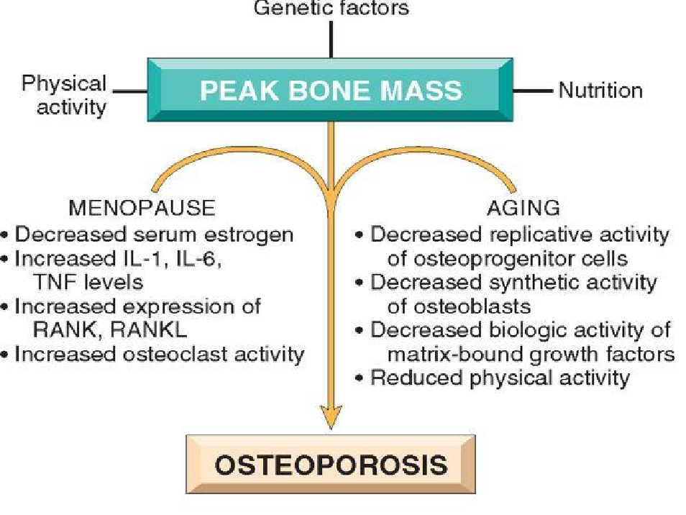

Slide 12
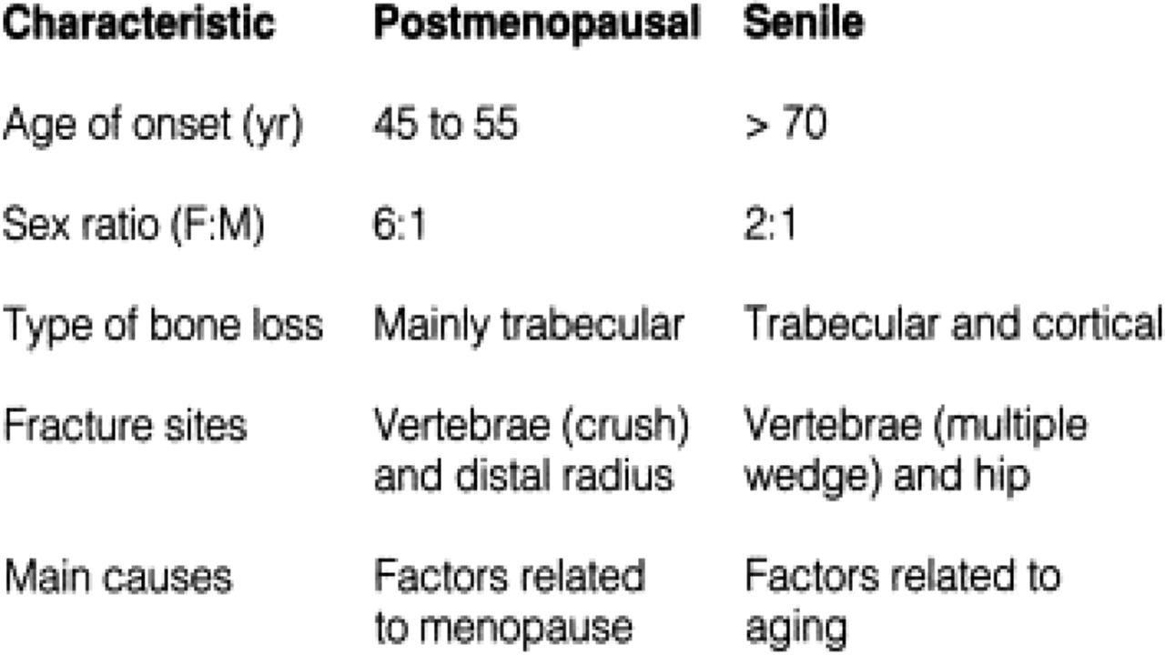

Slide 13
MORPHOLOGY (OSTEOPOROSIS)
▶Thinning of individual trabeculae
▶Loss of normal trabecular network
▶Mineralisation is normal

Slide 14
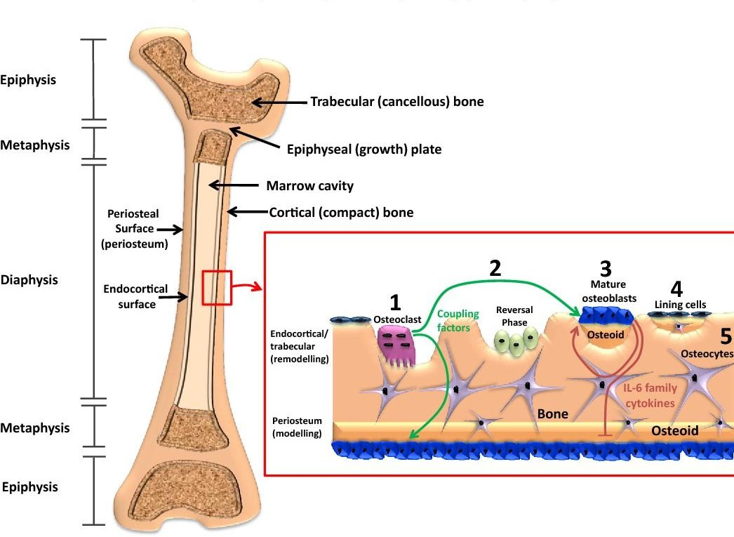

Slide 16
Morphology
In postmenopausal
mainly bones or portions of bones with increased surface area
cancellous compartment of vertebral bodies. The trabecular plates become perforated, thinned, and lose their interconnections, leading to progressive microfractures and eventual vertebral collapse.
In senile osteoporosis
the cortex is thinned by subperiosteal and endosteal resorption, and the haversian systems are widened

Slide 17
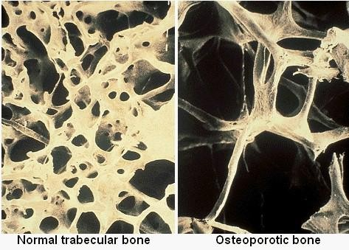

Slide 18
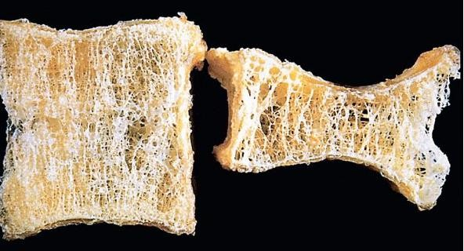
Osteoporotic vertebral body (right) shortened by compression fractures compared with a normal vertebral body. Note that the osteoporotic vertebra has a characteristic loss of horizontal trabeculae and thickened vertical trabeculae.

Slide 19
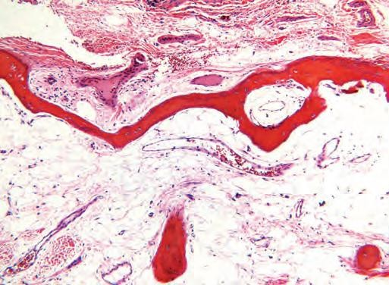
In advanced osteoporosis, both the trabecular bone of the medulla (bottom) and the cortical bone (top) are markedly thinned.

Slide 20
Clinical Manifestations
depend on which bones are involved.
Vertebral fractures
Thoracic and lumbar regions are painful, and when multiple can cause significant loss of height
various deformities
lumbar lordosis and kyphoscoliosis.
Complications of fractures
pulmonary embolism and pneumonia

Slide 21
Difference b/w osteoporosis and diseases associated with abnormal mineral homeostasis

Slide 22
DIFFERENCES
OSTEOPOROSIS
OSTEOMALACIA
RICKETS
Gender
Female >male
Female > male
Male ,female equally affected
Age group
Adult
Adult
Children
Pathogenesis
Deficient matrix Normal mineralization
Normal matrix Normal matrix
Deficient mineralization of defective mineralization of
new osteoid bone
bone and cartilage of epiphyseal growth plate
C/F
Pain after fracture Muscle normal
Generalized chronic ache Muscle weakness
Skeletal deformities
Pathological fractures common
Pathological fractures common
Micro fractures unusual

Slide 23
DIFFERENCES | OSTEOPOROSIS | OSTEOMALACIA | RICKETS
Serum Ca | Normal to low | low | low
Serum PO4 | Normal to low | low | low
ALP | Raised (post fracture) | Raised | Raised
Vit D
Normal to low (secondaryLow /Normal causes)
Normal to raised Raised
Low /Normal
Parathyroid hormone
Raised
X ray findings
Reduce bone density
Osteopenia Loosers zone or Pseudo fractures
Cupping and brush like appearance of epiphyse end
Widening of growth plat

Slide 24
LAB TEST FOR DIAGNOSIS OF OSTEOPOROSIS
▶Serum calcium level
▶Vitamin D level
▶PTH (parathyroid hormone level)
▶Liver function tests
▶Renal function tests
▶Thyroid function tests

Slide 25
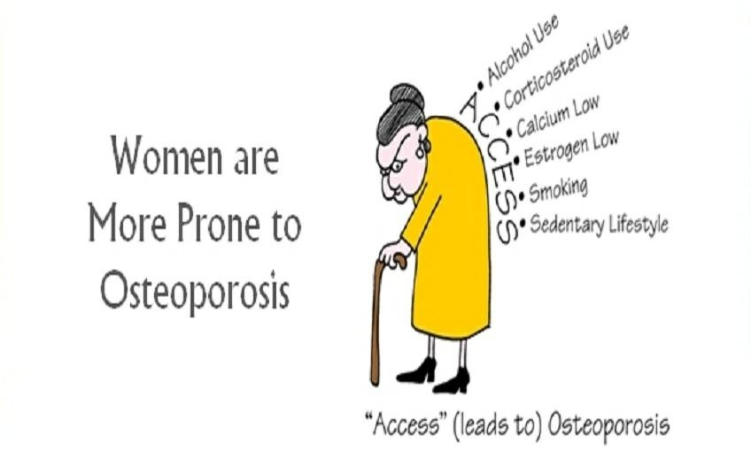
Summary (causes of osteoporosis)

Slide 26
