Slide 3
Motto Vision
To impart evidence based research oriented medical education
To provide best possible patient care
To inculcate the values of mutual respect and ethical practice of medicine
Wisdom
Truth
Service

Slide 4
Professor Umar Model of Integrated Lecture
60%
CORE SUBJECT
20%
HORIZONTAL
INTEGRATION
Physiology
biochemistry
8%
VERTICAL INTEGRATION
Pathology
pharmacology
7%
VERTICAL INTEGRATION
Clinical integration
5%
VERTICAL INTEGRATION
Research, professionalism
Ethics
Digital library

Slide 5
RHEUMATOLOGY LECTURE:2

Slide 6
“Osteoarthritis”
Dr Shamaila Mumtaz
FCPS (Medicine), FCPS (Rheumatology)
Rheumatologist, Rawalpindi Medical University

Slide 7
Learning Objectives
At the end of this session students will be able to learn:
How to diagnose “osteoarthritis” on the basis of history and examination
Relevant Investigations
Guidelines and recent advances

Slide 8
Rheumatological Diseases
Joint Diseases (Arthritis)
Soft tissue Rheumatism
Systemic Diseases (Auto-immune/Vasculitis)
Bone Disorders

Slide 9
Core Concept

Slide 10
Arthritis
Mechanical (Osteoarthritis)
Inflammatory (RA, SPA)
Infective (Septic, Tuberculous)
Crystal arthropathy (Gout)

Slide 11
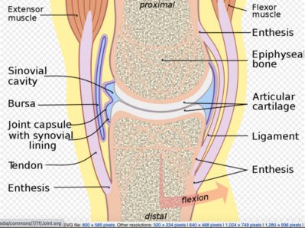
Protective mechanism of synovial joints

Slide 13
Osteoarthritis-definition
“Deterioration of articular cartilage resulting in bones rubbing together and creating pain, stiffness and impaired movement”

Slide 14
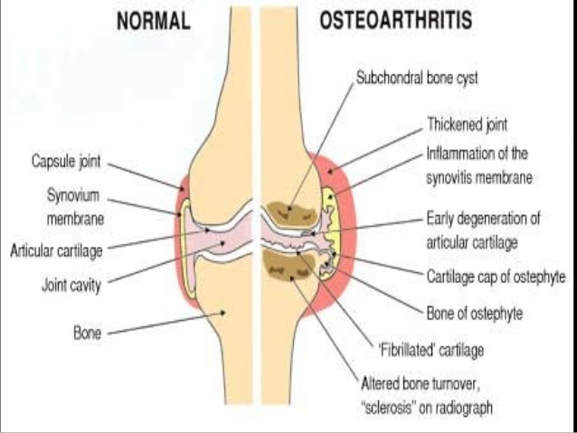
Anatomy & Physiology (Horizontal Integration)

Slide 15
Epidemiology
Symptomatic Osteoarthritis
(9% men, 18% women – above 60 years of age)
Aging Population

Slide 16
Risk Factors
Age & Gender
Obesity
Traumatic injury
Genetic predisposition (cartilage morphogenesis)
Occupation (competitive sports)

Slide 17
Clinical Presentation
Pain
Crepitus
Restricted motion
Deformities

Slide 18
Types of Osteoarthritis
Primary
(idiopathic)
Secondary
(congenital factors, trauma, other types of arthritis, endocrine and metabolic disorders)

Slide 19
Joint Involvement
Primary OA
(Knee, Hip, Hands (CMC, Nodal OA)
Secondary OA
(Atypical – shoulder, wrist)

Slide 20
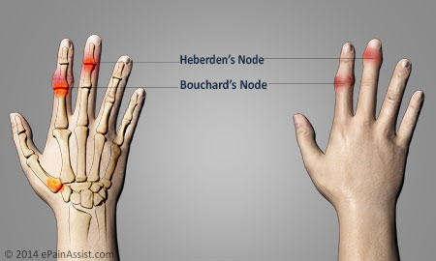
Osteoarthritis

Slide 21
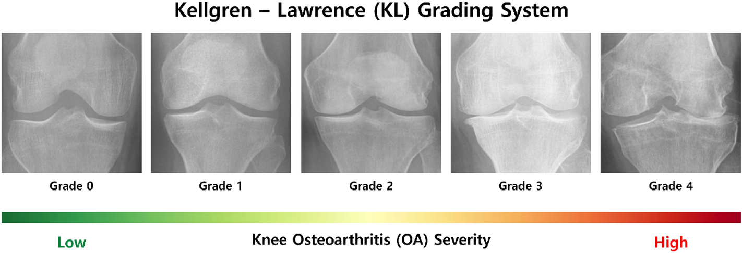
Grades of Osteoarthritis

Slide 22
Complications of Osteoarthritis
Chondrolysis
Stress fractures
Pinched nerve

Slide 23
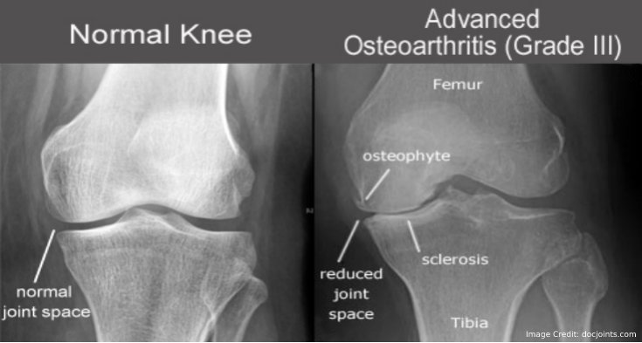
Diagnosis

Slide 24
Management
Non-pharmacological
Pharmacological

Slide 25
Non-pharmacological
Life style modifications
Weight reduction
Assistive devices
Knee braces, shoe insoles
Physiotherapy

Slide 26
Pharmacological
Pain relief
Acetaminophen
NSAIDs (topical, oral)
Opioids (weaker)

Slide 27
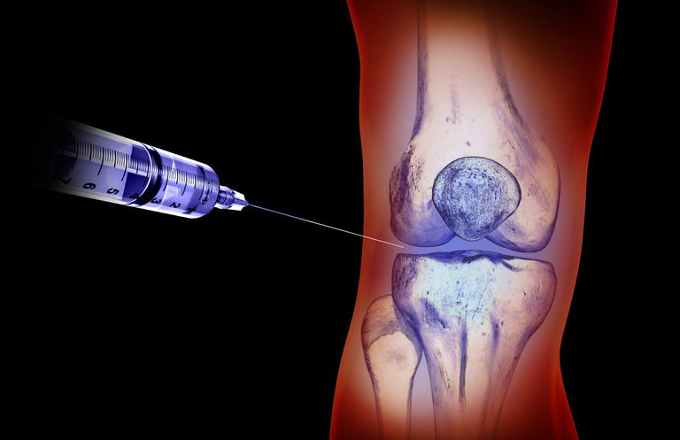
Intra-Articular Injections

Slide 28
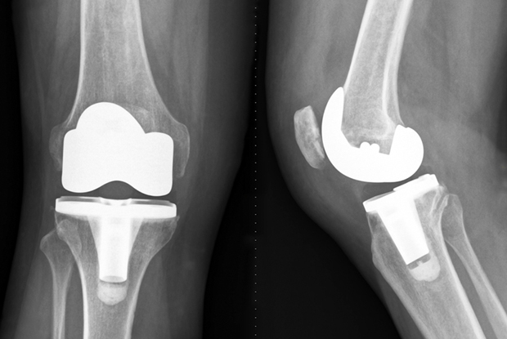
Joint Replacement Surgery

Slide 29
Take home message
Osteoarthritis is the most common reason for joint pain
OA commonly affects aging population. Always look for secondary causes in a young patient with OA.

