Slide 1
1

Slide 2
SEQUENCE OF LECTURE
Anatomy of orbit (Vertical Integration )
Proptosis, orbital cellulitis and IOID (Core Subject)
Digital Library Reference/ Longitudinal Integration (research and artificial intelligence)
End of Lecture Assessment
Bioethics
Source

Slide 3
Learning Objectives
3
By the end of this session you should be able to:
Outline Anatomy Of Orbit
Define and classify Proptosis
Enumerate causes of proptosis
Describe Orbital Cellulitis And summarze its treatment protocol
Explain Idiopathic Orbital Inflammatory Disease
Explain Cavernous Sinus Thrombosis

Slide 4
ANATOMY
VERTICAL INTEGRATION

Slide 5
5

Slide 6
Orbital walls
VERTICAL INTEGRATION
6

Slide 7
Orbital Rim
VERTICAL INTEGRATION
7

Slide 8
Orbital apex
VERTICAL INTEGRATION
8

Slide 9
VERTICAL INTEGRATION
9

Slide 10
Orbital contents
VERTICAL INTEGRATION
10

Slide 11
Orbital Pathologies
CORE SUBJECT
Clinical Features
11

Slide 12
Symptoms of orbital diseases
CORE SUBJECT
Eyelid/ conjunctival redness, swelling
Pain
Abnormal eye appearance
Diplopia
Blurry vision
12

Slide 13
Signs of orbital disease
CORE SUBJECT
Soft tissue signs
Proptosis
Enophthalmos
Ophthalmoplegia
Optic disc edema
13

Slide 14
1. Soft tissue involvement
CORE SUBJECT
14

Slide 15
2. Proptosis
CORE SUBJECT
Forwards displacement of the eyeball beyond orbital margins
Proptosis of>21mm or >2mm asymmetry between eyeballs is abnormal
15

Slide 16
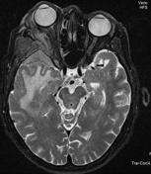
CORE SUBJECT
16

Slide 17
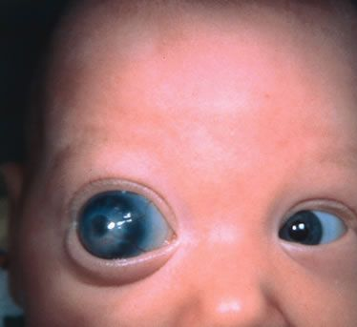
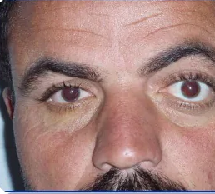
Psuedoproptopsis
CORE SUBJECT
False impression of protosis
Buphthalmos
High myopia
Lid retraction
C/L enophthalmos
17

Slide 18
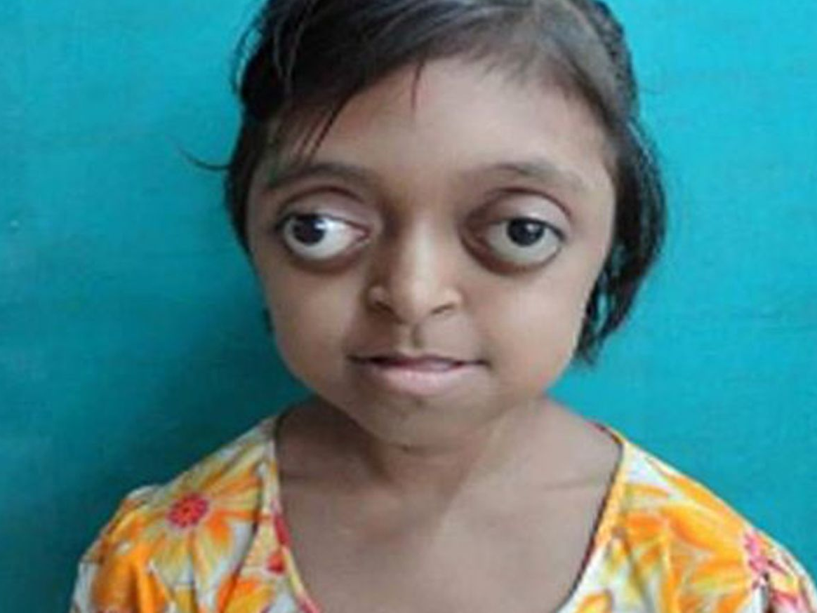
Exorbitism
CORE SUBJECT
Shallow orbits
18

Slide 19
Classification of Proptosis
CORE SUBJECT
19

Slide 20
1. Axial proptosis
CORE SUBJECT
Forward displacement of eyeball along orbital axis
Thyroid disease
Any mass in central/ intraconal space
Optic nerve glioma
20

Slide 21
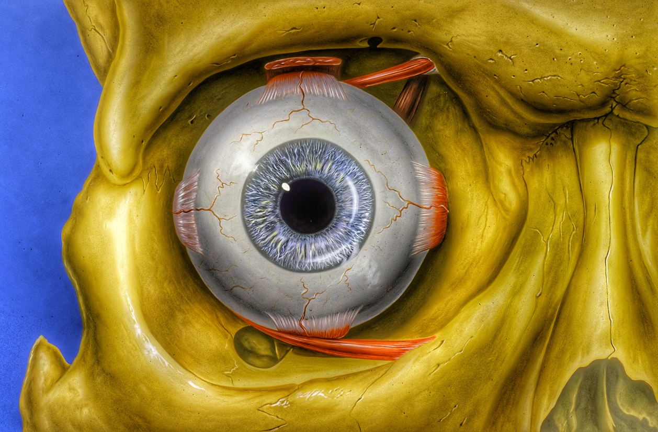
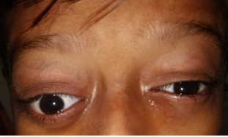
2. Non axial proptosis
CORE SUBJECT
21

Slide 22
Causes of proptosis:
CORE SUBJECT
22

Slide 23
CORE SUBJECT
23

Slide 24
3. Enophthalmos
CORE SUBJECT
Recession of globe within orbit
Traumatic / congenital orbital wall abnormality
Sclerosing orbital tumors
Orbital fat atrophy
24

Slide 25
4. Defective ocular motility
CORE SUBJECT
Restrictive vs paralytic ocular motility defect
25

Slide 26
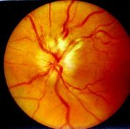
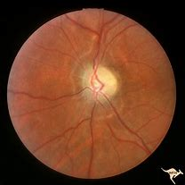
5. Optic disc edema
CORE SUBJECT
Compressive optic neuropathy
26

Slide 27
Investigations
CORE SUBJECT
CT/ MRI
Plain X rays
Ultrasonography
biopsy
27

Slide 28
Orbital infectious/ inflammatory disorders
CORE SUBJECT
28

Slide 29
Orbital Septum
CORE SUBJECT
29

Slide 30
1. Preseptal cellulitis
CORE SUBJECT
Infection of subcutaneous tissue anterior to orbital septum
Etiology– staph aureus, strept pyogenes
C/F
Painful, swollen, erythematous eyelids
No Proptosis
Investigations not required
Treatment
oral/systemic antibiotic
analgesics
30

Slide 31
CORE SUBJECT
31

Slide 32
2. Orbital cellulitis
CORE SUBJECT
Acute infection of orbital tissues posterior to orbital septum
Etiology– strep pneumoniae, staph aureus, strep pyogenes and H. influenzae
32

Slide 33
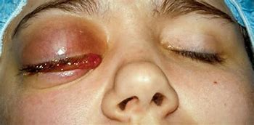
CORE SUBJECT
Symptoms
Systemic
Fever, General discomfort
Ocular
Pain, Swelling, Redness
Decreased vision
Decreased ability to move eye
Signs
Fever
Painful swollen lids
Proptosis
Limited & painful movements
Optic nerve dysfunction
33

Slide 34
Signs:
Swollen eyelids
Conjunctival chemosis
Proptosis
Painful eye movements
Ophthalmoplegia
Optic nerve involvement

Slide 35
Investigations
CORE SUBJECT
Raised TLC, CRP & ESR
CT scan orbit, PNS
35

Slide 36
Treatment
CORE SUBJECT
Inpatient
Antibiotics : IV or Oral
Analgesics : IV or Oral
Drainage of abscess
36

Slide 37
Complications
CORE SUBJECT
37

Slide 38
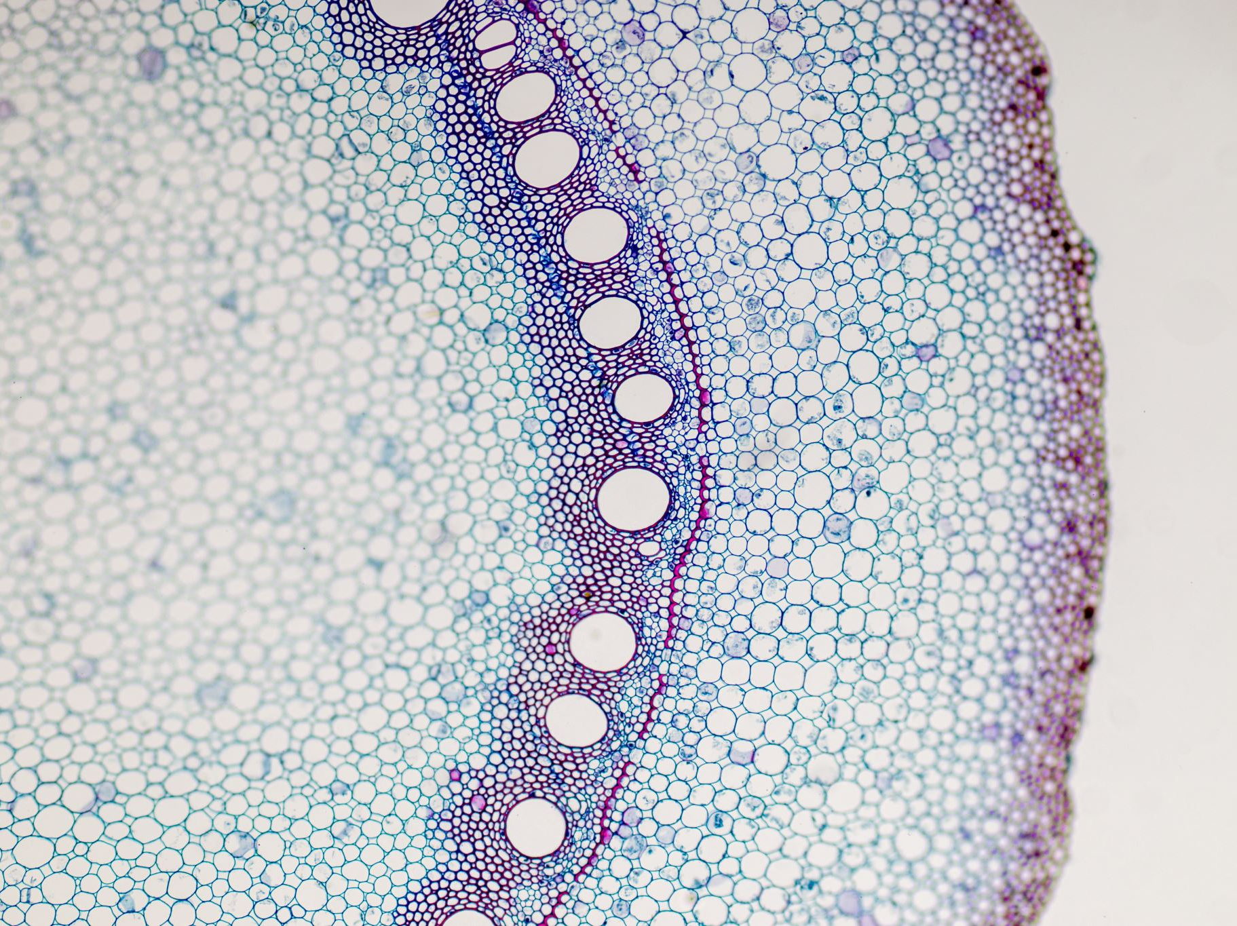
Difference b/w Preseptal & Orbital Cellulitis
CORE SUBJECT
38

Slide 39
CORE SUBJECT
39

Slide 40
IDIOPATHIC ORBITAL INFLAMMATORY DISEASE
CORE SUBJECT
Subacute
Pain, swelling, redness, Proptosis
Usually afebrile
CBC normal, raised CRP/ESR
MRI: diffuse enlargement of EOM
Systemic steroids; mainstay of treatment
40

Slide 41
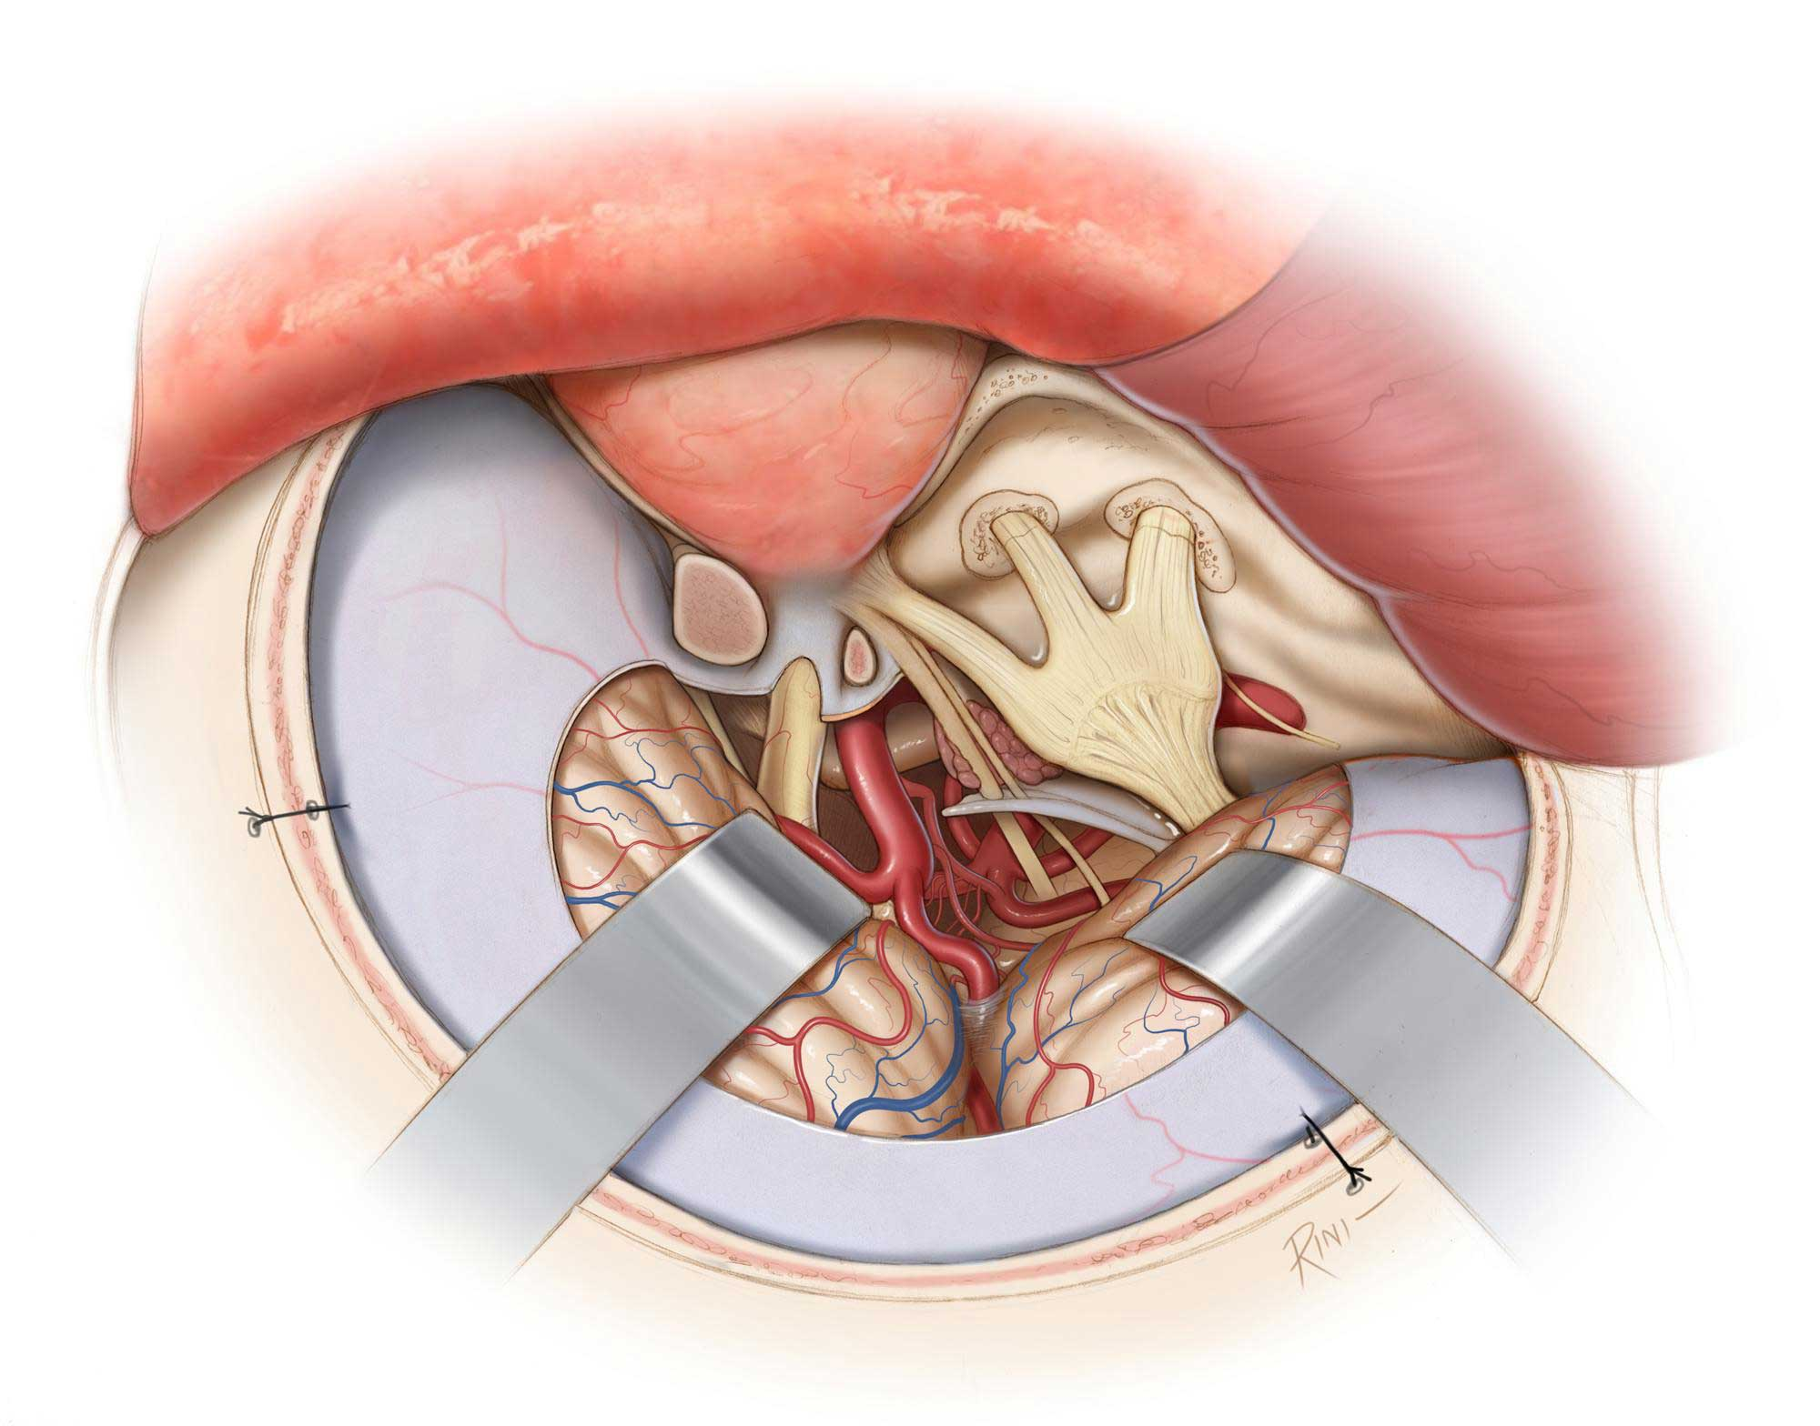
Cavernous Sinus Thrombosis
CORE SUBJECT
41

Slide 42
CAVERNOUS SINUS THROMBOSIS
CORE SUBJECT
Clotting in cavernous sinus
Usually resulting from infections:
Sinusitis
Otitis
Preseptal Cellulitis
Orbital cellulitis
High mortality rate
42

Slide 43
CORE SUBJECT
Symptoms
Rapid onset
severe headache
Malaise
Nausea
Vomiting
Often bilateral proptosis
Reduced vision.
signsgns
Fever
Painful swollen lids
Proptosis
Chemosis
congestion of facial,
conjunctival and retinal veins
Compromised function of 3rd to 6th cranial nerves.
43

Slide 44
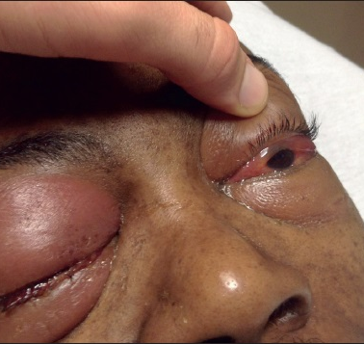
CORE SUBJECT
Diagnosis:
MRI & MRI venography
Lumbar puncture
CBC, ESR, CRP
Treatment:
IV antibiotics
Surgical drainage (sometimes)
44

Slide 45
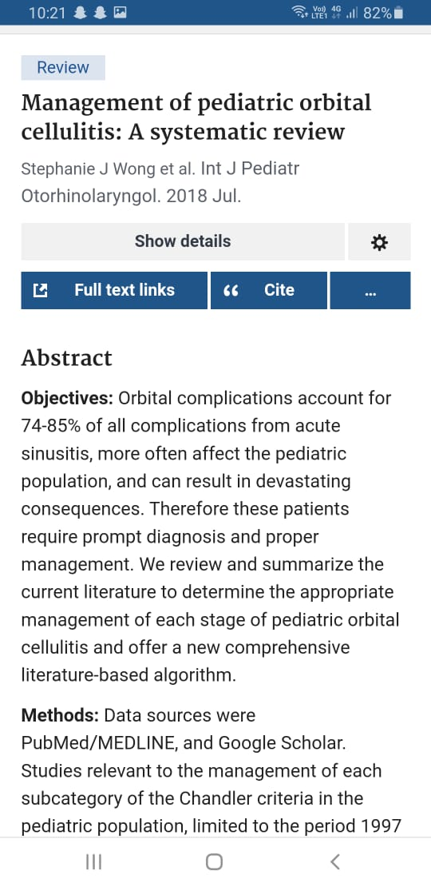
RESEARCH AND ARTIFICIAL INTELLIGENCE
LONGITUDINAL INTEGRATION
RESEARCH:
https://pubmed.ncbi.nlm.nih.gov/29859573/

Slide 46
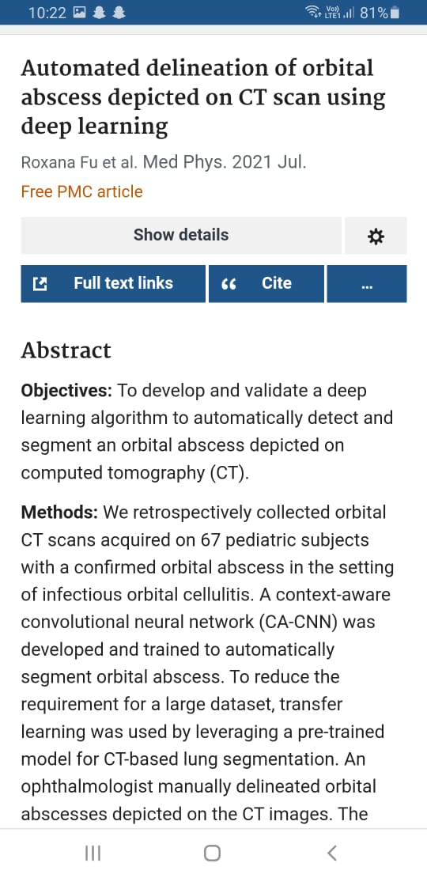
AI:
https://pubmed.ncbi.nlm.nih.gov/33906264/

Slide 47
SCENARIO:
A 3.5 years old baby presented with fever for 2 days associated with right eye swelling for one day duration. Parents gave hx of cough for past 20 days. Patient was toxic, febrile and photophobic with obvious swelling of orbital and peri orbital area.
Which investigation would you like to request?
What is the treatment of this condition?

Slide 48
SOURCE:
KANSKI
AMERICAN ACADEMY OF OPHTHALMOLOGY

Slide 49
49

Slide 50
50

