Slide 2
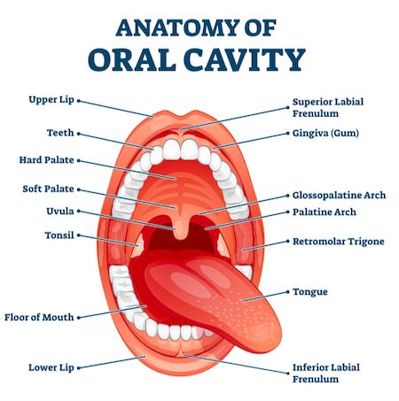
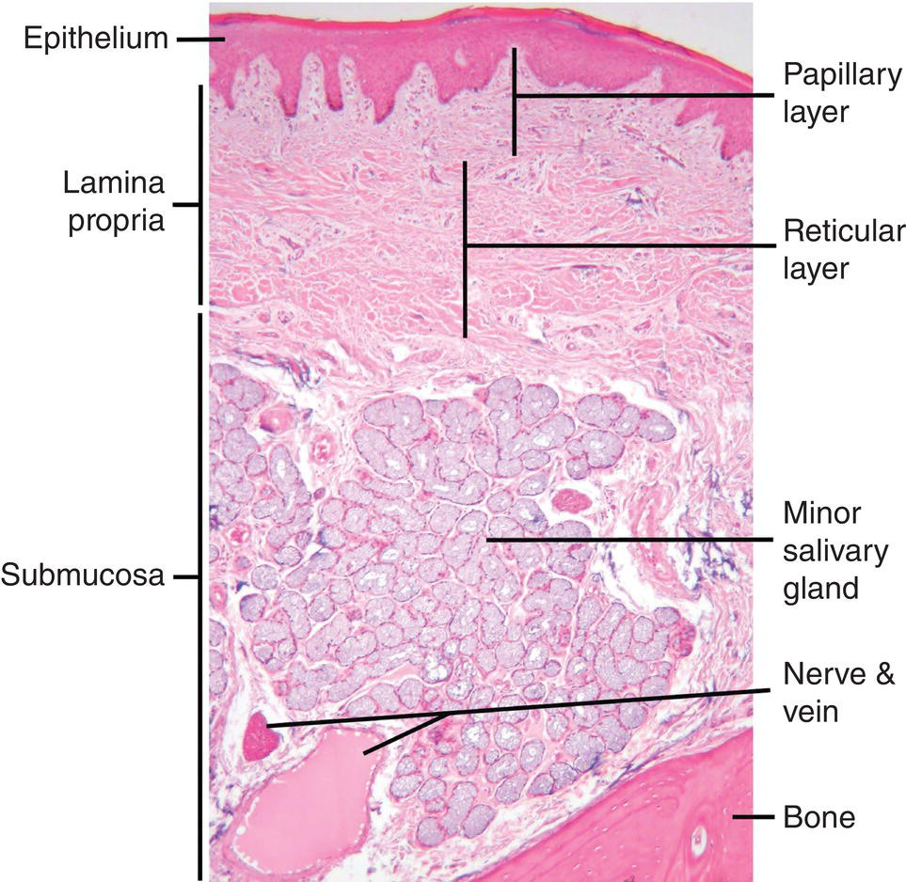
Oral Cavity & Salivary Gland Pathology
GASTROINTESTINAL HEPATOBILIARY & PARASITOLOGY II Module
3rd year MBBS
Dr. Mudassira Zahid
Associate Professor
Department of Pathology
Rawalpindi Medical University

Slide 4
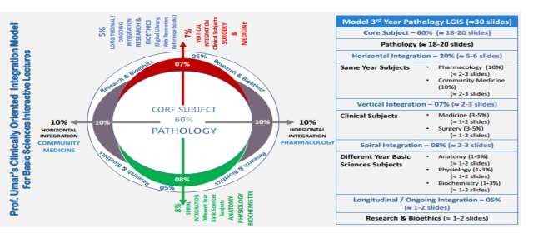

Slide 5
Learning Objectives
Describe Causes and Pathological Features of Inflammatory/Reactive Lesions of the Oral Cavity (C2)
Explain Oral Manifestations of Systemic Disease with Examples (C2)
Explain Causes and Pathogenesis of Precancerous and Cancerous Lesions (C2)
Discuss Epidemiology, Pathogenesis, and Morphology of Squamous Cell Carcinoma (C2)
Classify Salivary Gland Non-Neoplastic Lesions (C3)
Discuss Xerostomia and Sialadenitis (C2)
Learning Resources: Robbins & Cotran Pathologic Basis Of Disease 10th Edition

Slide 6
Anatomy Of Oral Cavity
SPIRAL INTEGRATION

Slide 7
Oral Lesions
CORE PATHOLOGY
1. Inflammatory Oral Lesions:
Aphthous Ulcer
Herpes Simplex Virus Infections
Oral Candidiasis
2. Proliferative Oral Lesions:
Fibroma
Pyogenic Granuloma
Leukoplakia
Erythroplakia
3. Neoplastic Oral Lesions:
Squamous Cell Carcinoma

Slide 8
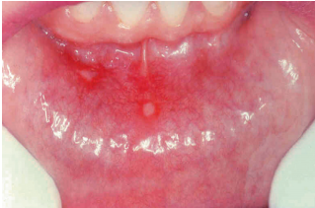
Aphthous Ulcer
VERTICAL INTEGRATION
Most Common Superficial Mucosal Ulcerations:
Characteristics:
More common in early age.
Painful and recurrent.
Often occur as solitary or multiple lesions.
Shallow, hyperemic (reddened) ulcerations.
Covered by a thin exudate, with a narrow zone of erythema (redness) around the edges.
Causes:
The exact cause is not known.
Associated with conditions like:
Celiac disease
Inflammatory bowel disease (IBD)
Behçet disease
Course:
Resolution: Most ulcers resolve spontaneously within 7 to 10 days but can recur.

Slide 9
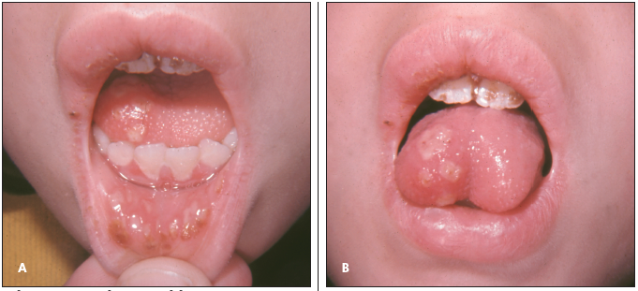
Herpes Simplex Virus Infections
VERTICAL INTEGRATION
Primary Infection:
Age of Presentation: Typically affects children aged 2-4 years.
Nature of Infection:
Self-limited infection.
Asymptomatic or presents with vesicles that rupture and heal without scarring.

Slide 10
Herpes Simplex Virus Infections
VERTICAL INTEGRATION
Latent Infection:
Age of Presentation:
Mostly occurs in adults, particularly those who are immunocompromised.
Can be triggered by factors such as:
Trauma
Allergies
Exposure to ultraviolet light
Upper respiratory tract infections
Pregnancy and menstruation
Exposure to extremes of temperature.

Slide 11
Herpes Simplex Virus Infections
VERTICAL INTEGRATION
Reactivation of the Virus:
The virus reactivates at the site of primary inoculation or in adjacent mucosa innervated by the same ganglion.
Presentation:
Groups of small vesicles (1 to 3 mm in size) appear.

Slide 12
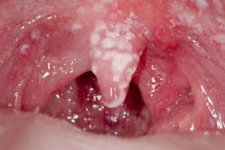
Oral Candidiasis (Thrush)
VERTICAL INTEGRATION
Cause: Fungal infection caused by Candida albicans.
Candida albicans is a normal component of the oral
flora but can cause disease under certain conditions.
Predisposing Factors:
Immunosuppression (e.g., due to medications, diseases like HIV).
Antibiotic use (which disrupts the normal microbial balance).
Clinical Presentation (Thrush):
Most common presentation of oral candidiasis.
Characterized by a superficial, curd-like white inflammatory membrane.
The membrane can be scraped off, revealing an erythematous (red) base underneath.

Slide 13
Fibroma
VERTICAL INTEGRATION
Submucosal Nodular Fibrous Tissue Masses:
Cause: Formed due to chronic irritation, leading to reactive connective tissue hyperplasia.
Common Site:
Most commonly found on the buccal mucosa.
Treatment:
Complete surgical excision of the mass.
Removal of the source of irritation to prevent recurrence.

Slide 14
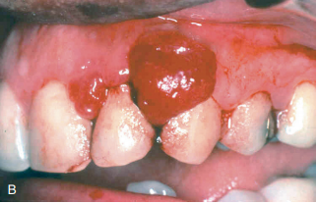
Pyogenic Granuloma
VERTICAL INTEGRATION
Pedunculated Masses:
Characteristics:
Red to purple in color.
Richly vascular.
Often ulcerated.
Most Common Site:
Gingiva.
Histologic Features:
Dense proliferation of immature vessels similar to those found in granulation tissue.
Treatment:
Complete surgical excision is the definitive treatment.

Slide 15
Leukoplakia
CORE PATHOLOGY
Definition: A white patch or plaque that:
Cannot be scraped off.
Cannot be clinically or pathologically characterized as any other disease.
Precancerous Nature:
Until proven otherwise by histologic evaluation, all leukoplakias must be considered precancerous.
Histologic Features:
Hyperplastic squamous epithelium.
Hyperkeratosis.
Sometimes dysplasia may be present.

Slide 16
Erythroplakia
CORE PATHOLOGY
Characteristics:
Red, velvety, eroded, and may present as a flat or slightly depressed area.
Risk of Malignancy:
High risk of malignancy.
Etiology:
Multifactorial; however, tobacco use is the most common risk factor for both leukoplakia and erythroplakia.
Histologic Features:
May show dysplastic squamous epithelium or carcinoma in situ.

Slide 17
Epidemiology
HORIZONTAL INTEGRATION
Characteristics:
Velvety red plaques.
Prevalence:
Ranges from 0.01% to 0.21%.
Risk of Malignancy:
90% of cases show severe dysplasia or frank malignancy.
Leukoplakia vs Erythroplakia:
The prevalence of leukoplakias is higher compared to erythroplakia.
However, most white lesions (leukoplakias) are not malignant or premalignant.
Speckled or verrucous leukoplakias have a higher likelihood of being premalignant.

Slide 18
Epidemiology
HORIZONTAL INTEGRATION
Progression to Carcinoma:
A study of 257 patients with oral leukoplakia found that 17.5% developed carcinoma.
The time from diagnosis (of either epithelial dysplasia or hyperkeratosis) to carcinoma ranged from 6 months to 39 years.

Slide 19
Squamous Cell Carcinoma
CORE PATHOLOGY
Any single lesion that persists more than 3 weeks, especially if red, ulcerated, or a lump with or without induration (i.e., the RULE mnemonic), should be regarded with suspicion and a histopathological diagnosis established.
Most common malignancy of the oral cavity.
Long-term survival rate has been less than 50% for the past 50 years.

Slide 20
Pathogenesis
CORE PATHOLOGY
HORIZONTAL INTEGRATION
Two Distinct Pathogenic Pathways.
Common Sites:
Tonsillar crypts or the base of the tongue
HPV Involvement:
HPV-16 is commonly associated.
HPV-positive tumors often overexpress p16, a cyclin-dependent kinase inhibitor.
Prognosis:
Patients with HPV-positive tumors have a better prognosis than those with HPV-negative tumors.
Risk Factors:
Chronic alcohol and tobacco users
Betel nut chewers
Genetic Mutations:
TP53, p63, and NOTCH1 mutations

Slide 21
Morphology
CORE PATHOLOGY
Microscopy:
Can show a range of differentiation, from well-differentiated keratinizing neoplasms to poorly differentiated or even anaplastic tumors.
The tumor infiltrates locally before metastasizing.
Metastasis:
Common metastasis sites include:
Cervical lymph nodes
Mediastinal lymph nodes
Lungs
Liver

Slide 22
Treatment
HORIZONTAL INTEGRATION
Radiotherapy:
External beam radiation (teletherapy) or interstitial therapy (e.g., brachytherapy, plesiotherapy) can be used.
Brachytherapy (Interstitial Therapy):
Implants of iridium (Ir 192) are often used for a few days, delivering a radiation dose equivalent to teletherapy but confined to the lesion and surrounding area.
Plesiotherapy causes fewer complications and is suitable only for tumors smaller than 2 cm and located in selected areas (e.g., nonmelanoma skin cancer).
cont.

Slide 23
Treatment
HORIZONTAL INTEGRATION
Radiotherapy:
Recent Advancements:
Newer modalities have been developed to deliver more precise radiation doses while reducing morbidity and minimizing exposure to healthy tissue. These include:
Proton therapy
Image-guided intensity-modulated radiation therapy
Stereotactic body radiotherapy
Chemoradiation (e.g., cisplatin)

Slide 24
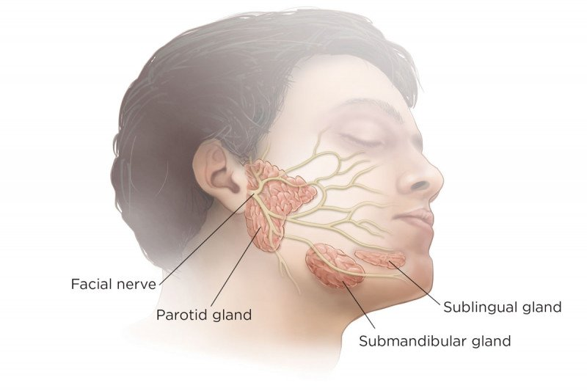
Salivary Gland Lesions
SPIRAL INTEGRATION

Slide 25
Epidemiology
HORIZONTAL INTEGRATION
Salivary Gland Neoplasms:
Account for 6% of all head and neck tumors.
Incidence:
Overall incidence: Approximately 5.5 cases per 100,000 individuals in the United States.
Malignant neoplasms: Account for 0.9 cases per 100,000 individuals.
cont.

Slide 26
Epidemiology
HORIZONTAL INTEGRATION
Mortality:
Mortality from malignant salivary gland neoplasms varies by stage and pathology.
The overall 5-year survival rate for malignant cases is 72%.
Age of Presentation:
Salivary gland neoplasms most commonly appear in the sixth decade of life.
Malignant lesions typically present after age 60 years.
Benign lesions usually present in patients older than 40 years.

Slide 27
Classification
CORE PATHOLOGY

Slide 28
Pleomorphic Adenoma
CORE PATHOLOGY
Clinical Features:
Painless, slow-growing, mobile, discrete masses.
Site:
Most commonly occur in the parotid gland and submandibular gland.
Benign Tumors:
These tumors exhibit both epithelial and mesenchymal differentiation.
Molecular Features:
The tumors consistently overexpress the transcription factor PLAG1.

Slide 29
Pleomorphic Adenoma
CORE PATHOLOGY
Gross Features:
Rounded, well-demarcated masses, typically less than 6 cm in greatest dimension.
Encapsulated.
Cut Surface:
Gray-white appearance with areas of myxoid and blue translucent chondroid (cartilage-like) regions.
cont.

Slide 30
Pleomorphic Adenoma
CORE PATHOLOGY
Microscopic Features:
The most striking histologic feature is the heterogeneity of the tumor.
Epithelial elements resembling ductal or myoepithelial cells are arranged in:
Ducts
Acini
Irregular tubules
Strands
Sheets
These epithelial structures are typically dispersed within a mesenchymal-like background of loose myxoid tissue containing islands of chondroid and, rarely, foci of ossification.

Slide 31
Mucoepidermoid Carcinoma
CORE PATHOLOGY
Site:
Most commonly occurs in:
Parotids
Major salivary glands
Minor salivary glands
Composition:
Composed of variable mixtures of:
Squamous cells
Mucus-secreting cells
Intermediate cells
Malignant Tumor:
The most common form of primary malignant tumor of the salivary glands.
Molecular Features:
Commonly associated with chromosome rearrangements involving MAML2.

Slide 32
Mucoepidermoid Carcinoma - Gross and Microscopic Features:
CORE PATHOLOGY
Gross Features:
Tumors can be as large as 8 cm in diameter.
Circumscribed but lack well-defined capsules and are often infiltrative.
Cut Surface:
Pale gray to white in appearance, often demonstrating small mucinous cysts.
Microscopic Features:
Contain cords, sheets, or cysts lined by:
Squamous cells
Mucous cells
Intermediate cells
Cytology:
Tumor cells may appear benign or highly anaplastic and unmistakably malignant.

Slide 33
CORE PATHOLOGY

Slide 34
Mucocele
CORE PATHOLOGY
Salivary Gland Duct Obstruction or Rupture:
Cause: Results from either blockage or rupture of a salivary gland duct.
Consequence:
Leakage of saliva into the surrounding connective tissue stroma.
Mucoceles are pseudocysts lined by inflammatory granulation tissue or fibrous connective tissue and filled with mucin and inflammatory cells, particularly macrophages

Slide 35
Sialadenitis.
CORE PATHOLOGY
Infection Following Ductal Obstruction:
Cause:
Infection with S. aureus and Streptococcus viridans following ductal obstruction by stones.
Effects:
Inflammation of the affected glands.
Interstitial inflammatory infiltrate.
May progress to overt suppurative necrosis and abscess formation.

Slide 36
Summary
Oral Mucosal Lesions and Cancer:
Aphthous Ulcers:
Painful, superficial ulcers of unknown etiology.
Fibromas and Pyogenic Granulomas:
Common reactive lesions of the oral mucosa.
Leukoplakia and Erythroplakia:
Oral mucosal lesions that may undergo malignant transformation.
Oral and Oropharyngeal Cancers:
The majority are squamous cell carcinomas (SCCs).
Oral cavity SCCs are strongly linked to tobacco and alcohol use.
The incidence of HPV-associated lesions has risen dramatically in oropharyngeal SCCs.

Slide 37
Summary
Salivary Gland Disorders and Neoplasms:
Sialadenitis:
Inflammation of the salivary glands caused by trauma, infection, or autoimmune disease.
Mucoceles:
Result from trauma or blockage of a salivary gland duct, leading to saliva leakage into surrounding connective tissue.
Pleomorphic Adenoma:
A benign, slow-growing neoplasm composed of a heterogeneous mixture of epithelial and mesenchymal cells.
Mucoepidermoid Carcinoma:
A malignant neoplasm of variable biological aggressiveness, composed of a mixture of squamous and mucous cells.

Slide 38
Assignment
Scenario: A 40-year-old female had a painless, slow-growing, mobile discrete mass on the left cheek for the past 2 years. On excision, it was a rounded, well-demarcated, encapsulated mass. On microscopic examination, it consists of epithelial elements resembling ducts, acini, irregular tubules embedded in a myxoid stroma.
What is the diagnosis?
Briefly describe the morphological features of this condition.
Classify the salivary gland neoplasms.
What is the most common neoplastic lesion of the oral cavity?
Enlist the proliferative lesions of the oral cavity.

Slide 39
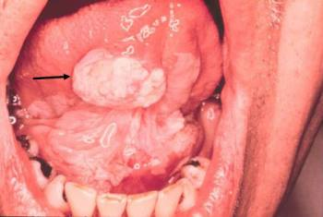
END OF SESSION ASSESSMENT

Slide 40
END OF SESSION ASSESSMENT

Slide 41
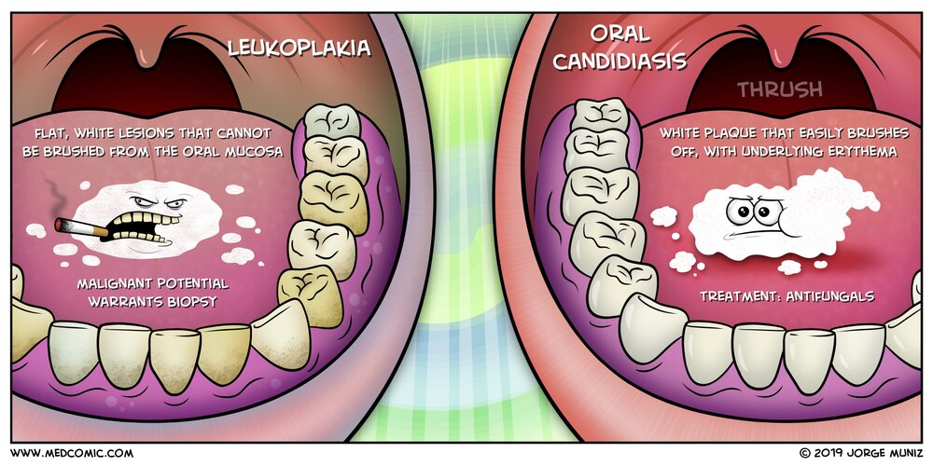
END OF SESSION ASSESSMENT

Slide 42
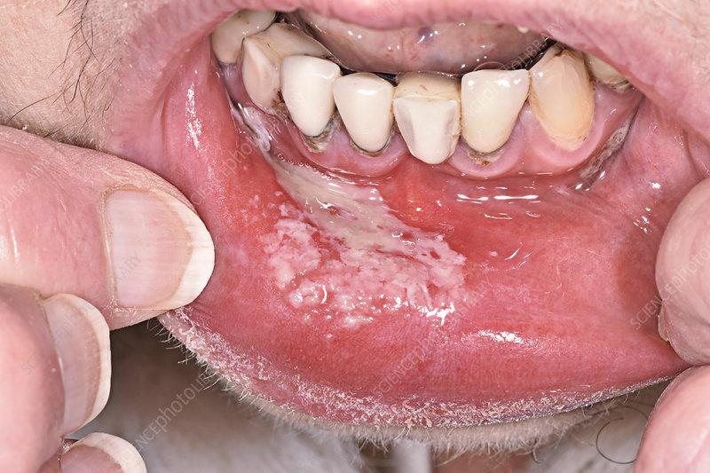
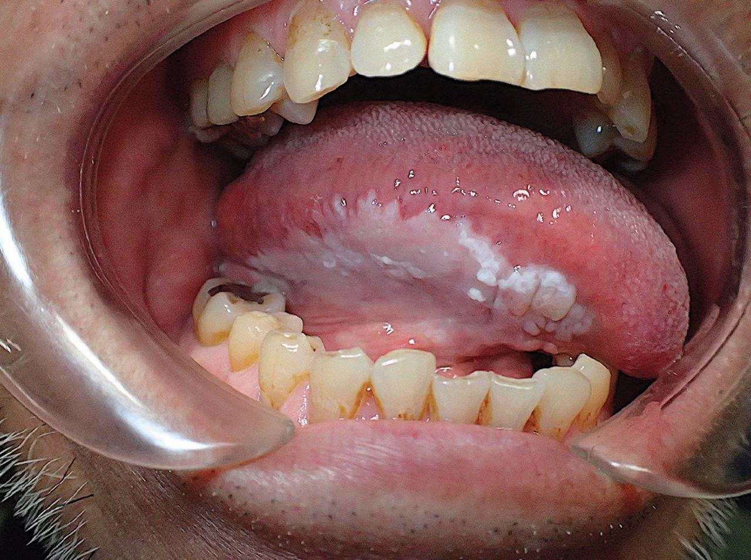
END OF SESSION ASSESSMENT

Slide 43
DOI: 10.3390/jcm11216406

