Slide 1
Oculo-orbital trauma

Slide 2
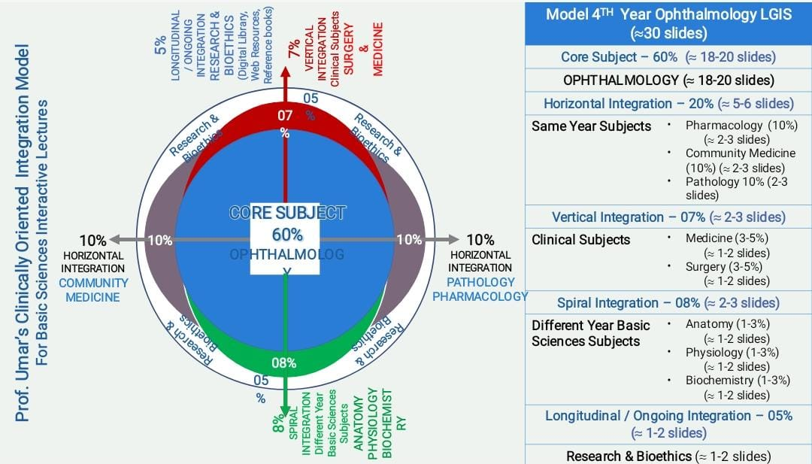
CONTENTS:
LEARNING OBJECTIVES
VERTICAL INTEGRATION
HORIZONTAL INTEGRATION
CORE SUBJECT
END OF LECTURE ASSESSMENT
DIGITAL LIBRARY REFERENCES
(RESEARCH, BIOETHICS,
ARTIFICIAL
INTELLIGENCE)

Slide 3
SPECIFIC LEARNING OBJECTIVES
By the end of the lecture students will be able to
Describe anatomy of eye and orbit
Classify different types of trauma
Describe findings, grading and treatment of chemical injuries

Slide 4
Integration with Pathophysiology:
Horizontal integration
The eye is protected from direct injury by lids, eyelashes and the projecting margins of the orbit. Neverthless , it can be injured in a variety of ways by chemicals, heat, radiation and mechanical trauma.

Slide 5
Classification according to nature
Core subject
Physical trauma
a. Perforating trauma
b. Blunt trauma
Chemical trauma
a. Acid
b. Alkali
c. Dye(salt of acid or alkali)

Slide 6
Thermal trauma
a.Heat
b.Cold
Radiation trauma
a.Ionizing agent
b.Ultra violet agent
c.Laser burn
Miscellaneous

Slide 7
Evaluation of trauma patient
Core subject
Evaluate general status
Evaluate eye problem
Periocular evaluation

Slide 8
Assessment
History
should be in detail
time and nature of injury
past ocular history
Visual acuity,lid function
Rule out life threatening injuries
Rule out globe threatening injuries
Examine both eyes
Documentation
Plan for repair

Slide 9
Eyelid Trauma
Periocular hematoma
Laceration

Slide 10
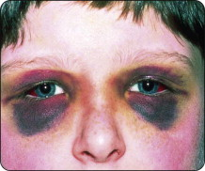
Periocular haematoma
Also known as “black eye” consists of a hematoma and/orperiocular ecchymosis (diffuses bruising) and oedema
Most common cause is
blunt trauma
Bilateral periocular hematoma
can be a sign of skull base
fracture

Slide 11
Laceration
Superficial lacerations
Lid margin lacerations
Lacerations with mild tissue loss
Lacerations with extensive tissue loss
Cannalicular lacerations

Slide 12
Eyelid tear

Slide 13
General principles of repair
1-Clean the wound
2-Remove foreign body
3-Careful handling of tissue
4-Careful alignment of anatomy
5-Close in layers
6-Timing - repair within 12 to 24 hours
7-Anaesthesia
GA/LA

Slide 14
Tear repair
Superficial lacerations without gaping can be sutured with 5-0/6-0 black silk,removed after 5 days
Lid margin laceration
Carefully align to prevent notching
a-Align with 5-0 silk suture
b-Close tarsal plate with fine absorbable suture(5-0 vicryl)
c-Place additional marginal silk suture
d-Close skin with multiple interrupted suture
3. Laceration with tissue loss
Primary closure and may also need a lateral cantholysis
4. Canalicular laceration
Either through silicone tubing or monocanalicular stent

Slide 15
Repairing lid margin laceration

Slide 16
Orbital Fractures
Orbital floor fracture
Roof fracture
Orbital apex fracture
Le Fort Mid Facial fracture

Slide 17
Orbital floor fracture
Core subject
Also known as “Blow-out fracture” is caused by blunt trauma (fist or tennis ball)
Assiciated with vertical diplopia with limitation of upgaze,downgaze or both
Infraorbital nerve anaesthesia
Forced duction test shows restriction
Increased IOP in upgaze
Enophtalmos may or may not be present
Hess Chart testing
CT scan with coronal sections aids in diagnosis

Slide 18
CT scan

Slide 19
Management of orbital floor fracture
Core subject
CT scan coronal,sagital view
Clinical signs and symptoms
Observed for 5-10 days for swelling to subside
Systemic steroids 1ml/day for 7 days to decrease edema

Slide 20
Indications for surgery
Core subject
Diplopia which limit upgaze/downgaze within 30 degrees of the primary position ,positive forced duction test after resolution of edema and imaging confirm floor fracture
Entrapment of inferior rectus
Large fracture involving half of the orbital floor

Slide 21
Orbital apex fractures
Core subject
Associates with other fractures of the face,orbit or skull
Optic canal,superior orbital fissure and structures that pass through them
Possible complications include damage to the optic nerve,decreased vision,CSF leak,carotid cavernous fistula

Slide 22
Orbital apex fractures
Core subject
Indirect traumatic neuropathy results from
Stretching
Tearing
Twisting
Bruising of the fixed canalicular portion of the nerve

Slide 23
Extraocular Foreign body
Sites
Conjuctiva
Cornea

Slide 24
Extraocular foreign body in cornea

Slide 25
Management of corneal foreign body
Careful slitlamp examination for exact position and depth
Removal under slitlamp with 27 G needle
Magnetic removal of a deeply embedded metallic FB
Residual “rust ring” may remove with sterile burr
Antibiotic ointment with cyclopegic and/or NSAIDs

Slide 26
IntraOcular foreign body
Sites
Anterior segment (Anterior chamber,iris, lens)
Posterior segment (Vitreous and retina)

Slide 27
Intraocular foreign body in posterior segment

Slide 28
Management
Accurate history, helpful for nature of FB
Examination
Entry exit point
gonioscopy,fundoscopy
documentation for damaged structures
CT scan
MRI contraindicated for metalic FB

Slide 29
Treatment
Anterior segment is removed through limbal approach
Posterior segment is removed through
Magnet
Pars plana vitrectomy and use of forceps

Slide 30
Blunt trauma

Slide 31
Integration with Pathophysiology :
Horizontal integration
Blunt trauma to globe result in concussion, contusion and anteroposterior compression with simultaneous expansion in equatorial plane associated with a transient and severe increase in IOP.
Although the impact is absorbed by iris-lens diaphragm and vitreous base, damage can also occur at distant site such as posterior pole.

Slide 32
EyeLid
Ecchymosis of eyelid
Traumatic ptosis

Slide 33
Conjuctival complications
Subconjuctival hemorrhage
Resolves spontaneously within 1-2 weeks

Slide 34
Corneal complications
Core subject
Corneal abrasion
Stromal edema
Tears in descemet membrane

Slide 35
Iris Complications
Traumatic miosis
Traumatic mydriasis
Iridodialysis

Slide 36
Ciliary body complications
Ciliary shock cause hypotony
Angle recession may cause angle recession glaucoma

Slide 37
Traumatic hyphaema

Slide 38
Lenticular complications
Core subject
Cataract
Phacolytic glaucoma
Lens matter in vitreous
Vossius ring
Subluxation
Dislocation

Slide 39
Posterior segment complications
Vitreous hemorrhage
Posterior vitreous detachment
Commotio retina
Retinal, subretinal and preretinal hemorrhage
Retinal breaks
Retinal detachment
Choroidal tear
Optic nerve avulsion

Slide 40
Commotio retinae

Slide 41
Choroidal rupture

Slide 42
Penetrating trauma
Three times more common im males than females
Typically occurs in a younger age group (15-34)
Most frequent causes are assault, accidents and sports

Slide 43
Corneal tear
Peaking of pupil
Shallow anterior chamber
May involve iris and lens
Primary repair should be done without delay

Slide 44
Corneal tear

Slide 45
Scleral Tear
Anterior scleral lacerations have a better prognosis. May be associated with iridociliary prolapse and vitreous incarceration
Posterior scleral lacerations is associated with retinal damage. Primary repair to restore globe integrity is initial priority

Slide 46
Scleral tear

Slide 47
Retinal detachment
Traumatic RD following penetrating trauma results from vitreous incarceration in wound
Retinal break may develop several weeks later, leading to a more rapidly progressing RD

Slide 48
Tractional retinal detachment

Slide 49
Retinal breaks and detachment

Slide 50
Chemical Injury
Acids
Alkalis

Slide 51
Integration with Pathophysiology:
Acids cause coagulation of surface proteins and thus set up physical barrier against deeper tissue presentation
Alkalis cause necrosis of conjuctival and corneal epithelium with destruction and occlusion of limbal vasculature. Resulting in corneal vasculization. Deeper penetration causing damage to iris, lens and trabecular meshwork. Ciliary epithelial damage results into hypotony and phythisis bulbi

Slide 52
Ocular Signs
Acid injury
Conjuctiva and cornea shows necrosis followed by slouging
Corneal surface tissue becomes opaque and swollen

Slide 53
Alkali injury
Conjuctiva and limbus becomes white due to destruction and occlusion of vasculature
Cornea is dull opaque and epithelium may become sloughed out

Slide 54
Management
Emergency treatment
Medical treatment
Surgical treatment

Slide 55
Emergency treatment
Irrigate the eye with cupious amount of normal saline for 15 to 20 minutes.
Neutralization of chemical
Acids with dilute alkali (sodium bicarbonate solution)
Alkali with weak acid (boric acid solution)
Removal of chemical matter with cotton swab or forceps
Remove the devitalised tissue

Slide 56
Medical Treatment
Topical
Antibiotics drops to prevent secondary infection
Cyclopegic drops to relieve pain and avoid posterior synechiae formation
Steroids are used for the first 7 days after which NSAID are used
Topical sodium ascorbate 10% to reduce inflammation
Tetracycline eye ointment acts as collagenase inhibitor

Slide 57
Oral
Analgesic for pain relief
Antibiotic tetracycline to prevent secondary infection
Vitamin C to reduce inflammation and promote healing

Slide 58
Surgical treatment
Advancement of tenon’s capsule and suturing to limbus
Limbal stem cell transplantation to restore normal corneal epithelium
Amniotic membrane graft to assist epithelial healing
Conjuctival or mucus membrane graft
Keratoplasty
Keratoprosthesis

Slide 59
EOLA( END OF LECTURE ASSESSMENT)
A 30 years old male presented to emergency department with history of trauma to right eye by tennis ball. Patient complaints of sudden decrease in vision for 1 hour. On examination he has raccoon eye, cornea is clear, Anterior segment formed, fundal view is not hazy.
What investigation you would like to perform in this patient?
What could be the possible for decrease vision in this patient?
What immediate management will be given to patient?

Slide 60
References:
Kanski clinical ophthalmology, trauma, 862-882.
Basic ophthalmology by Renu Jogi

Slide 61
Artificial Intelligence https://www.mdpi.com/2079-9284/10/2/52

Slide 62
Research and Ethics https://www.ncbi.nlm.nih.gov/pmc/articles/PMC3729297/

