Slide 2
Anemia in Pregnancy
Dr. MUHAMMAD ARIF (AP) MEDICINE DEPARTMENT RAWALPINDI MEDICAL UNIVERSITY

Slide 4
CORE CONCEPT
Learning Objectives
Recall Etiology, pathophysiology and common types of Anemia in pregnancy
Explain risk factors for anemia, clinical features and
investigations to confirm diagnosis
Management plan including prevention and discuss complications of anemia for both fetus and mother

Slide 5
CORE CONCEPT
Background Information
Commonest Medical disorder in pregnancy
Prevalence in Pakistan is 56%
Prevalence in USA is 2-4%
Nutritional anemia (IRON DEFICIENCY) is commonest
It is important contributor to maternal & perinatal morbidity & mortality as a direct or indirect cause

Slide 6
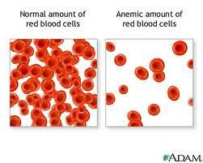
SPIRAL INTEGRATION
Definition – Anemia (WHO )
A condition where circulating levels of Hb are quantitatively or
qualitatively lower than normal
Non pregnant women
Pregnant women (WHO)
Hematocrit
Hb < 12gm% Hb < 11 gm%
< 33%

Slide 7
SPIRAL INTEGRATION
Anemia in Pregnancy
Anemia is the commonest hematological disorder seen during pregnancy in the developed world.
In Pakistan, anemia is 3-4times more common occurring in approx. 56% of the pregnant women.
The definition of anemia in pregnancy differs from non pregnancy state is because of physiological changes occurring in blood in relation to the pregnancy.

Slide 8
SPIRAL INTEGRATION
Anemia Severity Classification Hb values
Mild
Moderate
Severe
Very Severe
10.0-10.9 gm/dl
<7-10 g/dl
< 7.0g/dl
<4.0g/dl

Slide 9
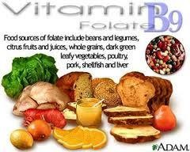
CORE CONCEPT
Etiology of Anemia in Pregnancy
Nutritional / Iron deficiency anemia (dietry habit)
Pre-pregnancy poor nutrition very important
(Meat, poultry and fish are rich sources of iron
Pythic acid, fibers, calcium, tannis , tea, coffee chocolate and infusions decreases iron absorption.
Besides Iron, folate and B12 deficiency also important
herbal
Chronic blood loss due to parasitic infections – Hookworm & malaria

Slide 10
VERTICAL INTEGRATION
ETIOLOGY
Multiple pregnancies.
Acute blood loss in APH, PPH (Ante/postpartum hemorrhage )
Recurrent infections (UTI) - anemia due to impaired erythropoiesis.
Hemolytic anemia in PIH.
Hemoglobinopathies like Thalassemia, sickle cell anemia
Aplastic anemia is rare.

Slide 11
HORIZONTAL INTEGRATION
Patho-physiology of Nutritional Anemia in Pregnancy
Augmented erythropoiesis in pregnancy
The plasma expands by 40-50%and increase in RBC
Mass is 18%.The predominant expansion of plasma volume is result in hem dilution and the hemoglobin per unit volume is decreased in spite of increase in total body red cell mass.
Iron stores are depleted with each pregnancy
Too soon & too many pregnancies result in higher prevalence of iron
deficiency anemia

Slide 12
SPIRAL INTEGRATION
Extra Iron Requirement & Loss During Pregnancy:
During pregnancy Total 800-1000 mg extra iron is required
500 mg for both Fetus & Placenta | 400-500 mg for increased red cell mass | 250 mg iron lost during delivery 220 mg basal losses
Due to cessation of menses & contraction of blood volume after delivery conservation of iron is around 400 mg

Slide 13
CORE CONCEPT
Factors Required for Erythropoiesis
Proteins for synthesis of Globin
Mineral – Iron for synthesis of heme
Hormones – Erythropoietin (produced from Kidney, stimulates stem cells in Bone Marrow), Thyroxine, Androgens
Trace elements – Zinc (also important for protein synthesis & Nucleic acid
metabolism), Cobalt, Copper

Slide 14
CORE CONCEPT
Factors Required for Erythropoiesis
Vitamins –
Vit B12 required for synthesis of RNA in early stage,
Folic acid required in later stage for DNA synthesis
Vitamin C necessary for conversion of folic acid to folinic acid, it enhances absorption of iron from small intestine
Pyridoxine B6 useful adjuvant in erythropoiesis
Vitamin A required for cell growth, differentiation & maintenance of integrity of epithelium, immune function

Slide 15
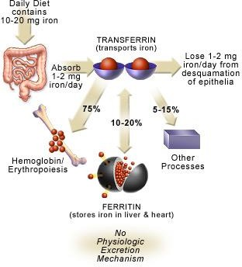
CORE CONCEPT
Pharmaco-kinetics of Iron
🞂​ Normal diet contain about 14 mg of iron
🞂​ Absorption of iron is 5-10% (1-2 mg) & 3-4% in pure veg diet
🞂​ Additional daily iron demand in
early pregnancy 2-3 mg/day
🞂​ In late pregnancy 6-7 mg/day
🞂​ So daily supplement of 40-60 mg of elemental iron is required during pregnancy
🞂​ Folic acid requirement is also
increased 400-600 ug/day
🞂​ In strict vegetarians Vit B 12 is also deficient

Slide 16
CORE CONCEPT
TYPES OF ANEMIA
NUTRITIONAL DEFICIENCY ANEMIA
Iron Deficiency Anemia
Folic Acid Deficiency Anemia
Vitamen B12 Deficiency Anemia
•
Heamoglobinopathies/Heamolytic Anemia
Thalassemia, sickle cell disorder,
RARE;-
Aplastic, Leukemia,Lymphoma, Autoimmune heamolytic

Slide 17
VERTICAL INTEGRATION
Iron Deficiency Anemia
Clinical Features
Depends on severity of anemia
High risk women – adolescent, multiple pregnancy, lower socio economic status
Mild anemic - asymptomatic
Moderate-Symptoms – pallor, weakness, fatigue, dyspnea, palpitation, poor performance at work
Severe anemia: palpitation and breathlessness which later lead to heart
failure

Slide 18
VERTICAL INTEGRATION
SIGNS OF ANEMIA
Signs –
pallor, tachycardia, tachypnea, crepts in lung bases, hepato- splenomegaly, pitting edema over abdominal wall, facial puffiness, raised JVP & legs swelling over feet & body
Heart murmur(ejection systolic) in mitral area,
Glossitis, stomatitis, cheilosis, brittle hair

Slide 19
VERTICAL INTEGRATION
Megaloblastic Anemia
Due to Deficiency of Either
1) Folic acid or
2) vitamin B12.
During Pregnancy megaloblastic anemia is nearly always due to folate deficiency, as vit B12 has high storage in the body tissues.
In developing countries the prevalence is around 30%

Slide 20
SPIRAL INTEGRATION
FOLIC ACID DEFICIENCY
The daily requirement for folic acid increases from 400ug in non pregnant women to 800ug in Pregnant women.
CAUSES
Dietary deficiency
Poor absorption
Increased Demand
Poor utilization
CLINICAL FEATURES
Mostly Asymptomatic
Nausea, Vomiting , Diarrhea, loss of appetite, Soreness, pain in tongue, unexplained fever, breathlessness
when symptomatic.

Slide 21
SPIRAL INTEGRATION
VITAMIN B12 DEFICIENCY
Synthesized by certain microorganisms and animals,
SO humans are ultimately dependent on these source
i.e meat, fish, eggs, and milk but not in plants.
Non pregnant levels of 205-1025ug/l fall to 20- 510ug/l at term.
Deficiency is usually associated with pernicious anemia and tropical sprue.

Slide 22
VERTICAL INTEGRATION
Investigation
Severity of anemia – Hb & Haematocrit, CBC at
1ST visit, 28-30 weeks & 36 weeks
Type of anemia – (Pheripheral film and Retics )
microcytic, macrocytic, dimorphic, normocytic, hemolytic, pancytopenia
Bone marrow activity – reticulocyte count (N 0.2-2%), higher bone marrow activity is seen in
Hemolytic anemia
Following acute blood loss
Iron def anemia on treatment
Cause of anemia – by various investigations

Slide 23
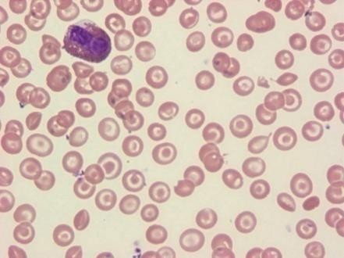
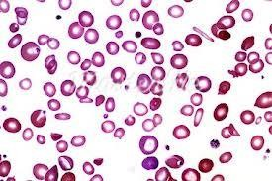
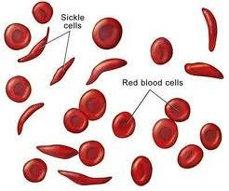
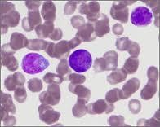
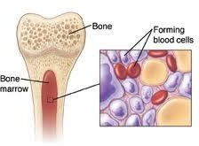
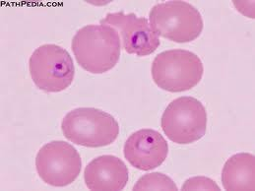
SPIRAL INTEGRATION
Peripheral film Stained with Leishman stain
Normal smear – Normocytic (Normal size RBC), normochromic (Normal colour RBC)
Iron deficiency – Microcytic (small RBC), hypochromic (pale RBC), anisocytosis (variation in size), poikilocytosis (variation in shape), with or without target cells
Malarial parasites can be seen
Aplastic anemia shows low/no counts
Sickle cells can be demonstrated
Toxic granules can be seen
Abnormal Blast cells seen in Leukemia
Target cells in Thalassemia
Target cells Thalassemia
Fe def anemia
Blast cells
Bone marrow
aplastic anemia
Malarial parasite

Slide 24
HORIZONTAL INTEGRATION
Red Cell Indices
RBC count – decreases in anemia (N 3.2 million/cu mm)
PCV - < 32%, (N37-47%)
MCV – low in Fe def anemia, microcytic
MCH - decreases
MCHC – decreases, one of the most sensitive indices (N26-30%)

Slide 25
HORIZONTAL INTEGRATION
Special Investigations
Serum Ferritin – ,Give better picture of iron stores.it is stable and is not effected by ingestion of iron. Abnormal if < 20 ng/ml (N 40-160 ng/dl), assess iron stores.in development of IDA serum ferrtin is 1st test to become abnormal.
Serum Iron – N 13-27 umol/l, decreases in Fe def anemia, diurnal variation,
effected by ingestion of iron,infections
Serum Iron binding capacity – 300-360 ug/dl, increases with severity of anemia
Percentage saturation of transferrin – 35-50%, decreases to less than 20% in Iron def anemia

Slide 26
Differentiation between iron deficiency anemia & Thalassemia diminished synthesis of Hb b chains in Thalassemia)
Investigations | Normal values | Fe Def Anemia | Thalassemia
MCV | 75-96 fl | reduced | V reduced
MCH | 27-33pg | reduced | V reduced
MCHC | 32-35 gm/dl | reduced | N or reduced
HbF | <2 % | normal | Raised
HbA2 | 2-3% | N or reduced | Raised >3.5%
Serum Iron | 60-120 ug/dl | reduced | Normal
Serum Ferritin | 15-300 ug/L | reduced | Normal
TIBC | 300-350 ug/dl | Raised | Normal
Bone iron stores |  | reduced | Normal
Free erythrocyte protoporphyrin (FEP) | <35 ug/dl | >50 | Normal

Slide 27
HORIZONTAL INTEGRATION
Other Investigations
Urine examination – RBC & Casts
Stool examination – occult blood, ova
Bone marrow examination – refractory anemia
BUN/Serum creatinine – Renal disease

Slide 28
VERTICAL INTEGRATION
Management
GOALS/ ASPECTS
Treatment of established iron deficiency anemia.
Prevention of Iron deficiency in non-anemic women
1) Established Iron Deficiency Anemia
Objectives of treatment are :
To achieve a normal HB level by the last month of pregnancy to withstand hemorrhage
associated with delivery
To Replenish the Iron stores by iron therapy , blood transfusion, fortify salt with Iron and prevention of various infections.
2) Prevention during pregnancy:
Iron Supplements
Treatment of Infection
Dietary Advice

Slide 29
VERTICAL INTEGRATION
Treatment for Iron Deficiency
Anemia
Improving Diet rich in iron & fruits & leafy vegetables
Treat worm infections, maintain general hygiene
Food fortification with iron & genetic modification of food
Iron & folic acid supplementation
in young girls & during pregnancy
Heme iron better, present in animal food & is better absorbed
Iron absorption enhanced by citrous fruits, Vit C
Avoid tea, coffee, Ca, phytates, phosphates, oxalates, egg, cereals with iron

Slide 30
VERTICAL INTEGRATION
Iron Rich Foods
Green leafy vegetables-chana sag, sarson ka sag, Palak. Sowa, salgam
Cereals - wheat, ragi, jowar, bajra
Animal flesh food - meat, liver
Vitamen C - lemon, orange, guava, amla, green mango etc.

Slide 31
VERTICAL INTEGRATION
Iron supplementation in Pregnancy
🞂​60 mg elemental iron & 400 ug of folic acid daily during pregnancy and 3 months there after
🞂​In anemia therapeutic doses are 180- 200 mg /d
🞂​Route of administration depends on, severity of anemia, Gest age, compliance & tolerability of iron
🞂​Various preparations – fumarate, gluconate, succinate, sulfate, ascorbate
🞂​ Carbonyl iron better tolerated
🞂​Oral iron can have side effects like nausea, vomiting, gastritis, diarrhoea, constipation
Iron supplementation not recommended in first trimester
Higher incidence of miscarriage
Birth defects
Bacterial infection (bacteria grow after taking iron from supplementation)

Slide 32
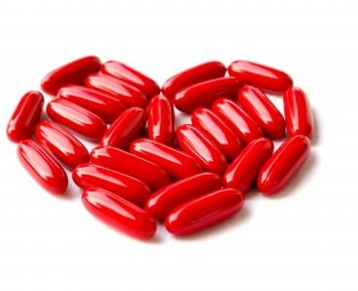
VERTICAL INTEGRATION
Oral Iron
🞂​ Hb 8-11 gm%, early preg
🞂​ Contraindication to Oral Iron Therapy
Intolerance to oral iron
Severe anemia in advanced
pregnancy
Non compliant
🞂​ Failure to Respond
Inaccurate diagnosis
Faulty absorption
Continuous blood loss
Co-existant infection
Concomitant folate deficiency
Indicators of response to therapy
Feeling of well being
Improved look of patient
Better appetite
Rise in Hb .5-.7 gm/dl per week (starts after 3 weeks)
Reticulocytosis in 7-10 days

Slide 33
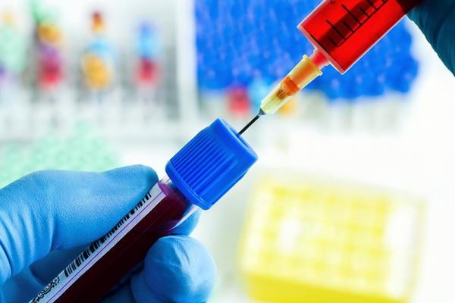
VERTICAL INTEGRATION
Parenteral Iron Transfusion
IRON SUCROSE for parenteral use
dose calculated;
Wt in Kg x iron deficit x 2.2 + 1000 mg for iron stores.
Response seen by increase in hemoglobin 1g/week.
Increase in retic count in 5-10 days
Clinical improvement in symptoms

Slide 34
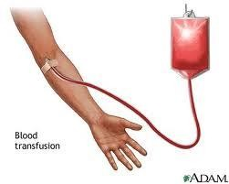
VERTICAL INTEGRATION
Indications for Blood Transfusion
Severe anemia first seen after 36 weeks
of pregnancy
Anemia due to acute blood Loss – APH & PPH
Associated Infection
Patient not responding to oral or parenteral therapy
Anemic & symptomatic pregnant women (dyspneic, with heart failure etc) irrespective of gestational age

Slide 35
VERTICAL INTEGRATION
Treatment of Megaloblastic Anemia
Folate Therapy
5mg oral folic acid per day which should be continued for at
least 4 weeks in the peurperium .
It is always useful to give folate in combination with iron therapy even in the absence of iron deficiency.
Other Measures; extra folate is advised to the women taking
anticonvulsants and when suffering from hemolytic conditions.
Prophylaxis:
WHO recommend daily folate intake of 800ug in antenatal period, and 600ug in lactation period. The prophylaxis should continue for 6 months during pregnancy and 3 months post- partum.

Slide 36
VERTICAL INTEGRATION
MANAGEMENT
Vitamen B12 Deficiency
The recommended intake of vit B12 is 2ug/day in non pregnant state and 3ug/day during pregnancy.
The patients suffering from Vit B12 deficiency are treated with parenteral cyanocobalamin 250ug IM every month.

Slide 37
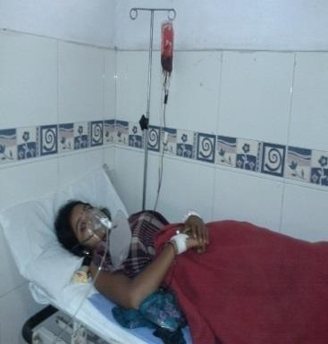
VERTICAL INTEGRATION
Management of Labor
Labor should be supervised (pain free epidural)
Proper counseling & consent to be taken
Blood (whole & packed) kept cross matched
Women nursed in propped up position
Intermittent O2 to be given
Precaution to prevent infection & blood loss
Strict aseptic precautions & minimal P/V exams
Prophylactic antibiotic given
Patent iv line but fluids are avoided
In decompensated patient diuretic given

Slide 38
VERTICAL INTEGRATION
Effect of Anemia on Pregnancy & Mother
🞂​ Higher incidence of pregnancy complications
preeclamsia,abruption placentae, preterm labor
🞂​ Predisposed to infections like – UTI, puerperal sepsis
🞂​ Increased risk to PPH
🞂​ Sub involution of uterus
🞂​ Lactation failure
🞂​ Maternal mortality – due to
CHF,
Cerebral anoxia,
Sepsis,
Thrombi-embolism

Slide 39
VERTICAL NTEGRATION
Effect of Anemia on Fetus & Neonate
Higher incidence of abortions, preterm birth, IUGR
IUD
Low APGAR at birth
Neonate more susceptible for anemia & infections
Higher Perinatal morbidity & mortality
Anemic infant with cognitive & affective dysfunction

Slide 40
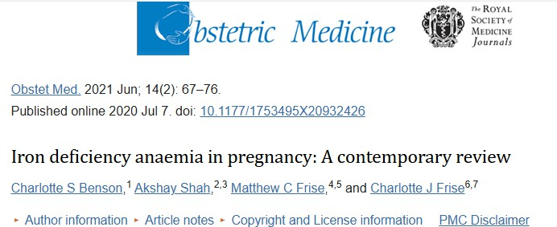
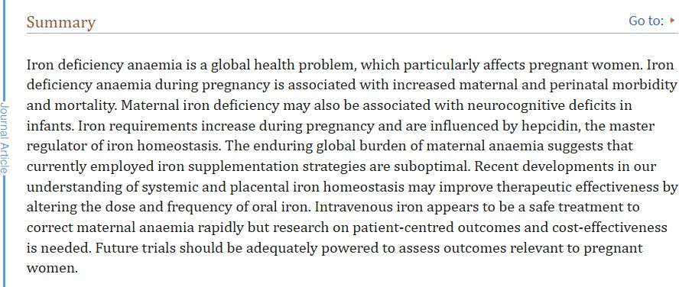

Slide 41
1- B
2 -A
3- B
4-C
5-A

