Slide 2
Non neoplastic lesions of eyelid
Ophthalmology/Eye Module 4th year MBBS
Dr Rabbia Khalid
Department of Pathology
Rawalpindi Medical University

Slide 4
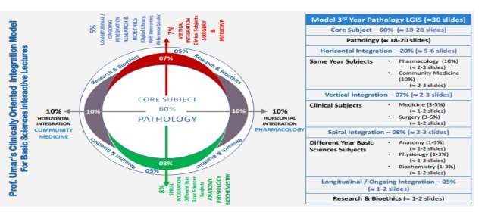

Slide 5
Learning Objectives
At the end of the practical, students must be able to:
Enumerate different non-neoplastic lesions of the eyelid.
Describe the identification points on the gross and microscopic features of non-neoplastic lesions of the eyelid.
Learning Resources: Robbins & Cotran Pathologic Basis Of Disease 10th Edition

Slide 6
Study Questions
Enlist the common benign lesions of the eyelid.
Name the syndromes associated with eyelid lesions.
Give the morphological and microscopic features of chalazion.
Describe internal and external hordeolum.
Enumerate the differences between chalazion and hordeolum.
What is xanthelasma and with which familial disorder is it associated?
Describe lesions associated with viral infections.
What are the different types of cysts and how are they managed?
What are the congenital non-neoplastic lesions?

Slide 7
Normal Eyelid (Cross Section)

Slide 8
Common Benign Lesions
Inflammation of a blocked gland (e.g., chalazion)
Infection and inflammation of a gland (e.g., hordeolum)
Lipid accumulation in the dermis (e.g., xanthelasma)
Cyst formation of adnexal or epidermal structures (e.g., epidermal inclusion cyst, cyst of Moll, cyst of Zeiss)
Melanocyte proliferation in the dermis and epidermis (e.g., nevus)
Proliferation of cells in the epidermis (acanthosis) and hyperkeratosis (e.g., seborrheic keratosis, acrochordon/skin tag)
Infection of the epidermis (usually viral) (e.g., verruca vulgaris, molluscum contagiosum)

Slide 9
Lesions Associated with Syndrome
Neurofibromatosis Type 1 – Plexiform neurofibroma
Tuberous sclerosis – Angiofibroma
Sturge-Weber syndrome – Port-wine stain

Slide 11
Microscopic
Lipogranulomatous Inflammation
Chronic inflammatory Cells
Giant cells
Epithelioid cells

Slide 13
Hordeolum
2 Types of Hordeolum:
External Hordeolum
Internal Hordeolum

Slide 14
(Stye)

Slide 16
Microscopy
Acute inflammatory cells
Marked neutrophilia

Slide 17
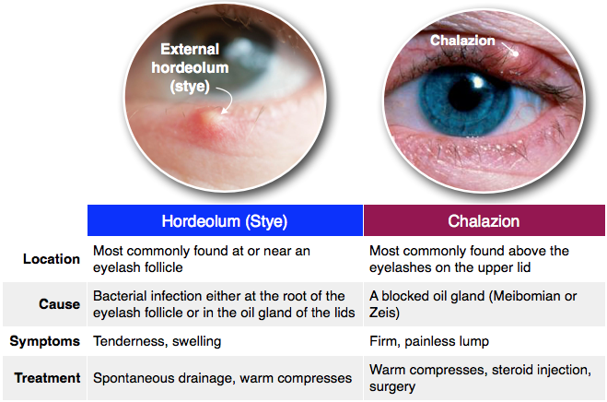

Slide 19
Acute
Chronic

Slide 26
CYSTS

Slide 30
Summary
A chalazion (meibomian cyst) is a chronic inflammatory lesion caused by the blockage of meibomian gland orifices and the stagnation of sebaceous secretions.
An external hordeolum (stye) is a small abscess caused by an acute staphylococcal infection of a lash follicle and its associated gland of Zeis or Moll.
An internal hordeolum is a small abscess caused by an acute staphylococcal infection of the meibomian glands.
Molluscum contagiosum is an infection caused by one of the pox viruses.

Slide 31
Scenario
A 20-year-old male presents with a single painful nodule in the right upper eyelid. A careful history reveals that the onset was three days ago and there is a history of painless eyelid nodules. A slit lamp exam reveals an erythematous pustule, 3 mm in size, on the inside of the eyelid, along with edema and erythema of the eyelid, telangiectasia of blood vessels at the margin of the eyelids, and in the skin of the cheeks and nose. The best treatment for this patient is which one of the following?
A. Oral antibiotics and hot compresses B. Topical antibiotics and hot compresses C. Steroid injection of the lesion D. Observation

Slide 32
Scenario Explanation
The patient has developed an internal hordeolum.
The presence of pain and the pustulous appearance differentiate an internal hordeolum from a chalazion.
The erythema and eyelid edema indicate that the hordeolum has progressed to preseptal cellulitis.
Preseptal cellulitis, also called periorbital cellulitis, requires oral antibiotics to prevent further spread and the development of orbital cellulitis.
First-line antibiotics typically include those from the cephalosporin or penicillin class, as well as sulfonamide/folic acid inhibitor combination drugs.

Slide 33
Scenario Explanation
The history indicates prior chalazia.
The telangiectasia of the eyelid margins and the face suggests the presence of acne rosacea, which predisposes the patient to recurring chalazia and hordeola.
To reduce the risk of recurrence, the following are recommended:
Regular application of hot compresses
Proper eyelid hygiene
Oral antibiotics including azithromycin and doxycycline
Application of antimicrobial lid wipes containing hypochlorous acid or tea tree oil

