Slide 2
Neuropathies
CNS & Psychiatry II 4th year MBBS
Department of Pathology
Rawalpindi Medical University

Slide 4
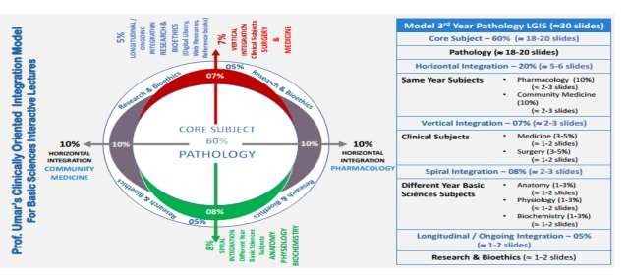

Slide 5
Learning Objectives
Classify neuropathies based on their types and causes.
Describe the pathophysiology and clinical presentation of various neuropathies.
Explain the morphology of neuropathies, including structural changes at the cellular and tissue levels.
Learning Resources: Robbins & Cotran Pathologic Basis Of Disease 10th Edition

Slide 6
Anatomy and physiology
VERTICAL INTEGRATION
Components of Peripheral Nerves:
Axon
Myelin Sheath

Slide 7
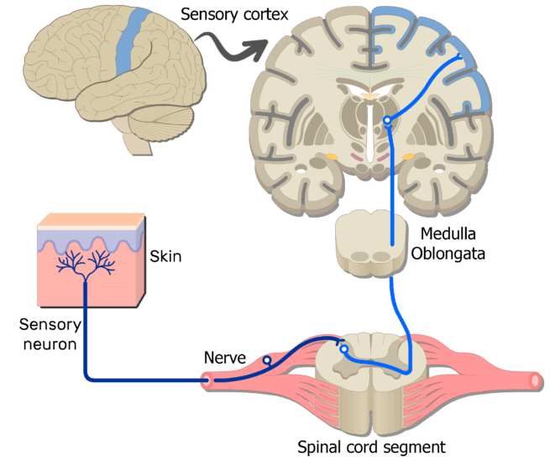
Somatic Sensory Function
VERTICAL INTEGRATION

Slide 8
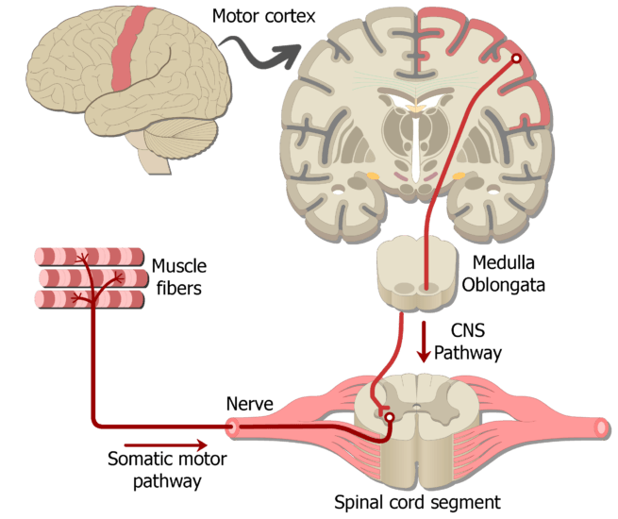
Somatic Motor Function
VERTICAL INTEGRATION

Slide 9
Neuronopathies
VERTICAL INTEGRATION
Neuronopathies result from the destruction of neurons, leading to the secondary degeneration of axonal processes.
Infections (e.g., herpes zoster) and toxins (e.g., platinum compounds) are examples of insults that can cause neuronopathies.
Damage occurs at the level of the neuronal cell body.
Peripheral nerve dysfunction affects both the proximal and distal parts of the body.

Slide 10
Axonal Neuropathies
CORE PATHOLOGY
Wallerian Degeneration:
Portions of axons distal to the point of transection degenerate.
Traumatic Neuroma:
A growth or knot of nerve tissue that forms at the site of a nerve injury.
Electrophysiologic Hallmark of Axonal Neuropathies:
Reduction in signal amplitude due to the dropout of axons from affected peripheral nerves.
Relative preservation of conduction velocity, despite the loss of axons.

Slide 11
CORE PATHOLOGY

Slide 12
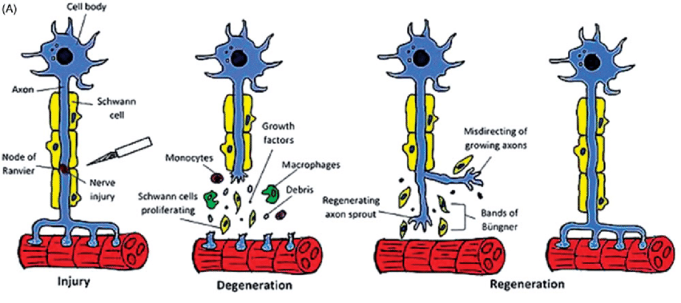
CORE PATHOLOGY

Slide 13
Demyelinating Neuropathies
CORE PATHOLOGY
Schwann cells and their myelin sheaths are the primary targets of damage in demyelinating neuropathies.
Electrophysiologic hallmark of demyelinating neuropathies:
Slowed nerve conduction velocity, reflecting the loss of myelin.
Individual myelin sheaths degenerate, resulting in discontinuous damage to myelin segments.
Schwann cells proliferate and initiate repair.
New myelin sheaths formed are shorter and thinner than the original ones.

Slide 14
CORE PATHOLOGY

Slide 15
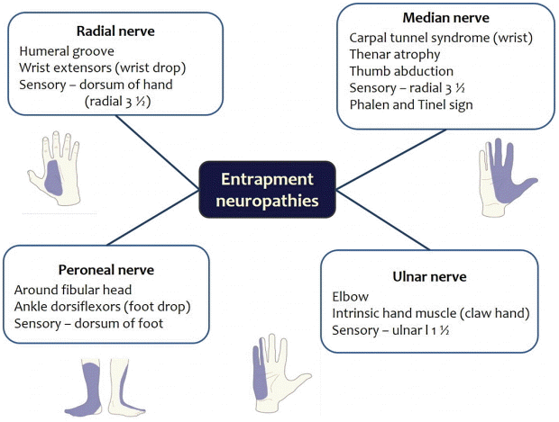
Peripheral Neuropathies
VERTICAL INTEGRATION
Mononeuropathies affect a single nerve, resulting in deficits in a restricted distribution dictated by the nerve anatomy.
Common causes of mononeuropathy include:
Trauma
Entrapment
Infections

Slide 16
Peripheral Neuropathies
VERTICAL INTEGRATION
Polyneuropathies are characterized by involvement of multiple nerves, usually in a symmetric fashion.
In most cases, axons are affected in a length-dependent fashion, leading to deficits that:
Start in the feet.
Ascend with disease progression.
The hands often start to show involvement by the time deficits extend to the level of the knee, resulting in a characteristic “stocking and glove” distribution of sensory deficits.

Slide 17
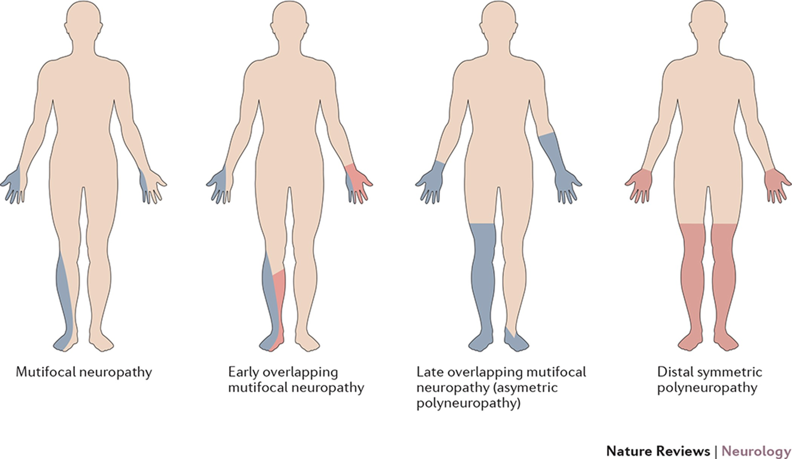
Distribution of neuronal function loss in different neuropathies
CORE PATHOLOGY

Slide 18
Peripheral Neuropathies
CORE PATHOLOGY
Mononeuritis multiplex describes a disease process that damages individual nerves in a haphazard fashion.
An affected patient might have:
A right wrist drop from involvement of the right radial nerve.
A left foot drop from peroneal nerve damage.
Vasculitis is a common cause of this pattern of injury.
Polyradiculoneuropathy affect both nerve roots and peripheral nerves, leading to:
Diffuse symmetric symptoms in both proximal and distal parts of the body.

Slide 19
Guillain-Barré Syndrome (Acute Inflammatory Demyelinating Polyneuropathy)
VERTICAL INTEGRATION
An immunologically mediated demyelinating peripheral neuropathy that may lead to life-threatening respiratory paralysis.
Symptoms: Weakness begins in the distal limbs and rapidly advances to affect proximal muscle function ("ascending paralysis").
Deep tendon reflexes disappear early in the process.
Sensory involvement, including loss of pain sensation, is often present but typically not a prominent feature.
Nerve conduction velocities are slowed due to multifocal destruction of myelin segments in many axons within a nerve.
Cerebrospinal fluid (CSF) protein levels are elevated due to inflammation and altered permeability of the microcirculation within the spinal roots as they traverse the subarachnoid space.

Slide 20
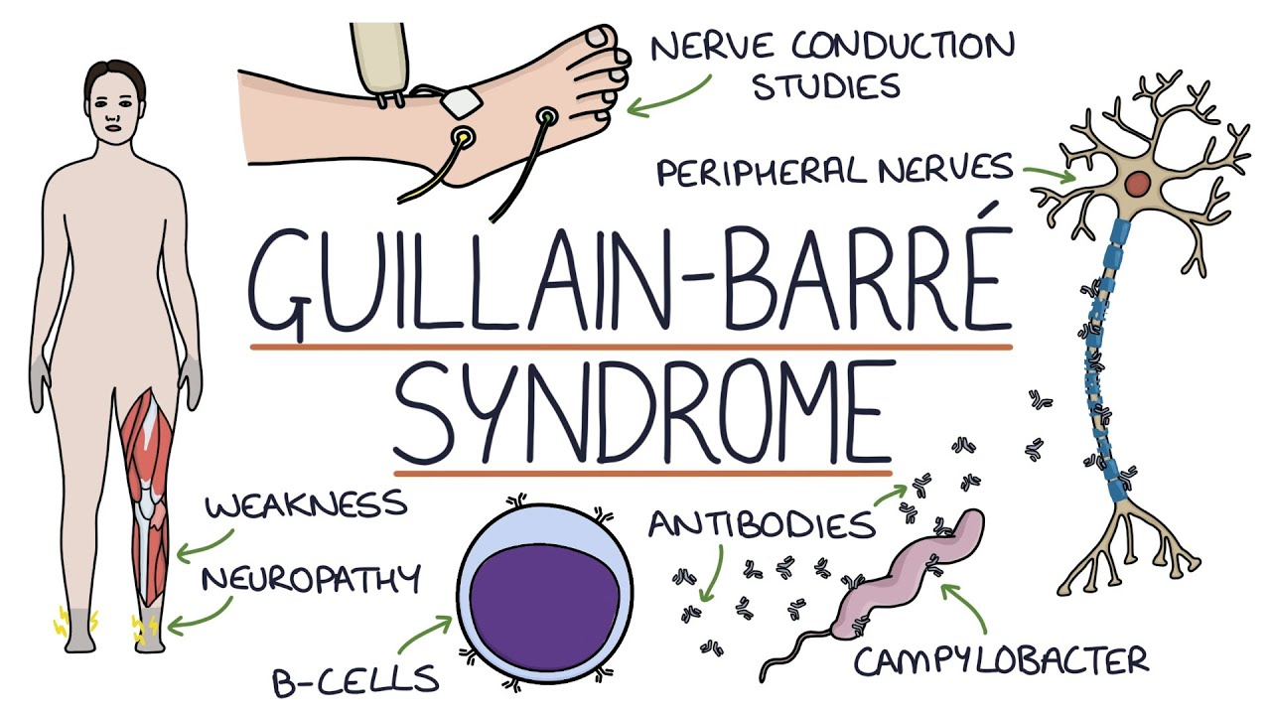
CORE PATHOLOGY

Slide 21
Leprosy (Hansen Disease)
CORE PATHOLOGY
Peripheral nerves are involved in both lepromatous and tuberculoid leprosy.
Lepromatous Leprosy:
Schwann cells are invaded by Mycobacterium leprae.
There is segmental demyelination and remyelination, along with loss of both myelinated and unmyelinated axons.
Later, endoneurial fibrosis and multilayered thickening of the perineurial sheaths occur.
Symmetric polyneuropathy is most severe in the relatively cool distal extremities and the face.
The infection prominently involves pain fibers, and the resulting loss of sensation contributes to injury.
This leads to the development of large traumatic ulcers.

Slide 22
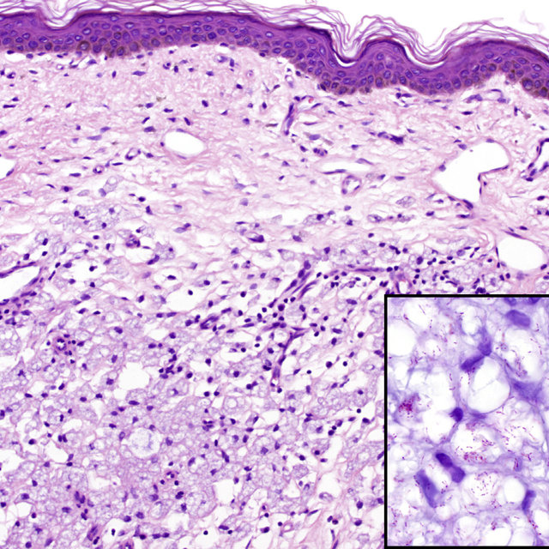
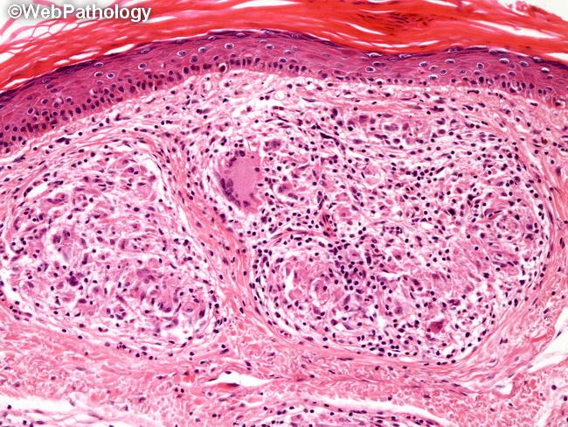
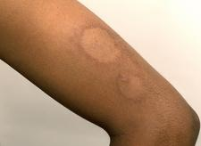
CORE PATHOLOGY

Slide 23
Leprosy (Hansen Disease)
CORE PATHOLOGY
Tuberculoid Leprosy:
Active cell-mediated immune response to M. leprae.
Dermal nodules contain granulomatous inflammation.
The inflammation injures cutaneous nerves in the vicinity.
Axons, Schwann cells, and myelin are lost.
Fibrosis of the perineurium and endoneurium occurs.
Much more localized nerve involvement compared to lepromatous leprosy.

Slide 24
Varicella-Zoster Virus
CORE PATHOLOGY
Following chickenpox, a latent infection persists within neurons of sensory ganglia.
The virus is reactivated years later and is transported along sensory nerves to the skin.
It infects keratinocytes, leading to a painful, vesicular skin eruption in a distribution that follows sensory dermatomes (known as shingles).
The most common involvement occurs in the thoracic or trigeminal nerve dermatomes.

Slide 25
Diabetic Neuropathy
CORE PATHOLOGY
Hyperglycemia causes the nonenzymatic glycosylation of proteins, lipids, and nucleic acids.
The resulting advanced glycosylation end-products (AGEs) interfere with normal protein function and activate inflammatory signaling.
Reactive oxygen species contribute to damage.
Ischemic damage also occurs.
This leads to an ascending distal symmetric sensorimotor polyneuropathy.
The neuropathy typically results in axonal neuropathy.

Slide 26
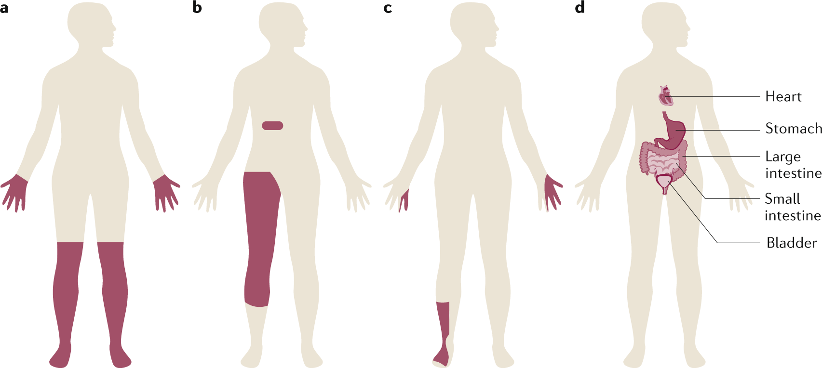
Diabetic Neuropathy
CORE PATHOLOGY

Slide 27
Diabetic Neuropathy
VERTICAL INTEGRATION
Numbness
Loss of pain sensation
Difficulty with balance
Paresthesias or dysesthesias
Dysfunction of the autonomic nervous system

Slide 28
Toxic Neuropathies
HORIZONTAL INTEGRATION
Alcohol
Heavy metals (e.g., lead, mercury, arsenic, thallium)
Medications, such as:
Chemotherapeutic agents:
Vinca alkaloids and taxanes (microtubule inhibitors that interfere with axonal transport)
Cisplatin
Neuronopathy due to these factors.

Slide 29
Neuropathies Caused By Physical Forces
HORIZONTAL INTEGRATION
Compression neuropathy (also known as entrapment neuropathy):
Carpal tunnel syndrome, the most common entrapment neuropathy, results from compression of the median nerve at the level of the wrist within the compartment delimited by the transverse carpal ligament.
Symptoms are limited to dysfunction of the median nerve and typically include:
Numbness and paresthesia of the tips of the thumb and first two digits.

Slide 30
Epidemiology
HORIZONTAL INTEGRATION
One study estimated that the prevalence of peripheral neuropathy in the family medicine setting is 8 percent in persons 55 years and older.
Diabetic neuropathy is the most common metabolic peripheral neuropathy.
The second most common metabolic neuropathy is that associated with uremia.

Slide 31
Neuropathies and Rehabilitation Medicine
SPIRAL INTEGRATION
Multimodal Management: Combines medications (gabapentinoids, antidepressants), physical therapy, and nerve stimulation for symptom relief.
Functional Restoration: Focuses on muscle strengthening, balance training, and assistive devices to improve mobility.
Pain Management: Utilizes pharmacological, physiotherapeutic, and non-invasive neuromodulation techniques for chronic neuropathic pain.
Patient Education: Emphasizes lifestyle modifications, fall prevention, and self-care strategies to enhance independence.

Slide 32
Research
Int. J. Mol. Sci. 2023, 24(4), 3554; https://doi.org/10.3390/ijms24043554

Slide 33
End Of Session Evaluation
While conducting research on patients with demyelinating disease, the student observed that the conduction velocity of the impulses was slower than in normal subjects. This observation is attributed to the loss of which one of the following physiological functions?
Node to node transmission of nerve impulse
Formation of action potential
Synaptic transmission of neurons
Nerve impulse formation at the neuromuscular junction
Excitability of end receptors

