Slide 2
Neurodegenerative Disorders
CNS & Psychiatry II 4th year MBBS
Department of Pathology
Rawalpindi Medical University

Slide 4
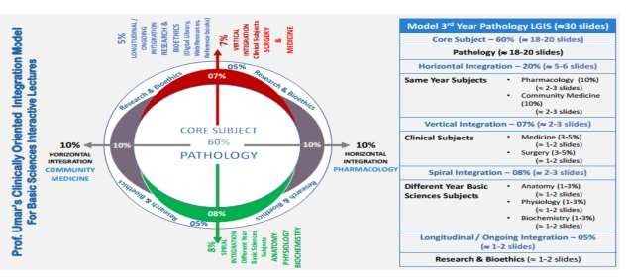

Slide 5
Learning Objectives
By the end of this session, the student should be able to:
Correlate the clinical features of multiple sclerosis with its pathogenesis and morphological changes.
List the laboratory diagnostic features of multiple sclerosis.
Describe the pathogenesis and morphology of Alzheimer's disease.
Enlist the signs and symptoms of Parkinson's disease and correlate them with its pathogenesis and morphology.
Learning Resources: Robbins & Cotran Pathologic Basis Of Disease 10th Edition

Slide 6
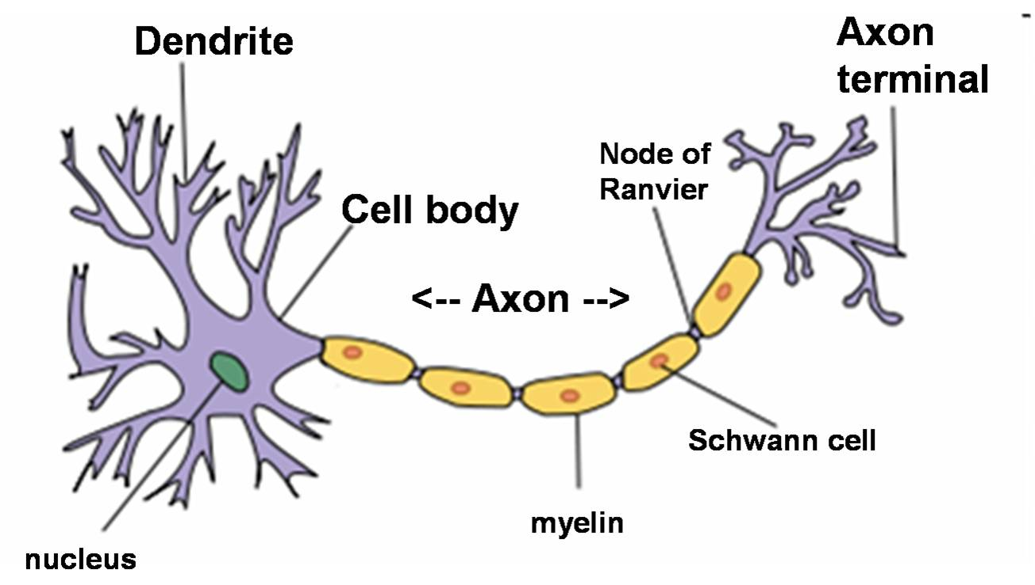
Neuron & Cells Of Nervous System
VERTICAL INTEGRATION
ANATOMY
PHYSIOLOGY
Parts of Neuron:
Dendrites: Extensions of a nerve cell that propagate the electrochemical stimulation.
Axons: Tightly covered by the myelin sheath, which acts as an insulator for the transmission of electrical impulses.
Cells of Nervous System:
Oligodendrocytes in the brain.
Schwann cells in peripheral nerves.

Slide 7
Primary Diseases Of Myelin
CORE PATHOLOGY
Group 1
Demyelinating Diseases
Group 2
Dysmyelinating Diseases
Multiple sclerosis
(immune-mediated injury)
2. Multifocal leukoencephalopathy (viral infection of Oligodendrocytes)
3. Drugs and other toxic agents
Leukodystrophy: It is associated with mutations that disrupt the function of proteins required for the formation of normal myelin sheath

Slide 8
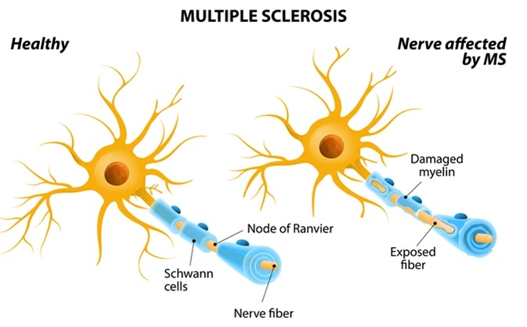
VERTICAL INTEGRATION

Slide 9
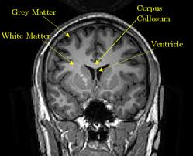
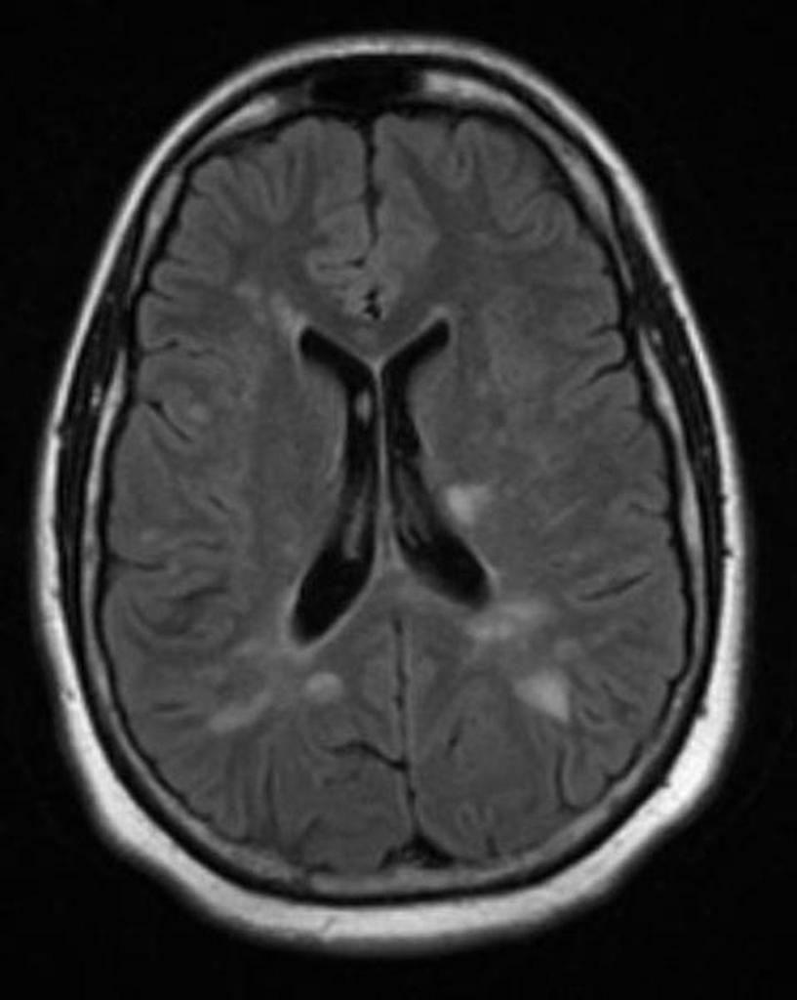
VERTICAL INTEGRATION

Slide 10
Multiple Sclerosis
VERTICAL INTEGRATION
Definition: Multiple sclerosis (MS) is an autoimmune disorder characterized by disseminated sclerotic plaques and destruction of myelin (demyelination) throughout the central nervous system (CNS). It progresses to a relapsing-remitting disease in 80% of cases and causes neurological deficits.
Multiple sclerosis affects:
White matter
Optic nerve
Spinal cord

Slide 11
Multiple Sclerosis Epidemiology
HORIZONTAL INTEGRATION
Disease Prevalence: Occurs in approximately 1 per 1000 persons in most parts of the United States and Europe.
Age of Onset: Mostly affects adults; rare in childhood or after 50 years of age.
Gender Ratio: Women: Men = 2:1
Familial Tendency: Typically seen in monozygotic (identical) twins.

Slide 12
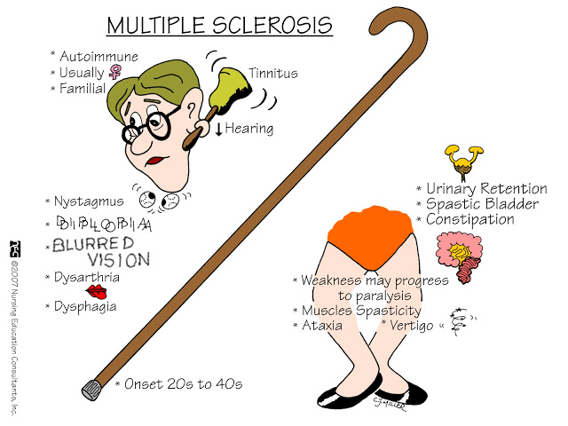
VERTICAL INTEGRATION

Slide 13
Pathogenesis
CORE PATHOLOGY
Genetic Factors:
HLA-DR2 allele is the commonly involved gene in multiple sclerosis.
Polymorphisms (genetic variations) in genes encoding receptors for cytokines and interleukins (IL-2, IL-7) are also implicated.
Role of Cytokines:
IL-2 and IL-7 are responsible for the activation and regulation of T cell–mediated immune responses.
T Cell Involvement:
CD4+ T cells and CD8+ T cells contribute to the development of demyelination.
Macrophage Activity:
In the early stages, macrophages contain myelin fragments; later, they contain proteins and lipids resulting from the chemical degradation of myelin.

Slide 14
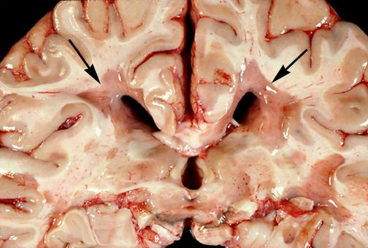
Morphology
CORE PATHOLOGY
Gross Appearance: Multiple, well-circumscribed lesions, termed plaques, are the characteristic feature of multiple sclerosis.
These plaques are frequently seen in the following areas:
Periventricular area
Optic nerves
Optic chiasma
Brainstem
Spinal cord

Slide 15
Morphology
CORE PATHOLOGY
Microscopic Appearance: Active & Inactive Plaques
Active plaques suggest myelin breakdown, while inactive plaques are in the dormant phase.
Types of Active Plaques:
Type I: Predominantly macrophage infiltrates.
Type II: Macrophages along with an antibody-mediated component.
Type III: Less well-defined borders and apoptosis of oligodendrocytes.
Type IV: Non-apoptotic oligodendrocyte loss.

Slide 16
Diagnosis of MS
VERTICAL INTEGRATION
History (Signs and Symptoms)
Neurological Examination
Blood Cell Profile (CP): Lymphocytosis
Complement Levels: Measured by ELISA
CSF Routine Examination (R/E):
Mildly elevated protein levels
Increased proportion of immunoglobulin
In one-third of cases, moderate pleocytosis (B cell lymphocytosis) is present.
Magnetic Resonance Imaging (MRI) Scan

Slide 17
Overview of Degenerative Diseases of the CNS
VERTICAL INTEGRATION
They are characterized by the loss of functionally related groups of neurons.
DISEASE | CLINICAL PATTERN
Alzheimer disease | Dementia
Frontotemporal lobar degeneration | Behavior changes, language disturbances
Parkinson Disease | Hypokinetic movement disorder
Huntington disease | Hyperkinetic movement disorder
Spinocerebellar ataxia | Cerebellar ataxia
Amyotrophic lateral sclerosis | Weakness with upper and lower motor neuron signs

Slide 18
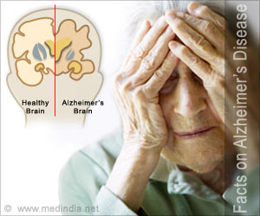
1. Alzheimer's Disease

Slide 19
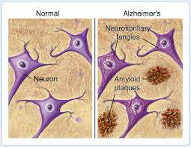
Alzheimer’s Disease
CORE PATHOLOGY
There is severe cortical dysfunction due to excessive amyloid deposits in the brain.
Alzheimer's disease causes problems with memory, thinking, and behavior.
The patient becomes completely disabled and mute after 5-10 years of disease progression.

Slide 20
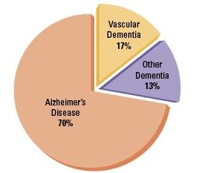
Prevalence
HORIZONTAL INTEGRATION
3-15% in individuals >60 years of age
5-10% are familial
Up to 5% have younger-onset
The cause is unknown, but genetics is also involved

Slide 21
Pathogenesis
CORE PATHOLOGY
The main abnormality in AD is the deposition of a peptide called beta-amyloid (or Aβ), which accumulates in the brain.
Aβ is derived from amyloid precursor protein (APP).
Abnormal cleavage of APP results in the formation of Aβ peptide - which cannot be degraded - so accumulates in neural tissue - toxic and severe inflammatory changes - neuronal death.

Slide 22
CORE PATHOLOGY

Slide 23
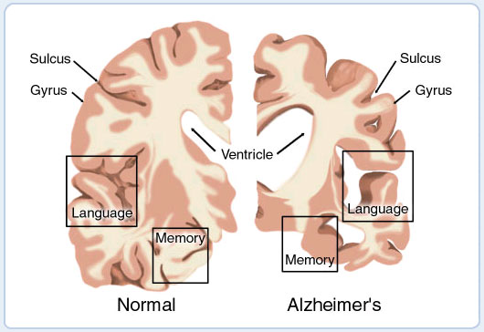
Morphology
CORE PATHOLOGY
Gross Examination: Cortical atrophy, resulting in a widening of the cerebral sulci, is observed.
It is most pronounced in the frontal, temporal, and parietal lobes.
Along with ventricular enlargement (hydrocephalus).
Microscopy: Presence of Plaques (an extracellular lesion): These are spherical collections of dilated, tortuous neuritic processes.
Neurofibrillary Tangles (an intracellular lesion): These are composed of tau protein and bundles of filaments inside the cytoplasm of neurons.

Slide 24
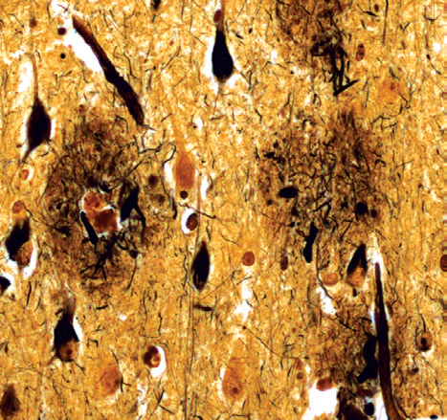
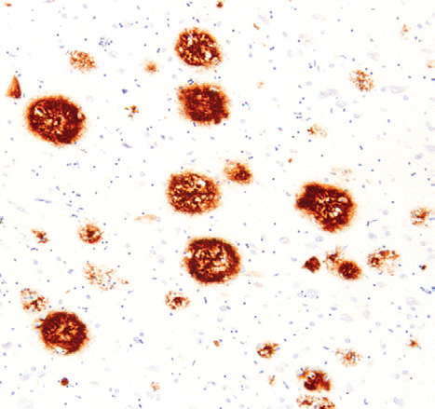
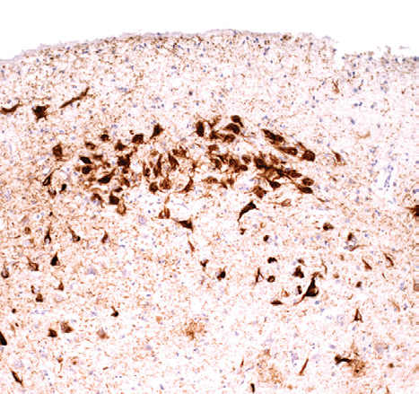
CORE PATHOLOGY
A
B
C
A. Plaques contain a central core of amyloid and a surrounding region of dystrophic neurites
B. Immunohistochemical stain for Aβ Peptide is present in the core of the plaques as well as in the surrounding region.
C. Neurons containing tangles stained with an antibody specific for tau.

Slide 25
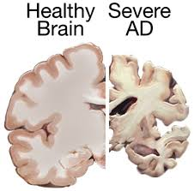
Diagnosis
VERTICAL INTEGRATION
Clinically:
Mini Mental State Examination (MMSE)
CT, MRI (brain atrophy)

Slide 26
2- Parkinson’s Disease

Slide 27
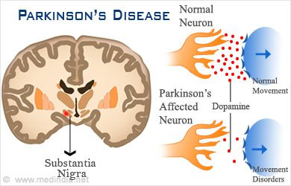
Parkinson’s Disease
HORIZONTAL INTEGRATION
Due to the death of dopamine-generating cells in the substantia nigra (midbrain).
Parkinsonism can also be induced by drugs such as dopamine antagonists.
Disease progresses over 10-15 years.
High mortality afterward is associated with trauma and infections.
It can be autosomal dominant or recessive.
Point mutations and duplications of the gene encoding α-synuclein result in its abnormal deposition in the brain.

Slide 28
Sign And Symptoms (PD)
VERTICAL INTEGRATION

Slide 29
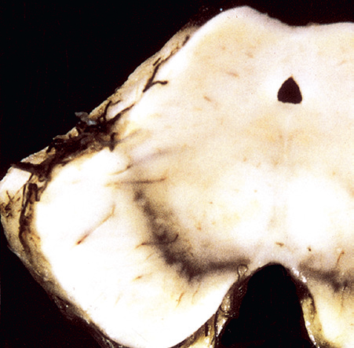
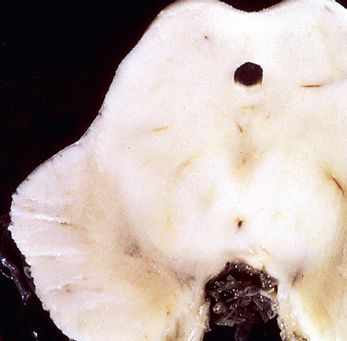
Morphology
CORE PATHOLOGY
Gross:
At autopsy, there is marked pallor of the substantia nigra and locus coeruleus.
Normal substantia nigra.
Depigmented substantia nigra

Slide 30
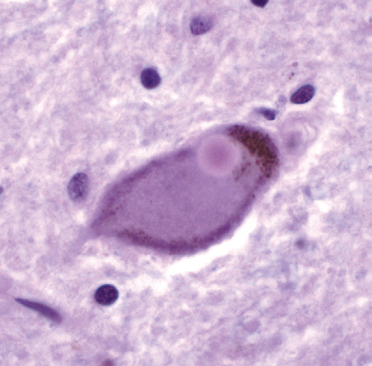
Morphology
CORE PATHOLOGY
Microscopy:
Presence of Lewy bodies:
These are single or multiple, round to elongated, intracytoplasmic, eosinophilic inclusions.
They often have a dense core surrounded by a pale halo.
Lewy body in a neuron from the substantia nigra

Slide 31
Prevention And Treatment
HORIZONTAL INTEGRATION
Treatment:
Levodopa
Cell transplantation of grafted dopaminergic neurons

Slide 32
Summary
Multiple sclerosis
Alzheimer disease
Parkinson’s disease
Multiple Sclerosis:
It is an autoimmune disorder characterized by disseminated sclerotic plaques and destruction of myelin (demyelination) throughout the CNS.
Multiple Sclerosis causes:
Blurred vision
Tinnitus
Muscle weakness
There is severe cortical dysfunction due to excessive amyloid deposits in the brain.
Alzheimer's causes:
Memory problems
Difficulty with thinking
Changes in behavior
This is due to the death of dopamine-generating cells in the substantia nigra (midbrain).
Parkinson’s causes:
Tremors
Rigidity
Difficulty with walking

Slide 33
Family Medicine Role in Neurodegenerative Disease
SPIRAL INTEGRATION
Early Detection & Diagnosis: Identify early symptoms like tremors, bradykinesia, and rigidity for timely referral and management.
Medication Management: Monitor response to levodopa, dopamine agonists, and adjust treatment to minimize side effects.
Multidisciplinary Coordination: Collaborate with neurologists, physiotherapists, speech therapists, and mental health professionals.
Patient & Caregiver Support: Make the patient independent for his daily routine work as much as possible . Provide education, lifestyle guidance, fall prevention, and emotional support for patients and families

Slide 34
Research
https://doi.org/10.1016/j.cell.2019.09.001

