Slide 2
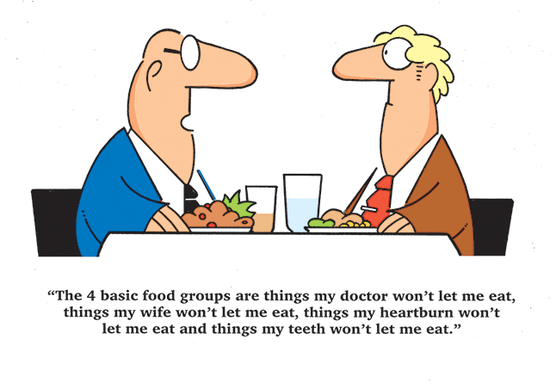
Neoplastic Lesions of Esophagus
GASTROINTESTINAL HEPATOBILIARY
& PARASITOLOGY II Module
3rd year MBBS
Dr. Mudassira Zahid
Associate Professor
Department of Pathology
Rawalpindi Medical University

Slide 3
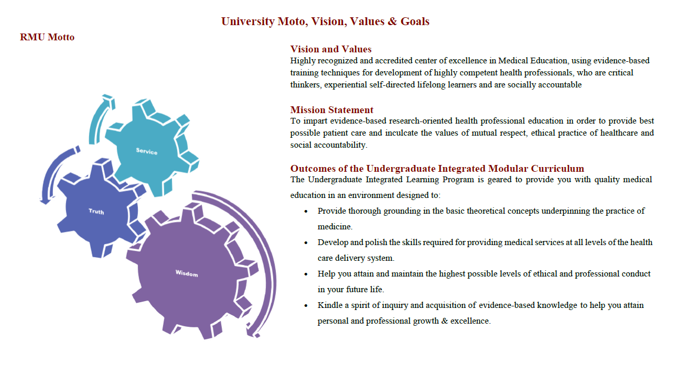

Slide 4
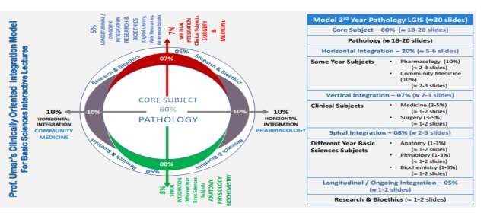

Slide 5
Learning Objectives
By the end of this session, the student should be able to:
Enlist the causative factors for esophagitis.
Define Barrett's esophagus.
Correlate the pathogenesis of Barrett's esophagus with GERD.
Differentiate between the morphological features of GERD and Barrett's esophagus.
Correlate the dysplastic changes in Barrett's esophagus with adenocarcinoma.
Enlist the risk factors for squamous cell carcinoma of the esophagus.
Differentiate between the morphology of adenocarcinoma of the esophagus and squamous cell carcinoma.
Learning Resources: Robbins & Cotran Pathologic Basis Of Disease 10th Edition

Slide 6
Anatomy and physiology
VERTICAL INTEGRATION

Slide 7
Anatomy and Histology
VERTICAL INTEGRATION

Slide 8
Symptoms of Esophagitis:
VERTICAL INTEGRATION
Difficult or painful swallowing (dysphagia).
Chest pain, particularly behind the sternum, that occurs with eating.
Swallowed food becoming stuck in the esophagus (food impaction).
Heartburn.
Acid regurgitation.

Slide 9
Reflux Esophagitis/GERD
VERTICAL INTEGRATION
Gastroesophageal Reflux Disease (GERD)
Inflammation resulting from the backflow of gastric acidic contents into the lower part of the esophagus.
The lower part of the esophagus is protected by:
Constant lower esophageal sphincter tone that prevents backflow of gastric contents.
Submucosal esophageal glands that produce mucin and bicarbonate, which neutralize acid.

Slide 10
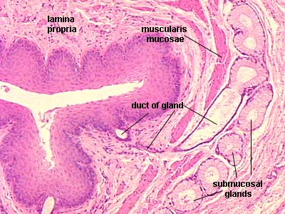
Reflux Esophagitis/GERD
VERTICAL INTEGRATION
Normally, the distal esophagus is lined by stratified squamous mucosa.

Slide 11
CORE PATHOLOGY

Slide 12
Factors Contributing to Reflux:
HORIZONTAL INTEGRATION
Alcohol
Tobacco
Obesity
Pregnancy
Hiatal hernia
Delayed gastric emptying

Slide 13
Gastroesophageal Reflux and Its Effects
CORE PATHOLOGY
Prolonged and persistent gastroesophageal reflux first causes inflammation and then metaplasia (columnar metaplasia).

Slide 14
Gastroesophageal Reflux and Its Effects
CORE PATHOLOGY

Slide 15
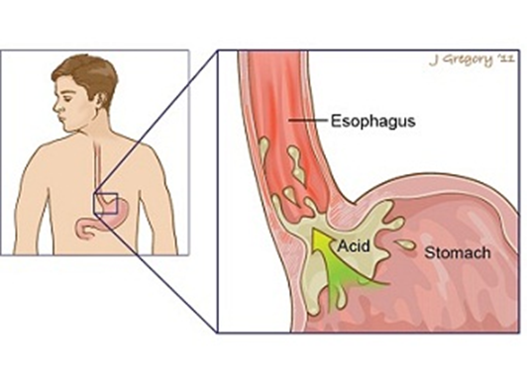
Barrett Esophagus
CORE PATHOLOGY
Definition:
Replacement of the normal distal stratified squamous mucosa by metaplastic columnar epithelium containing goblet cells (intestinal metaplasia).
Pathogenesis
It is usually a complication of long-standing gastroesophageal reflux disease (GERD).

Slide 16
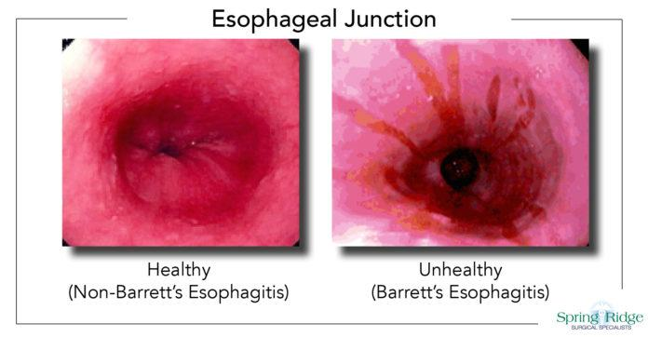
Barrett Esophagus
VERTICAL INTEGRATION
More common in males (4:1) and in white races.
On endoscopy, it is seen as one or several tongues or patches of red velvety mucosa extending upward from the gastroesophageal junction.

Slide 17
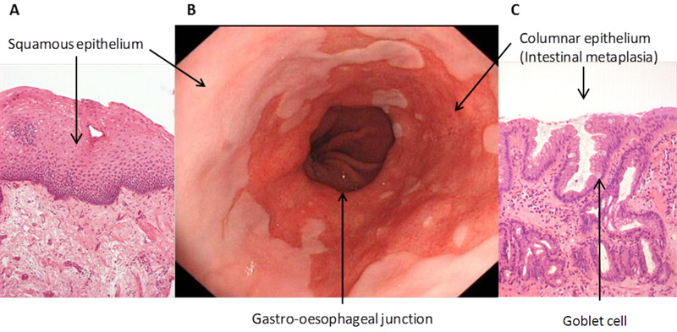
Microscopy
CORE PATHOLOGY
The esophageal squamous mucosa is replaced by metaplastic columnar epithelium with goblet cells.

Slide 18
Microscopy
CORE PATHOLOGY
The esophageal squamous mucosa is replaced by metaplastic columnar epithelium with goblet cells.

Slide 19
CORE PATHOLOGY

Slide 20
Dysplasia in Barrett Esophagus
CORE PATHOLOGY
As the lesion progresses, dysplasia may appear in the metaplastic columnar epithelium. This is why close follow-up is advised in Barrett esophagus. If dysplasia appears, surgery or other interventions may be required.
Dysplasia is graded as:
Low grade
High grade

Slide 21
Malignant Tumors
CORE PATHOLOGY
Squamous cell carcinoma
Adenocarcinoma

Slide 22
Adenocarcinoma
CORE PATHOLOGY
The only precursor of adenocarcinoma is
Barrett esophagus.
It takes many years to develop adenocarcinoma from Barrett esophagus.

Slide 23
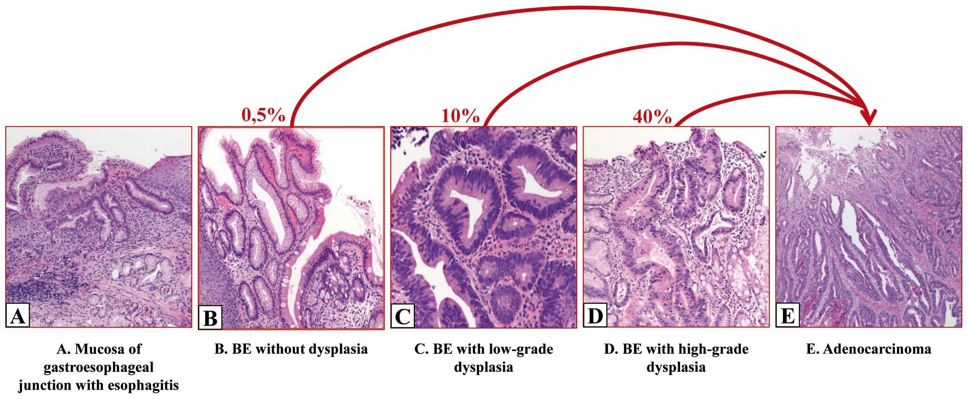
Risk of Cancer Progression Based on Dysplasia Grade
CORE PATHOLOGY
Degree of dysplasia is a strong predictor for progression to cancer:
Low-grade dysplasia = 1-2% chance
High-grade dysplasia = 10% chance

Slide 24
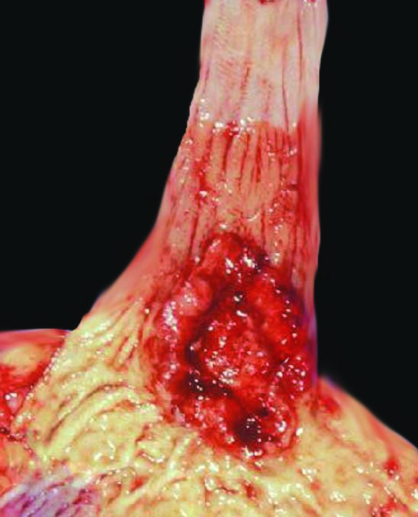
Morphology
CORE PATHOLOGY
Gross:
Distal 3rd of the esophagus
Flat or raised patches
Later develop into large nodular masses or form ulcerative or infiltrative lesions

Slide 25
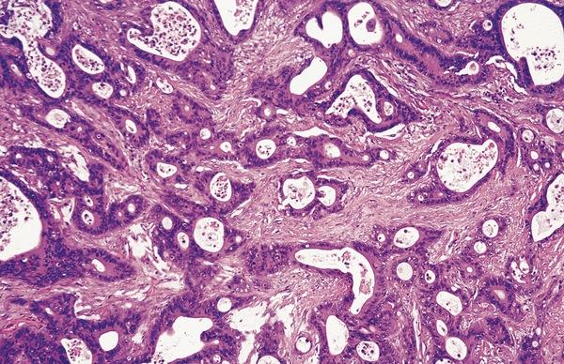
Microscopy
CORE PATHOLOGY
Neoplastic mucin-producing glands lined by pleomorphic cells with hyperchromatic nuclei and prominent nucleoli.

Slide 26
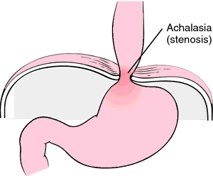
Squamous Cell Carcinoma of the Esophagus
HORIZONTAL INTEGRATION
It is the most common malignant tumor of the esophagus.
Risk Factors:
Tobacco and alcohol
Esophageal disorders
Caustic injury
Achalasia
Plummer-Vinson syndrome

Slide 27
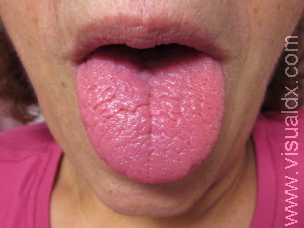
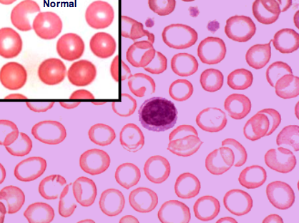
Plummer-Vinson Syndrome
HORIZONTAL INTEGRATION
Esophageal webs
Anemia
Atrophic glossitis

Slide 28
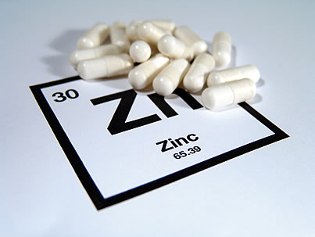
Risk Factors for Squamous Cell Carcinoma of the Esophagus
HORIZONTAL INTEGRATION
3. Dietary Factors:
Vitamin A, C, B deficiency
Zinc deficiency
Fungal contamination of food
High content of nitrites/nitrosamines
4. Genetic Factors:
Genetic predisposition
P53 gene mutation
P16 gene mutation

Slide 29
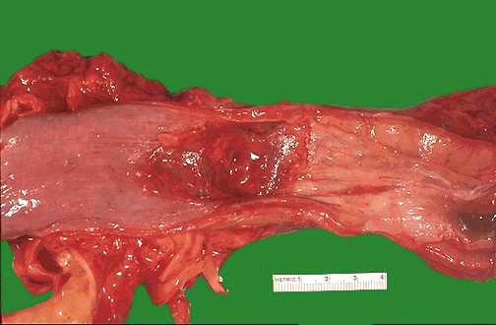
Morphology of Squamous Cell Carcinoma of the Esophagus
CORE PATHOLOGY
Gross:
Middle 3rd of the esophagus
Small gray-white plaques or thickening
Slowly grows into a polypoidal exophytic mass
May form ulceration
Or may present as a diffuse infiltrative tumor

Slide 30
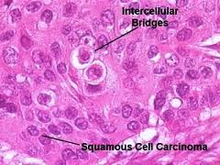
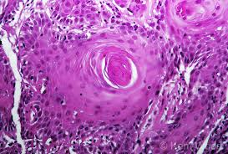
Microscopy of Squamous Cell Carcinoma of the Esophagus
CORE PATHOLOGY
Infiltrative sheets of pleomorphic squamous cells with hyperchromatic nuclei and prominent nucleoli, with or without keratin pearls.

Slide 31
CORE PATHOLOGY

Slide 32
Clinical Features of Squamous Cell Carcinoma of the Esophagus
VERTICAL INTEGRATION
Dysphagia
Obstruction
Weight loss
Anorexia
Pain

Slide 33
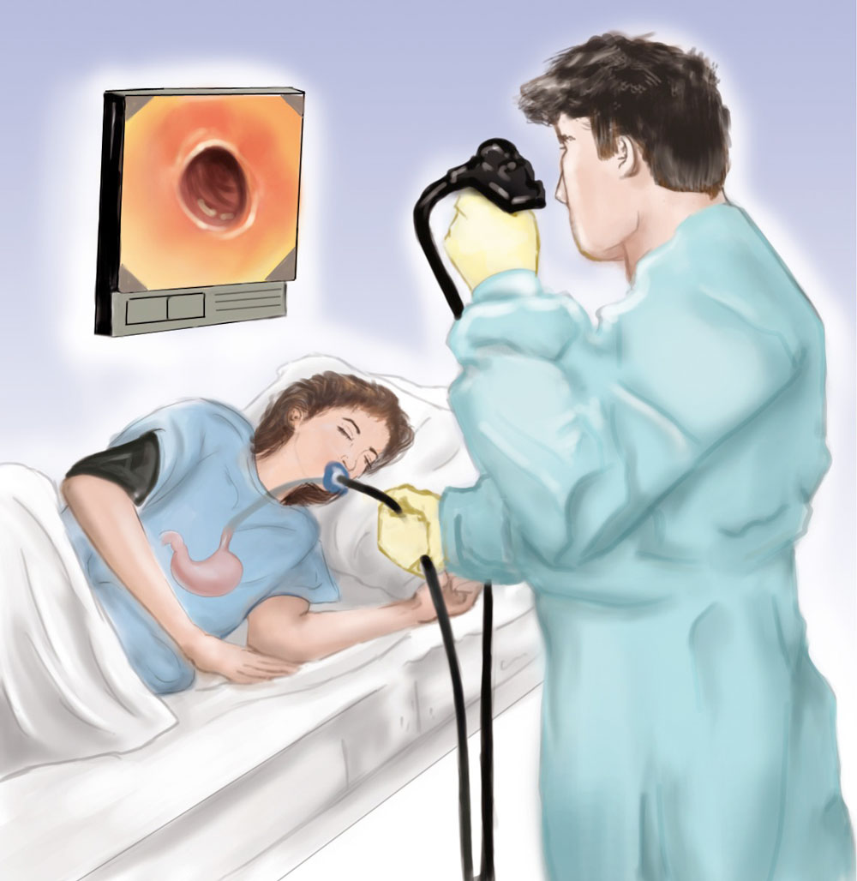
Diagnosis
VERTICAL INTEGRATION
Endoscopy and biopsy

Slide 34
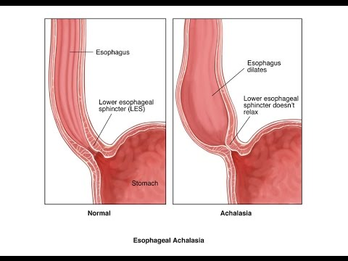
Achalasia
CORE PATHOLOGY
“Failure to relax”
Aperistalsis
Incomplete relaxation of the LES
Increased LES tone
Progressive dysphagia starting in teens
Types of Achalasia:
Primary – Loss of intrinsic inhibitory innervation of LES
Secondary – Uncertain etiology, including Chagas disease, polio, and autonomic neuropathy.

Slide 35
Professionalism
SPIRAL INTEGRATION
Approach to a condition with malignant potential
Patient education
Preventive measures
Education about cessation of smoking and alcohol
If needed regular follow up
Patient registry

