Slide 1
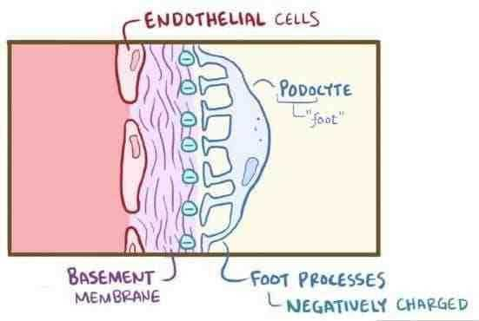
Nephrotic syndrome Renal module 4th Year MBBS
Dr. Kiran Fatima
Pathology Department
Rawalpindi Medical University

Slide 4
How to use HEC Digital Library
Steps to Access HEC Digital Library
Go to the website of HEC National Digital Library.
On Home Page, click on the INSTITUTES.
A page will appear showing the universities from Public and Private Sector and other Institutes which have access to HEC National Digital Library (HNDL).

Slide 5
Select your desired Institute.
A page will appear showing the resources of the institution
Journals and Researches will appear
You can find a Journal by clicking on JOURNALS AND DATABASE and enter a keyword to search for your desired journal.

Slide 6
Learning Objectives
Classify glomerular diseases
Describe the features of nephrotic syndrome
Describe, compare and distinguish the pathogenesis, clinical presentations, light microscopic features, Immunofluorescence and electron microscopic features of the glomerular diseases causing nephrotic syndrome

Slide 7
spiral

Slide 8
Pathology Core

Slide 9
Pathogenic mechanisms
Pathology
core
Glomerular permeability of
capillary walls
Permeability to plasma proteins- Heavy proteinuria
Increase lipoprotein
synthesis
Hyperlipidemia
Decreased S. albumin and
colloid pressure
Edema
Lipiduria

Slide 10
Complications
Pathology Core
Infections – due complementenimia
Renal vein thrombosis – Antithrombin III leakage
Iron def. – Transferrin leakage

Slide 11
Minimal change disease
Pathology Core
Common cause of primary glomerular disease of NS in children
Accounts for 80% of cases of nephrotic syndrome in children, and 10% to 15% of cases in adults
No cause is found in most patients.
Disease is immunologically mediated and related to abnormal T-cell function
Occasionally follows Resp. infection or routine prophylactic immunization

Slide 12
Minimal change disease
Pathology Core
Diffuse effacement of foot processes of visceral epithelial cells (podocytes), detectable only by electron microscopy, in glomeruli that appear virtually normal by light microscopy
Present with full-blown pure nephrotic syndrome
Severe edema, ascites, and pleural effusions may occur
Response to steroids is excellent
Types
Primary
Secondary –Associated with NSAIDS and acute interstitial nephritis

Slide 13
Causes of proteinuria in MCD
Pathology Core
Immune dysfunction provokes cytokine like circulating substance Ultra structural defects in podocytes
Loss of GBM poly anion Charge barrier defects
Nephrin protein mutation Defect in adhesion receptors Detachment of foot processes from GBM

Slide 14
MCD light microscopy
Pathology Core
Normal findings by light microscopy
Notes:
This normal glomerulus is stained with PAS to highlight basement membranes of glomerular capillary loops and tubular epithelium. The capillary loops of this normal glomerulus are well-defined and thin. The endothelial cells are seen in capillary loops. The mesangial regions are of normal size. Podocytes are present and forming the visceral epithelial surface. Bowman's space is seen along with parietal epithelial cells.

Slide 15
MCD electron microscopy
Pathology Core
Diffuse effacement of foot processes
Flattening, swelling, retraction of foot processes
epithelial cell vacuolization, microvillus formation
No electron dense material
The capillary loop in the lower half contains two electron dense RBCs. Fenestrated endothelium is present, and the basement membrane is normal. However, overlying epithelial cell foot processes are effaced giving the appearance of fusion

Slide 16
MCD Immunofluorescence
Pathology Core
Immunoflourescence microscopy (IF)- normal

Slide 17
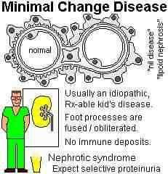
Pathology Core

Slide 18
Membranous nephropathy
Pathology Core
Diffuse thickening of the glomerular capillary wall due to the accumulation of deposits containing Ig along the subepithelial side of the basement membrane
Second most common entity associated with idiopathic nephrotic syndrome in adults

Slide 19
Etiology
Pathology Core
Mostly primary disease antibodies to a renal autoantigen eg phospholipase A2 receptor
Secondary could be due to
Drugs
Underlying malignant tumors
SLE.
Infections (chronic hepatitis B, hepatitis C, syphilis, schistosomiasis, malaria)
Autoimmune disorders such as thyroiditis

Slide 20
Pathogenesis
Pathology Core
Autoantigen
Endogenous (phospholipase A2 receptor)
Exogenous (HBV)
Immune complexes activate MAC
Activation of glomerular epithelial and mesangial cells
Release of proteases and oxidants
Damage to the capillary wall
Protein leakage

Slide 21
MGN light microscopy
Pathology Core
Early stage normal or uniform diffuse thickening of glomerular capillary wall
no increased cellularity.
Later uniform diffuse wall thickening
Subepithelial granular deposits with BM material deposition in between
Eventually sclerosis
Leucocyte infiltration seen in interstitium

Slide 22
MGN
Pathology Core
A silver stain of the glomerulus: basement membranes stained in black. There are characteristic "spikes" of basement membrane between the immune deposits of membranous glomerulonephritis. The black basement membrane material shown here appears as projections in the capillary loops.

Slide 23
MGN
Pathology Core
Electron Microscopy: the darker electron dense immune deposits are seen scattered within the thickened basement membrane.

Slide 24
MGN Immunofluorescence
Pathology Core
deposits of mainly IgG and complement collect in the basement membrane and appear in a diffuse granular pattern by immunofluorescence.

Slide 25
Pathology Core

Slide 26
Focal segmental glomerulosclerosis
Pathology Core
Primary FSGS adults—most common cause in US
Sclerosis of some, but not all, glomeruli (thus, it is focal); and in the affected glomeruli, only a portion of the capillary tuft is involved (thus, it is segmental).
Poor prognosis with high rate of progression to end-stage renal disease
Proteinuria is unselective

Slide 27
Focal segmental glomerulosclerosis types
Pathology Core
Primary disease (idiopathic focal segmental glomerulosclerosis)
In association with other known conditions, such as HIV infection (HIV-associated nephropathy), heroin addiction (heroin nephropathy), sickle-cell disease, and massive obesity
secondary event, reflecting scarring of previously active necrotizing lesions (e.g., IgA nephropathy)
Component of the adaptive response to loss of renal tissue (renal ablation, whether from congenital anomalies or acquired causes
Uncommon inherited forms of nephrotic syndrome where the disease may be caused by mutations in genes that encode proteins localized to the slit diaphragm, e.g., podocin

Slide 28
FSGS light microscopy
Pathology Core
focal and segmental involvement
Increased mesangial matrix, obliterated capillary lumina
segmental deposition of plasma proteins along the capillary wall (hyalinosis) and lipid droplets
sclerotic segments there is collapse of capillary loops
Glomeruli that do not show segmental lesions usually appear normal on light microscopy but may show increased mesangial matrix.
In time, there is global sclerosis of glomeruli, with pronounced tubular atrophy and interstitial fibrosis.
Notes:
This is focal segmental glomerulosclerosis (FSGS). An area ofcollagenous sclerosis runs across the middle of this glomerulus. As the name implies, only some (focal) glomeruli are affected and just part of the affected glomerulus is involved (segmental) with the sclerosis. In contrast to minimal change disease, patients with FSGS are more likely to have non-selective proteinuria, hematuria, progression to chronic renal failure, and poor response to corticosteroid therapy.

Slide 29
FSGS electron microscopy
Pathology Core
Both sclerotic and nonsclerotic areas show diffuse effacement of foot processes, and there may also be focal detachment of the epithelial cells and denudation of the underlying GBM

Slide 30
FSGS: IF
Pathology Core
Immunoflourescence microscopy (IF)- nonspecific trapping of immunoglobulins, usually IgM, and complement C3

Slide 31
Pathology Core

Slide 32
Congenital nephrotic syndrome of finnish type
Pathology Core
NPHS1 gene ----- encodes nephrin
Mutations in gene
NPHS2 ------PODOCIN
Steroid resistant NS

Slide 33
Membrano proliferative GN (MPGN)
Pathology Core
Most commonly occurs in children and young adults and presents with mixed nephrotic and nephritic syndromes
Type I
Caused by circulating immune complexes
Association with hepatitis B & C, SLE
Type II disease
Excessive complement activation
Autoantibody against C3 nephritic factor
Mutation in the gene encoding the complement regulating protein factor H

Slide 34
Membranoproliferative GN
Pathology Core
LM: The glomeruli are large cellular, with a lobular appearance, proliferation of mesangial and endothelial cells and infiltrating leukocytes .
The GBM is thickened, shows a double contour, or “tram track,” appearance, This “splitting” of the GBM is due to extension of processes of mesangial and inflammatory cells into the capillary loops and deposition of mesangial matrix
EM: Subendothelial and mesangial electron-dense deposits

Slide 36
MPGN
Pathology Core
Thickened loops, expanded and hypercellular mesangium in a patient with MPGN type 1

Slide 37
MPGN
Pathology Core

Slide 38
Pathology Core

Slide 39
Pathology Core

Slide 40
MPGN
Pathology Core
Immunoflorescence
Type I --- subendothelial deposits
Type II --- dense deposit disease

Slide 41
Secondary Causes causes of nephrotic syndrome
Pathology Core
SLE (lupus nephritis)
Diabetes mellitus.
Amyloidosis
Viral infections
Malignancy
Pre-eclampsia
Some glomerulonephritis (including RPGN)
Vasculitic disorders
Miscellaneous

Slide 42
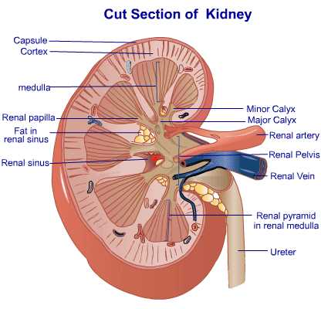
Diabetic nephropathy
Pathology Core
The kidneys are prime targets of diabetes
The lesions include mainly:
(1) glomerular lesions;
(2) renal vascular lesions, principally arteriolosclerosis
(3) pyelonephritis, including necrotizing papillitis.

Slide 43
Diabetic nephropathy
Pathology Core
Glomerular lesions
Capillary basement membrane thickening
Nodular glomerulosclerosis
Diffuse mesangial sclerosis

Slide 44
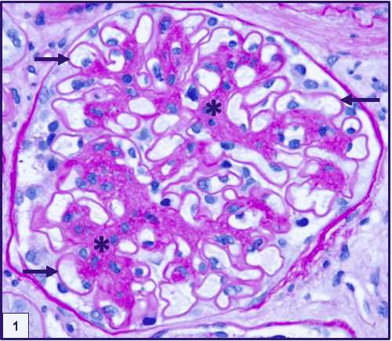
Diabetic nephropathy
Pathology Core
1. Capillary basement membrane thickening
Renal glomerulus showing markedly thickened glomerular basement membrane

Slide 45
Diabetic nephropathy
Pathology Core
2. Nodular glomerulosclerosis (Kimmelstiel-Wilson lesion)
Characterized by nodules of pink hyaline material that form in mesangial regions between glomerular capillary loops.
Caused by a marked increase in mesangial matrix
Markedly thickened arteriole at the lower right, which is typical of hyaline arteriolosclerosis seen in diabetic kidneys.

Slide 46
Diabetic nephropathy
Pathology Core
3. Diffuse mesangial sclerosis
Increase in mesangial matrix and mesangial cell proliferation and basement membrane thickening.

Slide 47
Diabetic nephropathy
Pathology Core
Both the diffuse and the nodular forms of glomerulosclerosis induce sufficient ischemia to cause scarring of the kidneys
Nephrosclerosis manifested by a finely granular–appearing cortical surface.
On sectioning there is marked thinning of the cortex.
Additional features seen here are some irregular depressions, the result of pyelonephritis

Slide 48
Amyloidosis
Pathology Core
Extracellular deposition of misfolded proteins that aggregate to form insoluble fibrils.
Results in tissue damage and functional compromise
Glomerular disease : deposition of amyloid in mesangium , capillary walls and in interstitium.
Causes:
Excessive production or mutations of proteins that are prone to misfolding and aggregation
Defective or incomplete proteolytic degradation of extracellular proteins.

Slide 49
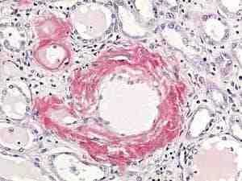
Renal amyloidosis
Pathology Core
LM-
Homogenous, smudgy deposits,
Congo red birefringence is most specific for diagnosis .
Faintly PAS positive Silver stain - negative.

Slide 50
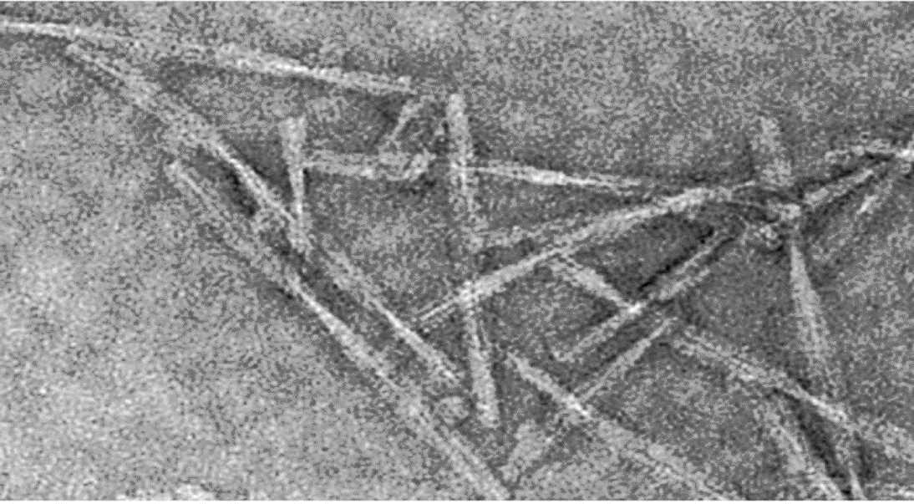
Amyloidosis electron microscopy
Pathology Core
EM-
Randomly arranged non-branching 7.5-10 nm fibrils
Notes:
Fig. 10. Close-up of a small renal artery stained with congo red and examined by light microscropy (Congo red stain, original magnification, 600x).

Slide 51
Lupus nephritis
Pathology Core
SLE is an autoimmune disease with systemic manifestations
Renal involvement in SLE: 100 %
Clinical manifestations: 50 – 70 % of patients
F:M ratio 10:1
CLINICAL PRESENTATION
microscopic hematuria
proteinuria (according to stage /class) of disease.

Slide 52
WHO Classes of lupus nephritis
Pathology Core
Minimal mesangial gn | LM- normal IF&EM- few mesangial deposits
Ii. Mesangio- Proliferative gn | LM: increased mesangial cellularity with patent capillaries. If &em – mesangial deposits
Iii. Focal proliferative gn | Focal and segmental proliferation in less than 50% of glomeruli. Increase in cells (endothelial, mesengial, wbc)

Slide 53
Pathology Core
iv. diffuse proliferative gn | diffuse proliferation in >50% glomeruli sub endothelial deposits thick glassy gbm with wire loop appearance
v. membranous gn | * membranous changes with slight mesangial proliferation
vi. chronic sclerosing gn | marked sclerotic changes association with class iii, iv & v

Slide 54
Family medicine
A 5-year-old child presents with periorbital edema, foamy urine, and abdominal distension. Urinalysis reveals massive proteinuria. What is the most likely diagnosis?
a) Acute glomerulonephritis
b) Nephrotic syndrome
c) Urinary tract infection
d) Renal cell carcinoma

Slide 55
Take home message
Nephrotic syndrome is a kidney disorder characterized by high levels of protein in the urine, low levels of protein in the blood, swelling (edema), and high cholesterol. It's often caused by damage to the glomeruli, the tiny filters in the kidneys. Treatment focuses on managing symptoms and addressing the underlying cause.

Slide 56
Research
https://www.ncbi.nlm.nih.gov/books/NBK470444/
Nephrotic Syndrome
Carolina Tapia; Khalid Bashir.
Author Information and Affiliations
Last Update: May 29, 2023.
Go to:
Continuing Education Activity
Nephrotic syndrome (NS) is a clinical syndrome defined by massive proteinuria (greater than 40 mg/m^2 per hour) responsible for hypoalbuminemia (less than 30 g/L), with resulting hyperlipidemia, edema, and various complications. It is caused by increased permeability through the damaged basement membrane in the renal glomerulus. It results from an abnormality of glomerular permeability that may be primary with a disease-specific to the kidneys or secondary to congenital infections, diabetes, systemic lupus erythematosus, neoplasia, or certain drug use. This activity reviews the causes, pathophysiology, and presentation of nephrotic syndrome and highlights the role of the interprofessional team in its management.

