Slide 1
Gram negative cocci
Nisseria
Microbe Module 3rd Year MBBS
By: Dr. Kiran Fatima
Pathology Department
Rawalpindi Medical University

Slide 2
MOTTO
VISION
To impart evidence based research
oriented medical education
To provide best possible patient care
To inculcate the values of mutual respect and ethical practice of medicine

Slide 3
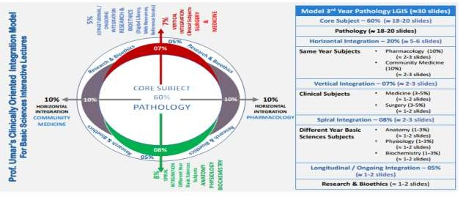

Slide 4
Learning objectives
Bacterial Characteristics: Identify Neisseria as gram-negative diplococci. Differentiate N. gonorrhoeae and N. meningitidis based on key characteristics.
N. gonorrhoeae (Gonorrhea):
Pathogenesis: Explain the mechanisms by which N. gonorrhoeae adheres to and invades mucosal epithelial cells, including the role of pili and other virulence factors.
Clinical Manifestations: Describe the signs and symptoms of gonorrhea.
Diagnosis: Outline the methods used to diagnose gonorrhea
Treatment: Describe appropriate antibiotic regimens for gonorrhea, considering antibiotic resistance. Explain the importance of partner notification and treatment.
Prevention: Discuss strategies for gonorrhea prevention
N. meningitidis (Meningitis):
Pathogenesis: Explain how N. meningitidis colonizes the nasopharynx, invades the bloodstream, and crosses the blood-brain barrier. Describe the role of the polysaccharide capsule in virulence.
Clinical Manifestations: Describe the signs and symptoms of meningococcal Diagnosis: Outline the methods used to diagnose meningococcal meningitisTreatment: Describe appropriate antibiotic therapy for meningococcal meningitis, emphasizing the need for prompt administration.
Prevention: Discuss the available vaccines against N. meningitidis serogroups

Slide 5
Neisseria
CORE SUBJECT
Aerobic
Gram-negative cocci resembling paired kidney beans often arranged in pairs (diplococci)
Oxidase positive
Most catalase positive
Endotoxin consists of Lipooligosaccharide(LOS)
Susceptible to cool temperatures, drying and fatty acids
Cultured on chocolate agar heated to 80 degrees
Celsius

Slide 6
Spiral

Slide 7
Neisseria
Core
Two important human pathogens in this genus are:
Neisseria gonorhoeae
Neisseria meningitidis

Slide 8
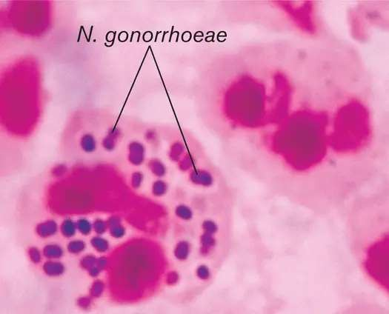
Neisseria gonorhoeae (gonococcus)

Slide 9
Neisseria gonorhoeae
Vertical integration
Readily transmitted by sexual contact.
No polysaccharide capsule.
Pilus protein gives antigenicity.
Lacks maltose fermentation.
Infect primarily the mucosal surfaces.
Higher risk of disseminated disease in patients with late complement deficiencies.
No vaccine available.

Slide 10
Neisseria gonorhoeae: epidemiology
HORIZONTAL INTEGRATION
Cause disease in HUMANS only.
Symptomatic in men and asymptomatic in women. Reinfection, partly due to antigenic diversity of
strains.
Asymptomatic carriage is major reservoir.

Slide 11
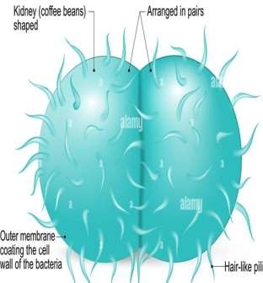
Neisseria gonorhoeae: pathogenesis
Core
Pili – main virulence factor; Mediate attachment to mucosal
cell surface
Antiphagocytic
Other virulent factors:
LipoOLIGOsaccharide- endotoxin
in cell wall
Outer membrane proteins IgA protease

Slide 12
Neisseria gonorhoeae: pathogenesis
Core
Outer membrane proteins:
Por (porin protein) prevents phagolysosome fusion following phagocytosis and thereby promotes intracellular survival
Opa (opacity protein) mediates firm attachment to
Epithelial cells and subsequent invasion into cells
Rmp (reduction-modifiable protein) protects other surface antigens from bactericidal antibodies (por protein, LOS)

Slide 13
Neisseria gonorhoeae: pathogenesis
Core
Lipooligosaccharide (LOS) , no O-somatic antigen polysaccharide side chain) has endotoxin activity
IgA₁ protease
Acquisition in last two decades of two types of
antibiotic resistance:
Plasmid-encoded beta-lactamase production
Chromosomally-mediated changes in cellular permeability inhibit entry of penicillins, tetracycline, erythromycin, aminoglycosides

Slide 14
Neisseria gonorhoreae: clinical features
Core
IN MEN
Urethritis; Epididymitis
Most infections among men.
Purulent discharge & dysuria after 2-5 day
incubation period.
primarily responsible for urethritis: N. gonorrhoeae
and Chlamydia trachomatis

Slide 15
Neisseria gonorhoeae: clinical features
Core
In women
Endocervix; endocervicitis most commonly involved. Purulent discharge and intermenstrual bleeding.
Salpingitis(pid) most common complication
Disseminated gonococcal infection (DGI):
Result of gonococcal bacteremia
Pustules on extremities
Arthralgias (pain in joints)
Tenosynovitis (inflammation of tendon sheath)
Septic arthritis

Slide 16
Neisseria gonorhoeae
Core
Females | Males
Asymptomatic infections frequently not diagnosed | Most initially symptomatic (95% acute)
Genital infection primary site is cervix (cervicitis), but vagina, urethra, rectum can be colonized | Genital infection generally restricted to urethra (urethritis) with purulent discharge and dysuria
Ascending infections in 10-20% including salpingitis, tubo-ovarian abscesses, pelvic inflammatory disease (PID) , chronic infections can lead to sterility | Rare complications may include epididymitis, prostatitis, and periurethral abscesses
Disseminated infections more common, including septicemia, infection of skin and joints (1-3%) | Disseminated infections are very rare
Can infect infant at delivery (conjunctivitis, opthalmia neonatorum) | More common in homosexual/bisexual men than in heterosexual population

Slide 18
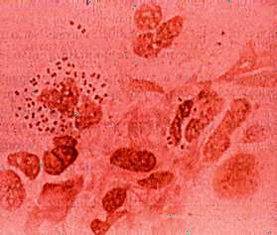
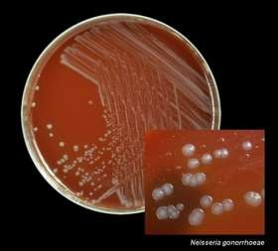
Neisseria gonorhoeae: investigation
Core
Polymorphonuclear leukocytes (PMN’s) seen microscopically in purulent urethral discharge.
Susceptible to drying and cooling, so immediate culture:
pre-warmed selective (e.g., modified Thayer-Martin, Martin-Lewis agars)
non-selective media
(chocolate blood agar).

Slide 19
Neisseria gonorhoeae: investigation
vertical
Some strains inhibited by vancomycin (in many selective agars) and toxic substances like fatty acids and trace metals in protein hydrolysates and agar found in nonselective media.
Nuclear acid amplification test.

Slide 20
Neisseria gonorhoeae: treatment
vertical
Uncomplicated cases: ceftriaxone
Combined with doxycycline or azithromycin
for dual infections with Chlamydia.
Penicillin no longer drug of choice due to:
Continuing rise in the Plasmid-encoded
beta-lactamase production
Chromosomally-mediated resistance

Slide 21
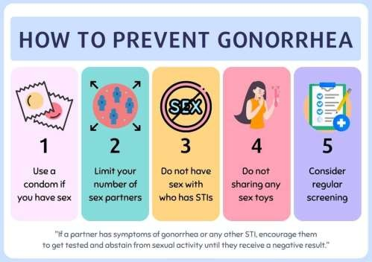
Neisseria gonorhoeae: prevention
horizontal
Use of condoms. Treatment of
symptomatic patients and their contacts.
Ophthalmia neonatorum: erythromycin ointments

Slide 22
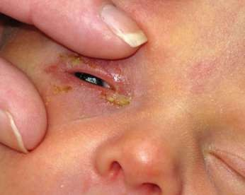
Neisseria gonorhoeae: prevention
horizontal
Chemoprophylaxis of newborns against ophthalmia neonatorum with 1% silver nitrate, 1%
tetracycline, or 0.5%
erythromycin eye ointments.
Treatment of newborns with ophthalmia neonatorum with ceftriaxone.

Slide 23
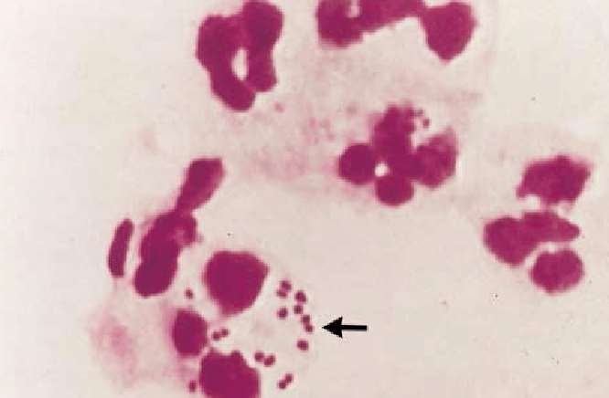
Neisseria meningitidis (meningococcus)

Slide 24
Neisseria meningitidis
vertical
Encapsulated small, gram-negative diplococci.
Second most common cause (behind S. pneumoniae) of community-acquired meningitis in previously healthy adults.
Oxidase positive.
Can do maltose fermentation.
No beta lactamase production.
Vaccine available.
colonize nasopharynx

Slide 25
Neisseria meningitidis: epidemiology
Core
Humans are the only natural hosts.
Highest incidence in children younger than 5 years 5% become chronic carriers.
35% carriage rate in close quarters inhabitants(aerosolization of respiratory tract secretions)
One of the most important cause of bacterial meningitis in infants older than 2 months.

Slide 26
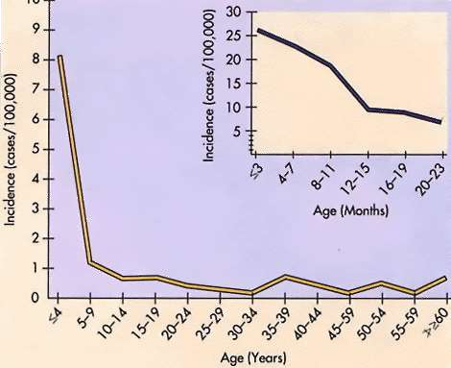
Neisseria meningitidis: epidemiology
Core
Lacking maternal antibody

Slide 27
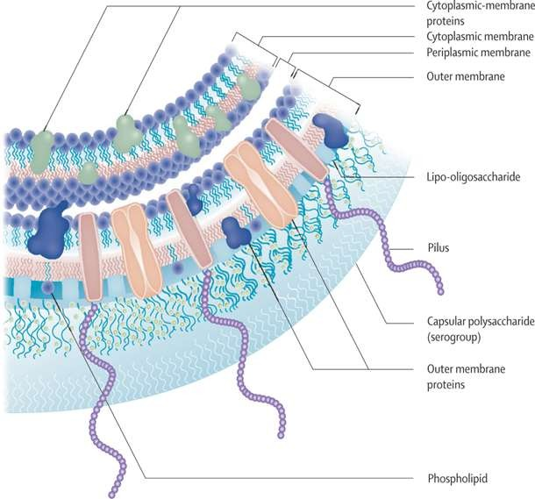
Neisseria meningitidis: pathogenesis
Core
Four important virulence factors:
Polysaccharide capsule
Endotoxin (LOS)
IgA protease
Factor H binding protein

Slide 28
Neisseria meningitidis: pathogenesis
Core
Pili-mediated, colonization of nonciliated cells of nasopharynx
Antiphagocytic polysaccharide capsule allows systemic.
Toxic effects mediated by hyperproduction of
lipooligosaccharide
Serogroups A, B, C, Y, W135 account for about
90% of all infections

Slide 29
Neisseria meningitidis: pathogenesis
Core
Specific receptors (GD1 ganglioside) for bacterial fimbriae on nonciliated columnar epithelial cells in nasopharynx of host.
Organisms are internalized into phagocytic vacuoles, avoid intracellular killing in absence of humoral immunity and complement system (patients with late complement deficiencies are particularly at risk)

Slide 30
Neisseria meningitidis: pathogenesis
Core
Replicate intracellularly and migrate to subepithelial space where excess membrane fragments are released
Hyperproduction of endotoxin (lipid A of LOS) and blebbing into surrounding environment mediates most clinical manifestations:
diffuse vascular damage (e.g., endothelial damage, vasculitis (inflammation of vessel walls),
thrombosis (clotting)
disseminated intravascular coagulation (DIC)

Slide 31
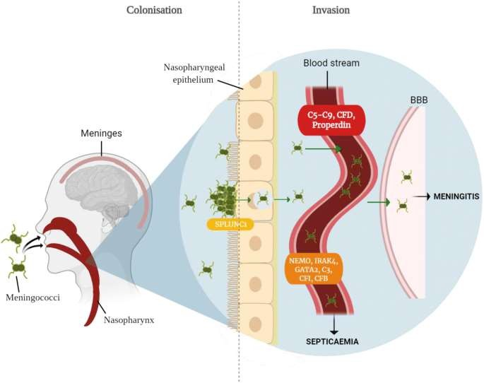

Slide 32
Neisseria meningitidis: immunogenicity
Core
Protective humoral immunity develops against the same or closely related organisms of the same serogroup, but not against other serogroups.
Bactericidal activity of the complement system is required for clearance of the organisms
Cross-reactive protective immunity acquired with colonization by closely related antigenic strains and with normal flora of other genera (e.g., E. coli K1)

Slide 33
Neisseria meningitidis: clinical symptoms
Core
Following dissemination of virulent organisms from the nasopharynx:
Meningitis
Septicemia (meningococcemia) with or without meningitis– WATERHOUSE FRIDERICHSEN SYNDROME
Meningoencephalitis
Pneumonia
Arthritis
Urethritis

Slide 34
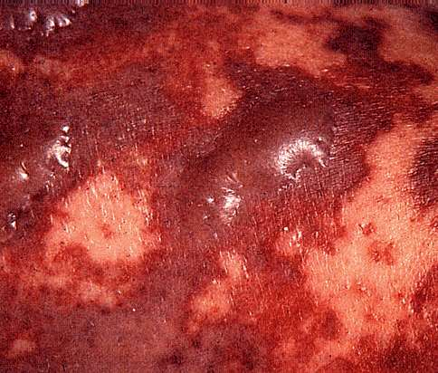
Neisseria meningitidis: clinical symptoms
Core
NOTE: Petechiae have coalesced into hemorrhagic bullae.

Slide 35
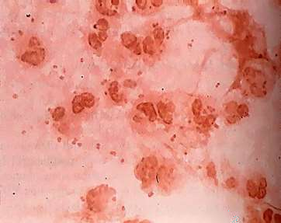
Neisseria meningitidis: clinical symptoms
Core
Gram-negative diplococci and polymorphonuclear leukocytes (PMN’s) can be seen microscopically in cerebrospinal fluid (CSF)
Transparent, non-pigmented nonhemolytic colonies on chocolate blood agar with enhanced growth in moist atmosphere with 5% CO₂
Oxidase-positive
Acid production from glucose
and maltose.

Slide 36
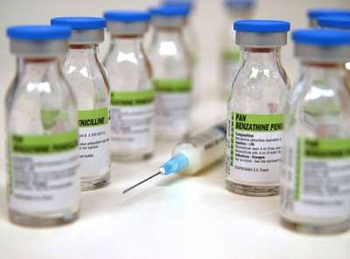
Neisseria meningitidis: treatment
horizontal
Penicillin G is drug of
choice;
Increasing MIC mediated by genetic alteration of target penicillin binding proteins is being monitored)
Chloramphenicol or cephalosporins as alternative.

Slide 37
Neisseria meningitidis: prevention
horizontal
Chemoprophylaxis:
Close contacts with rifampin or sulfadiazine (if
Susceptible).
Immunization:
Menactra: conjugated to diphtheria toxoid
Menveo: conjugated to nontoxic mutant of diphtheria
Toxin
Menomune: unconjugated
Menafrivac: conjugated, group A polysaccharide

Slide 38
Bioethics- autonomy
longitudinal
Requires that the patient have autonomy of thought, intention, and action when making decisions regarding health care procedures.
Decision-making process must be free of coercion or coaxing.
Patient must understand all risks and benefits of the procedure and the likelihood of success.

Slide 39
Research
Prevention of Neisseria gonorrhoeae With Meningococcal
B Vaccine: A Matched Cohort Study in Southern California
PMID: 35642527
https://doi.org/10.1093/cid/ciac436
https://academic.oup.com/cid/article-
abstract/76/3/e1341/6596517?redirectedFrom=fulltext

Slide 41
THANK YOU

