Slide 1
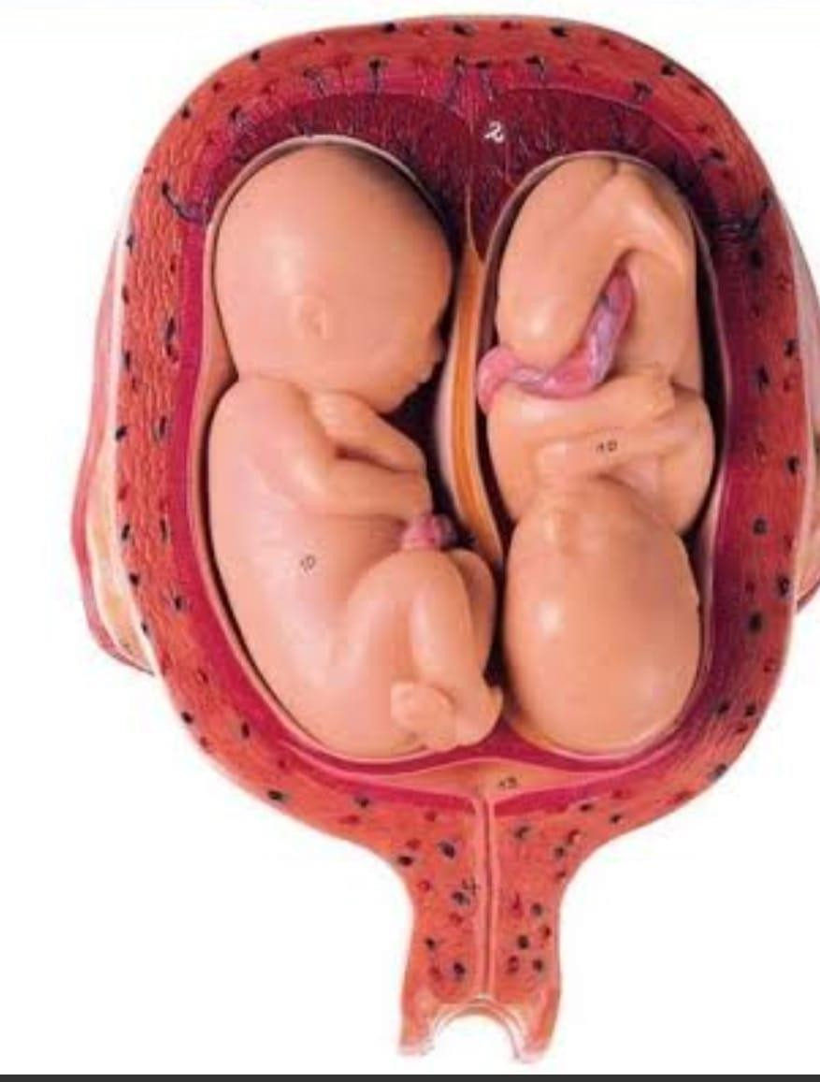
Multiple Pregnancies
OBS & GYNAE Unit II
Holy Family Hospital
Rawalpindi

Slide 2
University Motto, Vision, Values & Goals
Mission Statement
To impart evidence-based research-oriented health professional education Best possible patient care
Mutual respect, ethical practice of healthcare and social accountability. Vision and Values
Highly recognized and accredited center of excellence in Medical Education
Goals
Undergraduate Integrated Learning Program

Slide 3
Learning objectives
Multiple Pregnancy (core concept = 70%)
SEQUENCE OF
LGIS
Related anatomy (horizontal integration 15%)
Related clinical findings (vertical integration – 10%)
Research article related to topic (3%)
Ethics (2%)

Slide 5
Learning Objectives :
Definition of multiple pregnancy
Types of multiple pregnancies
Diagnosis
Complications associated with multiple pregnancy
Management

Slide 6
DEFINITION :
Any pregnancy which two or more embryos or fetuses present in the uterus at same time.

Slide 7
Terminology vs. number
Singletons ➔ one fetus
Twins ➔ two fetuses.
Triplets ➔ three fetuses.
Quadruplets ➔ four fetuses.
Quintuplets ➔ five fetuses.
sextuplets ➔ six fetuses.
Septuplets ➔ seven fetuses.

Slide 8
Cause of increasing Prevalence
Fertility drugs to induce ovulation
Assisted conception(Number of embryos transferred)
Increasing maternal age (two or more eggs during a single menstrual cycle

Slide 10
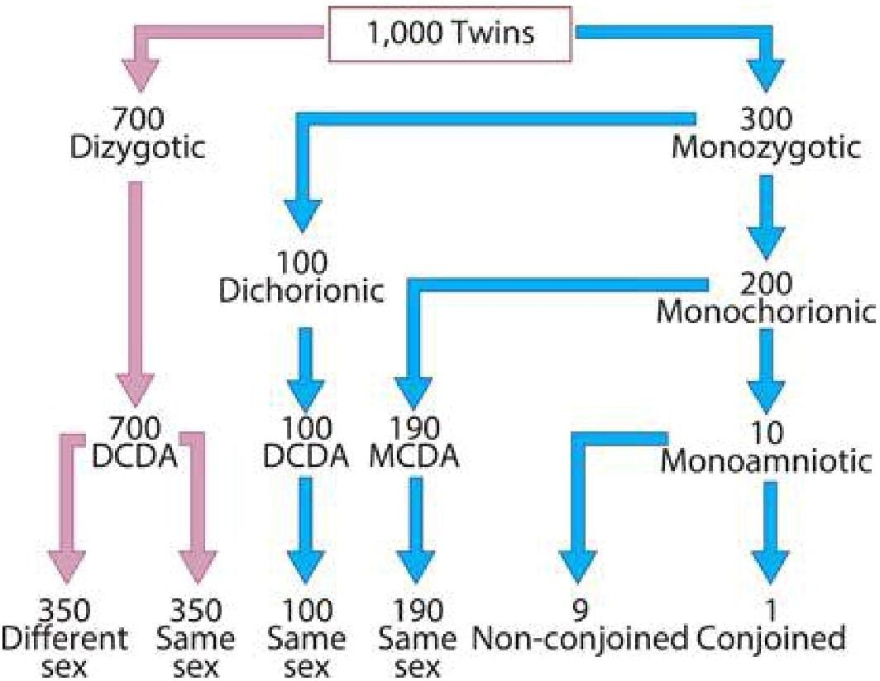
Incidence of monozygotic and dizygotic twin pregnancies. DCDA, dichorionic diamniotic; MCDA, monochorionic diamniotic

Slide 11
Multiple pregnancy may be classified according to:
Number of fetuses: twins, triplets, quadruplets, etc.
Number of fertilized eggs: zygosity.
Number of placentae: chorionicity.
Number of amniotic cavities: amnionicity

Slide 12
Type of pregnancy | Chorionicity and amnionicity
Dichorionic diamniotic twins | Both babies have a separate placenta and amniotic sac.
Monochorionic diamniotic twins | Both babies share a placenta but have separate amniotic sacs.
Monochorionic monoamniotic twins | Both babies share a placenta and amniotic sac.

Slide 13
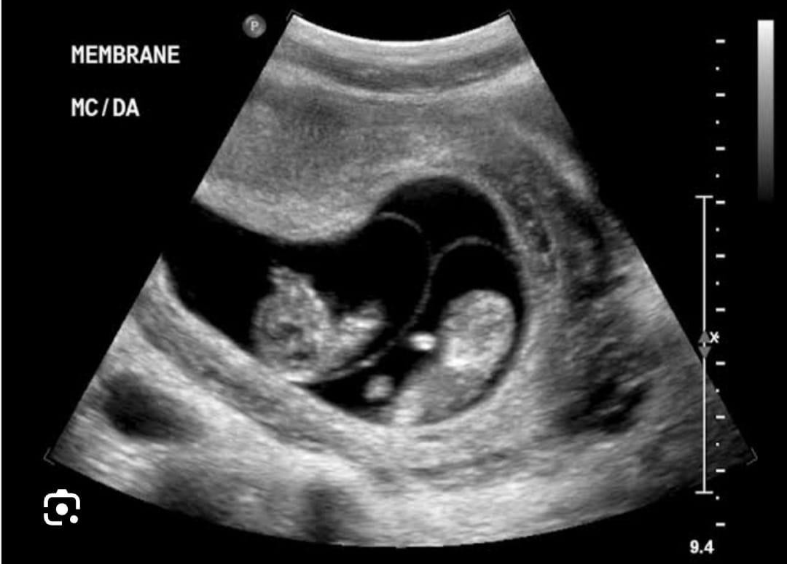
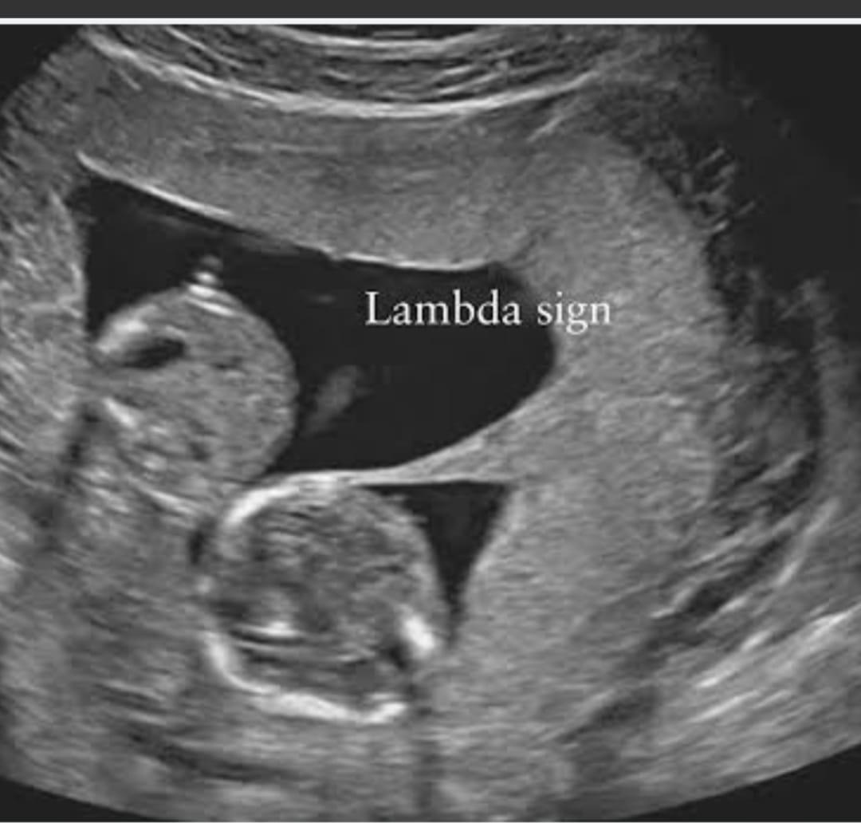

Slide 14
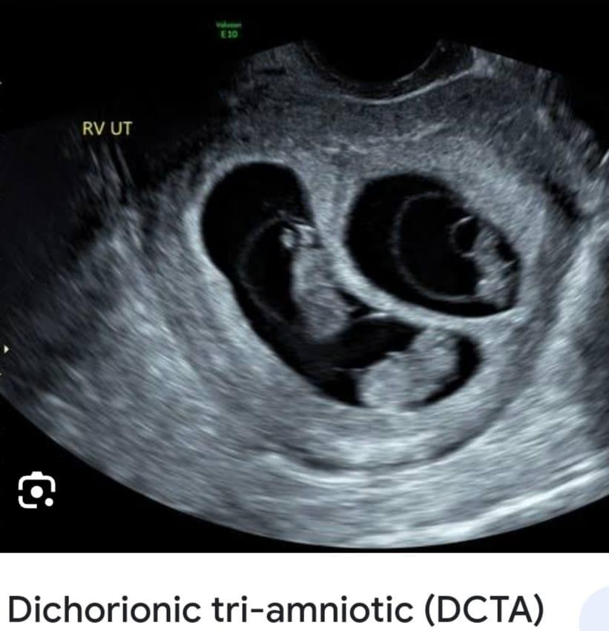
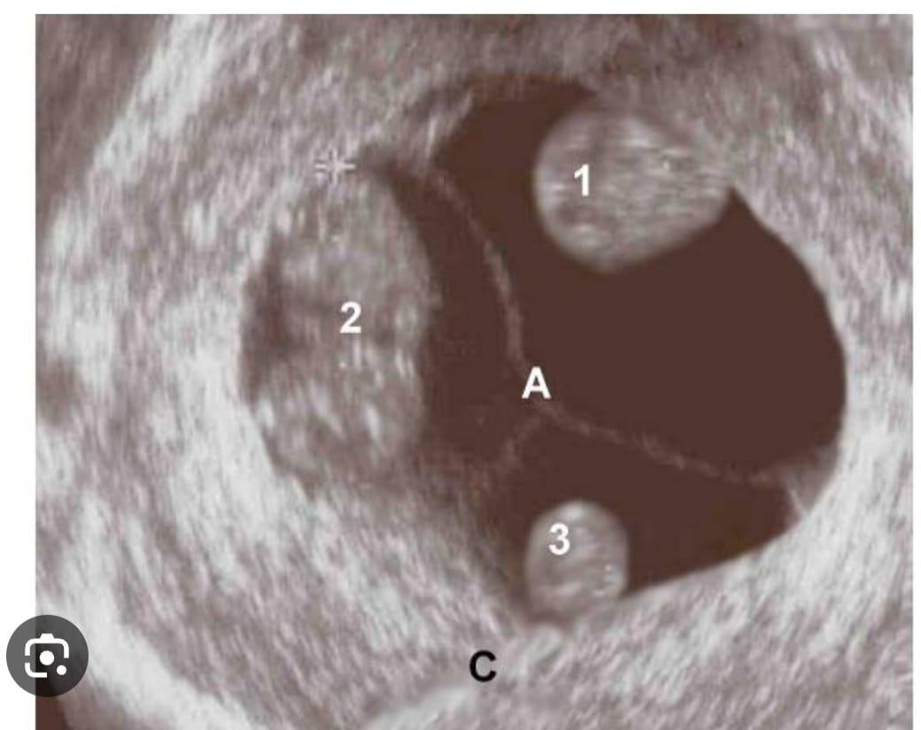

Slide 15
Monochorionic Pregnancy
A monochorionic pregnancy is a multiple pregnancy, most commonly a twin pregnancy,
in which babies are dependent on a single, shared placenta.
Approximately 30% of twin pregnancies

Slide 16
Monozygotic (identical) pregnancy
fertilization of a single ovum with subsequent division of the zygote.
abnormal unbalanced vascular anastomoses
arteriovenous (AV), venoarterial (VA), arterioarterial (AA) and venovenous (VV).

Slide 17
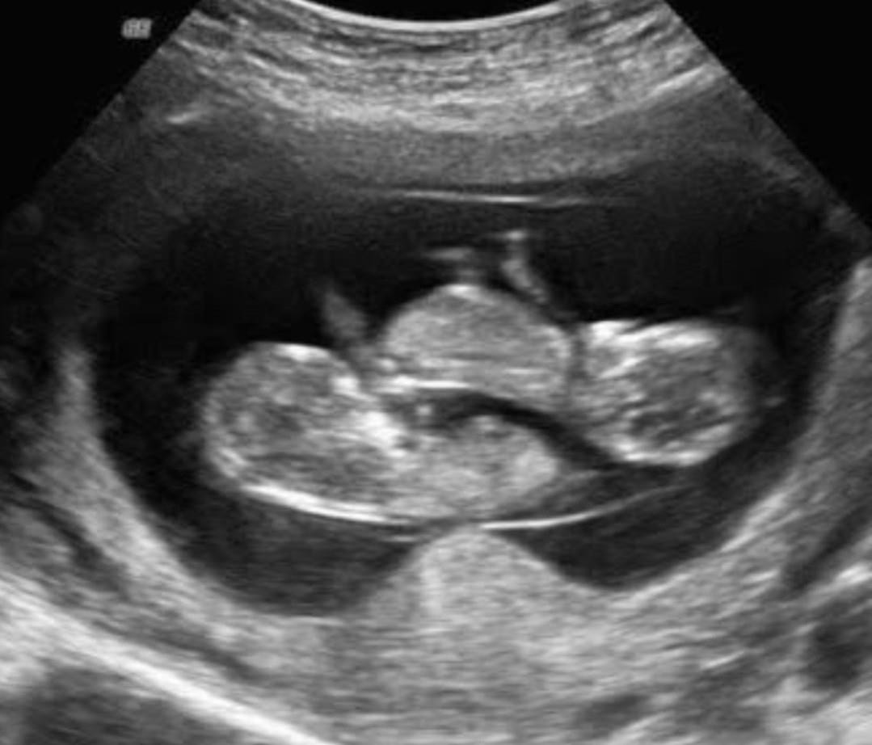
Monozygotic Pregnancy

Slide 18
Result from division of Fertilized Egg
0-72 hours Dichorionic Diamniotic
4-8 Days Dichorionic Monoamniotic (20%)
9-12 Days Monoamniotic (1%)
>12 Days conjoined Twins

Slide 19
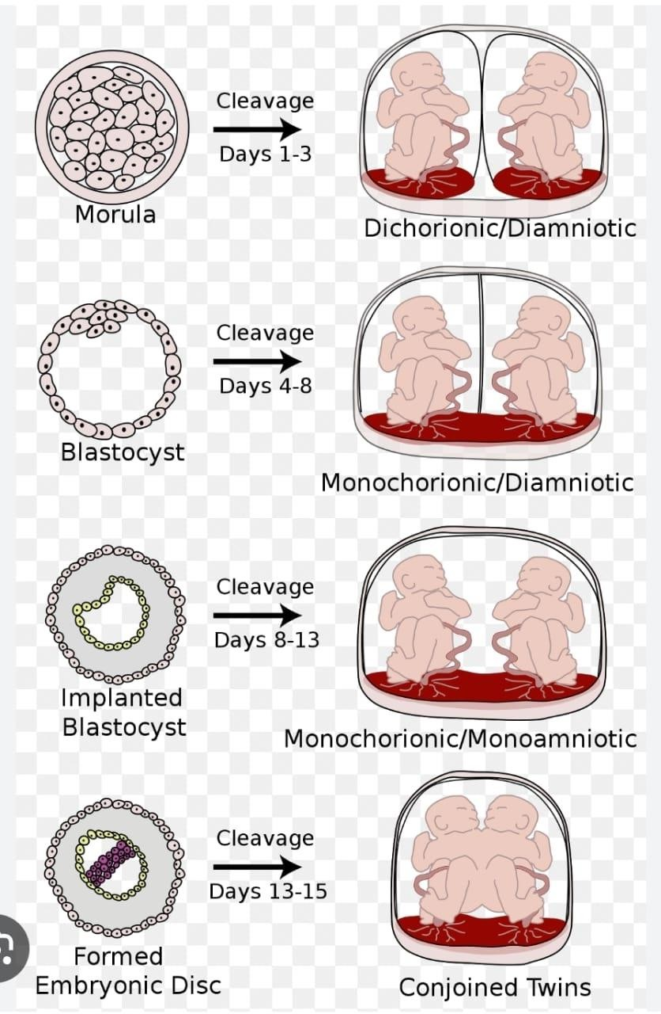

Slide 20
Dizygotic Twin Pregnancy
non-identical
ovulation and subsequent fertilization of two oocytes
dichorionic diamniotic twins, where each fetus has its own placenta and amniotic cavity.
two functionally separate placentae
placentae can become anatomically fused together and appear to the naked eye as a single placental mass.
same-sex or different-sex pairings.

Slide 21
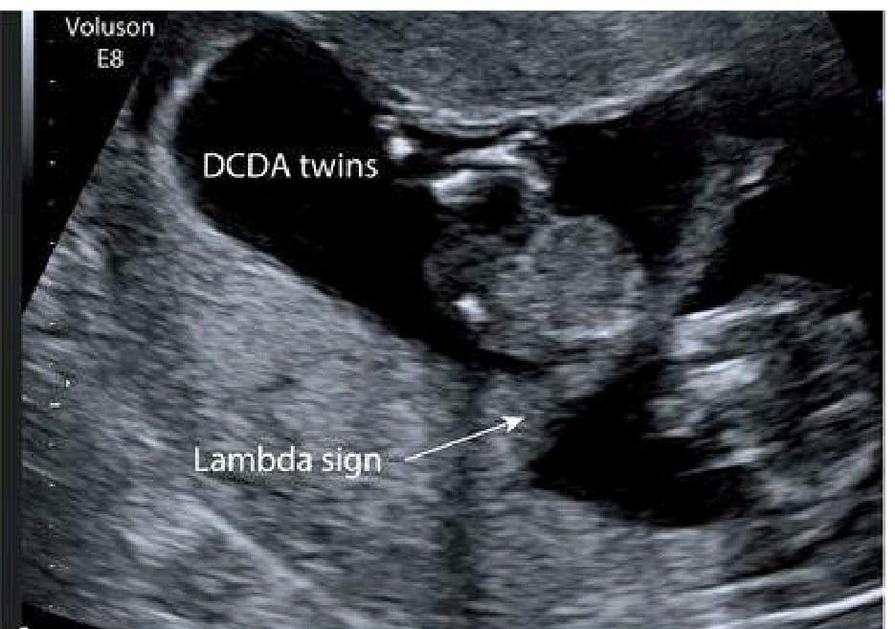
There is an extension of placental tissue into the base of the inter-twin membrane, forming the lambda sign.

Slide 22
Higher order multiples
The incidence of spontaneous triplet pregnancy is 1 in 6,000–8,000 births.
High morbidity and mortality
NICE recommends that women with uncomplicated monochorionic triamniotic /dichorionic triamniotic triplet pregnancies be offered at least 11 antenatal appointments with a health care professional from the core team.
It is not recommended to prolong pregnancy beyond 36 weeks’
gestation.
Calculate the risk of Down’s syndrome for each baby

Slide 23
Monochorionic monoamniotic twin pregnancy
Division of a single fertilized oocyte.
Least common pattern of placentation
High morbidity and mortality due to the high rate of perinatal mortality(cord entanglement resulting in fetal loss or neurological morbidity. )
Increased risk of congenital anomalies including neural tube defects and abdominal wall and urinary tract malformations.
Delivery by caesarean section generally at 32–34 weeks’ gestation.
Perinatal mortality occurs in approximately 20% of fetuses and infants.

Slide 24
Complications in Multiple Pregnancies
Higher than for singleton pregnancies
Preterm birth
FGR
Cerebral Palsy
Still Birth

Slide 25
Maternal Risk
Hypertensive disorders
Thrombo-embolic disease
Increased Risk
Antepartum Hemorrhage
Postpartum Hemorrhage

Slide 26
Complications unique to monochorionic twin pregnancies
Twin-to-twin transfusion syndrome(TTTS / TOPS)
Twin anemia polycythemia sequence(TAPS)
Umbilical cord entanglement

Slide 27
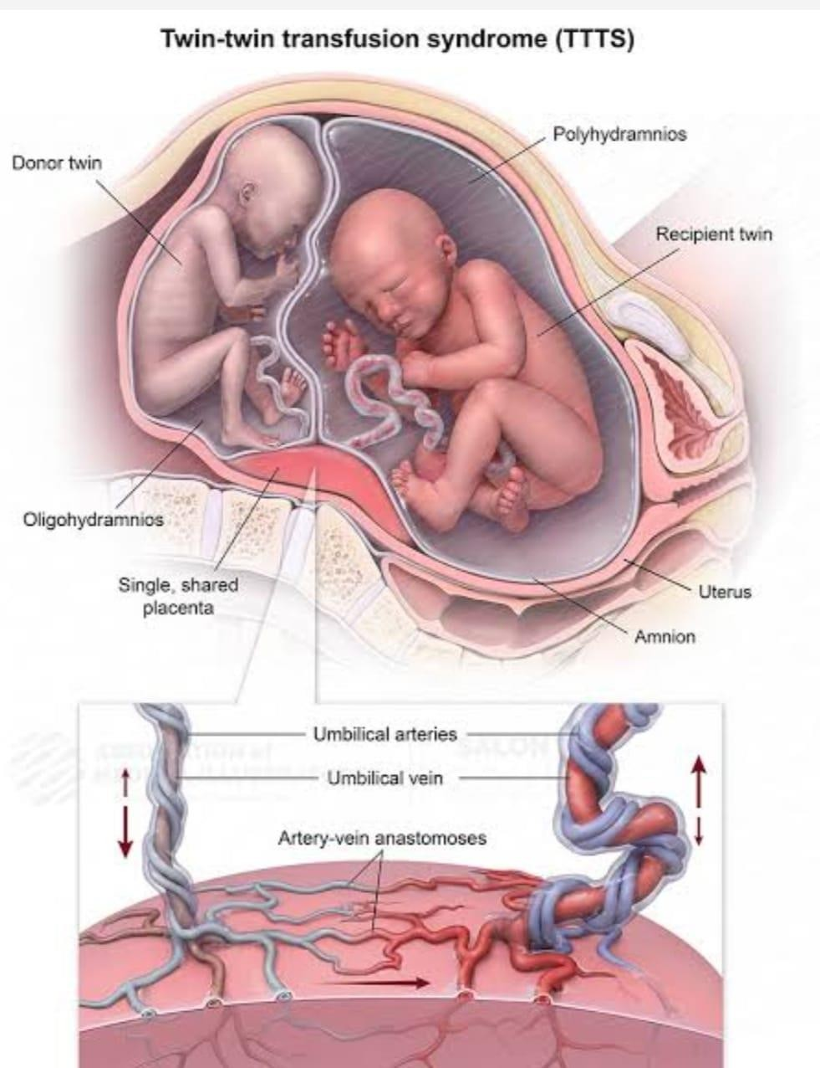
Physiopathology

Slide 28
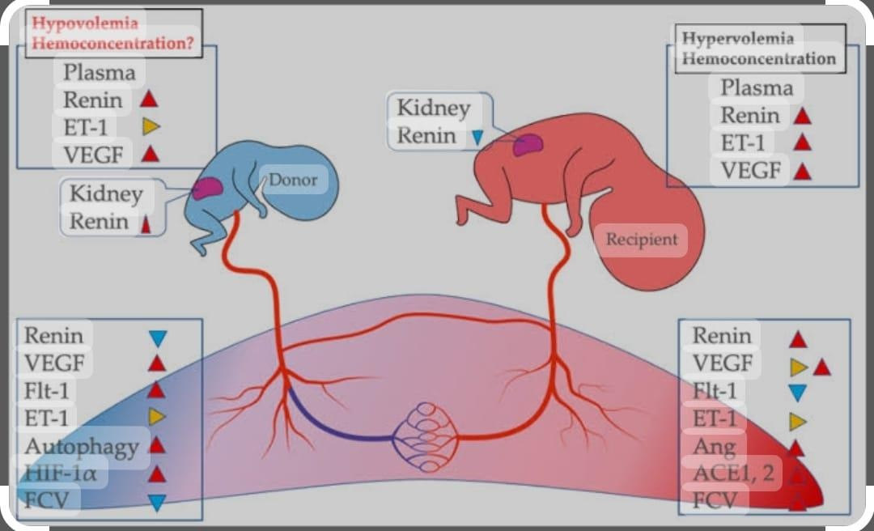

Slide 29
Rare complication (10−15% of monochorionic pregnancy)
Imbalance in the supply of oxygen and nutrients across the vascular anastomoses of the placenta between the twins.
Hypoxia,oxidative stress,ischemic reperfusion injury and molecules(VEGF,Renin,ACEI,)

Slide 30
TTTS is diagnosed based on the following ultrasound criteria:
Single placental mass.
Concordant gender.
Oligohydramnios with maximum vertical pool (MVP) less than 2 cm in one sac and polyhydramnios in the other sac (MVP >8 cm).
Discordant bladder appearances.
Haemodynamic and cardiac compromise.

Slide 31
TTTS graded in severity according Quintero staging:
Stage I: Oligohydramnios and polyhydramnios sequence and the bladder of the donor twin is visible. Dopplers in both twins are normal.
Stage II: Oligohydramnios and polyhydramnios sequence, but the bladder of the donor is not visualized. Dopplers in both twins are normal.

Slide 32
Cont…
Stage III: Oligohydramnios and polyhydramnios sequence, non- visualized bladder and abnormal Dopplers. There is absent/reversed end-diastolic velocity in the umbilical artery, reversed flow in a-wave of the DV or pulsatile flow in the umbilical vein in either fetus.
Stage IV: One or both fetuses show signs of hydrops
Stage V: One or both fetuses have died.

Slide 34
Treatment of TTTS
Referred for a tertiary care
Management options include:
Expectant management;
Amnioreduction.
Septostomy.
Selective feticide.
Fetoscopic laser ablation of vascular anastomoses. (definitive treatment for severe (defined as Quintero stage II or above)

Slide 35
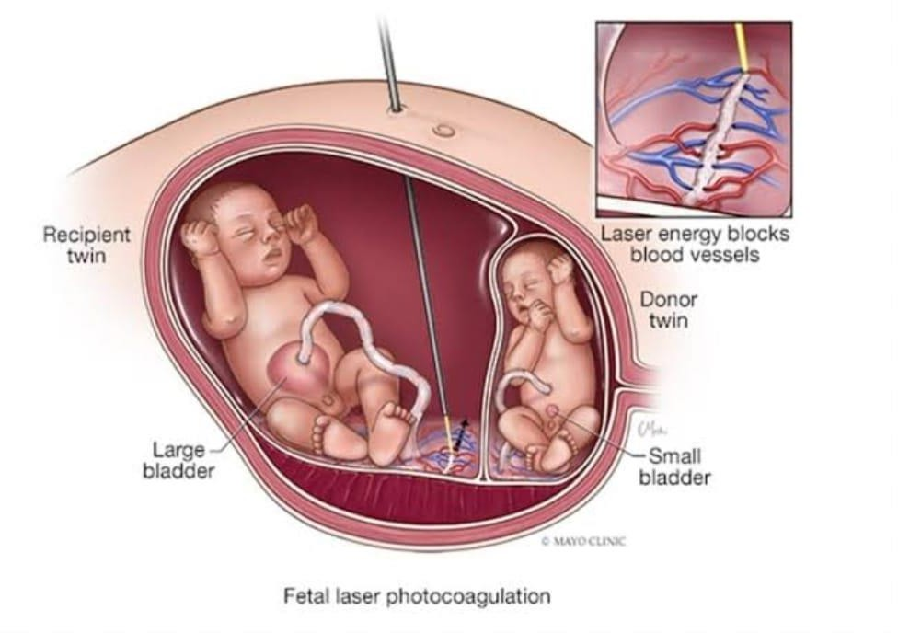

Slide 36
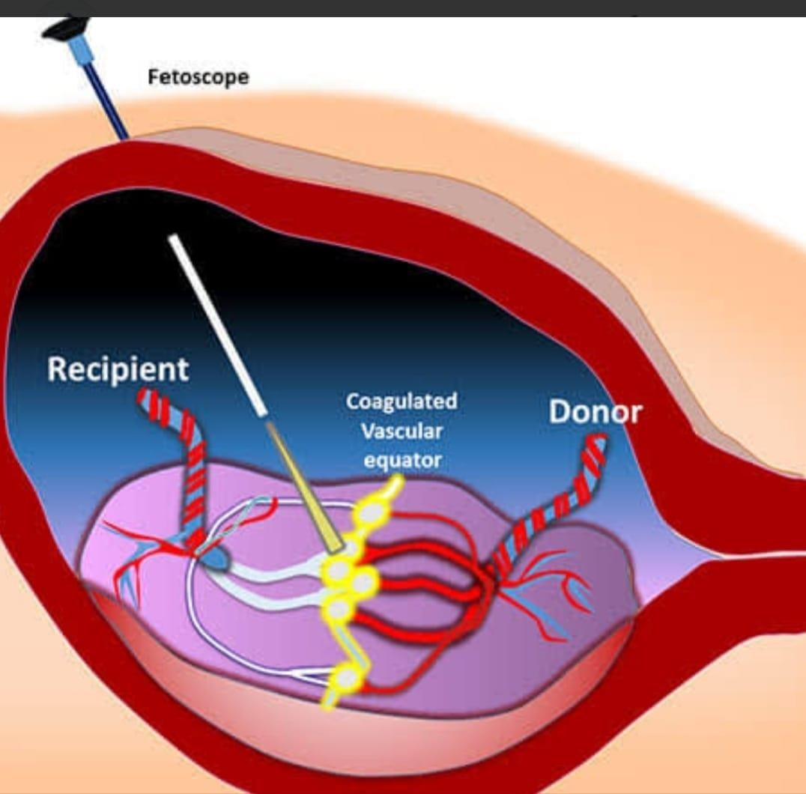
Fetoscopic laser ablation

Slide 37
Umbilical cord entanglement

Slide 38
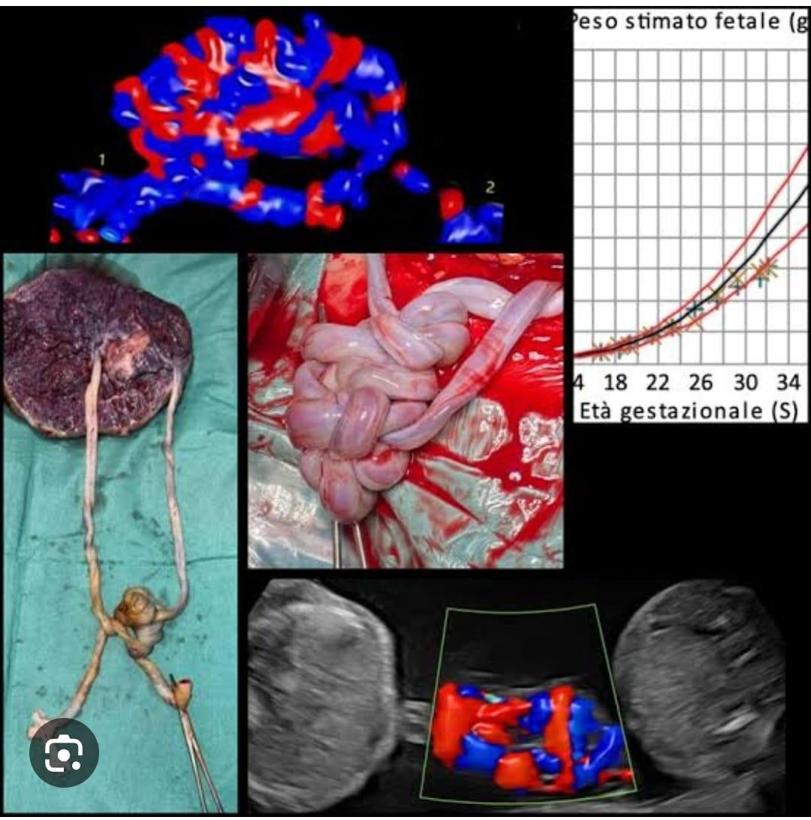

Slide 39
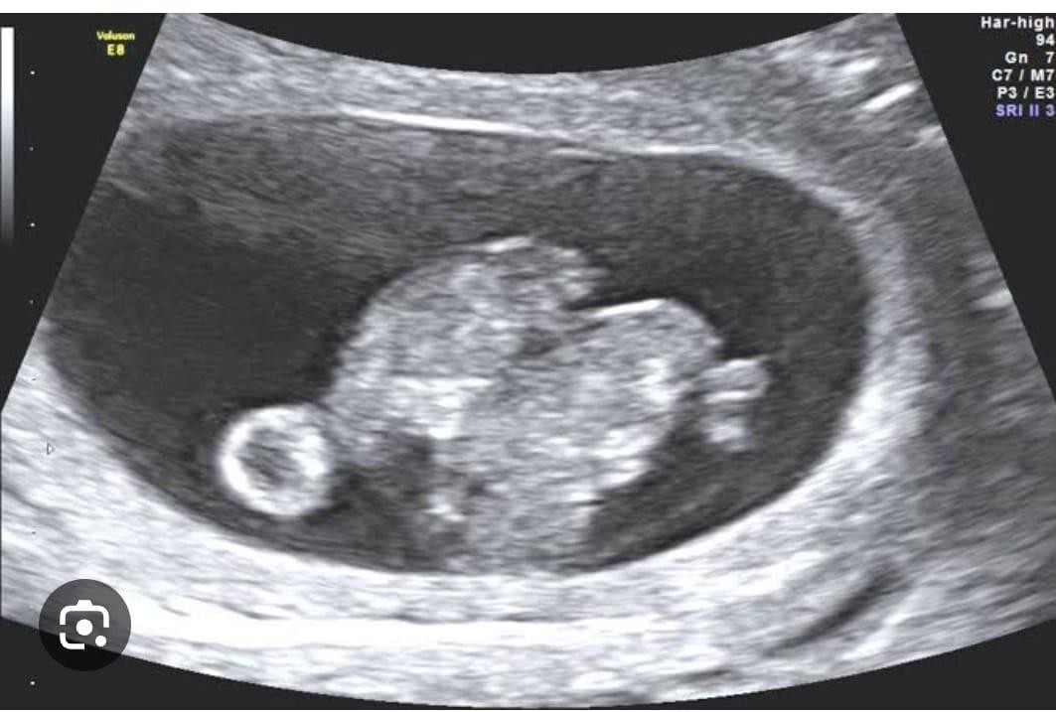

Slide 40
Antenatal care:
Uncomplicated dichorionic twin pregnancies: 8 antenatal appointments
Uncomplicated monochorionic diamniotic : 9 antenatal appointments

Slide 41
Screening in multiple pregnancy
First trimester scan(crown–rump length (CRL) 11 weeks 0 days to 13 weeks 6 days.
To accurately estimate gestational age.
To determine chorionicity.
To screen for Down’s syndrome.

Slide 42
Diet, lifestyle and nutritional supplements
Give women with a twin or triplet pregnancy the same advice about diet, lifestyle and nutritional supplements as in routine antenatal care
Higher incidence of anaemia in women with a twin or triplet pregnancy compared with women with a
singleton pregnancy
Perform a full blood count at 20 to 24 weeks to identify women with a twin or triplet pregnancy who
need early supplementation with iron or folic acid . Repeat at 28 weeks as in routine antenatal care.

Slide 43
Anomaly scan
Higher rates of congenital anomalies compared to singleton fetuses.
Monozygotic twins(two to three times more)
Anencephaly and holoprosencephaly.

Slide 44
Growth assessments
High risk of FGR
Discrepancy of 25% greater considered clinically significant
Discordant fetal growth,
Fetal anomaly
Discordant fetal death or TTTS.

Slide 45
Timing of Birth
• At 36 weeks for women with an uncomplicated monochorionic diamniotic twin pregnancy
• Between 32+0 and 33+6 weeks for women with an uncomplicate monochorionic monoamniotic twin pregnancy Twin and triplet pregnancy
• At 35 weeks for women with an uncomplicated trichorionic triamniotic or dichorionic triamniotic triplet pregnancy

Slide 46
Mode Of Birth

Slide 47
Twin pregnancy: dichorionic diamniotic or monochorionic diamniotic :
Women with an uncomplicated twin pregnancy planning their mode of birth planned vaginal birth and planned caesarean section are both safe choices for them and their babies if all of the following apply:
the pregnancy remains uncomplicated and has progressed beyond 32
weeks
there are no obstetric contraindications to labour
the first baby is in a cephalic (head-first)
presentation Twin and triplet pregnancy
there is no significant size discordance between the twins.

Slide 48
Mode Of Delivery
Twin pregnancy: monochorionic monoamniotic caesarean section to women with a monochorionic monoamniotic twin pregnancy:at the time of planned birth (between 32+0 and 33+6 weeks)

Slide 49
Bioethics
The bioethics of multiple pregnancy primarily revolve around the ethical considerations surrounding the increased risks to both the mother and fetuses in a multiple pregnancy, particularly when considering interventions like multifetal pregnancy reduction (MFPR), where a decision might be made to selectively terminate some fetuses to improve the chances of survival for the remaining ones; this raises complex questions about the moral status of the fetus and the balance between the mother's health and the potential lives of multiple fetuses

Slide 50
Future Research
Kilby MD, Bricker L, Royal College of Obstetricians and Gynaecologists. Management of Monochorionic Twin Pregnancy Green‐Top Guideline No. 51 (2024 Partial Update). BJOG: An International Journal of Obstetrics & Gynaecology.
Taylor MJ. The management of multiple pregnancy. Early human development. 2006 Jun 1;82(6):365-70.

Slide 51
Family Medicine
Early detection via ultrasound confirmation of multiple gestation and chorionicity/amnionicity assessment.
Frequent prenatal visits to assess fetal growth, maternal health, and early signs of complications.
Nutritional counseling to optimize maternal weight gain and supplement iron, folic acid, and protein intake.
Screening & timely referrals to maternal-fetal medicine (MFM) specialists for high-risk pregnancies.
Holistic, patient-centered counseling on expectations, risks, and lifestyle adjustments.
Mental health support for maternal anxiety and postpartum depression risks (higher in multiple births).
Integration of family and social support to assist with childcare and postpartum challenges.
Providing postnatal care

Slide 52
THANK YOU

