Slide 1
Movement disorders

Slide 2
Vision & Mission of RMU
Wisdom
Truth
Service
To impart evidence based research oriented medical education
To provide best possible patient care
To inculcate the values of mutual respect and ethical practice of medicine

Slide 3
Sequence Of Lecture
Learning outcomes (1 slide)
Core Subject (24 slides)
EOLA(End of lecture assessment) (1 slide)
Further reading/Digital Library References (I slide)
( Research, Bioethics, Artificial Intelligence)

Slide 4
Definition
Neurologic syndromes characterized by either an excess of movements or a paucity of voluntary and automatic movements, unrelated to weakness or spasticity

Slide 5
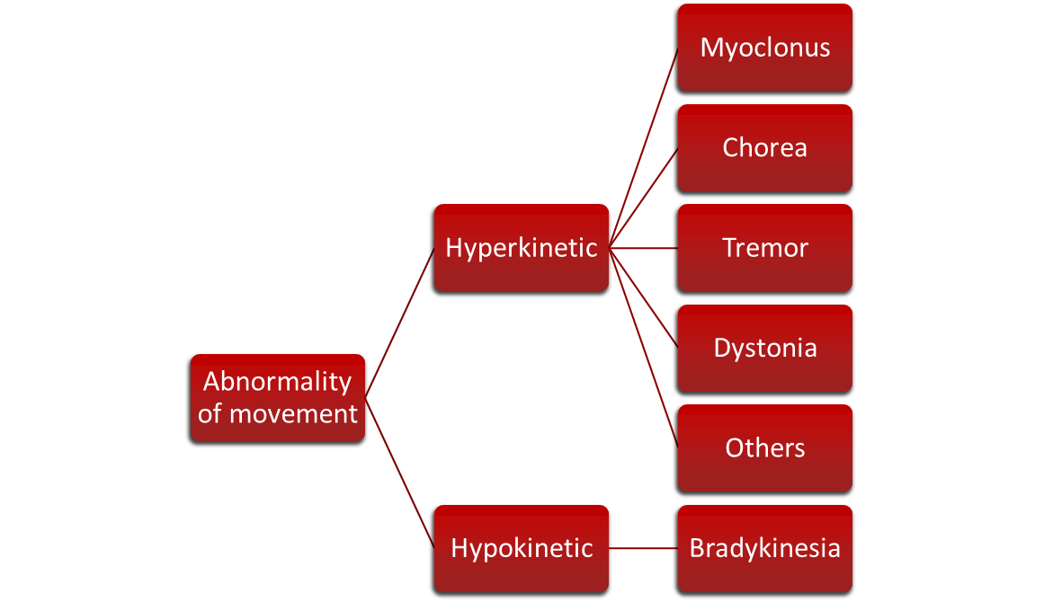

Slide 6
classification
Hyperkinetic
Hypokinetic

Slide 7
HYPERKINETIC
Restless leg syndrome
Tremors
Dystonia
Myoclonus
Chorea
Tics

Slide 8
hypokinetic
Parkinson 'disease
Parkinson’s plus syndromes
Progressive supranuclear palsy
Multiple system atrophy
Corticobasal ganglionic degeneration

Slide 9
Restless leg syndrome
Deep ill-defined discomfort in the legs that arises during prolonged rest or when the patient is drowsy and trying to fall asleep especially at night.
Sensory disturbances in the legs that are characteristically relieved by movements.

Slide 10
management
First line
long acting dopaminergic compounds
iron supplements
Second line
Anticonvulsants e.g. Gabapentin, Pregabalin
Benzodiazepine, Opioids

Slide 11
TREMORS
Rhythmic, oscillatory movement produced by alternating or synchronous contracting of antagonist muscle pairs.
Fast or slow, coarse or fine
Resting or action
Postural
Essential

Slide 12
Dystonia
An abnormal movement characterized by sustained muscle contractions, frequently causing twisting and repetitive movements, which may progress to prolonged abnormal postures
Focal dystonia
Segmental dystonia
Multifocal dystonia
Hemi dystonia
Generalized dystonia

Slide 13
myoclonus
Sudden shock like movements that are usually random and range in severity from mild to severe enough to move the whole body
Spinal Myoclonus
Palatal Myoclonus
Asterixis ( Negative Myoclonus)

Slide 14
chorea
Irregular, unpredictable, brief jerky movements that are usually of low amplitude.
Huntington disease
Benign hereditary chorea
Wilson’s disease
Sydenham chorea

Slide 15
tics
Abnormal movements ( Motor tics) or abnormal sounds ( phonic tics) that are brief, involuntary, rapid and non-rhythmic
Simple motor tics
Complex motor tics

Slide 16
Hypokinetic movements

Slide 17
Parkinson’s disease
Chronic, progressive disease characterized by Rigidity, Bradykinesia, Tremors and Postural instability.
Insidious onset, slow rate of progression
Disruption of daily function, roles and activities
depression

Slide 18
history
In 1817, a detailed medical essay was published by a British doctor “ Dr. James Parkinson”
James Martin Charcot was first to truly recognize the work of Dr. Parkinson and renamed the disease as Parkinson’s disease

Slide 19
Epidemiology
affects more than 2% population over 65
Average age of onset is 62.4 years
( between 50 to 79 years)
3. 10% before the age of 40 years
Parkinson’s disease or idiopathic parkinsonism
Secondary Parkinsonism
Post viral infections
Toxins
Drugs
Vascular disease
metabolic

Slide 20
pathophysiology

Slide 21
Clinical features

Slide 22
diagnosis
Clinical diagnosis
Investigations like CT Brain, MRI, PET Scan to rule out secondary cause
Copper, drug and toxins levels

Slide 23
Treatment
Directed at controlling symptoms and maintain functional independence.
No medical or surgical treatment to prevent disease progression

Slide 24
L-dopa (with carbidopa) is most effective and usually best tolerated
Dopamine agonists (ropinirole, pramipexole)
Others have only modest benefits (MAO-B inhibitors, anticholinergics, amantadine)

Slide 25
Drugs are symptomatic, not neuroprotective or neurotoxic
Level of patient function is best guide
Response to dopaminergic therapy (especially l-dopa) is the best available “test” for PD

Slide 26
L-dopa most effective for motor symptoms in general (bradykinesia, tremor, gait changes)
Family physicians can start levodopa !!
Dopamine agonists cause more non-motor side effects, and are best avoided in patients above 70

Slide 27
Surgical treatment
Pallidotomy is no longer performed in the management of Parkinsons – it is not as effective as Deep Brain Stimulation (DBS)
DBS is indicated for patients with drug resistant motor fluctuations
Bilateral Deep brain stimulation (DBS) of the subthalamic nucleus (STN) reduces both the primary symptoms of PD and its motor complications including tremor, bradykinesia, wearing off, dyskinesias, and dystonia

Slide 29
equipments
Rolling Walkers are best – canes & standard walkers are frequently carried by the patient
Shower chairs
Grab Bars
Raised Toilet Seats with armrests – ie Versa frame
Chairs with arms to assist patient to lower themselves to the chair without falling

Slide 30
Thank you

