Slide 1



Slide 2

MISCARRIAGE
Dr. Farah Deeba
OBG & GYNAE Unit II
Holy family hospital Rawalpindi

Slide 3


Prof. Umar’s Model of Teaching Strategy
Self Directed Learning Assessment Program
First Ten Minutes
Objectives :
To cultivate critical thinking, analytical reasoning, and problem-
solving competencies.
To instill a culture of self-directed learning, fostering lifelong
learning habits and autonomy.
How to Assess?
➢
Ten randomly selected students will be evaluated within the first 10 minutes of the lecture through 10 multiple-choice questions (MCQs) based on the PowerPoint presentation shared on Students Official WhatsApp group, one day before the teaching session.
➢
The number of MCQs from the components of the lecture will follow
the guidelines outlined in the Prof. Umar model of Integrated Lecture.
Component of LGIS
Core Know ledge
Horizontal Integration
Vertical Integration
Spiral Integration
No of MCQs
6-7
1-2
1
1

Slide 4
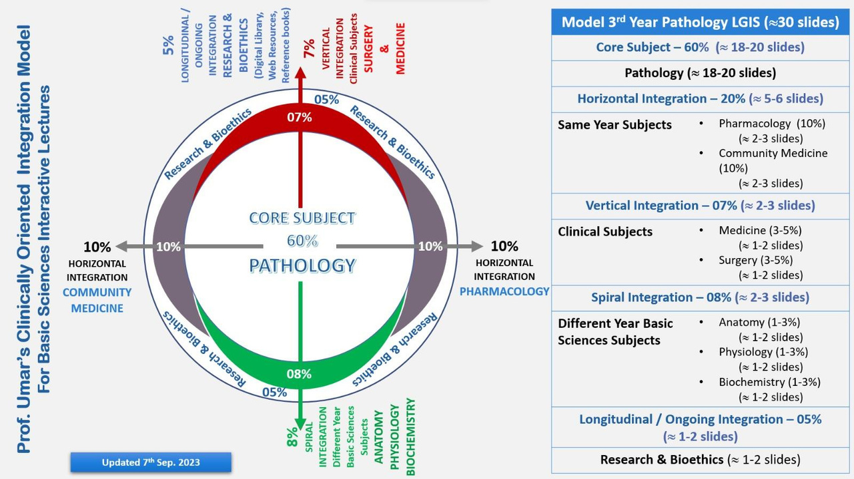
Professor Umar Model of Integrated Lecture
3

Slide 5
LEARNING OBJECTIVES
Define miscarriage
Describe different types of miscarriages along with their clinical feature
Describe principles of management of different type of miscarriages

Slide 6
MISCARRIAGE
DEFINITION:
Miscarriage is a pregnancy that ends before 24 weeks gestation or Expulsion of a fetus weighing less than 500gms
INCIDENCE
10-20%

Slide 7
ETIOLOGY OF MISCARRIGE
Chromosomal abnormalities, most common is trisomy (50%)
Medical / Endocrine disorders i.e. Poorly controlled diabetes, hypertension
Infection like bacterial, viral, parasitic
Autoimmune disorder (Antiphospholipid Syndrome, SLE)
Uterine abnormalities
Drugs and Chemicals
Cigarette smoking.
Radiotherapy
Chemotherapy

Slide 8
CLASSIFICATION
Spontaneous Miscarriage
Induced Miscarriage

Slide 9
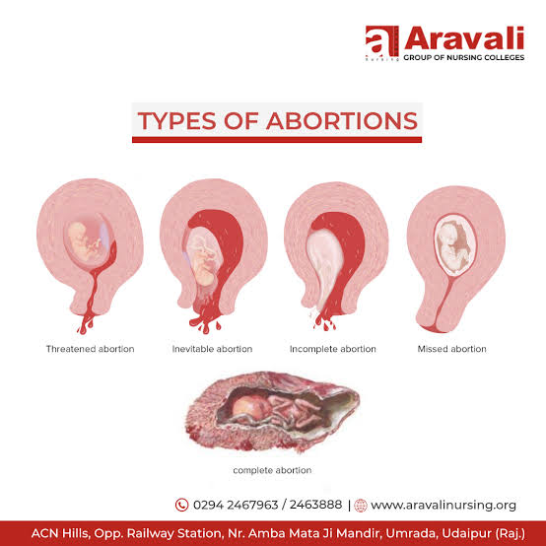
TYPES OF SPONTANEOUS MISCARRIAGE
Threatened Miscarriage
Inevitable Miscarriage
Incomplete Miscarriage
Complete Miscarriage
Missed Miscarriage
Septic Miscarriages

Slide 10
THREATENED MISCARRIAGE
There is threat to abort but pregnancy can continue, patient presents with vaginal bleeding and abdominal pain
Diagnosed by Speculum Examination demonstrating bleeding from closed cervical Os and USG showing viable pregnancy
Patient should be followed by repeat-USG.
Reassure
Bed rest

Slide 11
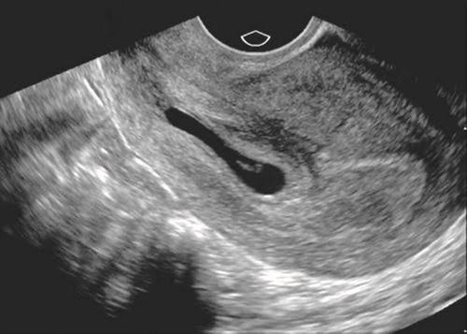
THREATENED MISCARRIAGE

Slide 12
INEVITABLE MISCARRIAGE
Process of expulsion has began that can not be stopped or reversed .
Bleeding with cramps and lower abdominal pain
Speculum Examination:Internal os is opened with blood coming out of it.
USG: Cardiac activity may or may not present It can proceed to incomplete or complete abortion.
Management: Expectant, Medical, Surgical

Slide 13
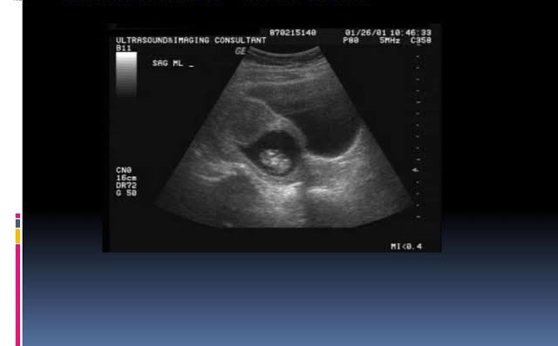
INEVITABLE MISCARRIAGE

Slide 14
INCOMPLETE MISCARRIAGE
Patient presents with the cramping lower abdominal pain, vaginal bleeding
Speculum Examination: cervical Os OPEN with passage of clots.
USG: product of conception inside the uterine cavity.
Management: Expectant, Medical, Surgical

Slide 15
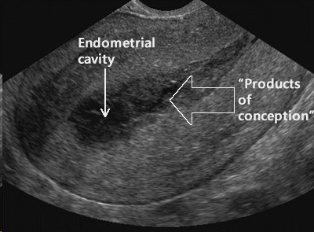
INCOMPLETE MISCARRIAGE

Slide 16

MANAGEMENT
MEDICAL MANAGEMENT
It involves administration of single or repeated , vaginal or sublingual dose of Prostaglandin E
No need of repeat scan
May need surgical treatment if medical treatment fails (failure rate 10%)
SURGICAL MANAGEMENT
Manual vacuum aspiration
Evacuation And Curettage

Slide 17
COMPLETE MISCARRIAGE
Fetus, placenta and membranes may be passed intact with minimal bleeding or pain. Now pain and bleeding is resolved
Speculum Examination: Closed cervical Os
USG: Empty Uterus
Management: Supportive Treatment
Need serum HCG to exclude ectopic pregnancy if no previous scan available with intrauterine pregnancy

Slide 18
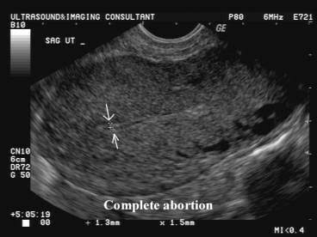
COMPLETE MISCARRIAGE

Slide 19
MISSED MISCARRIAGE
Failure to expel the product of conception after death of the fetus or embryo
Speculum Examination: Close cervical OS.
Management: Expectant, Medical, Surgical
USG shows Absent fetal activity and irregular gestational sac

Slide 20
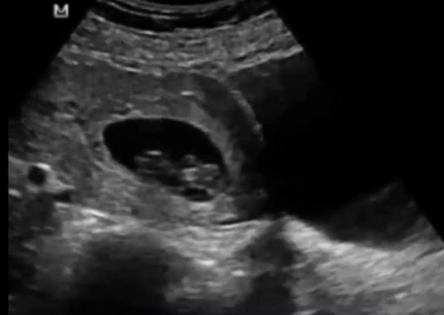
MISSED MISCARRIAGE

Slide 21

SEPTIC MISCARRIAGE
CLINICAL FEATURE
Infection can occur with missed, incomplete and illegal abortion
Fever,lower abdominal pain, history of miscarriage
EXAMINATION
Tenderness over uterus
Speculum Examination Offensive , blood-stained vaginal discharge
Complications pelvic cellulites and even septicemia and endotoxin shock.

Slide 22
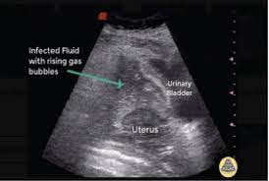
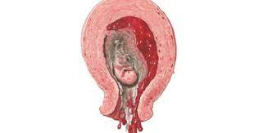
SEPTIC MISCARRIAGE

Slide 23
INVESTIGATIONS
All baseline, LFT, RFT, S/E,PT,APTT
HVS for C/S, Blood
Culture
Ultrasound Abdomen and pelvis
X ray Erect abdomen if required

Slide 24
MANAGEMENT
Counselling
Surgical Management
Medical Management

Slide 25
TREATMENT OF MISCARRIAGE AFTER 12 WEEKS OF GESTATION
If miscarriage occurred after 12weeks of gestation and fetus is still in utero. Then it is appropriate to induce labor by prostaglandin/Oxytocin administration, to expel the fetus, followed by evacuation of uterus if required .

Slide 26
MANAGEMENT OF SEPTIC MISCARRIAGE
Multidisciplinary approach
Broad spectrum IV antibiotics
IV Fluids
Anemia correction
ERPC/ Exploratory Laparotomy

Slide 27
RECURRENT MISCARRIAGE
Loss of three or more consecutive pregnancies
incidence is 0.5-2%

Slide 28
ETIOLOGICAL FACTORS
Genetic factors
chromosomal abnormalities like unbalance trans- location, trisomy are most important causes of 1st
trimester miscarriage
Anatomical disorders
Congenital uterine malformations
Cervical incompetence
Acquired cervical defects like sub mucosal fibroid and Asherman's
syndrome..
Endocrine cause
  luteal phase defect
  diabetes mellitus
  Thyroid dysfunction

Slide 29
ETIOLOGICAL FACTORS (Cont)
4- Reproductive tract infection
Herpes simplex, toxoplasma gondii, Malaria, Syphilis
5- Thrombophlic disorders
Antiphospholipid antibodies like lupus anticoagulants, and anticardiolipin antibodies, these aPLs antibodies are associated with placental thrombosis
Thrombophilia
6- Medical Disorders
Diabetes mellitus
Thyroid diseases
7- Smoking and Alcohol

Slide 30

INVETIGATIONS
Male and female chromosome analysis
Lupus anticoagulant and Anticardiolipin antibody
Thrombophilia screening( protein C , S, Antithrombin III, Factor V Leiden)
Early follicular phase LH and FSH
Pelvic ultrasound scan
Hysterosalpingogram
Hysteroscopy
Laparoscopy

Slide 31
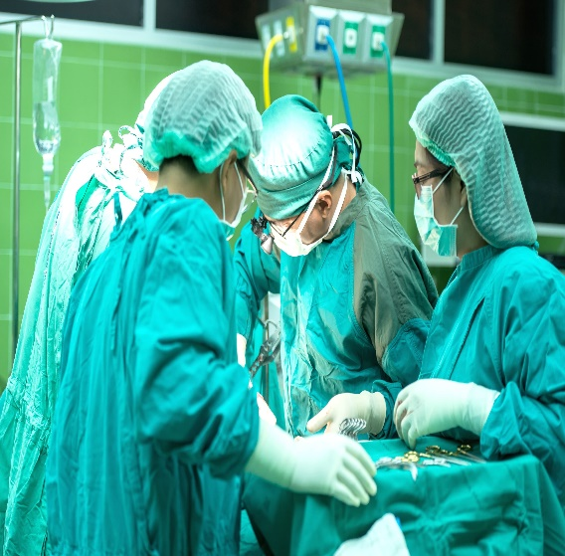
TREATMENT
Anatomical disorders – congenital uterine malformation should be diagnosed & treated surgically if required
Cervical incompetence should be treated by cervical cerclag at 12 to 16 weeks of gestation.
Asherman's Syndrome Intra uterine adhesions should be divided hysteroscope
Fibroid should be treated surgically.
Endocrine factors – luteal phase defect should be treated by progesterone support
Antiphospolipid antibodies – autoimmune diseases should be diagnosed and treated by low dose heparin and Aspirin to improve the outcome of pregnancy.

Slide 32
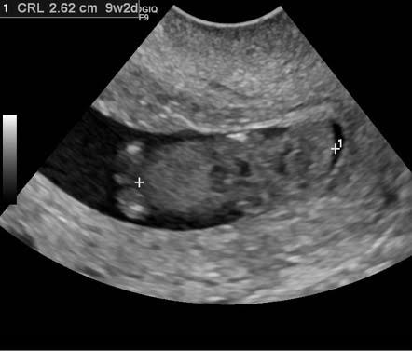
INDUCED ABORTIONS
Forced extraction or expulsion of fetus before 24 weeks of gestation or an embryo weighing less than 500mg.
When performed for an indication not permitted by law is called illegal abortion
Incidence of complication is higher in illegal abortion because it is performed by untrained person, under poor hygienic condition
If termination of pregnancy is done for legal indication, it is called therapeutic or legal abortion

Slide 33
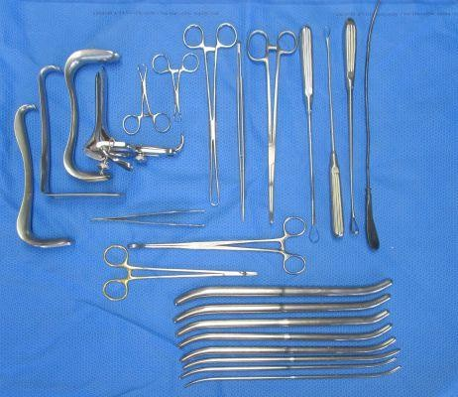
INSTRUMENTS USED IN ERPC

Slide 34
BIOETHICS
If any patient wants termination of unwanted pregnancy counsel her in detail regarding its complications, religious and legal aspects.
Always perform evacuation under aseptic conditions

Slide 35
FAMILY MEDICINE
Take detailed history of patient either it was a intrauterine pregnancy, spontaneous miscarriage or induced miscarriage
Give privacy to patients
Council patient regarding all aspects including medical treatment, surgical treatment if required and proper follow up
Always show empathy to patients

Slide 36

RESEARCH ARTICLES
Hardy K, Hardy PJ. 1(st) trimester miscarriage: four decades of study. Transl Pediatr. 2015 Apr;4(2):189-200. doi: 10.3978/j.issn.2224-4336.2015.03.05. PMID: 26835373; PMCID: PMC4729087.
Abdelazim, Ibrahim A., et al. "Miscarriage definitions, causes and management: review of literature." ARC J Gynecol Obstet 2.3 (2017): 20-31.

Slide 37
Case Scenario
  Miss M presented in ER with complaint of lower abdominal pain and PV spotting for last 3 hours. USG showed intrauterine pregnancy of 10 weeks with Positive FCA. On speculum examination, Os was closed. What is your diagnosis?
1. Incomplete Miscarriage
2. Inevitable Miscarriage
3. Threatened Miscarriage
4. Missed Miscarriage

Slide 38
Case Scenario
  Miss M presented in ER with complaint of lower abdominal pain and PV spotting for last 3 hours. On examination abdomen was soft. USG revealed viable intrauterine pregnancy of 10 weeks. On speculum examination ,Os was closed. What is your diagnosis?
1. Incomplete Miscarriage
2.Inevitable Miscarriage
3. Threatened Miscarriage
4.Missed Miscarriage

Slide 39


