Slide 1
METALLIC Irritant LEAD
Dr Filza Ali
Dr Gulzaib
Forensic Medicine & Toxicology

Slide 3
Motto of RMU

Slide 4
VISION OF RMU THE DREAM/ TOMORROW
To impart evidence based research oriented medical education
To provide best possible patient care
To inculcate the values of mutual respect and ethical practice of medicine

Slide 5
PROF Dr. UMAR’s LGIS MODEL

Slide 6
SEQUENCE OF LGIS
Learning Objectives
Core concept 70 %
Horizontal integration related to Pathology and Pharmacology 15 %
Relevant clinical concepts and medico legal application of core knowledge / Vertical integration 10%
Research article relevant to the topic 3%
Ethics and family medicine 2%

Slide 7
LEARNING OBJECTIVES:
Classify the types of Inorganic metallic Irritant (Lead)
Briefly describe its mechanism of action and clinical features of Acute and Chronic Lead poisoning.
Mention the fatal dose, fatal period and management of lead poisoning in acute and chronic exposure.
State the medicolegal importance of lead poisoning.
Briefly explain the autopsy findings of a victim of Lead poisoning.

Slide 8
Classification of Metallic Irritant LEAD
Core Concept
Lead Acetate…. sugar of lead, salt of Saturn
Lead Oxide
Lead Carbonate
Lead Tetra oxide…sindur
Lead Chromate
Tetraethyl Lead

Slide 9
Lead: Mechanism Of Action
Core Concept
MOA:
Spasm of capillaries/arterioles
Fixation of lead in brain/peripheral
nervous system.

Slide 10
Core Concept

Slide 11
Acute Poisoning:
Core Concept
Tetraethyl lead:lead encephalopathy
headache
sleeplessness
Tremors of eyes,mouth,fingers
loss of vision
Convulsions
insanity

Slide 12
Fatal Dose Fatal Period:
Core Concept
Fatal Period: 2-3 days
Fatal Dose:
Lead Acetate…..20grams
Lead Carbonate …..4grams
Pure tetra ethyl Lead…..1-2 drops

Slide 13
Treatment:
Core Concept
Stomach wash:1%magnesium/sodium sulphate
Morphine: for pain
Chelating agents: EDTA,penicillamine.
Wash with kerosine: within 15min in case of poisoning with Tetraethyl lead

Slide 14
Chronic poisoning
Core Concept
Plumbism, Saturnism, Saturnine.
Facial pallor: Around mouth,earliest
and most consistent sign,due to
vasospasm.
Anemia with punctate basophilia:
Hypochromic anemia
Reticulocytosis
Poikilocytosis

Slide 15
Core Concept
Increase in mononuclear cells
Decrease in polymorphonuclear cells
Punctate basophilia:
Dark blue pin head like spots in cytoplasm of RBC’s, stain with basic dyes,due to toxic action of lead on porphyrin meta500microgm/day

Slide 16
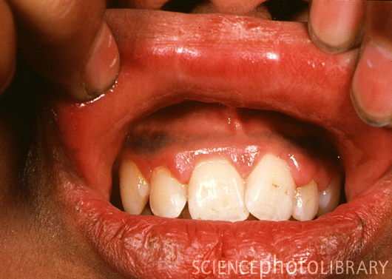
Core Concept
Lead line: Blue black line in gums,color is due to hydrogen sulphide.
Colic and constipation: “dry belly ache”
Encephalopathy:
Renovascular changes:

Slide 17
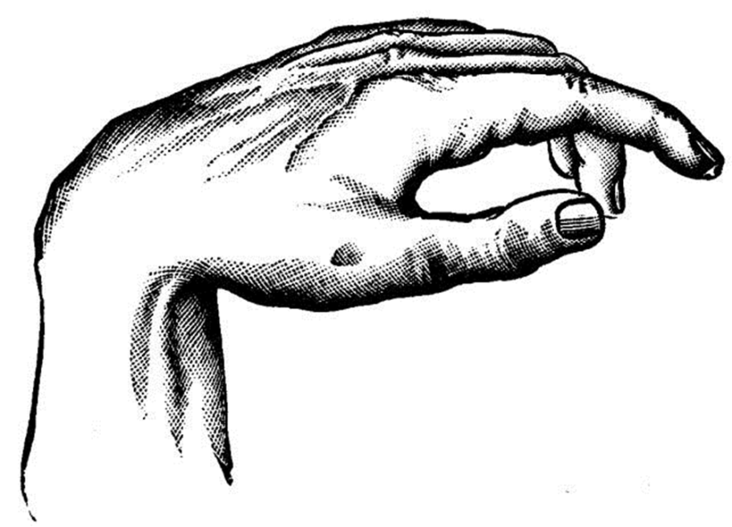
Core Concept
Paralysis: Foot drop & wrist drop
Reproductive system:
Sterility in both sexes
Amenorrhea
Menorrhagia
General:
Weakness,
Anorexia
Headache

Slide 18
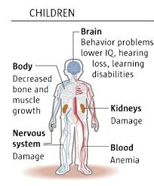
Core Concept

Slide 19
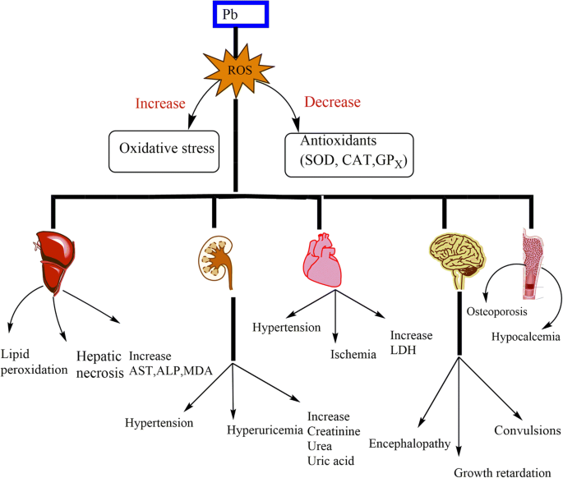
Core Concept

Slide 20
Diagnosis:
Core Concept
Blood :
More than 200 punctate basophilia cells/cmm
0.25mg of lead/litre of urine
Urine:
Excretion of porphyrins in urine
On X-ray:
Transverse opaque bands at the end of long bones in children.
Liver is opaque in case of tetra ethyl poisoning

Slide 21
Treatment Of Chronic Poisoning:
Core Concept
Treatment:
Chelating Agents: ETDA, BAL, Penicillamine.

Slide 22
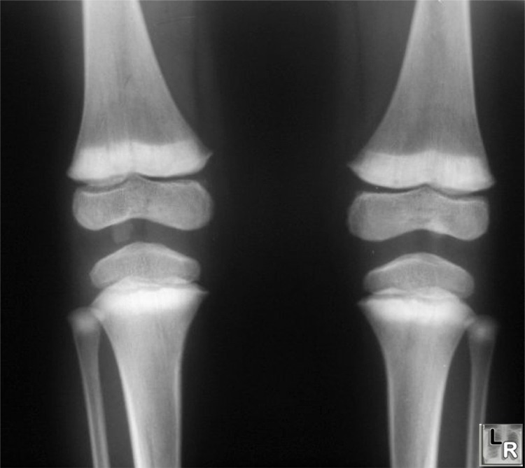
Core Concept

Slide 23
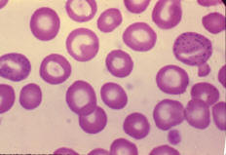
Core Concept

Slide 24
RESEARCH
RESEARCH
https://www.ncbi.nlm.nih.gov/pmc/articles/PMC4961898/
https://www.who.int/news-room/fact-sheets/detail/lead-poisoning-and-health
https://tbiomed.biomedcentral.com/articles/10.1186/1742-4682-10-13
https://www.amjmed.com/article/0002-9343(72)90015-0/abstract

Slide 25
BIOMEDICAL ETHICS
ETHICS
SOCIAL AND ENVIRONMENTAL JUSTICE CONCERNS: Research work to determine the practicality and feasibility of carrying out remedial work to reduce, limit, or eliminate exposures harmful to the public.
LOOKING AHEAD TO WHAT MUST BE DONE: In the case of lead, preventing exposure is the only method known to be effective in reducing the risk of adverse health outcomes.
HUMAN PROTECTION: Work place protection and prevention should be made to avoid unnecessary exposure.

Slide 26
FAMILY MEDICINE
FAMILY MEDICINE
Treatment will depend on the underlying cause.
If victim received with lead poisoning , remove the source of poison
Health education and awareness
Screening of family members
Involving high authorities

Slide 27
How To Access Digital Library
1. Go to the website of HEC National Digital Library.
2. On Home Page, click on the INSTITUTES.
3. A page will appear showing the universities from Public and Private Sector and other Institutes which have access to HEC National Digital Library HNDL.
4. Select your desired Institute.
5. A page will appear showing the resources of the institution
6. Journals and Researches will appear
7. You can find a Journal by clicking on JOURNALS AND DATABASE and enter a keyword to search for your desired journal.

Slide 28
TEXT BOOKS & PRACTICAL NOTEBOOK:
Principles & Practice of Forensic Medicine.
by Nasib R. Awan
Parikh’s Textbook of Medical Jurisprudence,
Forensic Medicine & Toxicology.
Practical Manual Of Forensic Medicine
& Toxicology

Slide 29
THANK YOU

