Slide 2
Genetic and Acquired Disorders of Bone
CNS & Psychiatry II 4th year MBBS
Department of Pathology
Rawalpindi Medical University

Slide 3
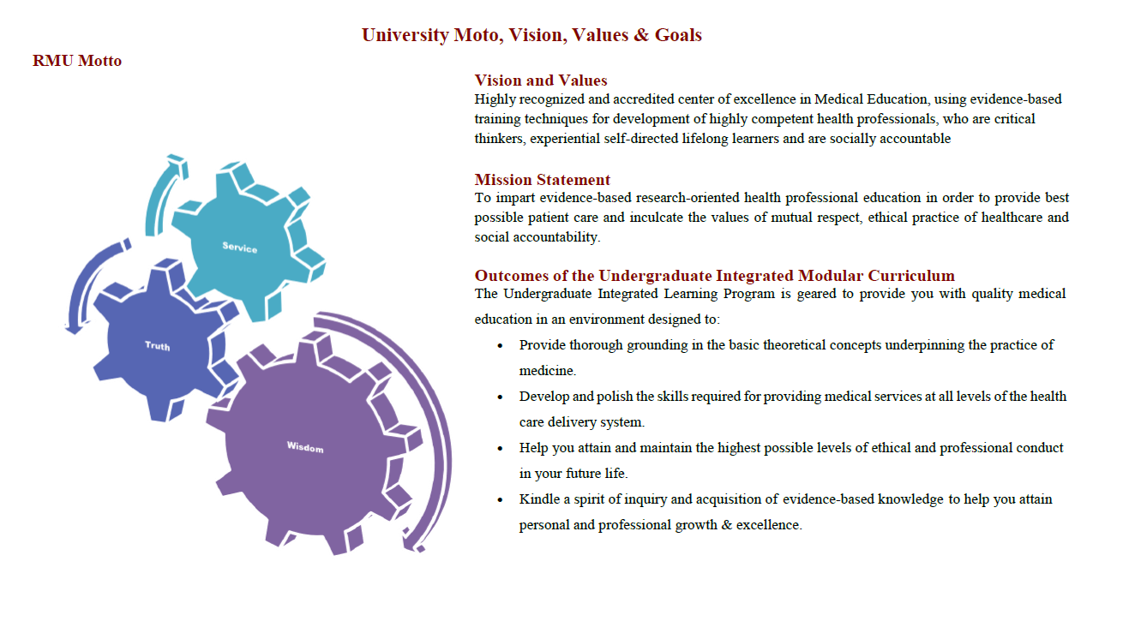

Slide 4
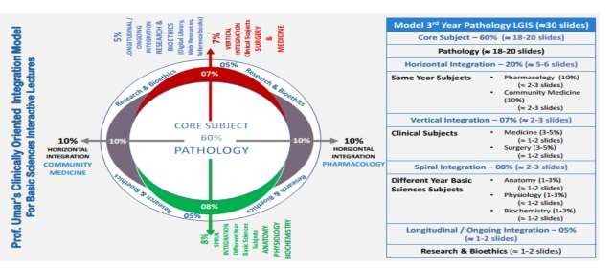

Slide 5
Learning Outcomes
At the end of the lecture, students should be able to:
Enlist the congenital and acquired bone disorders.
Describe the pathogenesis of metabolic bone disorders.
Recognize the clinical and morphological features of metabolic bone disease.

Slide 6
Steps to Access HEC Digital Library
Go to the HEC National Digital Library website Open your browser and visit the official HEC National Digital Library page.
Click on "INSTITUTES" On the homepage, locate and click on the INSTITUTES option.
Select Your Institute A page will appear listing universities from both public and private sectors, as well as other institutes that have access to the HEC National Digital Library (HNDL). Choose your desired institute from the list.
View Resources of Your Institution After selecting your institute, a new page will display the available resources for that institution.
Find Journals and Research On this page, you will find options for Journals and Research.
Search for Journals To find a specific journal, click on JOURNALS AND DATABASES. Enter a keyword related to the journal you're searching for to find the desired result.

Slide 7
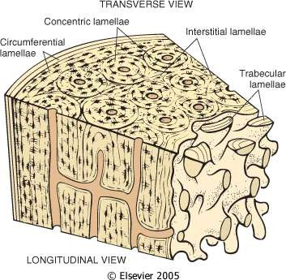
Introduction
VERTICAL INTEGRATION
CORE PATHOLOGY
Bone is a dynamic tissue that is constantly being remodeled throughout life.
Osteoblasts are cells that produce osteoid, which is primarily composed of type I collagen.
Bone mineral content is made up of calcium and phosphate, which form calcium hydroxyapatite.
Osteoclasts are multinucleated cells responsible for the resorption of bone.

Slide 8
CORE PATHOLOGY

Slide 9
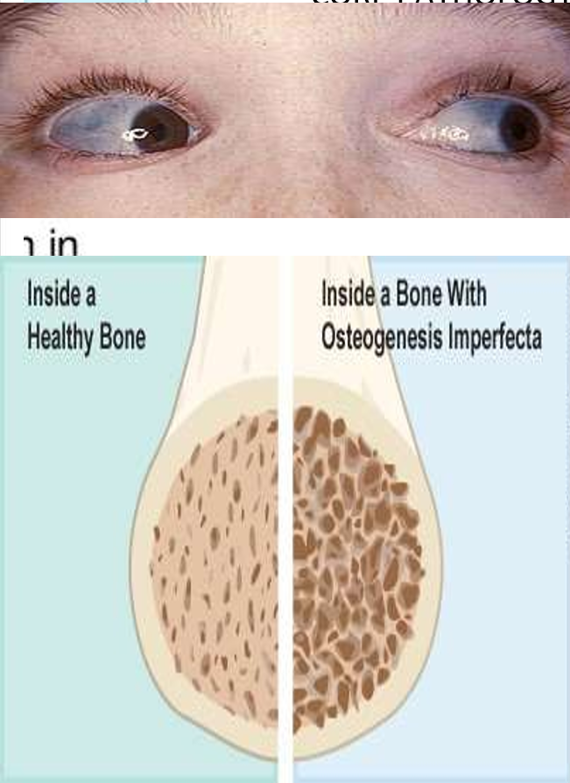
CORE PATHOLOGY

Slide 10
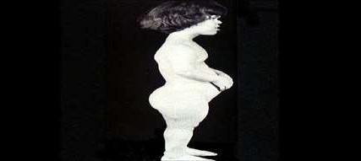
Achondroplasia
CORE PATHOLOGY
Disease most associated with human dwarfism.
Occurs in 1 in 15,000 to 17,000 people.
Caused by a missense mutation in the FGFR3 gene, which affects the growth and development of bones. This mutation leads to abnormal cartilage formation, resulting in short stature and other skeletal abnormalities.

Slide 11
Phenotype & Symptoms
VERTICAL INTEGRATION
CORE PATHOLOGY
Height: Individuals with achondroplasia typically have a height of around 4 feet, with short extremities. They may also exhibit slight to moderate obesity and a large head.
Delays and Complications:
Delayed motor milestones (e.g., walking or sitting).
Bowing of the lower legs.
Frequent ear infections due to a short Eustachian tube.
Breathing difficulties caused by airway restriction.
Mortality: Around 2-5% of infants with achondroplasia may die due to complications associated with the condition.

Slide 12
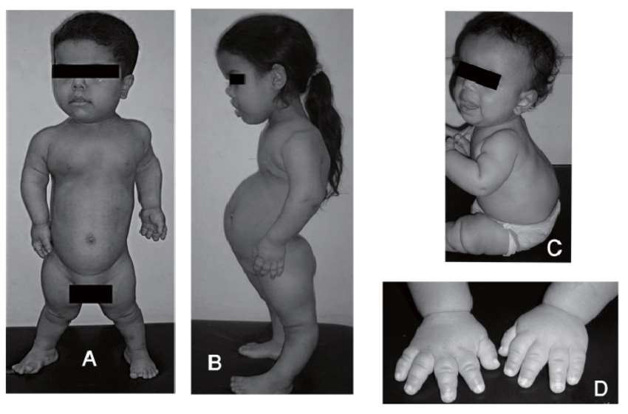
CORE PATHOLOGY

Slide 13
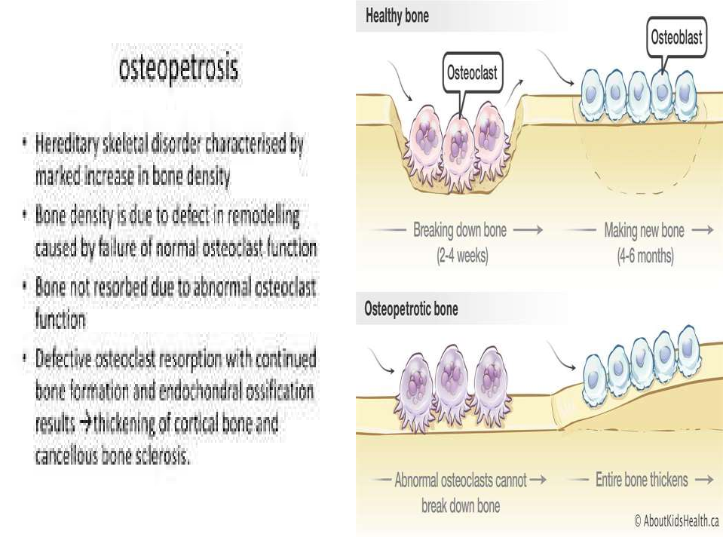
CORE PATHOLOGY

Slide 14
VERTICAL INTEGRATION

Slide 15
Acquired Metabolic Bone Diseases
CORE PATHOLOGY
The acquired metabolic bone diseases include:
Osteoporosis: Weakened bones, increased fracture risk.
Osteomalacia: Softening of bones due to vitamin D, calcium, or phosphate deficiency.
Skeletal changes of hyperparathyroidism: Bone weakening from excessive parathyroid hormone.
Chronic renal failure (renal osteodystrophy): Bone mineralization issues due to kidney failure.
Osteitis deformans (Paget's disease of bone): Abnormal bone remodeling causing bone enlargement and deformation.

Slide 16
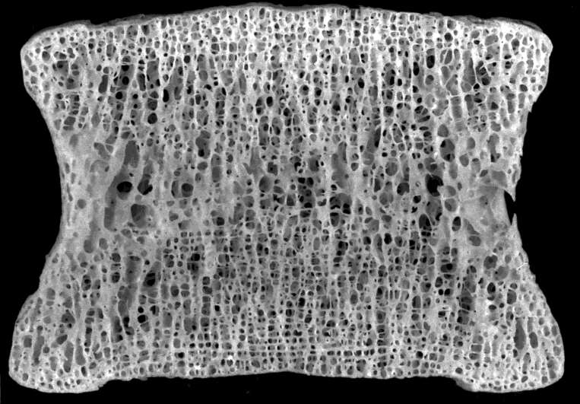
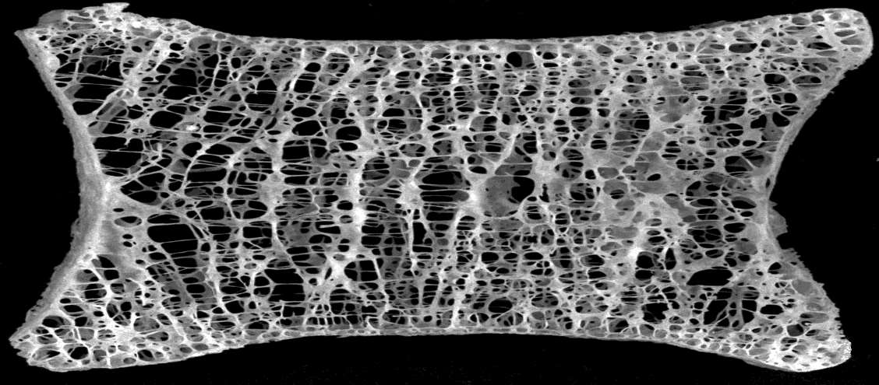
Osteoporosis
CORE PATHOLOGY
Normal Bone
Decreased volume of mineralized bone per unit of bone
Cortical thinning and increased porosity
Decreased number and thickness of trabeculae
Decreased bone strength
Increased risk of fracture
Osteoporotic Bone

Slide 17
Osteoporosis
CORE PATHOLOGY
Decrease in bone density
Thinning and increased porosity of the bone cortices and trabeculae
As a clinical term:
Generalized loss of bone density
Skeletal fragility
Bone pain
Pathological fractures (spine, wrist, hip, ribs)
Particularly in postmenopausal women and both genders

Slide 18
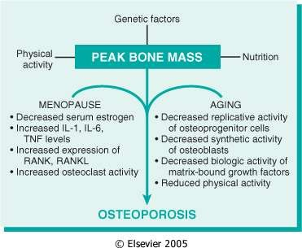
Osteoporosis
CORE PATHOLOGY
Primary osteoporosis, unrelated to other diseases, is classified by age groups into:
Postmenopausal
Senile
Idiopathic (premenopausal women and younger men)
Juvenile
Postmenopausal osteoporosis is the most frequent form of osteoporosis and the most common metabolic bone disease.

Slide 19
CORE PATHOLOGY

Slide 20
Diseases Of Mineralization: Osteomalacia And Rickets
CORE PATHOLOGY
Osteomalacia is a term used to encompass a group of diseases in adults, characterized by:
Delay in mineralization as osteoid is laid down.
Rickets is the equivalent term used in children, where the disease manifests particularly at the growth areas of bone.

Slide 21
Rickets and Osteomalacia Causes
CORE PATHOLOGY
Deficiency or abnormal metabolism of vitamin D
Deficiency or abnormal utilization/excretion of inorganic phosphate (Pi)
Vitamin D Deficiency may be due to:
A dietary lack of the vitamin
Insufficient ultraviolet exposure to form endogenous vitamin D
Most commonly, malabsorption interfering with the intestinal absorption of fats and fat-soluble vitamin D
Abnormal metabolism of vitamin D commonly occurs in chronic renal failure.

Slide 22
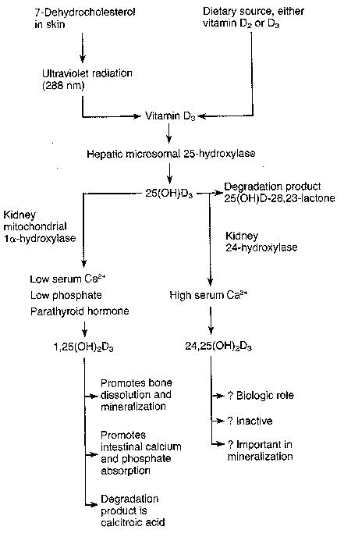
Vitamin D & Calcium
Homeostasis…
Sunlight is critical!
Active Form

Slide 23
The Most Common Cause of Osteomalacia
CORE PATHOLOGY
Intestinal malabsorption of fats and fat-soluble vitamin D
Other Contributing Factors:
Hepatic disease (e.g., biliary tract obstruction, primary biliary cirrhosis, alcoholic liver disease)
Chronic pancreatitis
Intestinal diseases (e.g., regional ileitis, sprue)
Surgical operations (e.g., gastrectomy, resection of portions of the small intestine)
Peptic ulcer patients receiving long-term treatment with antacids containing aluminum hydroxide, which forms insoluble complexes with Pi in the intestine and blocks its absorption.

Slide 24
Complications
CORE PATHOLOGY
Fractures and deformities of softened bones
Kyphosis
Bowing of the long bones (curved limb bones)
Narrowing of the pelvis
A prominent forehead (frontal bossing) due to osteoid excess
Beading of the ribs at the costochondral junctions (rachitic rosary) caused by overgrowth of cartilage and osteoid
Lateral flattening of the rib cage with forward displacement of the sternum (pigeon breast)

Slide 25
VERTICAL PATHOLOGY

Slide 26
Hyperparathyroidism
CORE PATHOLOGY
Generalized Osteitis Fibrosa Cystica (Von Recklinghausen's Disease of Bone)
Diffuse or focal resorptive loss decreased osteoblastic activity
Fibrous replacement of bone
overproduction of parathyroid hormone in primary or secondary hyperparathyroidism
Excess osteoclastic activity leading to bone resorption
Primary Hyperparathyroidism:
Adenoma
Cancer
Secondary Hyperparathyroidism:
Hyperplasia
Calcium and Vitamin D insufficiency
Calcium and Vitamin D deficiency
Renal failure

Slide 27
Primary Hyperparathyroidism
CORE PATHOLOGY
Metabolic disorder characterized by the secretion of excessive amounts of PTH.
Caused by parathyroid cells that are either neoplastic or hyperplastic in the absence of any known stimulus.
Common causes:
Functioning adenoma of a single parathyroid gland (80%)
Diffuse hyperplasia of all four parathyroid glands (15%)
Primary parathyroid carcinoma
Multiple parathyroid adenomas

Slide 28
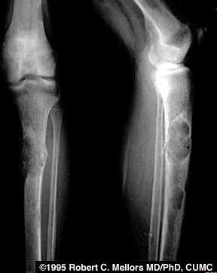
Secondary Hyperparathyroidism
CORE PATHOLOGY
Chronic renal failure
Associated with hyperphosphatemia and hypocalcemia.
Renal osteodystrophy results in :
Osteomalacia
Rickets ("renal rickets")
Osteitis fibrosa
Non-parathyroid carcinomas (e.g., lung, kidney, or others) may produce a PTH-like hormone, leading to a syndrome resembling hyperparathyroidism.

Slide 29
Secondary Hyperparathyroidism
CORE PATHOLOGY
VERTICAL INTEGRATION
The clinical presentations are divisible into three categories:
Hypercalcemia:
Neuromuscular weakness
Fatigue
Gastrointestinal symptoms
Coma in severe hypercalcemic crisis
Renal Involvement:
Renal stones (often bilateral)
Calcification of the kidneys (nephrocalcinosis)
Metastatic calcification of other tissues
3. Bone Changes:
Bone resorption and fibrous replacement:
Diffuse osteopenia
"Cystic" or tumor-like lesions of bone ("brown tumors")
Pathological fractures
Generalized osteitis fibrosa cystica

Slide 30
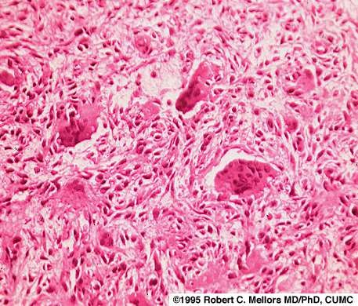
Microscopy of the Brown Tumor
CORE PATHOLOGY
Proliferated osteoclasts and fibroblasts
Fibrous stroma
A region of hemorrhage and hemosiderin deposition, which imparts a brown color
Bone Changes in Primary Hyperparathyroidism:
The bone changes regress or disappear within a few weeks after surgical removal of the parathyroid lesion.
The lesion is an adenoma, or less commonly, diffuse hyperplasia of the parathyroid gland.

Slide 31
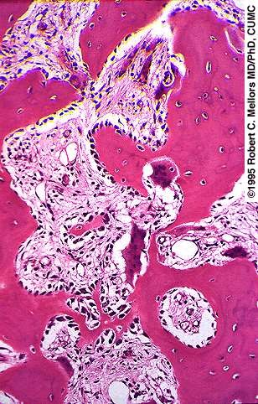
Paget's Disease
CORE PATHOLOGY
High bone turnover
High blood flow
Disordered bone architecture
Weakness of bone
Current evidence suggests slow infection by paramyxovirus.

Slide 32
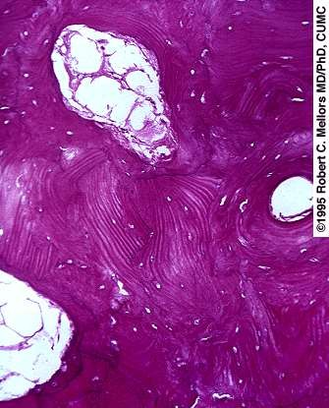
Pathology of Paget's Disease
CORE PATHOLOGY
three phases, :
Osteolytic Phase:
Active bone resorption
Mixed Osteolytic and Osteoblastic Phase:
Both osteoclastic and osteoblastic activity
Osteosclerotic Phase:
Sclerotic bone formation
Characteristic "mosaic" pattern of cement lines outlining irregular patches of sclerotic lamellar bone.

Slide 33
Complications (in advanced cases)
VERTICAL PATHOLOGY
Femur and tibia may be bowed
Hips may be deformed
Vertebral bodies may be compressed, resulting in:
Kyphosis or scoliosis
Skull may be enlarged
Hearing loss
Pathological fractures
Bone tumors:
Osteogenic sarcoma (most common)
Fibrosarcoma
Giant cell tumor

Slide 34
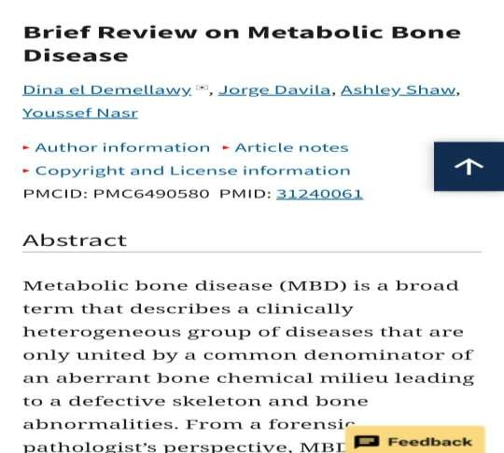
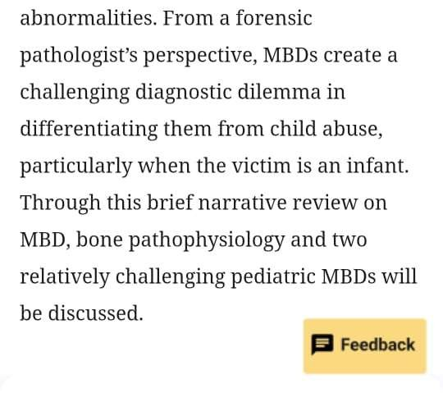
Research
https://pmc.ncbi.nlm.nih.gov/articles/PMC6 490580/

Slide 35
Family Medicine
Clinical Case Question:
A 55-year-old man presents with bone pain and recurrent kidney stones. Lab results show:
Elevated calcium
Normal phosphate
High parathyroid hormone (PTH)
Increased urinary calcium excretion
What is the most likely diagnosis?
A) Osteogenesis Imperfecta B) Osteomalacia C) Primary Hyperparathyroidism D) Rickets E) Osteoporosis

Slide 36
Family Medicine
Answer: C. Primary Hyperparathyroidism
Explanation:
Elevated calcium, high PTH, and increased urinary calcium excretion are classic signs of primary hyperparathyroidism, where excessive PTH causes bone resorption and increased calcium levels.
Normal phosphate helps rule out conditions like osteomalacia or rickets.

Slide 37
PATHOLOGY LAB REPORT
Patient Information:
Name: XYZ Age: 65 years Sex: Female
Clinical History: Postmenopausal women with history of multiple fractures over the past two years. Complains of chronic back pain and remarkable decrease in height. DEXA score indicates a T-Score of -2.8.
Specimen Type: Blood Sample
Laboratory finding:
Serum Calcium: Result: 9.2mg/dL Serum Phosphate Result: 3.5mg/dL
Reference Range: 8.5-10.5mg/dL
Interpretation: Normal
Reference Range: 2.5-4.5mg/dL
Interpretation: Normal
Vitamin D(25-hydroxyvitamin D):
Result: 18ng/mL Reference Range: 20-50 ng/mL
Interpretation: Deficient
Parathyroid Hormone (PTH):
Result: 55pg/mL
Bone Turnover Marker: Result: 25ng/mL
Reference Range: 10-65 pg/mL
Interpretation: Normal
Reference Range: 11-43 ng/mL
Interpretation: Normal

Slide 38
PATHOLOGY LAB REPORT
Patient Information:
Name: XYZ
Age: 65 years
Sex: Female
Clinical History:
Postmenopausal woman with a history of multiple fractures over the past two years.
Complains of chronic back pain and a remarkable decrease in height.
DEXA score indicates a T-Score of -2.8 (suggesting osteoporosis).
Specimen Type: Blood Sample
Laboratory Findings:
Serum Calcium: 9.2 mg/dL (Normal range: 8.5-10.5 mg/dL)
Serum Phosphate: 3.5 mg/dL (Normal range: 2.5-4.5 mg/dL)
Vitamin D (25-hydroxyvitamin D): 18 ng/mL (Low; Reference range: 20-50 ng/mL)
Parathyroid Hormone (PTH): 55 pg/mL (Normal range: 10-65 pg/mL)
Bone Turnover Marker: 25 ng/mL (Normal range: 11-43 ng/mL)

Slide 39
PATHOLOGY LAB REPORT
Interpretation:
The patient is likely experiencing osteoporosis, especially with the history of fractures, low Vitamin D levels, and the T-Score of -2.8.
Low Vitamin D levels may be contributing to the bone loss.
PTH levels are within the normal range, suggesting that primary hyperparathyroidism is less likely.
The bone turnover marker is within the normal range, indicating some level of bone metabolism activity but not excessive.

Slide 40
Take Home Message
Metabolic Bone Diseases
Disorders that affect bone strength and density due to imbalances in bone metabolism.
Conditions like osteoporosis, osteomalacia, and Paget’s disease lead to weakened bones and increased fracture risk.
Treatment includes lifestyle changes, supplements, and medications to restore bone health and prevent further damage.

