Slide 1
Meningitis

Slide 2
Vision & Mission of RMU
Wisdom
Truth
Service
To impart evidence based research oriented medical education
To provide best possible patient care
To inculcate the values of mutual respect and ethical practice of medicine

Slide 3
Sequence Of Lecture
Learning outcomes (1 slide)
Core Subject (24 slides)
EOLA(End of lecture assessment) (1 slide)
Further reading/Digital Library References (I slide)
( Research, Bioethics, Artificial Intelligence)

Slide 4
Meningitis
Acute infection of the meninges presents with a characteristic combination of pyrexia, headache and meningism.
Meningism consists of headache photophobia and stiffness of the neck often accompanied by other signs of meningeal irritation including Kernig's sign and Brudzinski’s sign
Meningism is not specific to meningitis can occur in patient with subarachnoid haemorrhage

Slide 5
Types of meningitis
Depending upon causative organism types are
Viral meningitis
Bacterial meningitis
Fungal meningitis
Parasitic meningitis
Non-infective meningitis

Slide 6
Viral meningitis
Most common cause of meningitis
Benign and self limiting illness requiring no specific therapy
Most common viruses are enteroviruses
Others include mumps, influenza, herpes simplex, varicella zoster, epstein bar, HIV

Slide 7
CLINICAL FEATURES
Viral meningitis mainly occur in children or young adults
Presents with acute onset of headache and irritability and rapid development of meningisim
Headache is usually most severe feature
There may be high pyrexia but focal neurological signs are rare

Slide 8
management
Diagnosis is made by lumber puncture
Csf contains excess of lymphocytes, glucose and protein levels are commonly normal
No specific treatment is required
Patient should be treated symptomatically in quiet environment

Slide 9
Bacterial meningitis
Bacterial meningitis is usually part of bacteremia illness, although direct spread from adjacent focus of infection can occur
Depending upon age most common organism include E coli, Group B streptococci, listeria monocytogenes in neonate
In pre school children Hemophilus influenzae, Neisseria meningitides and streptococcus pneumoniae
In older children and adult mainly Neisseria and streptococcus pneumoniae

Slide 12
Clinical features
Headache,drowsiness,fever and neck stiffness are usual presenting features
In severe bacterial meningitis patient may be comatose later developing focal neurological signs
Features specific to meningococcal meningitis include fever ,neck stiffness, altered consciousness and rash
When along with sepsis signs evolve rapidly with abrupt onset of obtundation due to cerebral edema

Slide 13
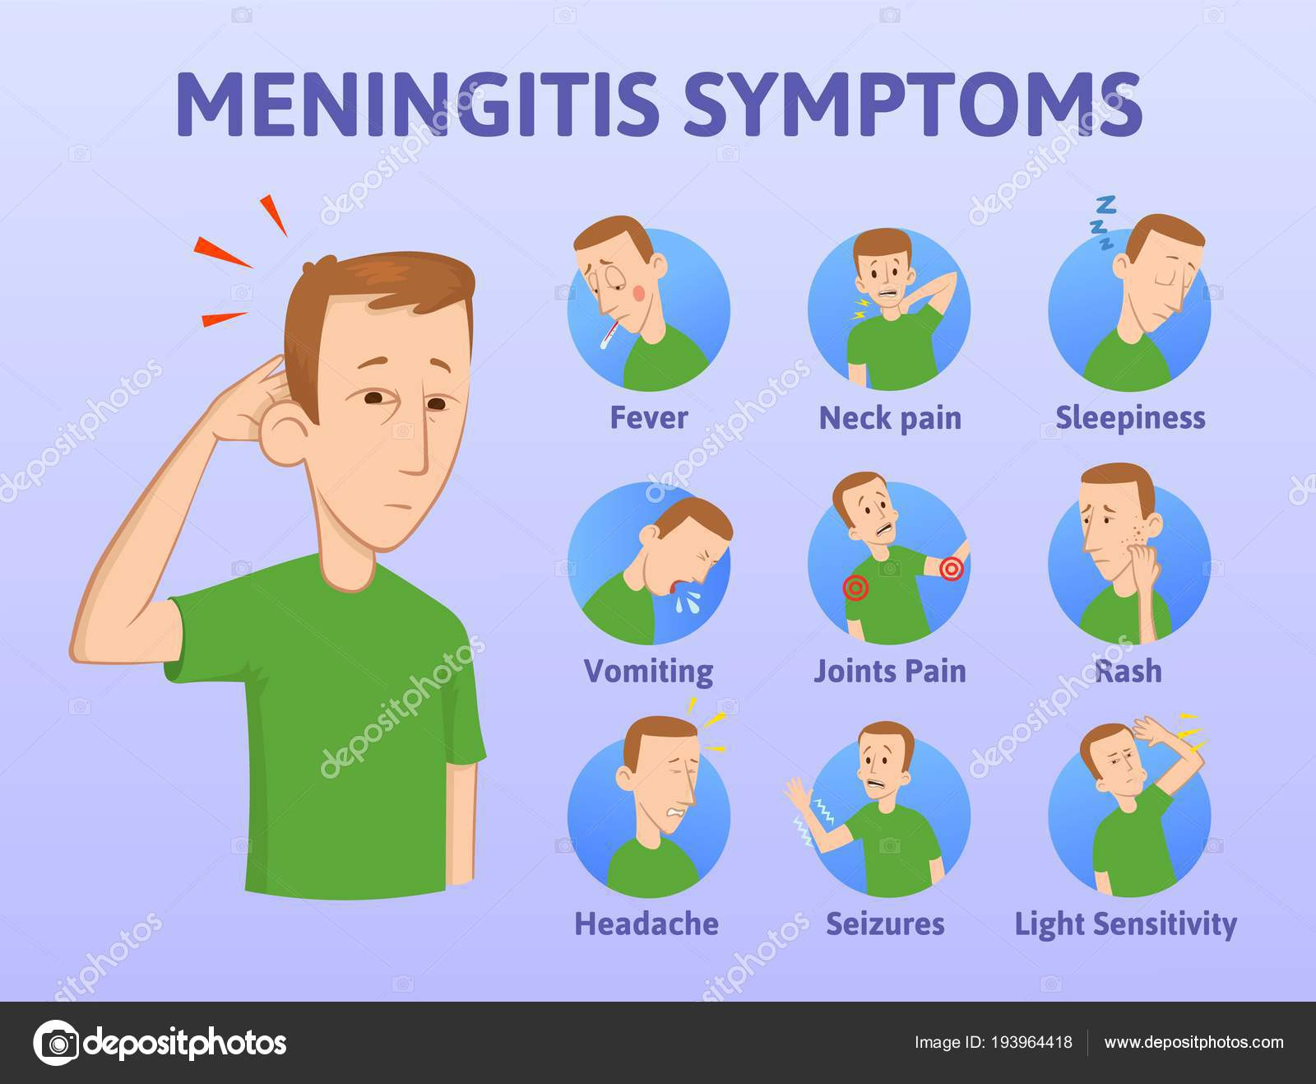
In pneumococcal
and Hemophilus
infections there may be an
accompanying otitis media.
In pneumococcal meningitis
there may be accompanying
pneumonia
Listeria is an increasing
cause of meningitis in
Immunosuppressed
people with and pregnant
Women.

Slide 14
investigations
Lumber puncture is mandatory unless there is contraindication
CT should be performed if patient is drowsy, has focal neurological signs, seizures, immunosuppressed, has undergone a recent neurosurgery or suffered a head injury
If lumber puncture is deferred blood cultures should be taken
In bacterial meningitis CSF is cloudy due to presence of many neutrophils

Slide 15
Protein content is elevated and glucose significantly reduced
Gram film and cultures may show identification of organism
PCR techniques can be used in both blood and CSF to identify bacterial DNA

Slide 16
management
In suspected bacterial meningitis the patient should be given parenteral benzyl penicillin immediately and prompt hospital admission should be arranged
Adjunctive glucocorticoid therapy is useful in reducing hearing loss and neurological sequelae in both children and adults
In complications intensive care facilities may be required

