Slide 2
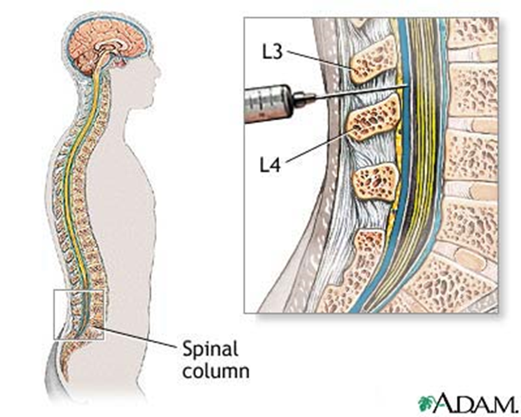
Meningeal Infections
CNS & Psychiatry II 4th year MBBS
Dr Mudassira Zahid
Department of Pathology
Rawalpindi Medical University

Slide 3
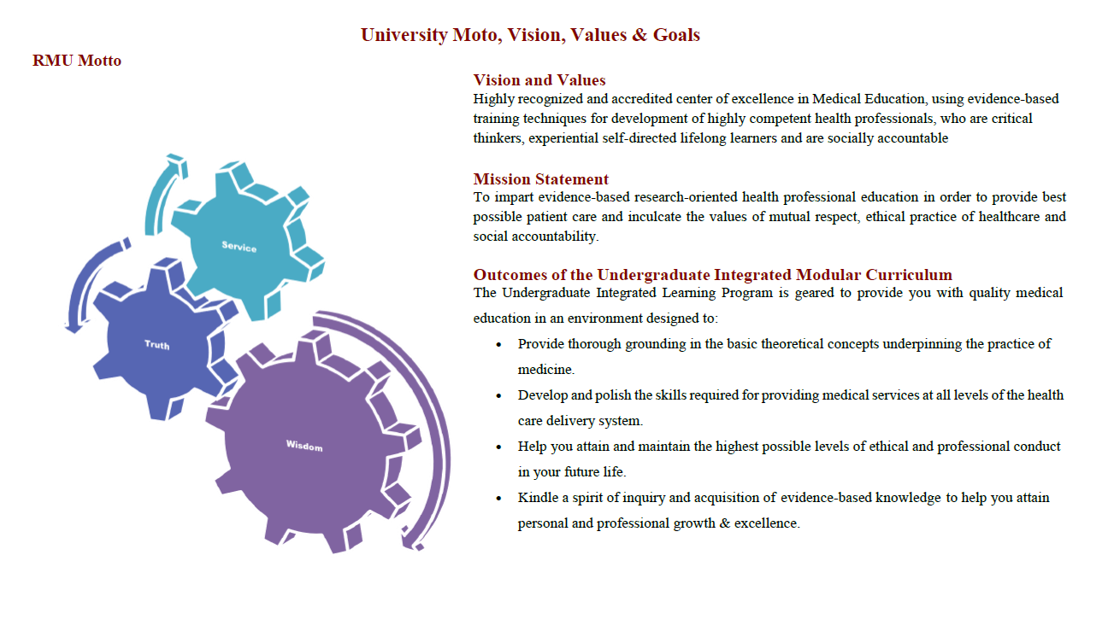

Slide 4
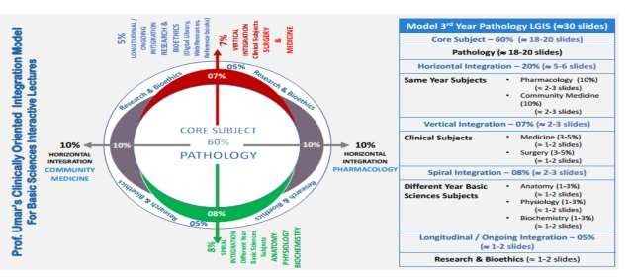

Slide 5
Learning Objectives
Acute Meningitis: Explain the pathophysiology, morphology, and presentation of acute meningitis
Chronic Bacterial Meningoencephalitis:
Describe the pathophysiology, morphology, and presentation of chronic bacterial meningoencephalitis
Viral Infections:
Explain the pathophysiology, morphology, and presentation of viral infections
Learning Resources: Robbins & Cotran Pathologic Basis Of Disease 10th Edition

Slide 6
VERTICAL INTEGRATION

Slide 7
Meningitis
CORE PATHOLOGY
Meningitis: Infection of the leptomeninges within the subarachnoid space.
Acute pyogenic (usually bacterial)
Aseptic (usually viral)
Chronic (usually tuberculous, spirochetal, or cryptococcal)
Meningoencephalitis: Infection of both the leptomeninges and brain.
Chemical meningitis: Inflammatory response against a nonbacterial irritant introduced into the subarachnoid space.

Slide 8
CNS Infections Routes of Entry for Infections
VERTICAL INTEGRATION
Hematogenous Spread:
Arterial spread is the most common means of entry
Retrograde venous spread through anastomoses between veins of the face and venous sinuses of the skull
Direct Implantation:
Traumatic introduction of foreign material (e.g., injury or surgery)
Rarely iatrogenic, such as from a lumbar puncture
Local Extension:
Infections of the skull or spine
Sources include air sinuses (mastoid or frontal), infected teeth, cranial or spinal osteomyelitis, and congenital malformations (e.g., meningomyelocele)
Peripheral Nerves:
Viruses such as rabies and herpes zoster travel retrograde along the nerve

Slide 9
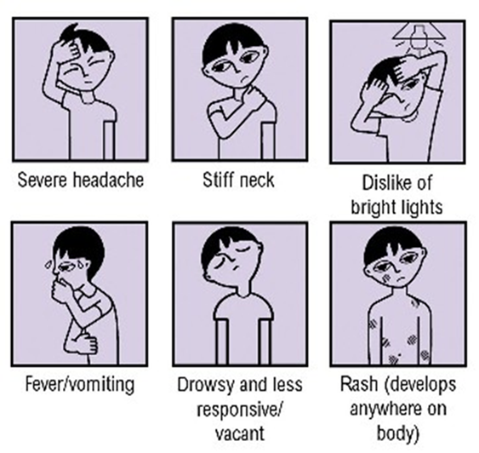
Meningitis Clinical Presentation
VERTICAL INTEGRATION
Irritability
Clouding of consciousness
Photophobia
Neck stiffness

Slide 10
Pyogenic meningitis
CORE PATHOLOGY
Pyogenic meningitis: A thick layer of suppurative exudate covers the brainstem and cerebellum and thickens the leptomeninges.
Causative Organisms by Age Group
Neonates: Escherichia coli and group B streptococci
Adolescents & young adults: Neisseria meningitidis
Older individuals: Streptococcus pneumoniae and Listeria monocytogenes

Slide 11
Acute Pyogenic Meningitis (Bacterial Meningitis)
CORE PATHOLOGY
Gross Findings in Pyogenic Meningitis
An exudate is evident within the leptomeninges over the surface of the brain.
The meningeal vessels - engorged and prominent.
Tracts of pus - along blood vessels on the brain surface.
Gross Findings in Severe Infection
Focal cerebritis: Inflammatory cells infiltrate the walls of the leptomeningeal veins - spread into the substance of the brain to form a brain abscess.
Ventriculitis: Extension of inflammation into the ventricles.

Slide 12
Acute Pyogenic Meningitis (Bacterial Meningitis)
CORE PATHOLOGY
Microscopic Findings in Pyogenic Meningitis
Aggregates of inflammatory cells around the leptomeningeal blood vessels.
Neutrophils fill the entire subarachnoid space in severely affected areas.
Abscesses may form in the brain.
Phlebitis leads to venous occlusion and hemorrhagic infarction of the underlying brain.

Slide 13
Aseptic Meningitis (Viral Meningitis)
CORE PATHOLOGY
The disease is typically self-limiting.
It is of viral origin in most cases, but it is often difficult to identify the responsible virus.
Gross Findings in Aseptic Meningitis
There are no distinctive macroscopic findings except for brain swelling, seen in only some patients.
Microscopic Findings in Aseptic Meningitis
No recognizable abnormality or
A mild to moderate leptomeningeal lymphocytic infiltrate.

Slide 14
Chronic Meningitis: Tuberculous Meningitis
CORE PATHOLOGY
Causative organisms: Mycobacteria Spirochetes
Additional Findings
Brain parenchyma is often involved.
Gross Findings in Tuberculous Meningitis
Gelatinous or fibrinous exudate in the subarachnoid space, most often at the base of the brain.
The exudate obliterates the cisterns and surrounds the cranial nerves.
Discrete white granules scattered over the leptomeninges.
Subarachnoid obliterative endarteritis.

Slide 15
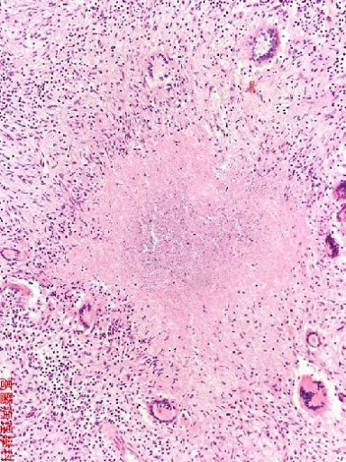
Chronic Meningitis: Tuberculous Meningitis
CORE PATHOLOGY
Microscopic Findings in Tuberculous Meningitis
Inflammatory infiltrate composed of lymphocytes, plasma cells, and macrophages.
Granulomas with caseous necrosis and giant cells.

Slide 16
Chronic Meningitis
VERTICAL INTEGRATION
MEDICINE
Spirochetal Infections
Causative Organism: Treponema pallidum
Clinical Diseases:
Neurosyphilis: A tertiary stage of syphilis.
Tabes dorsalis: Another form of neurosyphilis resulting from damage to the sensory nerves in the dorsal roots.

Slide 17
Chronic Meningitis Syphilitic Meningitis
VERTICAL INTEGRATION
MEDICINE
Presentation in Spirochetal Infections
Neurosyphilis:
Insidious progressive loss of mental and physical functions
Mood alterations (including delusions of grandeur)
Severe dementia
Tabes Dorsalis:
Impaired joint position sense and ataxia (locomotor ataxia)
Loss of pain sensation
Joint damage (Charcot joints)
Sensory disturbances, particularly characteristic “lightning pains”
Absence of deep tendon reflexes

Slide 18
Fungal Meningitis
CORE PATHOLOGY
Chronic Meningitis
Leads to chronic meningitis.
Can be associated at times with parenchymal infection.
Immunosuppression increases the risk.
Causative Organisms:
Cryptococcus neoformans
Histoplasma capsulatum
Coccidioides immitis

Slide 19
CSF Examination
CORE PATHOLOGY

Slide 20
Preventive Measures
HORIZONTAL INTEGRATION
COMMUNITY MEDICINE
Meningococcal Vaccine in Pakistan
Vaccines against Meningococcal are now available in Pakistan.
This vaccine can be given as a single injection to people aged 2 – 55 years.
Quadrivalent polysaccharide (ACYW135) vaccine.
Mandatory for Umrah and Hajj pilgrims.
Helps decrease outbreaks.

Slide 21
Brain Abscesses
VERTICAL INTEGRATION
ANATOMY
Bacterial Infections: Route of Entry
Direct implantation of organisms
Local extension from adjacent foci (e.g., mastoiditis, paranasal sinusitis)
Hematogenous spread (e.g., infective endocarditis, infections of lungs or bones, or after tooth extraction)

Slide 22
Brain Abscesses
CORE PATHOLOGY
Cerebral Abscesses in the Frontal Lobe: Discrete destructive lesions with central liquefactive necrosis arrows)
Gross Findings in Bacterial Meningitis
Discrete destructive lesions with central liquefactive necrosis
Surrounded by a rim of vascularized granulation and fibrous tissue
Outside the fibrous capsule is a zone of reactive gliosis
CSF Examination
WBCs elevated
Protein elevated

Slide 23
Viral Encephalitis
CORE PATHOLOGY
Parenchymal Infection of the Brain
Almost invariably associated with meningeal inflammation (meningoencephalitis).
Important Etiological Organisms:
Rabies virus and Poliovirus
Rubella and CMV – Intrauterine viral infection following transplacental spread
Zika virus – Developmental abnormalities of the brain.

Slide 24
Viral Encephalitis
CORE PATHOLOGY
Histologic Features in Parenchymal Brain Infection
Perivascular and parenchymal mononuclear cell infiltrates
Microglial nodules
Neuronophagia
Certain viruses also form characteristic inclusion bodies.

Slide 25
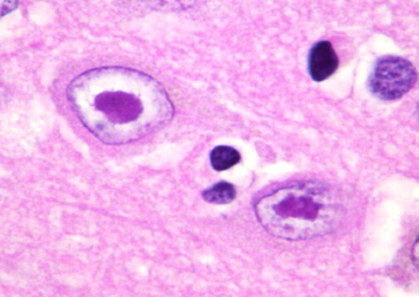
Encephalitis-Herpes viruses I
CORE PATHOLOGY
Most common in children and young adults.
Involvement of the frontal and temporal lobes – alterations in mood, memory, and behavior.
Morphology in Herpes Virus Encephalitis
Necrotizing lesions with hemorrhage
Perivascular inflammatory infiltrates
Large eosinophilic intranuclear viral inclusions (Cowdry type A bodies) – found in both neurons and glial cells.

Slide 26
Encephalitis-Rabies Virus
CORE PATHOLOGY
Rabies Encephalitis
Fatal encephalitis infection
Transmitted from rabid animals, by a bite
Natural reservoirs: mammals
Dog bite
Exposure to some bat species, even without evidence of a bite
Incubation period (usually a few months) depends on the distance between the wound and the brain.
Morphology: The Purkinje cells have intracytoplasmic, eosinophilic inclusions (arrows) called Negri bodies.

Slide 27
Encephalitis-Rabies Virus
HORIZONTAL INTEGRATION
Bite Site Virus Replicates and attaches to acetylcholine receptor
Axonal transport Ascending along the peripheral nerves
Reaches the Brain
Symptoms
Incubation Period

Slide 28
Encephalitis
CORE PATHOLOGY
A. Cryptococcus
India ink preparation, large capsules surrounding budding yeast cells.
B. Mucor species (Zygomycosis)
Broad, aseptate hyphae that have wide-angled branching.
C. Neurocysticercosis
Multiple cysts located between the gray and white matter.
D. Toxoplasmosis
A cyst (arrow) filled with bradyzoites.

Slide 29
Drugs Used For CNS Infections
HORIZONTAL INTEGRATION
PHARMACOLOGY
Age or Predisposing Feature | Antibiotics
Age 0-4 wk | Ampicillin plus either cefotaxime or an aminoglycoside
Age 1 mo-50 y | Vancomycin plus cefotaxime or ceftriaxone
Age >50 y | Vancomycin plus ampicillin plus ceftriaxone or cefotaxime plus vancomycin*
Impaired cellular immunity | Vancomycin plus ampicillin plus either cefepime or meropenem
Recurrent meningitis | Vancomycin plus cefotaxime or ceftriaxone
Basilar skull fracture | Vancomycin plus cefotaxime or ceftriaxone
Head trauma, neurosurgery, or CSF shunt | Vancomycin plus ceftazidime, cefepime, or meropenem

Slide 30
Drugs Used For Viral Infections
HORIZONTAL INTEGRATION
PHARMACOLOGY
Herpes Simplex
Acyclovir (10 mg/kg IV every 8 hours) – for HSV-1 and HSV-2 meningitis.
Cytomegalovirus
Ganciclovir is given in an induction dosage of 5 mg/kg IV every 12 hours for 21 days.
Maintenance dosage of 5 mg/kg every 24 hours.

Slide 31
Drugs Used For Tuberculous Infection
HORIZONTAL INTEGRATION
PHARMACOLOGY
Drug Dosages for Tuberculous Meningitis The dosages of drugs for tuberculous meningitis are similar to those used for pulmonary tuberculosis:
Isoniazid: 300 mg/day
Rifampin: 600 mg/day
Pyrazinamide: 15-30 mg/kg/day
Ethambutol: 15-25 mg/kg/day
Streptomycin: 7.5 mg/kg every 12 hours
Recommended duration of treatment: 9 to 12 months.

Slide 32
Prevention of Meningitis and Its Complications
SPIRAL INTEGRATION
FAMILY MEDICINE
Vaccination: Routine meningococcal, pneumococcal, and Hib vaccines reduce the risk of bacterial meningitis.
Infection Control: Hand hygiene, respiratory precautions, and early treatment of respiratory infections prevent disease spread.
Early Diagnosis & Treatment: Prompt use of antibiotics and antivirals prevents severe complications like hydrocephalus and seizures.
Monitoring & Supportive Care: Early referral to tertiary care with ICU management, seizure control, and neuroprotection reduce long-term neurological deficits.

Slide 33
Research
doi: 10.1016/j.ebiom.2021.103274

